Slide 1
Insurance 101, Outpatient PC Billing, & Value-Based Care
Victoria Sweetnam MD
Ginna Evans MBA, RHIA, CPC, CRC, FAHIMA
Tammie Quest MD, FAAHPM
Notes:
Presenter: Victoria Sweetnam

Slide 2
Learning Objectives
Evaluate value-based outpatient palliative care
04
Understand fundamentals of: eligibility for outpatient PC services, payment for outpatient PC, and billing for outpatient palliative care services
01
Appraise outpatient billing pearls including application of add-on codes, telehealth, CCM/CCCM, TCM, and advanced care planning
02
Compare common outpatient PC billing pitfalls and optimization strategies
03
Notes:
Presenter: Victoria Sweetnam

Slide 3
Additional Resources before We Dive In
CAPC
Updates in billing and coding for PC in 2026 given by Phil Rodgers, MD and Chris Jones, MD, MBA: https://www.capc.org/events/recorded-webinars/palliative-care-billing-in-2026-whats-new-what-matters-and-whats-next/
Palliative Care Billing 101: https://www.capc.org/documents/download/1086/
Meet with your practice's coding team to do an internal audit of your billing to ensure you are getting credit for all the work you do!
Know that from year-to-year CMS billing guidelines can and usually change
Fundamentals of Billing and Coding: Outpatient Billing: https://www.capc.org/documents/download/1084/
Notes:
Presenter: Victoria Sweetnam

Slide 4
Learning Objective
Understand fundamentals of:
  Eligibility for outpatient PC services
  Payment for outpatient PC
  Billing for outpatient palliative care services
Notes:
Presenter: Victoria Sweetnam

Slide 5
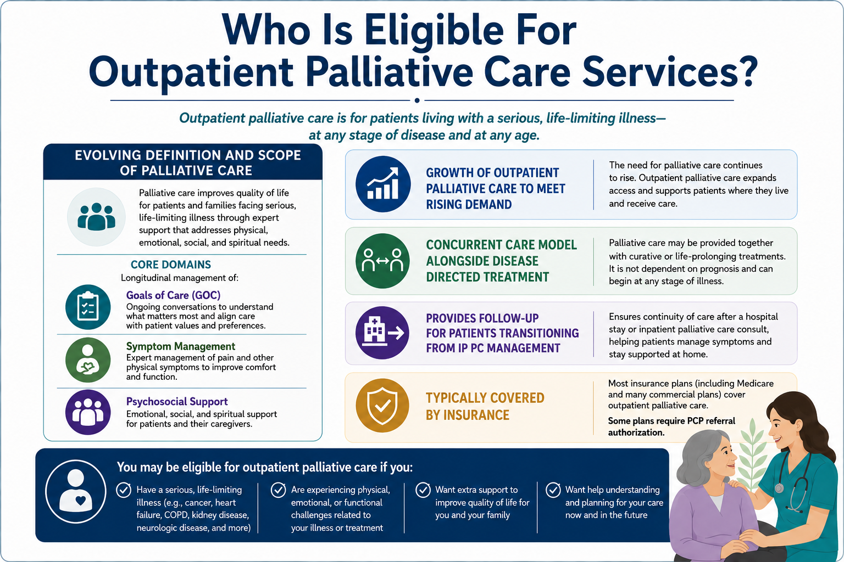
By OpenAI's ChatGPT, May 2026 (www.chatgpt.com). Figure generated using the prompt "create an image to organize the following information"
Notes:
Presenter: Victoria Sweetnam

Slide 6
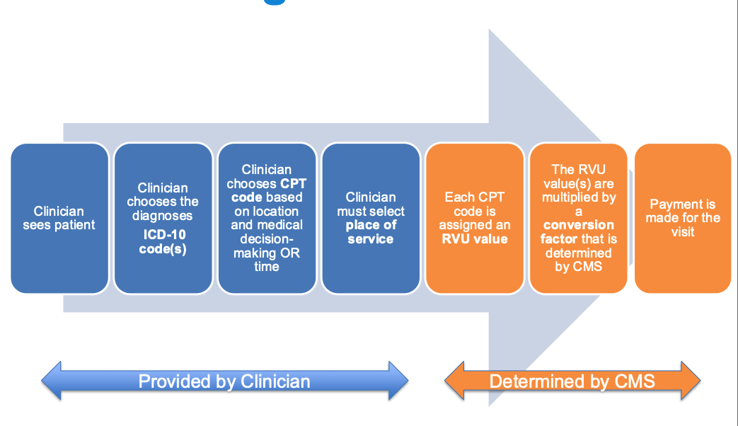
The 100 Foot View: How Does Billing Work?​
Figure from CAPC. Retrieved from: doi:https://www.capc.org/events/recorded-webinars/palliative-care-billing-in-2026-whats-new-what-matters-and-whats-next/ on April 22,2026. RVU¹
Notes:
Presenter: Victoria Sweetnam
FACILITATOR:
I will just highlight some definitions here to help with understanding:
ICD-10 codes--> "the why" or diagnosis--> Remember that every payer uses ICD-10 codes on claims (standardized diagnostic language in the US)
CPT (current procedural terminology) codes: "the what" (service). This is a greater umbrella for everything you do clinically for billing (office visits, procedures, imaging, care management services)
E/M (Evaluation/management) codes : types of CPT codes when evaluating a patient, medical decision making, and managing care (not doing procedures).
RVU (relative value unit) are the foundation for physician reimbursement and productivity measurement
Conversion factor is typically updated every year by CMS

Slide 7
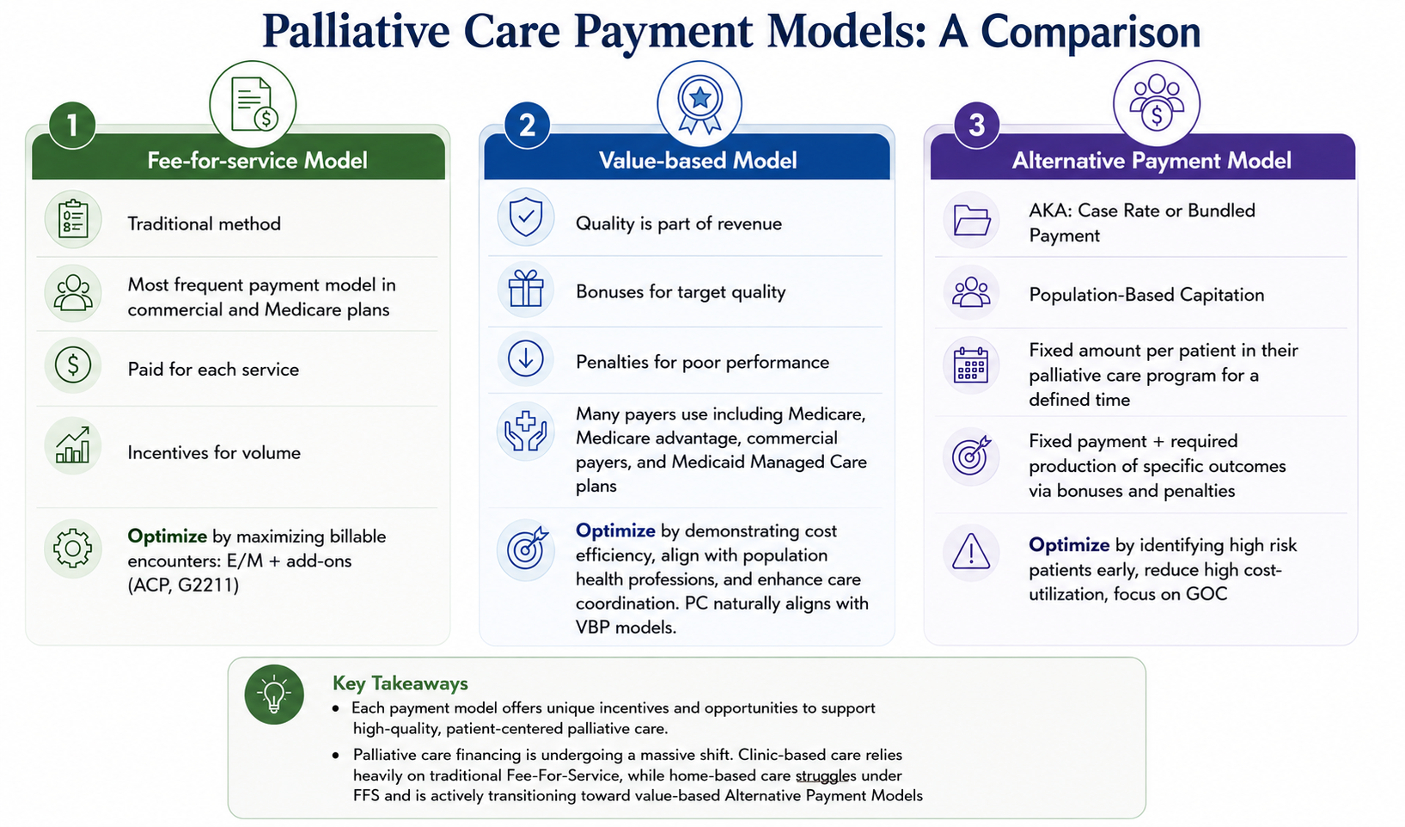
Ambulatory Palliative Care Gets Paid through Various Payer Models
2
By OpenAI's ChatGPT, May 2026 (www.chatgpt.com). Figure generated using the prompt "create an aesthetic organized image with the following"​
​
Notes:
Presenter: Victoria Sweetnam
FACILITATOR:
Some helpful definitions:
Case Rates: bundled or capitated payment per patient over fixed time
Medicaid waivers: is for patients that need institutional level care and provides them resources to support them living at home (they can facilitate palliative care services). This allows for new services like home pall care or home-based IDT to be allowed to be paid for
Communication/virtual care codes are used to bill for care delivered without a standard in person visit (i.e., to manage phone calls (audio-only visits), brief check-in, E-visits for portal messages, remote monitoring)

Slide 8
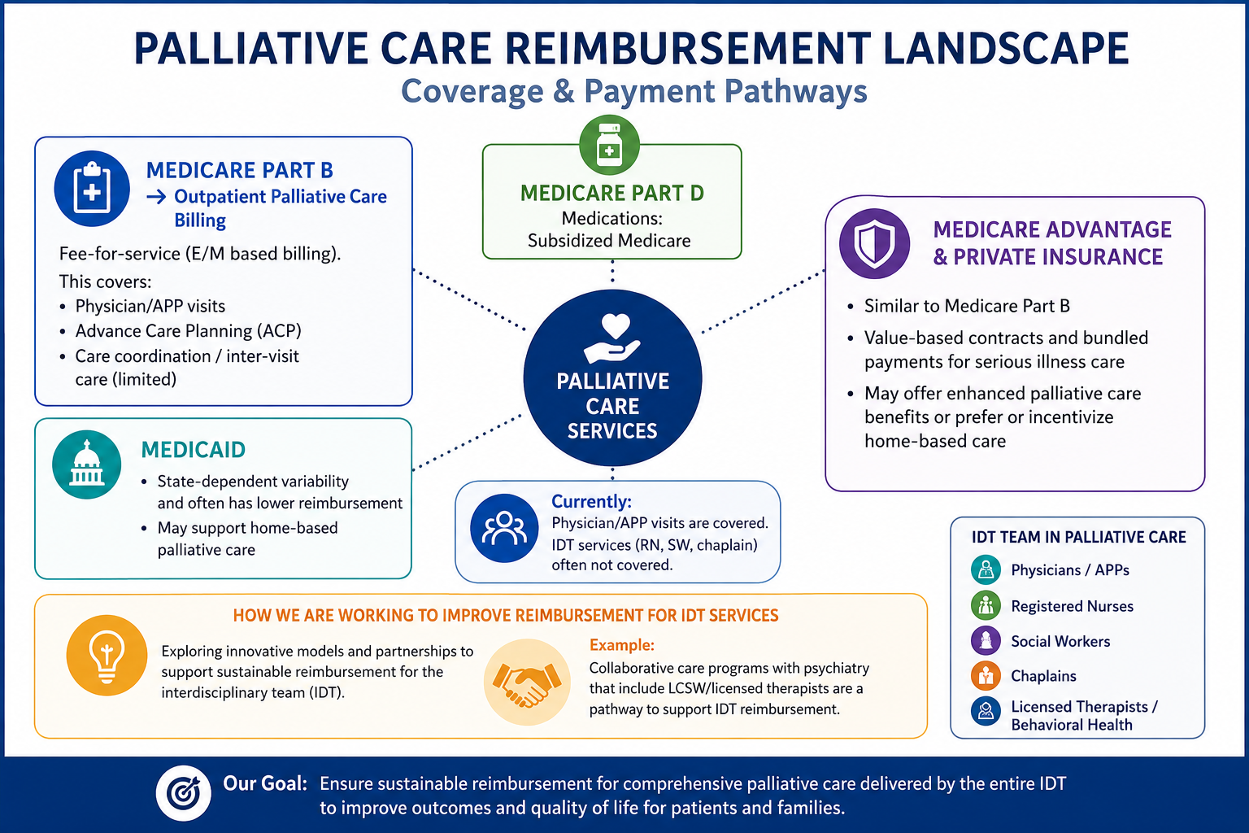
By OpenAI's ChatGPT, April 2026 (www.chatgpt.com). Figure generated using the prompt "create an image to organize the following information"​
​
Notes:
Presenter: Victoria Sweetnam
Facilitator:
Medicare advantage: both private and heavily subsidized by the government.

Slide 9
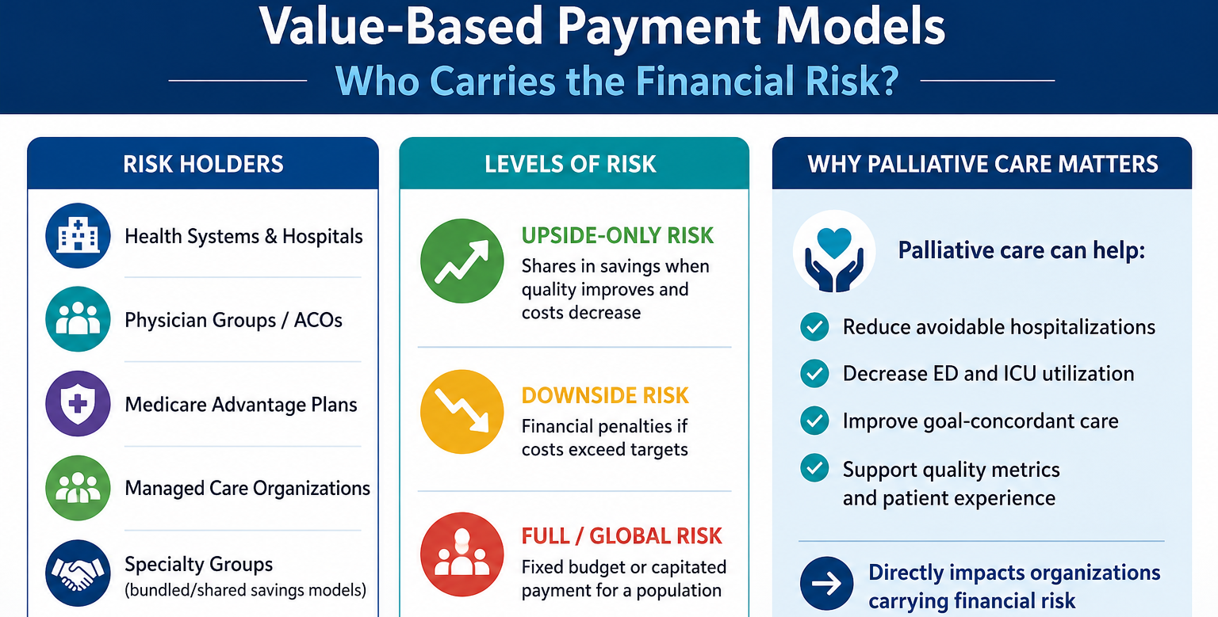
By OpenAI's ChatGPT, April 2026 (www.chatgpt.com). Figure generated using the prompt "create an image to organize the following information"​
​
Notes:
Presenter: Victoria Sweetnam

Slide 10
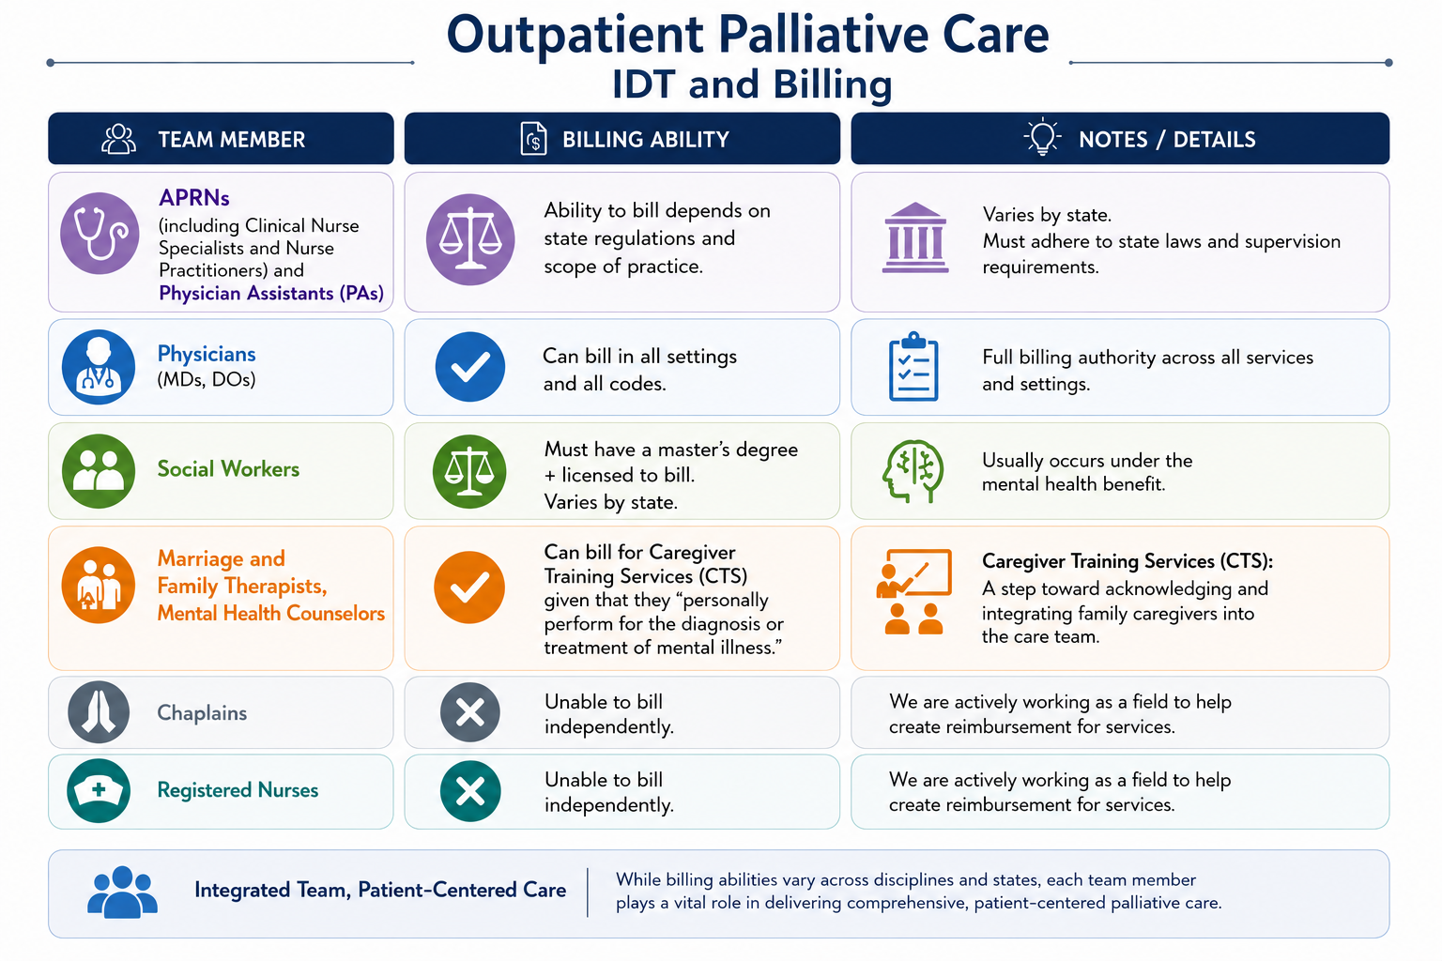
By OpenAI's ChatGPT, April 2026 (www.chatgpt.com). Figure generated using the prompt "create a schematic for the following information"​
​
Notes:
Presenter: Victoria Sweetnam

Slide 11
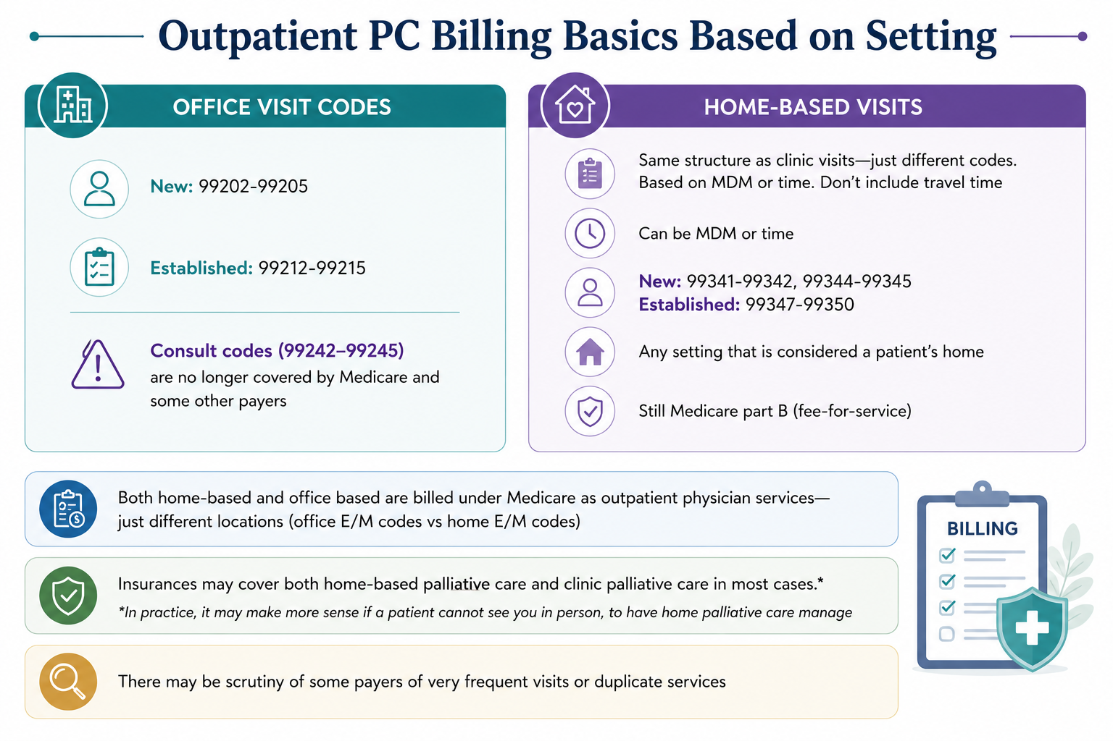
By OpenAI's ChatGPT, May 2026 (www.chatgpt.com). Figure generated using the prompt "make an aesthetic figure for Outpatient PC Billing Basics Based on Setting to organize the following information"​
​
Notes:
Presenter: Victoria Sweetnam

Slide 12
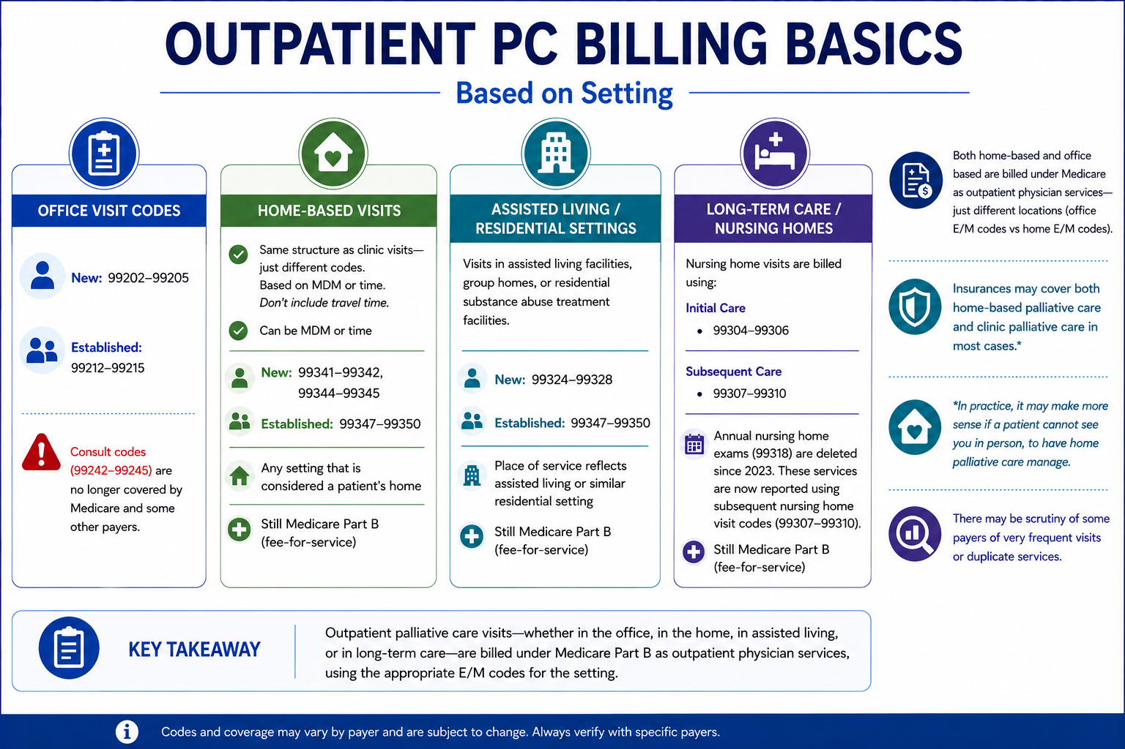
By OpenAI's ChatGPT, April 2026 (www.chatgpt.com). Figure generated using the prompt "create an image to organize the following information"​
​
Notes:
Presenter: Victoria Sweetnam

Slide 13
Documentation for Outpatient PC Billing
-Key Points
-Terminology
Notes:
Presenter: Tammie Quest

Slide 14
Documentation Pearls for Outpatient PC Billing
Documentation should be concise and support billing requirements to include a medically appropriate history and physical
Documentation should let consultants/others know key info for good patient care + have just the minimum required for billing
Each note should be able to “standalone” to support that date’s billing
Notes:
Presenter: Tammie Quest

Slide 15
Key Point: Before you document after the encounter, decide if you are billing on complexity ("MDM")) vs time. This will save you time and ensure you have all required elements.
Notes:
Presenter: Tammie Quest
FACILITATOR: If billing on complexity, the billing "grid elements" for the different LOS will need to include specific elements. If you bill on time, you do not need the specific language for all of the grid elements, you just need a total time statement. We will get into the specifics of this later in the lecture.

Slide 16
Outpatient Billing Documentation³
Write your time statement with only the things you did and include a total time number from MN to MN on day of service (i.e. don't say ">30 minutes")
Billing based on complexity/"MDM" --> levels 1-5
Billing Statement Based on Time
  Total Time: *** minutes spent preparing to see the patient (reviewed relevant labs/tests), obtaining and/or reviewing separately obtained history, performing a medically appropriate evaluation, counseling and educating the patient/family/caregiver, ordering medications, tests and/or procedures, referring and communicating with other healthcare professionals, documenting clinical information in the electronic health record, care coordination
Billing Statement Based on Time for Advanced Care Planning
Time Spent in Advanced Care Planning:_________minutes
Notes:
Presenter: Tammie Quest
FACILITATOR: These are examples of billing statements one can use for time (we will talk more in depth later about what this entails) and ACP statements (which is a separate concept entirely and billed separately always on time). The Take-home here is still that you either bill on time or complexity. Make sure that you write your time statements with only the things that you did and include a total time number on day of service from MN to MN.

Slide 17
New vs. Established Patients
New: A patient who has not received any professional services from the same specialty and subspecialty in the same group practice in the past three years.
Established: A patient who has received professional services from the same specialty and subspecialty in the same group practice in the past three years.
When APPs are working with physicians, they are considered working in the exact same specialty and subspecialty as the physician.
Notes:
Presenter: Tammie Quest

Slide 18
What is better: Billing on Time or Complexity ("MDM")?
Spoiler alert: it depends.
Notes:
Presenter: Tammie Quest

Slide 19
Billing on Time
Notes:
Presenter: Tammie Quest

Slide 20
Pearls: Billing on Time
What activities count?
  Pre-charting/preparing to see the patient
  Anything in the encounter face-to-face with the patient (counseling, educating w/patient or caregiver, physical examination)
  Documentation
  Ordering meds, imaging
  Communicating with other providers (outside of your specialty) about that patient
  Care coordination
Document an exact "total time" from MN to MN on day of service
Notes:
Presenter: Tammie Quest
FACILITATOR:
Try and be as specific with the "exact total time"--> don't just write >30 minutes

Slide 21
Billing on Complexity ("Medical Decision Making")
Notes:
Presenter: Tammie Quest

Slide 22
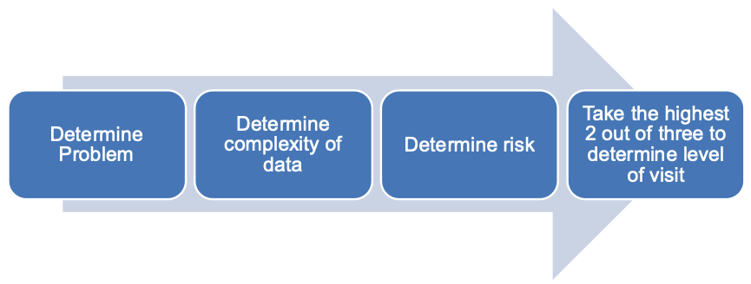
To Determine a Code/LOS by Complexity
Figure by CAPC, retrieved from https://www.capc.org/documents/download/1084/ on May 10, 2026. ⁴
Notes:
Presenter: Tammie Quest

Slide 23
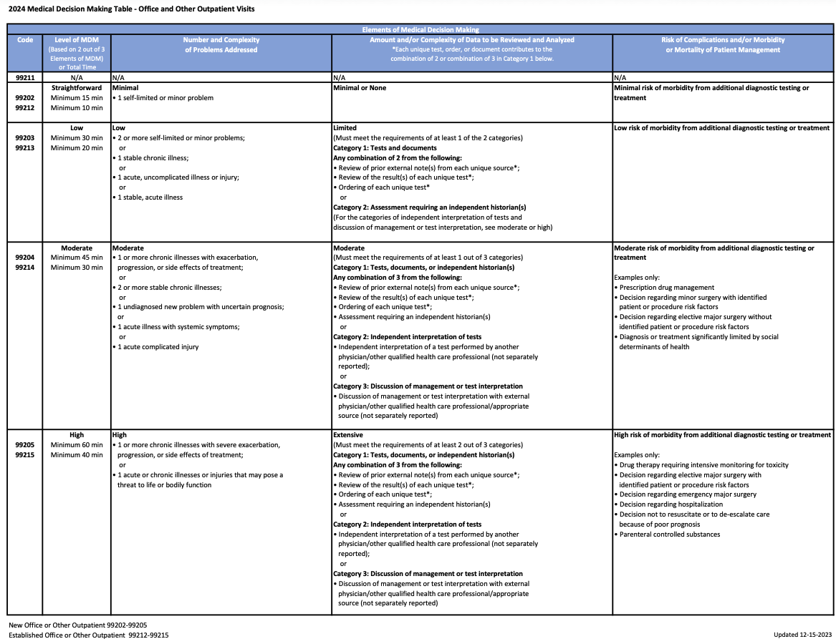
Figure adapted from AMA, retrieved from Medicare Claims Processing Manual on March 25, 2026.⁵
Notes:
Presenter: Tammie Quest

Slide 24
Figure adapted from AMA, retrieved from Medicare Claims Processing Manual on March 25, 2026.⁵
Notes:
Presenter: Tammie Quest

Slide 25
Figure adapted from AMA, retrieved from Medicare Claims Processing Manual on March 25, 2026.⁵
Notes:
Presenter: Tammie Quest

Slide 26
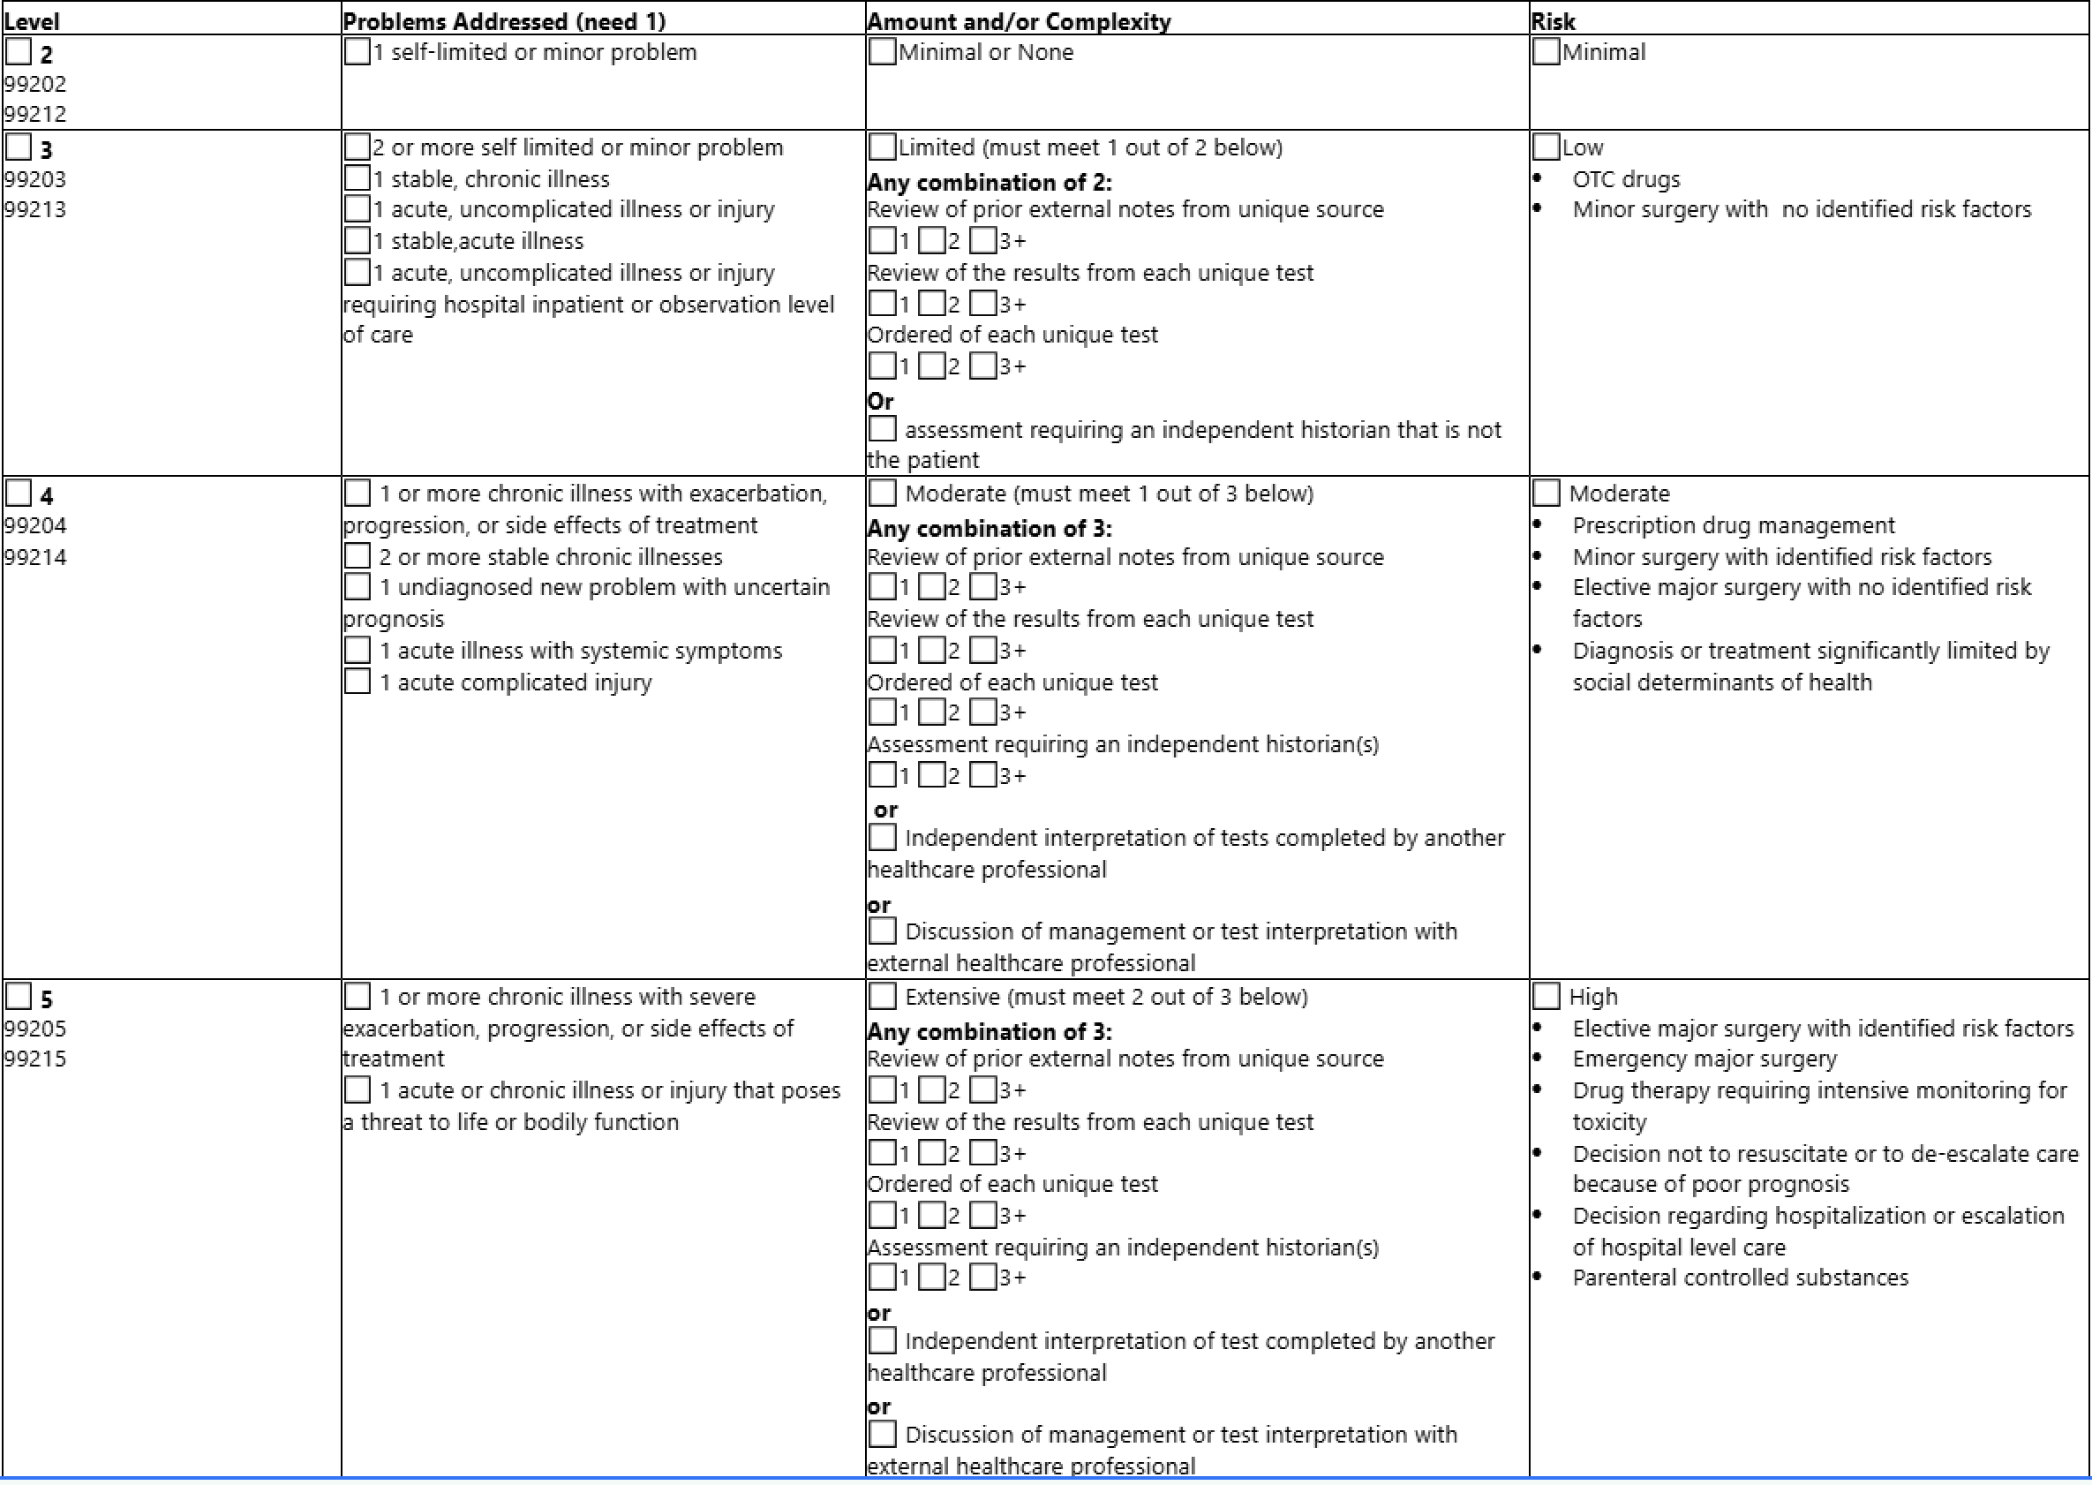
Outpatient Billing Documentation
Billing Statement Based on Medical Decision Making
"link to drugs requiring intensive monitoring" ​
Figure adapted from AMA, retrieved from Medicare Claims Processing Manual on March 25, 2026.⁵
Notes:
Presenter: Tammie Quest
FACILITATOR:
Here is a guide to help you see via checkboxes

Slide 27
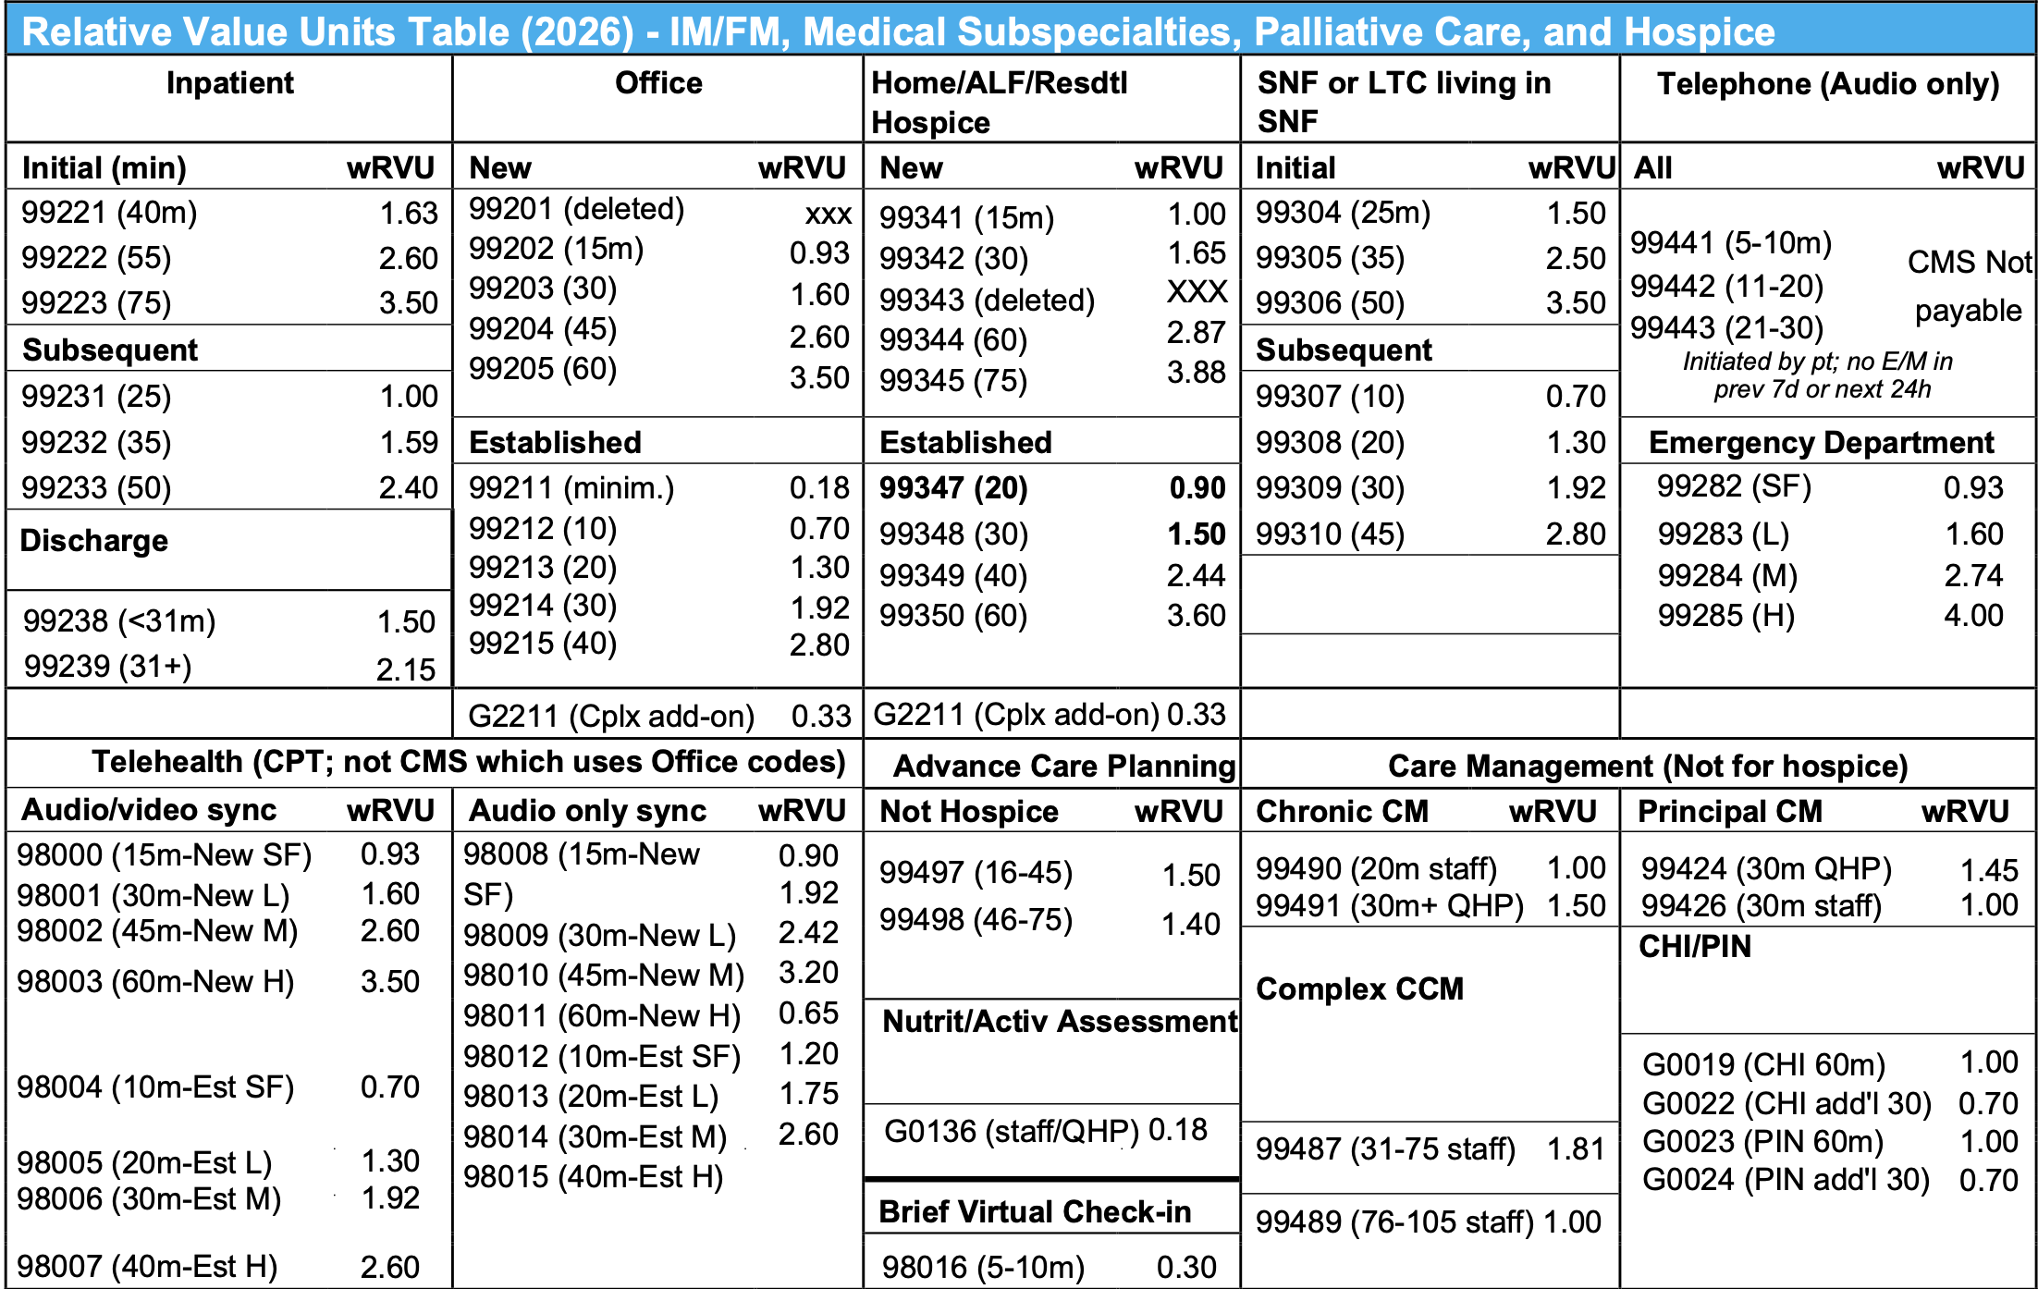
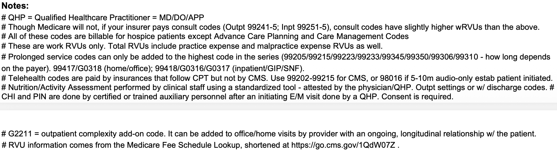
Figure by CAPC, retrieved from https://www.capc.org/documents/download/1088/[educational material] on May 11, 2026.⁶
Notes:
Presenter: Ginna Evans

Slide 28
In Summary: Core Outpatient E/M Codes⁷
Visit Type | Code | Time | Notes
New | 99202–99205 | 15–74 min | 99204-05 common​
Established | 99212–99215 | 10–54 min | 99214–15 common
Consults | 99242–99245 | (Variable) 20-69 min | Often replaced; still exist in CPT, but Medicare and many others generally do not recognize/pay them. When not recognized uses new/established office visit codes instead
Notes:
Presenter: Ginna Evans

Slide 29
In Summary: Core Outpatient E/M Codes (wRVU)⁷
Visit Type | Code | Time | wRVU
New | 99202 | 15–29 | 0.93
 | 99203 | 30–44 | 1.60
 | 99204 | 45–59 | 2.60
 | 99205 | 60–74 | 3.50
Established | 99212 | 10–19 | 0.70
 | 99213 | 20–29 | 1.30
 | 99214 | 30–39 | 1.92
 | 99215 | 40–54 | 2.80
Notes:
Presenter: Ginna Evans

Slide 30
Learning Objective
Appraise outpatient billing pearls including: application of add-on codes, telehealth, and advanced care planning
Notes:
Presenter: Ginna Evans

Slide 31
Add-On & Prolonged Codes (wRVU)⁷
Code | Name | wRVU
+99417/G2212 | Prolonged Services for extended visits (depending on payer preference) | 0.61
+G2211 | Visit Complexity for longitudinal care (updated 2026 for office, home, residence) | 0.33
Notes:
Presenter: Ginna Evans

Slide 32
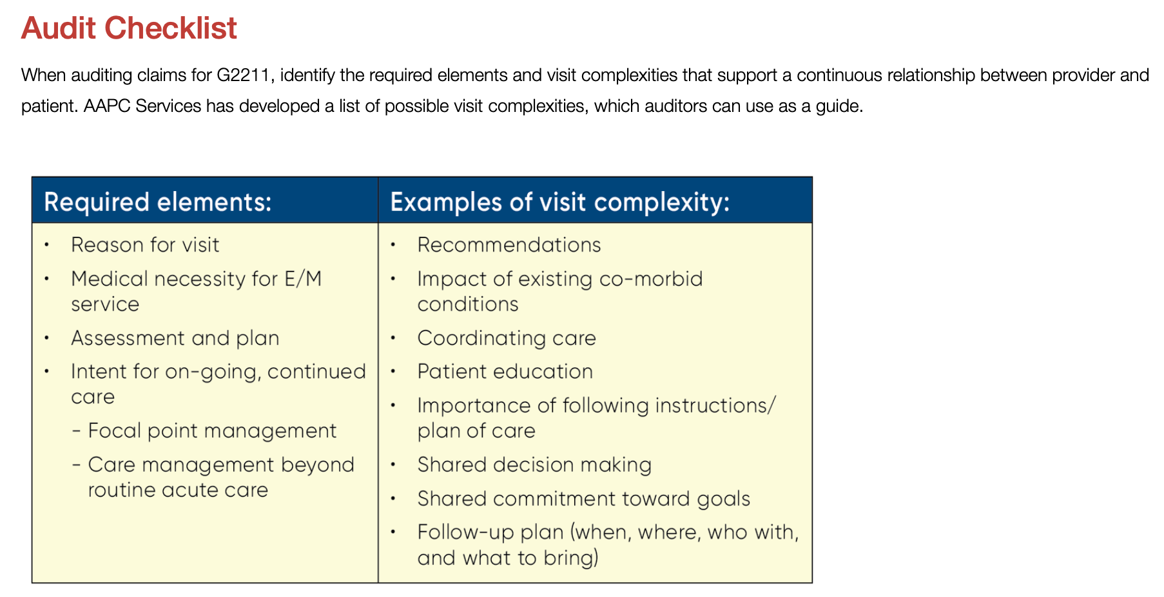
Add-on: The G2211 Code
Do you own this problem?
Physicians should bill G2211 if they are the continuing focal point for all needed services, such as a primary care practitioner, or they provide ongoing care for a single, serious, or complex condition
Figure by AAPC Knowledge Center, retrieved from https://www.aapc.com/blog/91931-bill-g2211-with-confidence-and-modifier-25/ on March 25, 2026.⁸
Notes:
Presenter: Ginna Evans
FACILITATOR:
-commonly "owned" problems in palliative care: cancer-related pain, neoplasm fatigue, cancer cachexia, dyspnea, anxiety, depression, insomnia. Think of your ESAS!
-Some payers that are paying and others are not. Fixed on the backend.

Slide 33
E/M: Advance Care Planning (wRVU)⁵
Code | Description | wRVU
99497 | ACP initial First 16-45 minutes | 1.50
+99498 | ACP additional units 46 minutes and beyond | 1.40
Notes:
Presenter: Ginna Evans

Slide 34
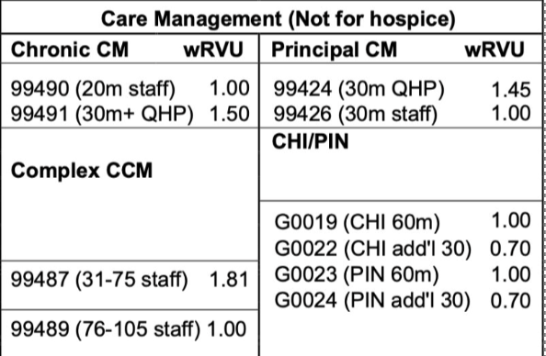
E/M: Care Management Codes (wRVU)^{7,9}
Another opportunity for clinic revenue
To create a "medical home,"
E.g., monitoring programs/clinics for A1c, BP monthly
Proactive way of managing a patient
Requirements:
    >2/= chronic conditions, ongoing care coordination
    Often underutilized in PC but should be as this code is best used in high-touch outpatient populations with frequent phone coordination needs.
Figure by CAPC, retrieved from https://www.capc.org/documents/download/1088/[educational material] on May 11, 2026.⁶
Notes:
Presenter: Ginna Evans

Slide 35
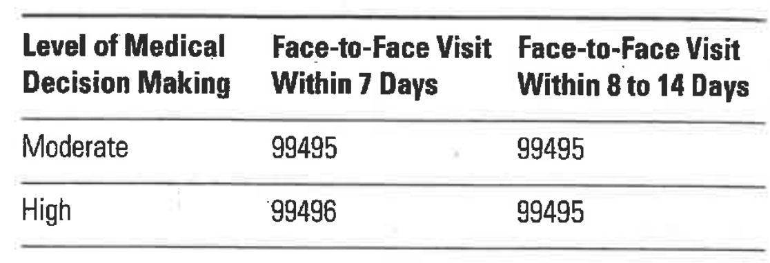
E/M: TCM Codes⁷
Another opportunity for clinic revenue
Codes: 99495 & 99496
Requires a moderate or high level of complexity/MDM during transition from the patient's inpatient --> community setting
Day of discharge + next 29 days
One F2F visit within time-frame of D/C (by physician)+ 1 non-F2F within 2 days (physician/other qualified health professional and/or licensed clinical staff under his/her direction)
  Ideal for hospital discharge clinics by a provider and a RN to check on a patient
Figure by American Medical Association. CPT 2026 Professional Edition. American Medical Association; 2025.⁷
Notes:
Presenter: Ginna Evans

Slide 36
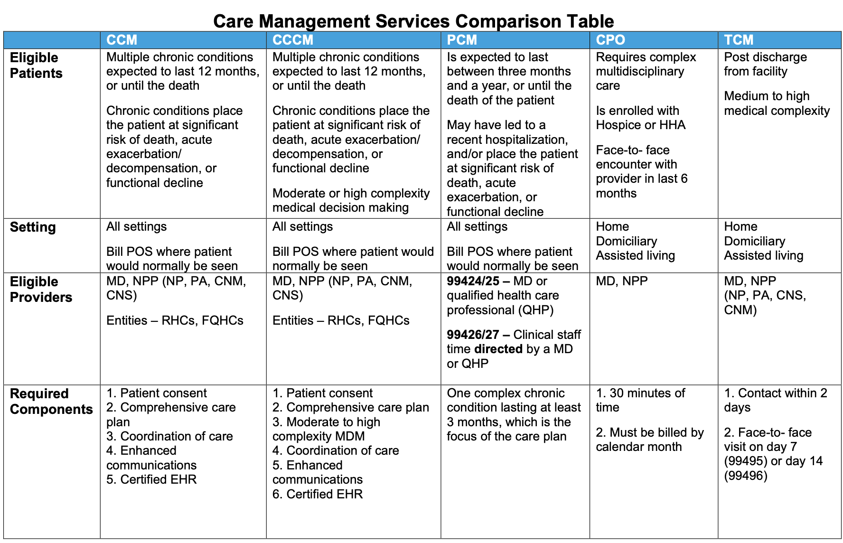
Figure by CAPC, retrieved from https://www.capc.org/documents/download/362/[educational material] on May 11, 2026.¹⁰
Notes:
Presenter: Ginna Evans

Slide 37
Add-On: Physical activity and nutrition (formally SDOH (wRVU)⁷
Code | Description | wRVU
G0136 | Used to be Social Determinants Of Health (SDOH) assessment--> updated 2026 now physical activity and nutrition. One visit per 6 mo. CMS only. Validated instrument. 5-15min of staff time (typically by staff). | 0.18
Notes:
Presenter: Ginna Evans
FACILITATOR:
Look at 49:55 https://www.capc.org/events/recorded-webinars/palliative-care-billing-in-2026-whats-new-what-matters-and-whats-next/

Slide 38
Add-on: Caregiver Training⁷
Effort to try to bring the caregiver into the careteam
Code | Description | wRVU
G0541 | Initial (full) 30 minutes. Caregiver training in direct care strategies and techniques to support care for patients with ongoing condition and to reduce complications (w/o patient present), F2F ​ | 0.18
G0542 | G0541 + Each additional 15 minutes | 0.70
G0543 | Group caregiver training in direct care strategies to support care for patients with ongoing condition and to reduce complications (w/o patient present) F2F with multiple sets of caregivers | 1.40
Notes:
Presenter: Ginna Evans

Slide 39
Additional Codes: the Virtual Brief Check-In 98016
CPT 98016: a brief synchronous communication technology service
A single 5–10 minute medical discussion that is not related to an E/M service in the previous 7 days and does not lead to one within the next 24 hours or soonest available appointment.
Described as the CPT replacement for the old CMS “virtual check-in” code.
Think of 98016 ≈ ~0.3 wRVU
Useful for:
  Symptom check-ins
  Medication clarification
  Early triage conversations
But won’t generate much RVU volume alone → better as part of a broader longitudinal strategy (e.g., CCM + G2211 + E/M)
Consider for inter-visit care!
Notes:
Presenter: Ginna Evans

Slide 40
ACP for the Outpatient Provider¹¹⁻¹²
Needs SEPARATE documentation from encounter. SEPARATE TIME is also documented pertaining to only ACP.
  Line through a note or create a separate note to designate ACP; also include a separate time statement. You need to make this SUPER CLEAR
ACP Units
  99497 (16-30 min)
  +99498 (each additional 30 min)
Pearls:
  Recommendation: bill your medical visit on complexity + bill your ACP (because you have to) on time
    It would be HARD to bill both the medical visit and the ACP both on time. May be an audit flag.
    If you did bill both on time, the language would need to be SUPER CLEAR
    Often get better reimbursement for complexity + ACP
Notes:
Presenter: Tammie Quest

Slide 41
What Counts as ACP? ¹¹⁻¹²
Does not require completion of a formal advanced directive
Can include things like:
  Counseling
  Discussion of ADs and of the risks/benefits
  Alternatives to various ACP tools (AD, living will, durable power of attorney, POLST/MOST)
  A patient's values and overall goals for treatment,
  Palliative and treatment-focused options
  Ways to avoid hospital readmission including hospice, care preferences should the patient suffer another adverse health event
  Discussion of surrogate decision makers
  *Review with your compliance team to ensure good understanding about ACP at your institution
Notes:
Presenter: Tammie Quest

Slide 42
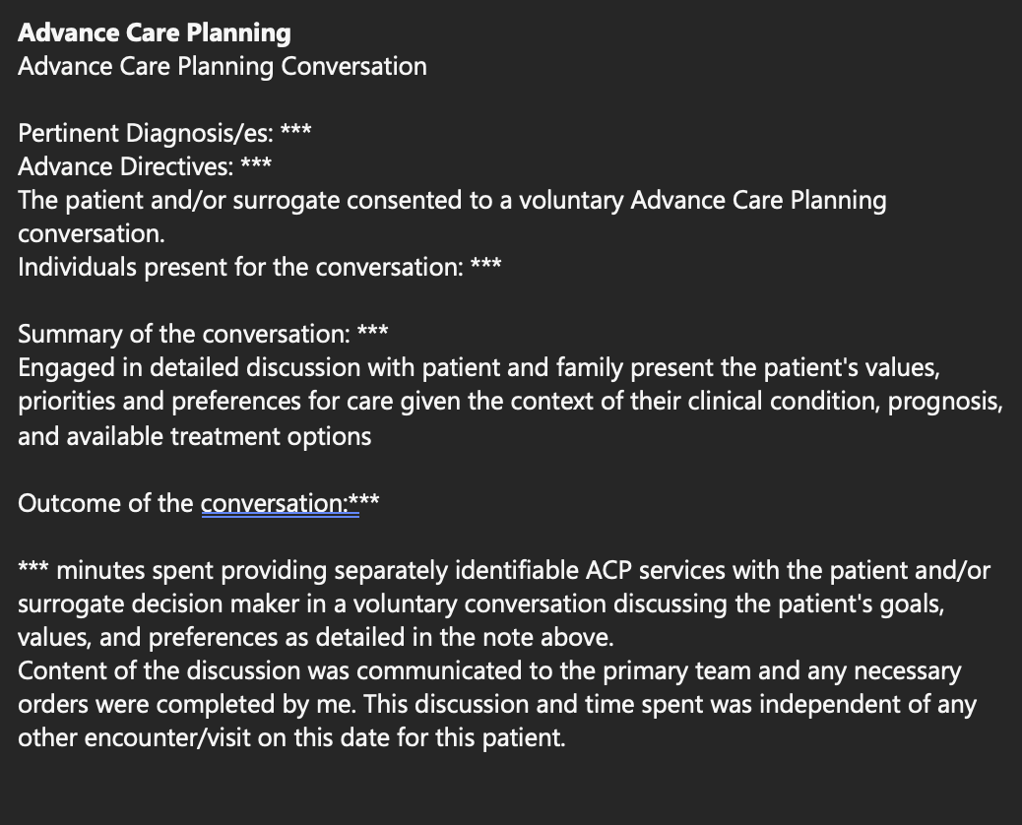
Initial ACP
Note
This must be a NEW ACP conversation that has NOT been had by any provider during the same year. Cannot bill twice in the same year for a NEW ACP conversation
Need to create a new note entirely for this conversation or make it VERY CLEAR within the same note that this was separate time accounted for and billed for
Notes:
Presenter: Tammie Quest

Slide 43
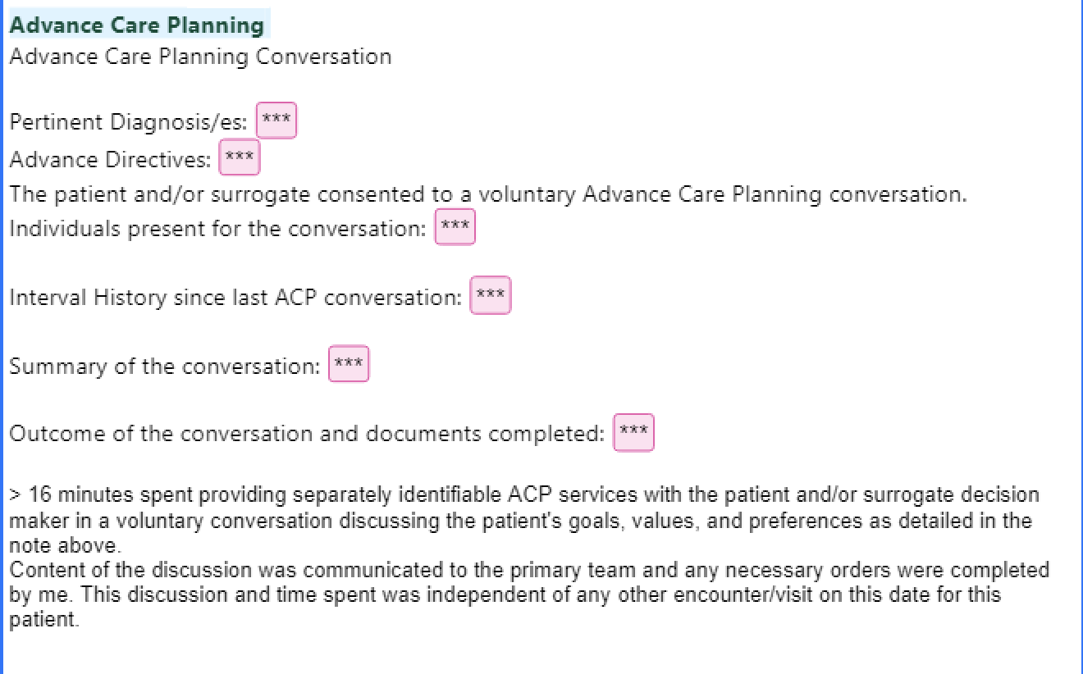
Subsequent
ACP Note
Since this is a subsequent ACP conversation, you must document what has clinically CHANGED in the patient since last ACP conversation was documented.
*NOTE: there is NO change in the ACP code for initial vs subsequent convesattion
***
Image created by author
Notes:
Presenter: Tammie Quest

Slide 44
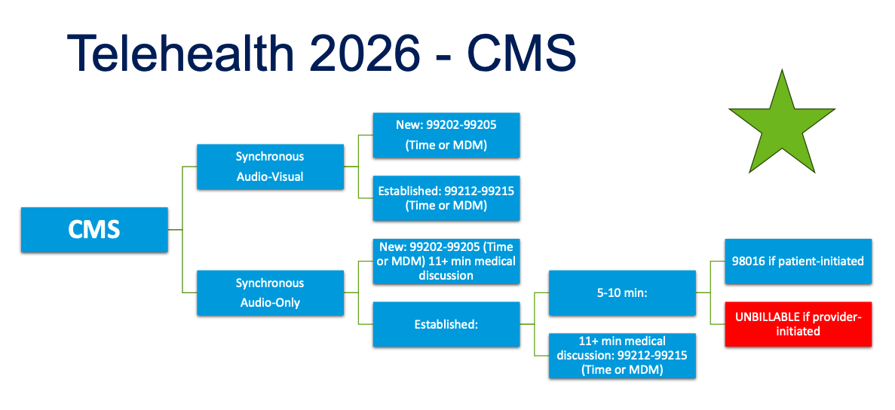
CPT only copyright 2024. American Medical Association. All rights reserved.
Figure from CAPC. Retrieved from: doi:https://www.capc.org/events/recorded-webinars/palliative-care-billing-in-2026-whats-new-what-matters-and-whats-next/ on April 22,2026. ¹²
Notes:
Presenter: Victoria Sweetnam

Slide 45
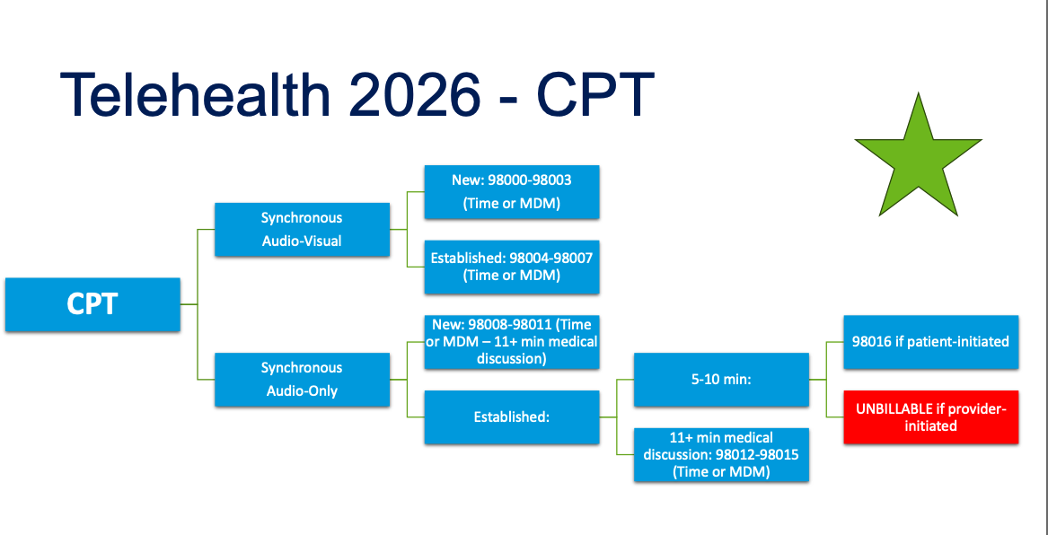
Figure from CAPC. Retrieved from: doi:https://www.capc.org/events/recorded-webinars/palliative-care-billing-in-2026-whats-new-what-matters-and-whats-next/ on April 22,2026. ¹²
CPT only copyright 2024. American Medical Association. All rights reserved.
Notes:
Presenter: Victoria Sweetnam
Facilitator:
Think about using these audio-only calls or brief check-in codes when you are on call, for portal messages

Slide 46
Telehealth in Outpatient PC
Post-COVID this expanded
Bill standard E/M codes + modifier (95 for video, 93 for audio only)
Helpful for patients
  who have been coming to clinic but are now declining and terminal, not ready yet for hospice
  Need acute symptom management and cannot physically come in
Rule of thumb: if a patient cannot see me in clinic, they are likely not most appropriate for PCC and likely most appropriate for home palliative care
  It is best practice for long-term controlled medication management, also dictated by state laws, to be able to see a patient in person.
    In the Emory SCC, patients on controlled medications are seen at least q6 months in person and in between q3 months virtually is allowed
    Exceptions, per state, for the terminally ill
Notes:
Presenter: Victoria Sweetnam

Slide 47
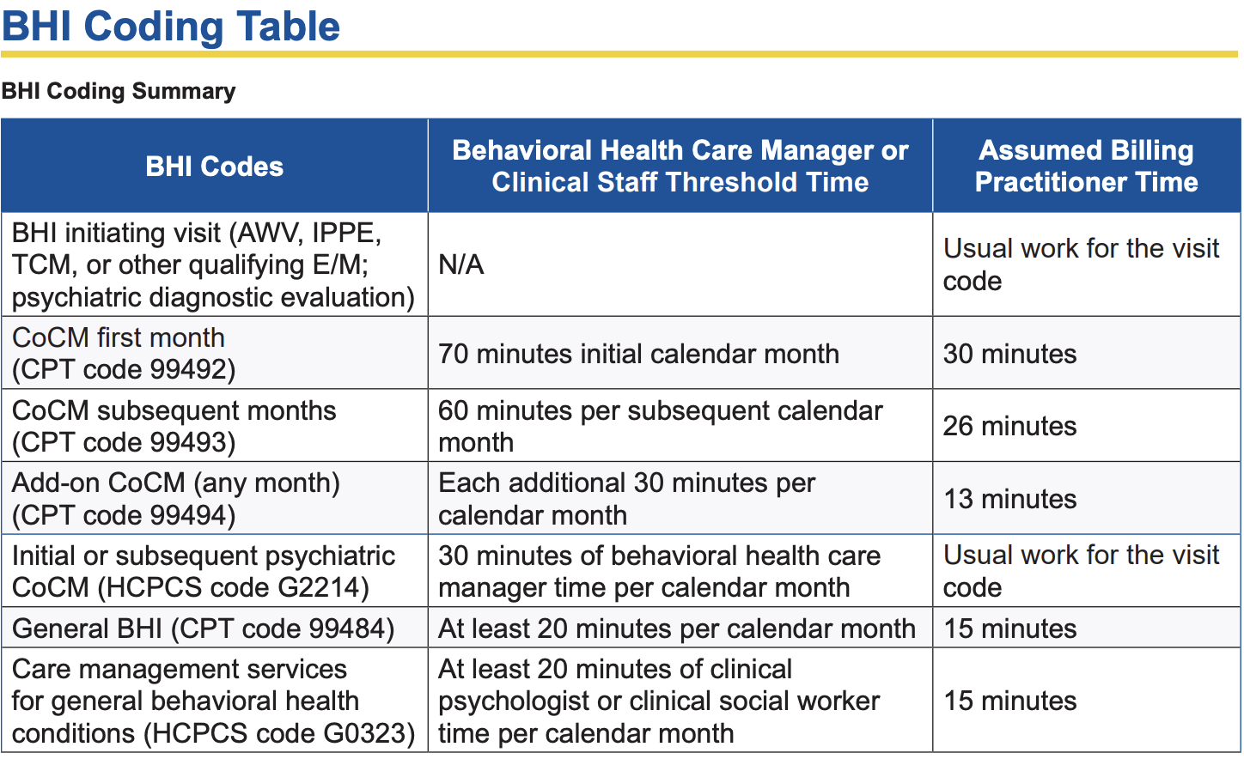
Palli-psych Collaborative Care Model
In SCC, we have a collaborative care model with palliative care and psychiatry
LCSW become trained licensed therapists and conduct therapy with patients
  Expands access to mental health
  Increases interdisciplinary communication "in house" for better care
  Our LCSW/therapies are specialized in caring for complex serious illness (especially cancer)which is unique in the mental health space
Payment is based on time
Codes: 99492-99494
Opportunity for IDT re-imbursement!
Figure from CMS, retrieved from: https://www.cms.gov/files/document/mln909432-behavioral-health-integration-services.pdf on April 22,2026.​¹³
​
Notes:
Presenter: Victoria Sweetnam

Slide 48
Learning Objective
Compare common outpatient PC billing pit-falls and optimization strategies
Notes:
Presenter: Victoria Sweetnam

Slide 49
Outpatient PC Billing Pitfalls
Underbilling for what you actually do
  Not billing enough of ALL the time spent
  Not using correct time documentation
  Under-coding complexity and not documenting the supporting elements
  Not realizing that you are actually conducting ACP and not billing for it.
It may be higher yield to bill on complexity for the visit and then bill units of separate ACP.
If billing both E/M visit on time AND ACP on time, ensure both are CLEARLY seperately documented
Poor ICD-10 linkage
Forgetting your add-on codes! Revenue comes from stacking E/M complexity with appropriate add-on codes, not just visit volume
  Forgetting G2211 when eligible
Notes:
Presenter: Victoria Sweetnam
FACILITATOR: ICD-10 codes tell the story, how sick they are, could result in a denial/kick back to billing

Slide 50
Outpatient PC Billing Optimization Strategies
Get credit for the inter-visit care
  "Brief Check-In Code" 98016 for portal messages, on-call messages
Utilize the add-on codes
Bill the ACP; it is more than just completing formal documents
Master when its best to use time vs. complexity billing
Based on complexity of our PC patients, most MDM visits are a level 4 or 5
See if your clinic could set up a way to utilize CCM or TCM codes
Notes:
Presenter: Victoria Sweetnam

Slide 51
Summary: High Yield Outpatient PC Add-on and E/M Codes and RVU Compensation
Code | Description | wRVU | When to Use
G2211 | Longitudinal care complexity | 0.33 | Ongoing patient relationship
99497 | Advance Care Planning (16–30 min) | 1.5 | GOC, code status discussions, ACP planing
+99498 | Each add’l 30 min ACP | 1.4 | Extended ACP time
99490,99491 | Chronic Care Mgmt | 1.0, 1.5 | Non-face-to-face care
99487,88489 | Complex Chronic Care Mgmt | 1.81,1.0 | Primarily on-face-to-face care, monthly proactive monitoring
99495,99496 | Transitional Care Codes | 2.29, 3.10 | Transition IP to community
G0136 | Physical activity and nutrition (former SDOH) | 0.18 | Formal nutrition and activity assessment q6mo
Notes:
Presenter: Victoria Sweetnam

Slide 52
Learning Objective
Evaluate value-based care in outpatient PC
Notes:
Presenter: Victoria Sweetnam

Slide 53
What is Value-Based Care and How Does Outpatient Palliative Care Fit?
Value= quality/ cost
Palliative care naturally aligns with value-based care and value-based payment models¹⁴
Outpatient palliative care focuses on improving patient outcomes, reducing crises and hospitalizations, improving patient experience, enhancing QOL
Notes:
Presenter: Victoria Sweetnam

Slide 54
Where does the value come from?
1) Avoided utilization
Metrics: fewer ED visits, fewer hospital admissions, shorter hospital stays
2) Earlier goals-of-care discussions
Avoids: non-beneficial/harmful higher level care at EOL (i.e., hospital or ICU care)
Earlier appropriate transition to hospice use full benefit
Improved goal-concordant care
3) Quality symptom control
Prevents crises that lead to ED visits
Patients with serious illness have high symptom burden and often get "lost in the system"
4) Improved care coordination
Reduces fragmentation across primary care, subspecialties, and the larger health system
5) Patient Satisfaction
Metrics: Press Ganey
Notes:
Presenter: Victoria Sweetnam

Slide 55
Billing Practice!
Notes:
Presenter: Victoria Sweetnam

Slide 56
Billing Example
Scenario: This is an established patient. E/M visit showed that the provider increased opioid pain medications for severe worsening cancer pain due to POD which took 25 minutes. ACP discussion with patient included stopping cancer-directed therapies given declining PPS and change in goals. Hospice was then decided upon. This ACP discussion took 47 minutes). Communicated with the oncologist about the above.
99215 = 2.8 wRVU
  25 minutes spent for the E/M
  Problem: 1 or more chronic illnesses with severe exacerbation
  Cat 2 of data: Reviewed and interpreted the images of the last MRI Abdomen which correlates with POD and worsening cancer pain with need for escalating opioid requirements. Also reviewed the last CMP and CBC
  Cat 3 of data: Spoke with oncologist
+ ACP units 1 & 2 (99497 1.5 wRVU + 99498 1.4 wRVU) (47 mins total)
Complexity billing + ACP time --> Total =5.7 wRVU
*Here, it is more beneficial to bill on complexity for E/M instead of time
Notes:
Presenter: Victoria Sweetnam

Slide 57
References
Center to Advance Palliative Care (CAPC). Palliative Care Billing in 2026: What’s New, What Matters, and What’s Next. Recorded January 27, 2026. Accessed April 22, 2026. https://www.capc.org/events/recorded-webinars/palliative-care-billing-in-2026-whats-new-what-matters-and-whats-next/
Esch AE, Silvers A. Navigating payment models: what palliative care teams need to know. Center to Advance Palliative Care. Published June 18, 2025. Accessed May 7, 2026. https://www.capc.org/blog/navigating-payment-models-what-palliative-care-teams-need-to-know/?utm_source=chatgpt.com
American Medical Association. 2023 CPT E/M descriptors and guidelines. Updated January 1, 2023. Accessed May 11,2026. https://www.ama-assn.org/system/files/2023-e-m-descriptors-guidelines.pdf
Center to Advance Palliative Care. [Fundamental of Billing and Coding: Outpatient Billing]. Published [2026]. Accessed May 7, 2026. https://www.capc.org/documents/download/1084/
Centers for Medicare & Medicaid Services. Medicare Claims Processing Manual. CMS Publication No. 100-04. Updated [Insert Revision Date]. Accessed May 11, 2026. https://www.cms.gov/regulations-and-guidance/guidance/manuals/internet-only-manuals-
Center to Advance Palliative Care. Relative Value Units Table (2026)-IM/FM, Medical Subspecialties, Palliative Care, and Hospice. Published 2026. Accessed Nay 11, 2026. https://www.capc.org/documents/download/1088/
American Medical Association. CPT 2026 Professional Edition. American Medical Association; 2025.
Bill G2211 With Confidence (and Modifier 25).” AAPC Knowledge Center. Published March 24, 2025. Accessed May 6, 2026. https://www.aapc.com/blog/91931-bill-g2211-with-confidence-and-modifier-25/
Center to Advance Palliative Care. Chronic Care Management (CCM) & Complex Chronic Care Management (CCCM) Codes. Published 2025. Accessed May 11, 2026. https://www.capc.org/documents/download/357/
Center to Advance Palliative Care. Care Management Services Comparison Table. Published 2026. Accessed May 11, 2026. https://www.capc.org/documents/download/362/
Jones CA, Acevedo J, Bull J, Kamal AH. Top 10 Tips for Using Advance Care Planning Codes in Palliative Medicine and Beyond. J Palliat Med. 2016;19(12):1249-1253. doi:10.1089/jpm.2016.0202
Rodgers P, Jones C. Palliative Care Billing in 2026: What’s New, What Matters, and What’s Next. Center to Advance Palliative Care. Published January 27, 2026. Accessed May 11, 2026. https://www.capc.org/events/recorded-webinars/palliative-care-billing-in-2026-whats-new-what-matters-and-whats-next/
Centers for Medicare & Medicaid Services. Behavioral Health Integration Services. Medicare Learning Network. Published January 2026. Accessed May 11, 2026. https://www.cms.gov/files/document/mln909432-behavioral-health-integration-services.pdf
Esch AE, Silvers A. Navigating Payment Models: What Palliative Care Teams Need to Know. Center to Advance Palliative Care. Published June 18, 2025. Accessed May 11, 2026. https://www.capc.org/blog/navigating-payment-models-what-palliative-care-teams-need-to-know/
Notes:
Presenter: Victoria Sweetnam

Slide 58
Thank you

Slide 59
Appendix:
Additional Definitions from the Complexity Grid for Reference
Notes:
Presenter: Ginna Evans
FACILITATOR: These are some slides for your reference only that help define elements of the complexity grid

Slide 60
MEDICAL DECISION-MAKING DEFINITIONS
PROBLEMS⁷
Problem: Disease, condition, illness, injury, sign, symptom, finding, complaint or other matter addressed with or without a diagnosis established at the time of encounter
The problems a patient has ARE the diagnoses.
Each diagnosis has a diagnosis ICD-10 code
  ICD-10 codes are important because they
    Help support medical complexity
    Help with medication/imaging approvals by insurance
  ICD-10 diagnosis codes have to be specific
Diagnoses are listed in order of importance with the first being as "most important" discussed --> designated in Epic EMR with a solid diamond shape
Notes:
Presenter: Tammie Quest

Slide 61
MEDICAL DECISION-MAKING DEFINITIONS PROBLEMS⁷
Minimal Problem - Problem that does not require presence of a provider. If the service is provided under the supervision of the provider, see 99211
Self-limited or Minor problem - Problem that runs a definite and prescribed course, is transient in nature and not likely to permanently alter health status
Stable, chronic illness: A problem with an expected duration of at least a year or until the death of the patient whether or not stage or severity changes (e.g., uncontrolled diabetes and controlled diabetes are a single chronic condition).
  Stable - Defined by the specific treatment goals for an individual patient
  A patient that is not at their treatment goal is not stable, even if the condition has not changed and there is no short- term threat to life or function.
    For example, uncontrolled pain in IV cancer patient that is not at goal 3-4/10 tolerable/functional level of pain requiring opioid pain medication that is being titrated is NOT a stable, chronic illness.
Notes:
Presenter: Tammie Quest

Slide 62
MEDICAL DECISION-MAKING DEFINITIONS PROBLEMS⁷
Acute, uncomplicated illness or injury: A recent or new short-term problem with low risk of morbidity for which treatment is considered.
  Little to no risk of mortality with treatment, and full recovery without functional impairment is expected.
  Normally a self-limited or minor problem but is not resolving consistent with a definite and prescribed course.
  E.g., cystitis, allergic rhinitis, or a simple sprain.
Chronic illness with exacerbation, progression, or side effects of treatment: An illness that is acutely worsening, poorly controlled or progressing with an intent to control progression and requiring additional supportive care or requiring attention to treatment for side effects, but that does not require consideration of hospital level of care.
Undiagnosed new problem with uncertain prognosis: A problem in the differential diagnosis that represents a condition likely to result in a high risk of morbidity without treatment. E.g.,a lump in the breast.
Acute illness with systemic symptoms: An illness that causes systemic symptoms and has a high risk of morbidity without treatment. Systemic symptoms may not be general but may be single system. E.g., pyelonephritis, pneumonitis, or colitis.
Notes:
Presenter: Tammie Quest

Slide 63
MEDICAL DECISION-MAKING DEFINITIONS
PROBLEMS⁷
Acute complicated injury: An injury which requires treatment that includes evaluation of body systems that are not directly part of the injured organ, the injury is extensive, or the treatment options are multiple and/or associated with risk of morbidity. An example maybe a: An injury which requires treatment that includes evaluation of body systems that are not directly part of the injured organ, the injury is extensive, or the treatment options are multiple and/or associated with risk of morbidity. An example maybe a: An injury which requires treatment that includes evaluation of body systems that are not directly part of theinjured organ, the injury is extensive, or the treatment options are multiple and/or associated with risk of morbidity. An example maybe a head injury with brief loss of consciousness.
Chronic illness with SEVERE exacerbation, progression, or side effects of treatment: The severe exacerbation or progression of a chronic illness or severe side effects of treatment that have significant risk of morbidity and may require hospital level of care.
Acute or chronic illness or injury that poses a threat to life or bodily function: An acute illness with systemic symptoms, or an acute complicated injury, or a chronic illness or injury with exacerbation and/or progression or side effects of treatment, that poses a threat to life or bodily function in the near term without treatment. Examples may include acute myocardial infarction, pulmonary embolus, severe respiratory distress, progressive severe rheumatoid arthritis, psychiatric illness with potential threat to self or others, peritonitis, acute renal failure, or an abrupt change in neurologic status.
Notes:
Presenter: Tammie Quest

Slide 64
MEDICAL DECISION-MAKING DEFINITIONS
DATA⁷
Test – Tests are imaging, laboratory, psychometric, or physiologic data. A clinical laboratory panel (eg, basic metabolic panel [80047]) is a single orderable test. The differentiation between single or multiple unique tests is defined in accordance with the CPT code set.
External – External records, communications and/or test results are from an external physician, other qualified health care professional, facility or healthcare organization
External physician or other qualified healthcare professional – An external physician or other qualified health care professional is an individual who is:
  not in the same group practice or
  is a different specialty or subspecialty
Notes:
Presenter: Tammie Quest

Slide 65
MEDICAL DECISION-MAKING DEFINITIONS
DATA⁷
Independent historian(s) – An individual (e.g., parent, guardian, surrogate, spouse, witness)
Provides a history in addition to a history provided by the patient who is unable to provide a complete or reliable history (e.g., due to developmental stage, dementia, or psychosis) or
A confirmatory history is judged to be necessary
A case where there may be conflict or poor communication between multiple historians and more than one historian(s) is needed, the independent historian(s) requirement is met.
The independent history does not need to be obtained in person but does need to be obtained directly from the historian providing the independent information
Notes:
Presenter: Tammie Quest

Slide 66
MEDICAL DECISION-MAKING DEFINITIONS
DATA⁷
Independent Interpretation: The interpretation of a test for which there is a CPT code and an interpretation or report is customary. Does not apply when the provider is reporting the service or has previously reported the service for the patient. A form of interpretation should be documented but need not conform to the usual standards of a complete report for the test.
Appropriate source: For the purpose of the Discussion of Management data element, an appropriate source includes professionals who are not health care professionals but may be involved in the management of the patient (eg, lawyer, parole officer, case manager, teacher). It does not include discussion with family or informal caregivers.
Notes:
Presenter: Tammie Quest

Slide 67
The risk of complications and/or morbidity or mortality of patient management7
This includes decisions made at the encounter associated with diagnostic procedure(s) and treatment(s).
This includes the possible management options selected and those considered but not selected after shared decision making with the patient and/or family.
For example, a decision about hospitalization includes consideration of alternative levels of care.
Medical Decision Making ​
​
RISK​
Notes:
Presenter: Tammie Quest

Slide 68
Medical Decision Making – Risk⁷
Risk: Definitions of risk are based upon the usual behavior and thought processes of a physician or other qualified health care professional in the same specialty. Terms such as ‘high’, ‘medium,’ ‘low,’ or ‘minimal’ risk, and do not require quantification for these definitions. For example, a low probability of death may be high risk, whereas a high chance of a minor, self-limited adverse effect of treatment may be low risk.
For the purposes of medical decision making, level of risk is based upon consequences of the problem(s) addressed at the encounter when appropriately treated. Risk also includes medical decision making related to the need to initiate or forego further testing, treatment and/or hospitalization.
Social determinants of health: Economic and social conditions that influence the health of people and communities. Examples may include food or housing insecurity.
Morbidity: A state of illness or functional impairment that is expected to be of substantial duration during which function is limited, quality of life is impaired, or there is organ damage that may notbe transient despite treatment.
Notes:
Presenter: Tammie Quest

Slide 69
Medical Decision
Making - Risk⁷
Drug therapy requiring intensive monitoring for toxicity: A drug that requires intensive monitoring is a therapeutic agent that has the potential to cause serious morbidity or death.
Monitoring is performed for assessment of these adverse effects and not primarily for assessment of therapeutic efficacy.
Intensive monitoring may be long-term or short term.
Long-term intensive monitoring is not less than quarterly.
Monitoring may be by a lab test, a physiologic test or imaging. Monitoring by history or examination does not qualify.
Examples may include monitoring for a cytopenia in the use of an antineoplastic agent between dose cycles or the short-term intensive monitoring of electrolytes and renal function in a patient who is undergoing diuresis.
Examples of monitoring that does not qualify include monitoring glucose levels during insulin therapy as the primary reason is the therapeutic effect (even if hypoglycemia is a concern); or annual electrolytes and renal function for a patient on a diuretic as the frequency does not meet the threshold.
Notes:
Presenter: Tammie Quest

