Slide 1
Integrative Medicine in Outpatient Palliative Care:
An Evidence-Informed, Patient-Centered Approach
Christine S. Koniaris, MD FAAHPM

Slide 2
Disclosures
No relevant financial disclosures

Slide 3
Professional Background
Internal Medicine residency
HPM fellowship
  FAAHPM
Integrative Medicine fellowship
  U of AZ Andrew Weil Center for Integrative Medicine
Certifications:
  Psychedelic/Ketamine Assisted Psychotherapy from the Integrative Psychiatric Institute (IPI)
  Culinary Health Education Fundamentals (CHEF) Coaching through Harvard
Diplomate, American Board of Lifestyle Medicine

Slide 4
Learning Objectives
Recognize the scope and scale of integrative medicine use in palliative care
Understand the concept of epistemic humility and how it shapes integrative clinical practice
Apply an evidence-based framework for evaluating the integrative modality's quality and safety
Define integrative medicine and describe its role in serious illness
Apply evidence-based non-pharmacologic therapies to common symptoms
Identify safety considerations and drug–herb interactions
Learn how to counsel patients using an evidence-informed, harm-reduction approach

Slide 5
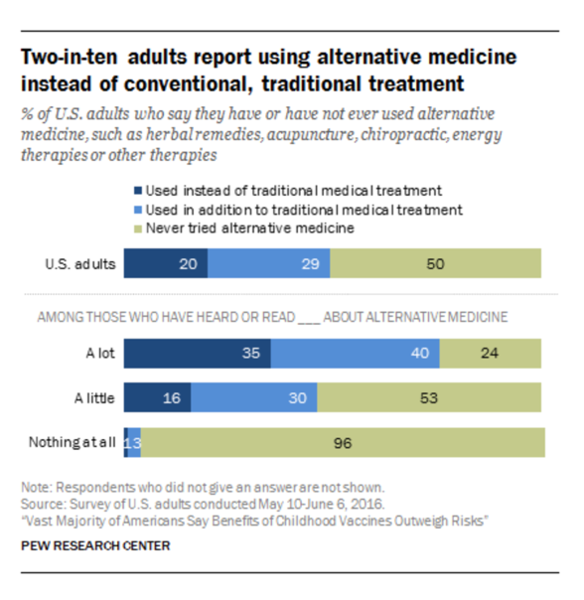
Why Integrative & Non-Pharmacologic Care Matters in Serious Illness
Prevalence of CAM use in patients with serious illness and palliative populations³
2002 -> 2022
  Inc. in use by 36.7%
  Yoga to 15.8%
    for pain – 28.8%
  Meditation to 17.3%
  Acupuncture to 2.2%
  Using CAM for pain increased to 49.2%
    Chiropractic – 85.7%
Figure by Pew Research Center, retrieved from: https://www.pewresearch.org/science/2017/02/02/americans-health-care-behaviors-and-use-of-conventional-and-alternative-medicine/ on March 12, 2026.⁴
Notes:
Your patients are already using these therapies. The question is whether they're using them safely and effectively.
Our role: Understand what patients are using • Provide evidence-based guidance • Create space for honest, non-judgmental dialogue

Slide 6
Because the newer methods of treatment are good, it does not follow that the old ones were bad: for if our honorable and worshipful ancestors had not recovered from their ailments, you and I would not be here today.
— Confucius (c. 551–478 BCE)
Notes:
Quote attributed to Confucius
Want to thank my colleague Suzanne Gilberg-Lenz, MD FACOG, as the inspiration for the next few slides

Slide 7
Epistemic Humility: Working at the Edges of Evidence
Core Principle
The Challenge
The Opportunity
Absence of evidence is not evidence of absence.
Recognizing the limits of current medical knowledge is not a weakness, it is a cornerstone of rigorous clinical reasoning.
Many integrative therapies are
  individualized,
  context-dependent, and
  difficult to standardize
  making them genuinely hard to evaluate through conventional trial design.
Expanding what counts as meaningful data, including
  traditional systems,
  lived patient outcomes, and
  clinical experience,
  enriches rather than undermines evidence-based care.

Slide 8
Epistemic Humility: What It Does and Does Not Mean
Acknowledging uncertainty honestly and openly with patients. Willingness to say: "We don't fully know yet"
  Acknowledging when trial evidence is limited but mechanistic rationale is strong
  Being honest with patients about evidence quality in both directions
Respecting patient experience, values, and lived outcomes as meaningful signals.
  Recognizing that patient experience is a form of data, even without RCTs and that long-standing traditional use may signal population-level safety
  Applying the same critical thinking to conventional andintegrative medicine
Openness to multiple ways of knowing, including traditional healing systems
Integrating evidence, clinical judgment, and patient preference in every decision
What Epistemic Humility IS NOT
What Epistemic Humility IS
Abandoning evidence-based medicine or its principles
Endorsing therapies that carry meaningful risk of harm
Accepting all claims as equally valid without critical appraisal
Replacing rigorous critical thinking with belief or anecdote alone
Delaying or substituting effective conventional treatment when it is clearly indicated
Recommending everything a patient brings in
Treating all approaches as equivalent regardless of evidence
Uncritical acceptance of traditional or alternative claims
Dismissing or deprioritizing conventional therapies that have robust evidence
Notes:
Our role is not to accept or reject but to interpret, contextualize, and guide safely.
Holding: "Potentially promising, needs more study" alongside "Here is what we know about mechanism and current evidence"

Slide 9
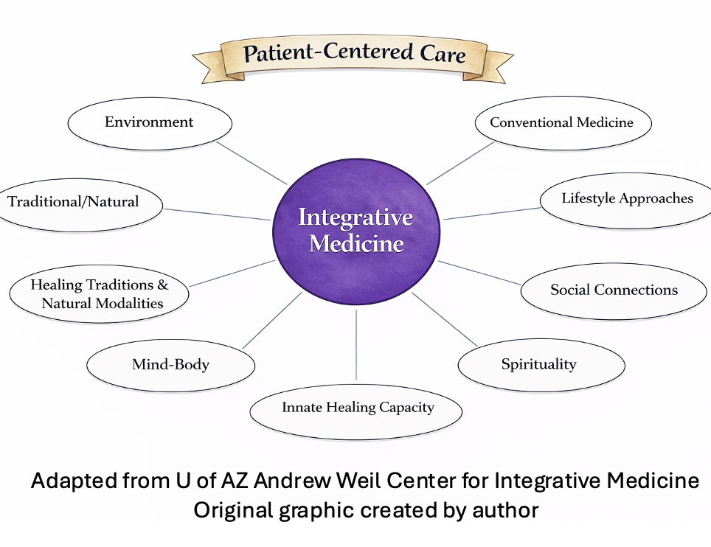
Definitions¹
The Pillars of Integrative Medicine
Conventional medicine
Standard medical care
Complementary medicine
Alternative medicine
Integrative medicine
Whole person health
Notes:
Goal: “do no harm”

Slide 10
Why Integrative Medicine in Outpatient Palliative Care?
High patient interest in non-drug strategies
  Empowerment
Improved coping
Persistent symptom burden despite pharmacologic therapy many times signals of other things impacting the symptom
Symptom clusters addressed, potentially with less medication burden
Adjunctive, not alternative, approach
Goal-concordant, proportional, patient-centered care
Notes:
FACILITATOR:
30–60% CAM use in oncology
But can convert the alternative-minded patients

Slide 11
Running Case #1: Ms. L
58-year-old woman with metastatic breast cancer
  CIPN, anxiety, insomnia, fatigue
  On duloxetine, gabapentin
  Doesn’t want to take more medications but tired of “feeling this way”
  Asks: "Are there natural approaches that might help?"

Slide 12
Running Case #2: Mr. B
78-year-old man with ES COPD and severe SOB
  Maximally managed pharmaceutically, on O2
  C/o continued breathing difficulty
  + Insomnia
  + Anxiety
  Fear of dying: widowed, kids out-of-state
  Vietnam veteran
  Are there any integrative approaches that you could offer?

Slide 13
Complementary Alternative Therapy (CAM)
5 CAM domains²
  Mind-body therapies
    Meditation, guided imagery, hypnosis, biofeedback, prayer, expressive therapies, yoga, Tai Chi, Qigong
  Biologically based practices
    Botanicals, supplements, nutrition and functional foods
  Manipulative and body-based methods
    Osteopathic manipulation, chiropractic, massage
  Whole Medical Systems/alternative medical systems
    Traditional Chinese Medicine, Ayurvedic medicine, classical homeopathy and indigenous healing systems
  Energy Therapies
    Reiki, Healing Touch, therapeutic touch

Slide 14
Mindfulness-Based Interventions
Improve anxiety, depression, quality of life^{8,9}
Reduce distress and pain
  Mindfulness Based Stress Reduction (MBSR)*
  Mindfulness Based Cognitive Therapy (MBCT)*
  Eye Movement Desensitization and Re-processing (EMDR)
Low risk, less feasible in outpatient clinic but group programs and on-line
  Referral to therapist
* are structured, often group-based programs lasting weeks, designed to integrate mindfulness into daily life

Slide 15

Mindfulness Practices & Techniques
Low risk and feasible in outpatient clinic
Include:
  Meditation
    Body scan
    Loving Kindness
    Breath-Focused
    Mindful walking
      Shinrin-yoku
      Contemplative labyrinth
  5-Senses grounding
  Informal Mindfulness
  Guided Imagery10
  EFT
Notes:
FACILITATOR:
Example of GI given

Slide 16
Breathing Techniques
氣, प्राण, πνεῦμα = “life force”, “vital energy” -> breath
Many breathing options
A form of meditation – mindful breathing, somatic breathing
Controlled and conscious breathing regulates the autonomic nervous system
Reduces anxiety, manage dyspnea and pain, and decrease feelings of panic
Fan therapy, pursed-lip breathing and positioning supported in dyspnea literature and already done in PC¹¹
Brief coaching of different techniques feasible in clinic
  Can start with posture
Notes:
Enough for 1+ more lectures

Slide 17
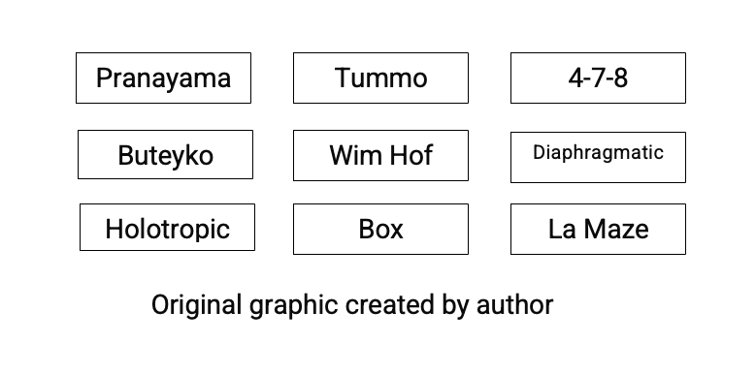
Breathing Examples
And more!

Slide 18
Yoga & Gentle Movement
Yoga, Tai Chi, Qigong, aerobic and strength training
Improves fatigue, sleep, anxiety, depression, pain and QOL^{12,13}
Also improves coping, mental well-being, and mindful awareness
  Evidence strongest in breast cancer populations
  Chair-based or restorative forms preferred in frail patients
Can discuss in clinic what options seem feasible

Slide 19
Hypnotherapy
Evidence for¹⁴
  Nausea
  Procedural distress
  Anxiety
  Pain
  Dyspnea
  Depression
  Loss of hope
Safe
Delivered by a trained clinician; self-hypnosis as adjunct
Society for Clinical & Experimental Hypnosis (SCEH)
American Society of Clinical Hypnosis (ASCH)
American Hypnosis Association (AHA)

Slide 20
Acupuncture in Serious Illness
ASCO–SIO guideline supports adjunctive use for cancer pain
Evidence for CIPN symptom improvement¹⁵
Useful for nausea, vomiting, fatigue, dyspnea, insomnia, and post-surgical pain
Helpful in anxiety, fear, depression w/ increased well-being
Decreases medication need
Considered safe w/ few side effects

Slide 21
Acupuncture in Serious Illness
Needs to be provided by a certified practitioner
NADA protocol could potentially be provided during clinic
Patients and caregivers experienced relief of suffering after receiving NADA acupuncture, improved well-being, extra energy and inner strength to cope¹⁶
Key Professional Organizations in Acupuncture
National Acupuncture Detoxification Association (NADA)
American Academy of Medical Acupuncture
AAAOM

Slide 22
Examples of Therapeutic Touch
Massage therapy
Reflexology
Acupressure
Reiki therapy
Craniosacral therapy
Healing Touch/Energy therapy
Osteopathic Manipulative Treatment (OMT)
Chiropractic Care

Slide 23
Massage & Touch-Based Therapies
Can help w/ depression^{17,18}
Reduce agitation and aggressive behavior
Enhances relaxation and comfort
Can help w/ pain and anxiety¹⁹
Gentle touch
Ensure MT is credentialed and knowledgeable in this patient population
Screen for bone metastases, thrombocytopenia, lines/ports
Key Professional Organizations in Massage Therapy
American Massage Therapy Association (AMTA)
GA Board of Massage Therapy
National Certification Board for Therapeutic Massage and Bodywork (NCBTMB)
Notes:
IN dementia

Slide 24
Botanical Medicine
50 – 80% of people try botanicals or CAM with or without clinical guidance
Less than 40% of all patients disclose their use of CAM to their primary care physicians
Only about 24% of physicians feel adequately versed in botanicals and integrative medicine
Our role: Understand what patients are using • Provide evidence-based guidance • Create space for honest, non-judgmental dialogue
Notes:
in one study of oncology patients , it was estimated that between 11% and 95% of the patients receiving cancer treatment also used CAM treatments, yet between 20% and 77% did not disclose their CAM use to their oncologist.
The most common reasons endorsed for nondisclosure were:
doctor’s lack of inquiry
anticipation of the doctor’s disapproval, disinterest, or inability to help
perception that disclosure of CAM use is irrelevant to their conventional care
CAM users have a higher desire for control and are more desirous of being actively involved in their health care decisions than those who have not used CAM.
Stubbe DE. Complementary and Alternative Medicine: If You Don't Ask, They Won't Tell. Focus (Am Psychiatr Publ). 2018 Jan;16(1):60-62. doi: 10.1176/appi.focus.20170052. Epub 2018 Jan 24. PMID: 31975902; PMCID: PMC6519570.
Our role: Understand what patients are using • Provide evidence-based guidance • Create space for honest, non-judgmental dialogue

Slide 25
Herbs & Supplements in Palliative Care
High prevalence of use; often undisclosed
Drug–herb interactions
  CYP450 metabolism
  Additive effects (e.g., bleeding, sedation)
Hepatic and renal considerations (toxicity, metabolism, clearance)
Use harm-reduction counseling framework
Need to make sure that they understand that you are an advocate
Cultural sensitivity
“What vitamins, teas, powders, botanicals or natural products do you take?”
  Name/brand
  3rd party certified?
  How do you think it/they help you?
Notes:
FACILITATOR:
It’s not b/c everyone is talking about it, and you can find it in all the stores that it is benign

Slide 26
Board Testing vs. Clinical Practice: Supplements Part 1
Supplement
Indication
Key Side Effects / Interactions
St. John's Wort
Depression, Anti-inflammatory
CYP3A4 inducer; decreases efficacy of many drugs incl. opioids; serotonin syndrome; increased bleeding
ALA
Diabetic neuropathy
Hypoglycemia
Turmeric (curcumin)
Anti-inflammatory
GERD, iron deficiency, increased clotting time, hypoglycemia in DM; interacts with anticoagulants & oncology tx
Ginko Biloba
Memory/Dementia
Bleeding risk
Saw Palmetto
BPH
Bleeding risk

Slide 27
Board Testing vs. Clinical Practice: Supplements Part 2
Supplement
Indication
Key Side Effects / Interactions
Devil's Claw
Osteoarthritis, Chronic Low Back Pain, MSK pain
GI, Neurological, Hypoglycemia; inhibits CYP3A4 & CYP2C9; increases INR; worsens PUD
Ginger
Nausea, Anti-inflammatory
Bleeding risk, increases glucose metabolism
Chondroitin
Joint Pain
Interacts with blood thinners
Kava
Anxiety, Insomnia
Hepatotoxicity
Cannabinoids
Neuropathic pain, Nausea, Appetite, Anti-spasmodic
Sedation, Paranoia/hallucinations, Hypotension, Tachycardia

Slide 28
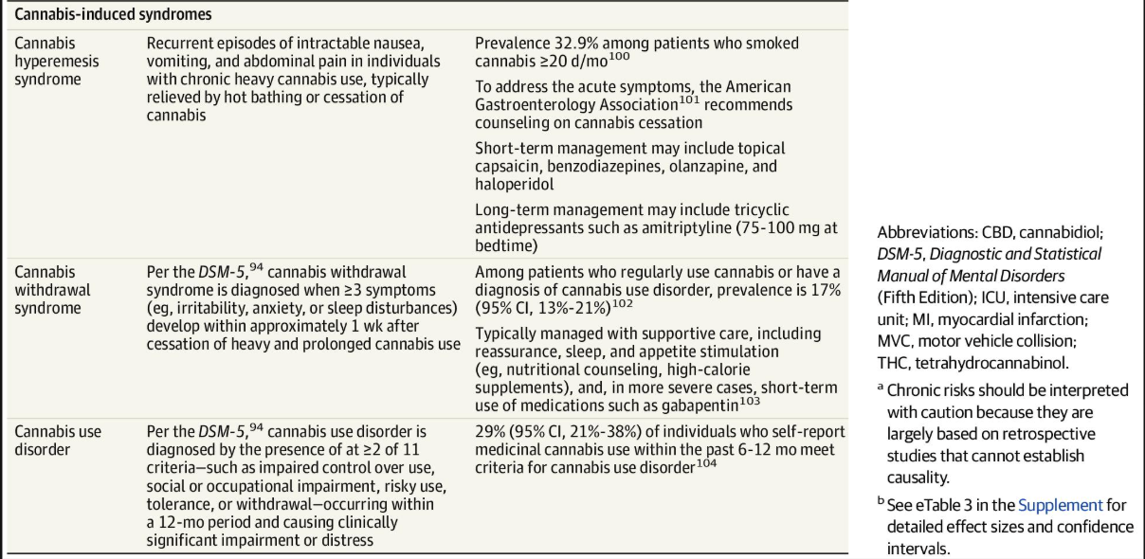
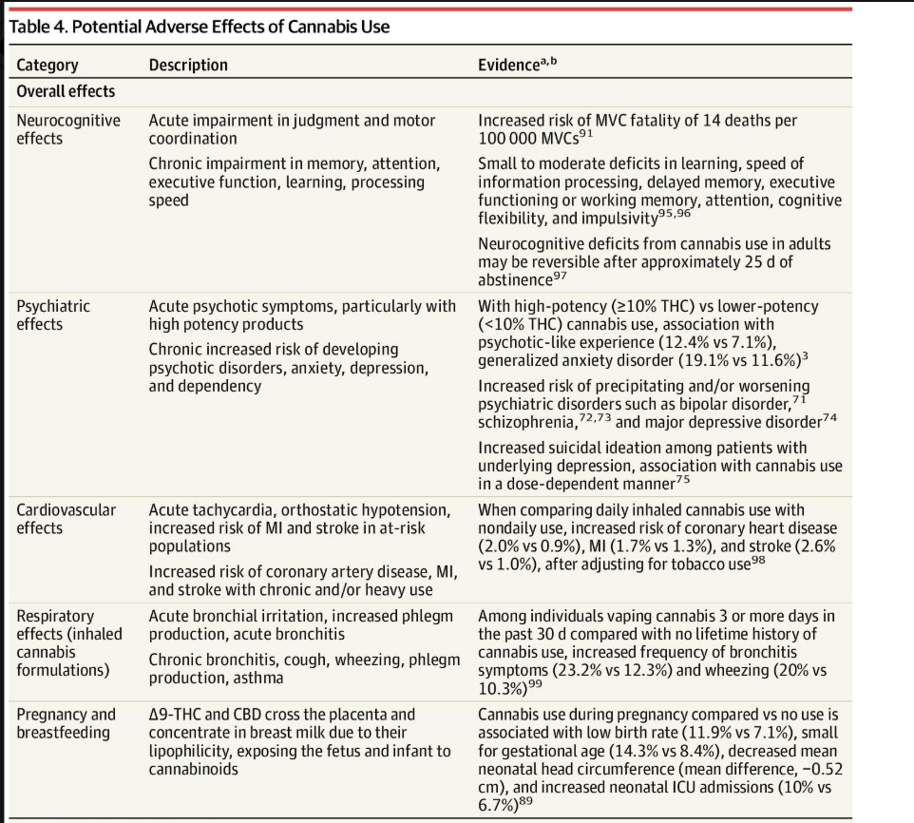
Potential Adverse Effects of Cannabis Use
Therapeutic Use of Cannabis and Cannabinoids. JAMA. November 25, 2025.
Content used under license from the JAMA Network® © American Medical Association

Slide 29
Whole Medical Systems & Energy Therapies
Whole Medical Systems: Ayurveda, TCM, Naturopathy, Homeopathy
Energy/Biofield Therapies: Reiki, (therapeutic touch), Healing Touch, Vibrational Medicine/sound baths – increasing use and interest
Other therapies: essential oils/clinical aromatherapy, music therapy, prayer therapy, nutrition therapy, art therapy, narrative therapy
  Some of these modalities have limited high-quality evidence in serious illness^{21,22}
  Difficult to study
  May provide relaxation or meaning if low risk
  can help reduce pain, anxiety, fatigue, nausea, reduce stress, and improving sleep quality
  Emphasize cultural humility and safety
Ensure practitioner is certified
Ask for permission to reach out to all the practitioners that patient sees to ensure a collaborative approach
Notes:
EO’s could be used in clinic setting

Slide 30
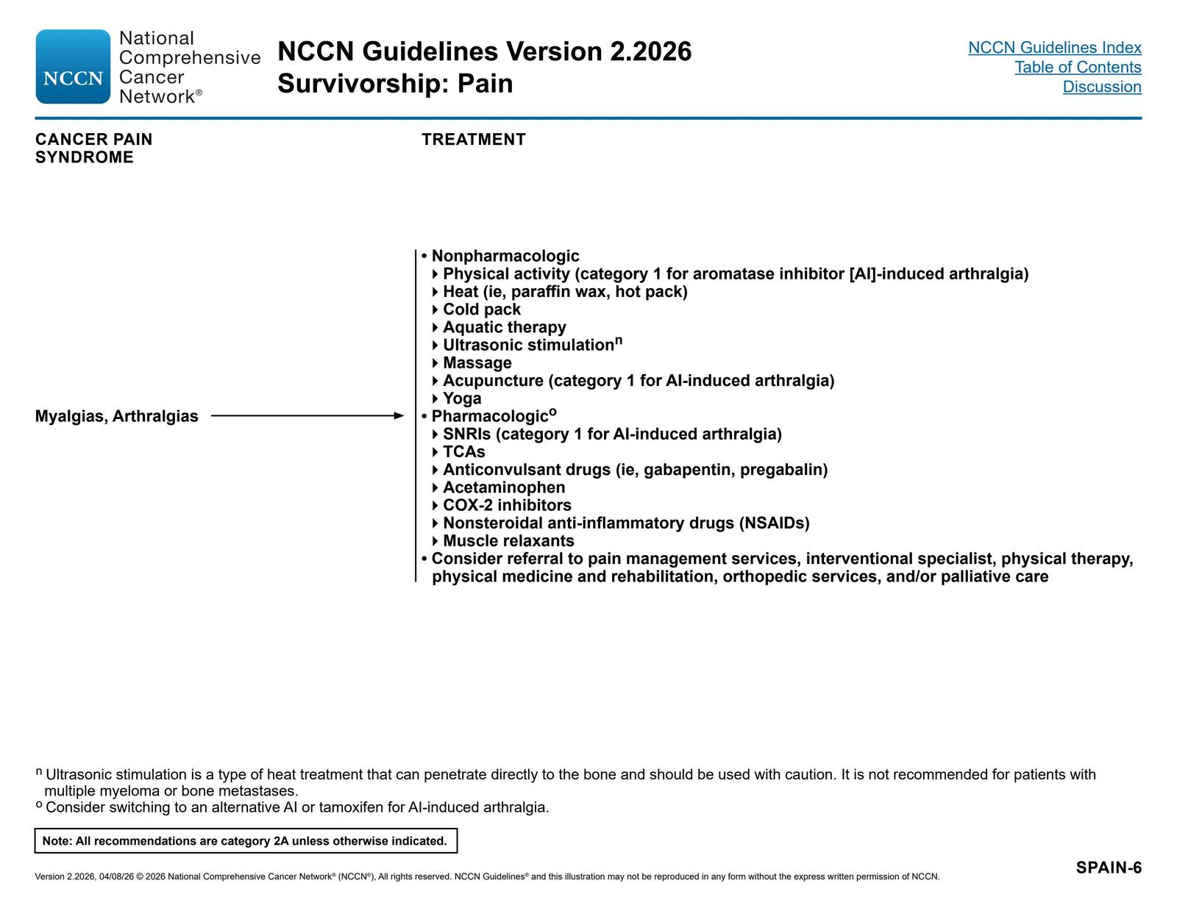
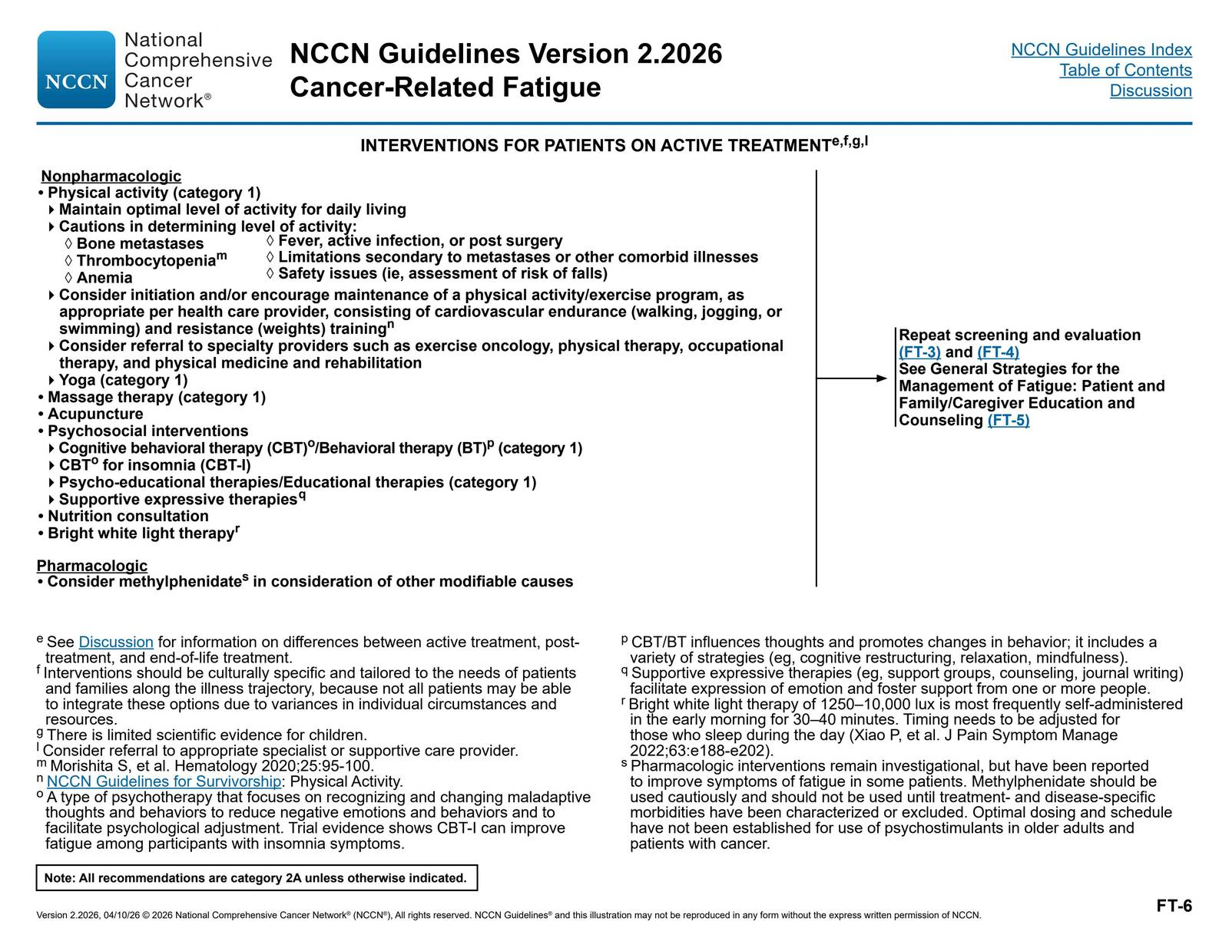

Slide 31
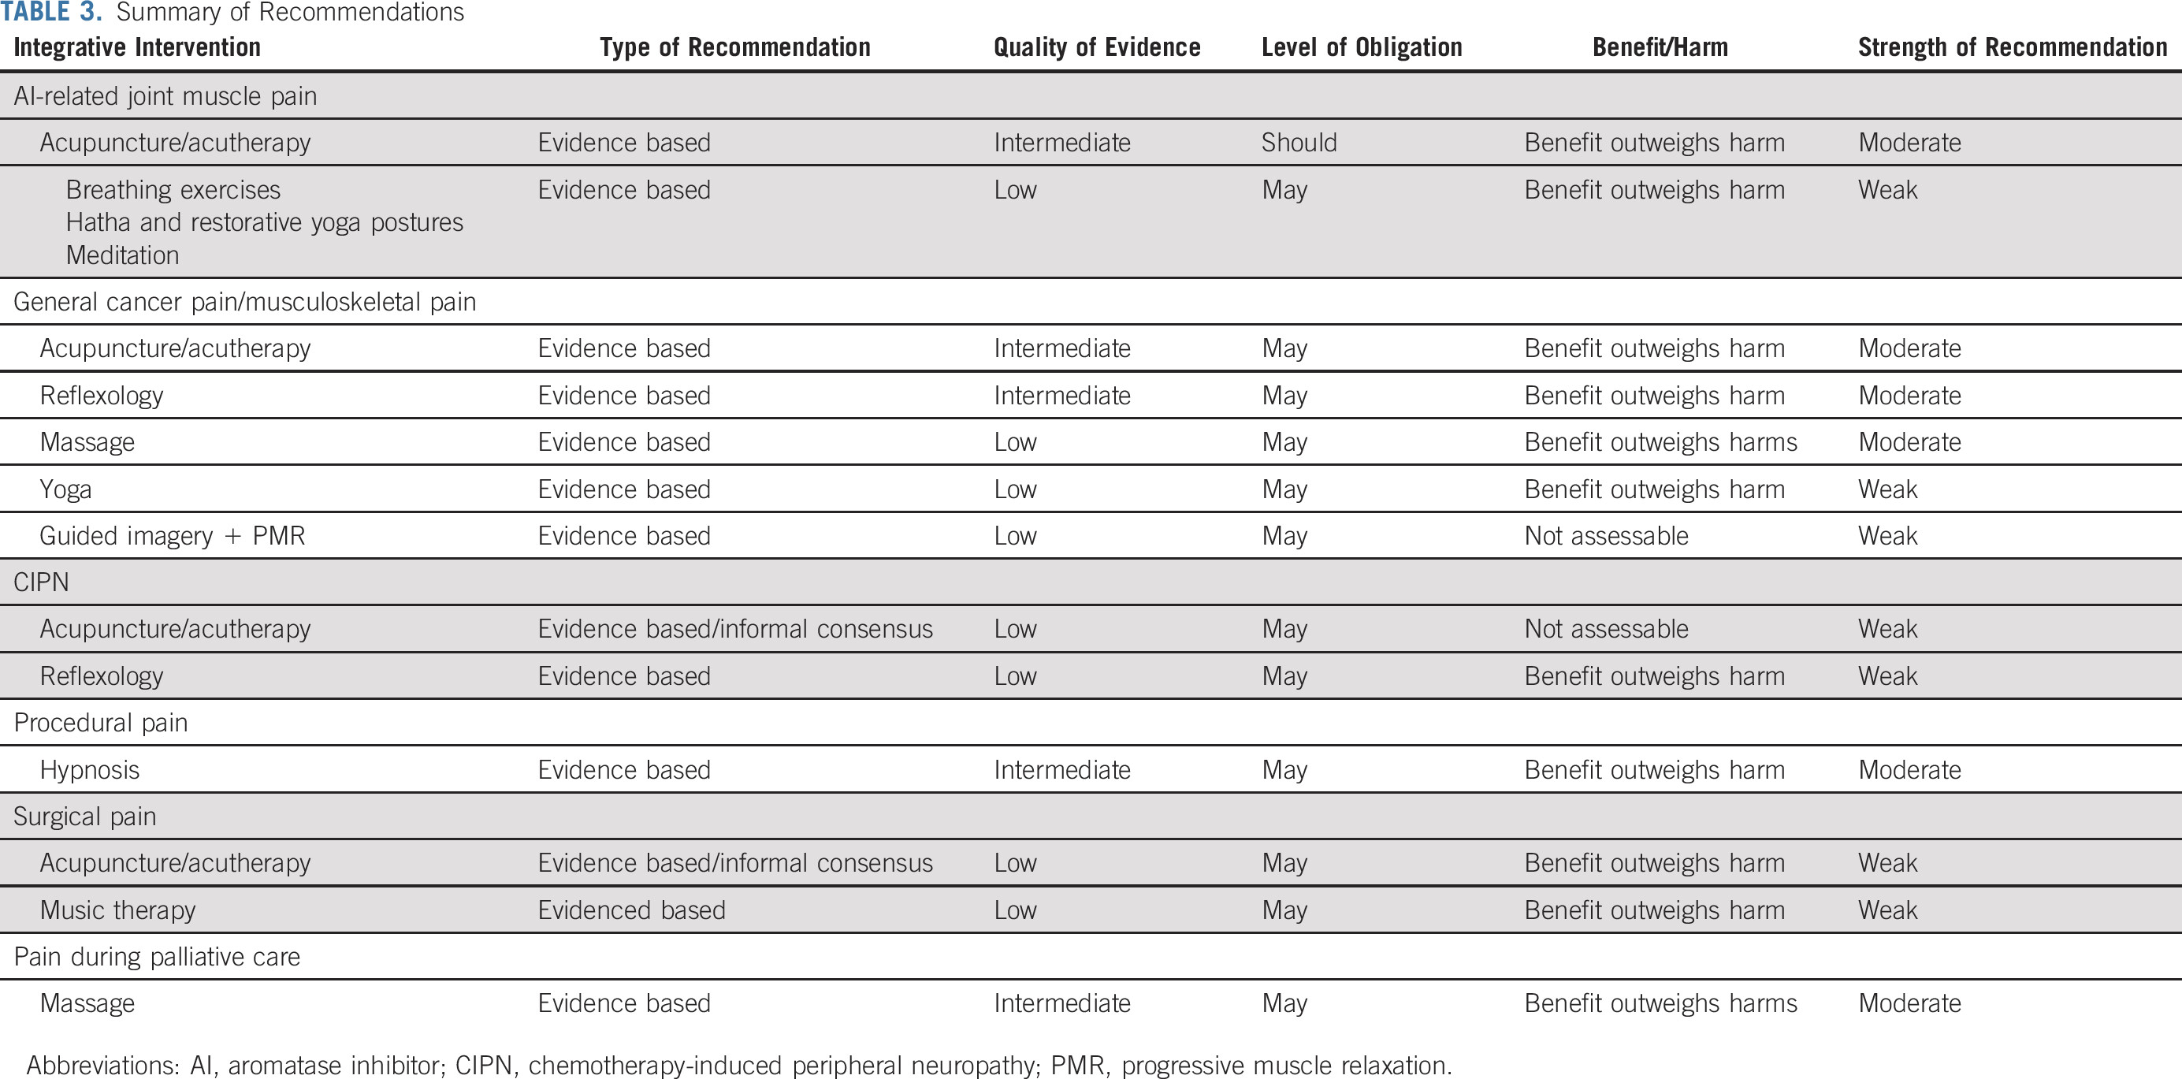
Role of integrative medicine in symptom burden, quality of life, and goal-concordant care
Figure from Mao et al., retrieved from: doi:10.1200/JCO.22.01357 on March 12, 2026.5

Slide 32
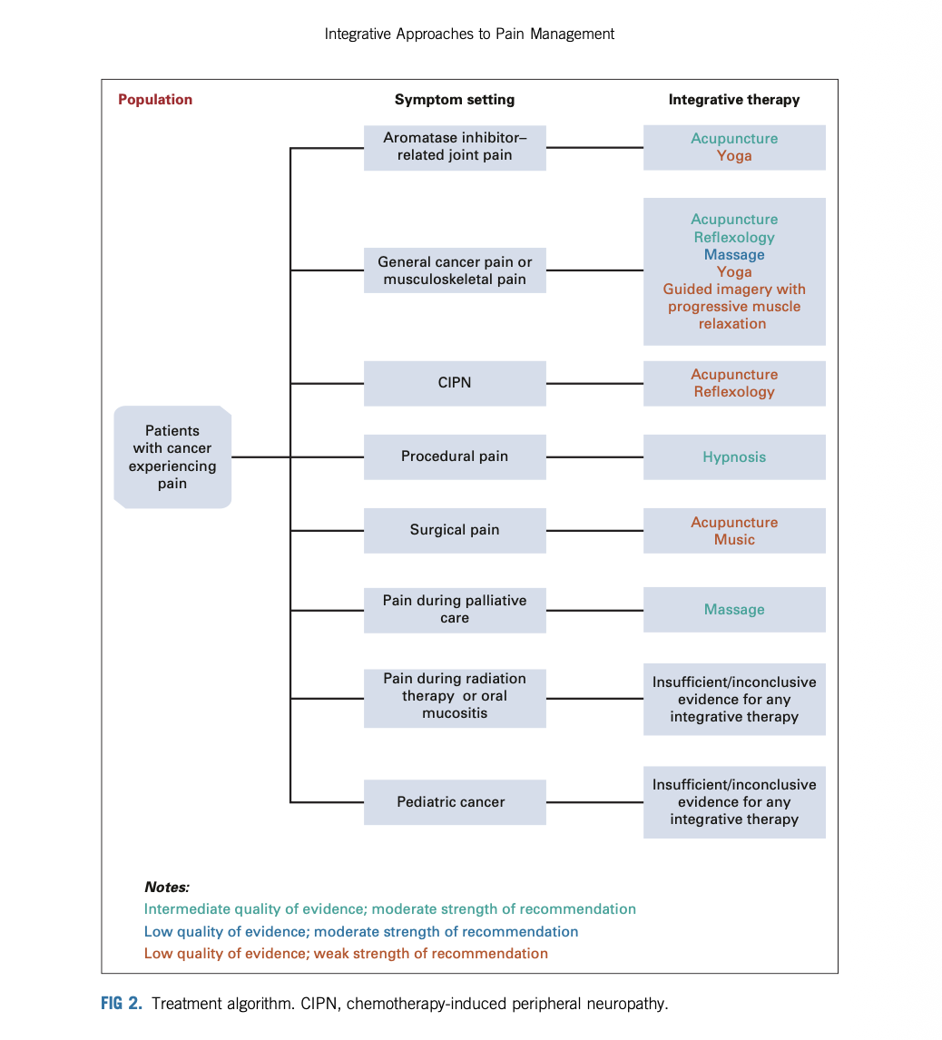
Figure from Jun et al., retrieved from DOI:10.1200/JCO.22.01357 on March 12, 2026.⁵

Slide 33
Low Risk, Limited Evidence: Clinical & Communication Framework
Clinical Approach
Communication Approach
Clinical Boundaries
Absence of strong evidence ≠ evidence of harm
Consider safety, burden, cost, and goals of care
Practice culturally attuned care
Be open and start with curiosity
  “Tell me more”
  “What are you hoping for?”
Avoid immediate correction
Validate emotion and intent
Assess underlying goals and needs
Support autonomy with safe boundaries
Share concerns about risks and cost
Offer low-risk, evidence-based (if possible), value-aligned integrative options
Refer when appropriate (e.g., integrative specialist)

Slide 34
Outpatient Integrative Workflow
Assess Symptom & Goals
Match Evidence-Based Integrative Option
Reassess & Document Response
Ms. L – integrative options based on symptoms, goals, functional status:
  CIPN/fatigue/anxiety
    Mindfulness-Based Interventions
    Yoga/Exercise
    Acupuncture
    Nutrition therapy
    Aromatherapy
    Referral to a naturopath/supplements
    Energy therapies
    Support groups, religious or community organizations
    Hobbies
Mr. B – integrative options based on symptoms, goals, functional status:
  Address trauma/fear of dying:
    KAP/PAP
    Mindfulness-Based Interventions
  Address SOB/anxiety:
    MBI and hypnosis
    Exercise
    Acupuncture
    Nutrition therapy
    Aromatherapy and botanicals
  Loneliness
    Support groups
    Religious organizations
    Veteran organizations
Notes:
Lots of options depending on availability at institution and in community and cost. PAP – veteran organizations, legal in CO and OR

Slide 35
Caring for the Clinician
High burnout prevalence in HPM
Mindfulness-based interventions reduce clinician stress23,24
Brief grounding or breathing practices are feasible:
  During clinic
  With patients
  Between visits
Additional supportive practices:
  Aromatherapy
  Mindful movement
  Music / sound
Notes:
Also care of family members

Slide 36
US Centers for Integrative Medicine
Andrew Weil Center @ U of AZ
Osher Centers
  Harvard
  UCSF
  Vanderbilt
  U of Wash.
  U of VT
  U of Cincinnati
  U of Utah
Mayo Clinic, MN
U of MD
MSKCC, NY
MedStar Health Center in MD
UPMC, NY
UNC
Wake Forest, NC
Hartford Hospital, CT
UHCMC, OH
Notes:
Not all are created equal. Offer combinations of acupuncture, massage, yoga, MBI, energy therapies

Slide 37
Integrative Palliative Medicine
Integrative Therapies
acupuncture, massage, mindfulness, aromatherapy, music therapy, herbal medicine
Whole-Person Care
emotional, spiritual, psychosocial support, goals of care, quality of life
Integrative Therapies + Whole-Person Care
Integrative Palliative Medicine
Conventional + Integrative Therapies
Conventional + Whole-Person Care
Conventional Palliative Care
opioids, antiemetics, corticosteroids, disease-modifying treatments
Original graphic created by author
Notes:
FACILITATOR:
Many of these modalities discussed disrupt the DMN

Slide 38
References
National Cancer Institute. Complementary and Alternative Medicine. National Cancer Institute. Updated September 24, 2021. Accessed March 12, 2026. https://www.cancer.gov/about-cancer/treatment/cam
Koithan M. Introducing complementary and alternative therapies. The Journal for Nurse Practitioners. 2009;5(1):18-20. doi:10.1016/j.nurpra.2008.10.012.
Nahin RL, Rhee A, Stussman B. Use of Complementary Health Approaches Overall and for Pain Management by US Adults. JAMA. 2024 Feb 20;331(7):613-615. doi: 10.1001/jama.2023.26775. PMID: 38270938; PMCID: PMC10811586.
Pew Research Center. Americans’ health care behaviors and use of conventional and alternative medicine. Pew Research Center. Published February 2, 2017. Accessed March 12, 2026. https://www.pewresearch.org/science/2017/02/02/americans-health-care-behaviors-and-use-of-conventional-and-alternative-medicine/
Mao JJ, Ismaila N, Bao T, et al. Integrative medicine for pain management in oncology: Society for Integrative Oncology–ASCO guideline. J Clin Oncol. 2022;40(34):3998-4024. doi:10.1200/JCO.22.01357
Julienne E. Bower et al. Management of Fatigue in Adult Survivors of Cancer: ASCO–Society for Integrative Oncology Guideline Update. J Clin Oncol 42, 2456-2487(2024). DOI:10.1200/JCO.24.00541
Marchand L, Lewin D, Kozak L. Addressing symptom clusters with complementary and integrative health therapies in palliative care populations: a narrative review. OBM Integr Complement Med. 2021;6(1):1007. doi:10.21926/obm.icm.2101007
Saragih IS, Tarihoran DETAU, Tzeng H-M, Saragih ID. Mindfulness-based interventions for pain, anxiety, depression, and quality of life in patients receiving palliative care: a meta-analysis. J Res Nurs. 2026;0(0). doi:10.1177/17449871261419719
Carlson LE, et al. Integrative oncology care of symptoms of anxiety and depression in adults with cancer: Society for Integrative Oncology–ASCO guideline. J Clin Oncol. 2023;41:4562-4591. doi:10.1200/JCO.23.00857
Correa-Morales JE, Mantilla-Manosalva N, Rodríguez-Cardona X, et al. Guided imagery for symptom management of patients with life-limiting illnesses: a systematic review of randomized controlled trials. J Palliat Med. 2024;27(6):802-812. doi:10.1089/jpm.2023.0445
Tan SB, Liam CK, Pang YK, Ng DL, Wong TS, Khoo KWS, Ooi CY, Chai CS. The effect of 20-minute mindful breathing on the rapid reduction of dyspnea at rest in patients with lung diseases: a randomized controlled trial. J Pain Symptom Manage. 2019;57(4):802-808. doi:10.1016/j.jpainsymman.2019.01.009
Rolle LD, et al. The impact of exercise interventions on domains of quality of life in women diagnosed with breast cancers during chemotherapy treatment: a meta-analytic review. Lancet Healthy Longev. 2024:100819.
Hou L, Wang J, Mao M, Zhang Z, Liu D, Gao S, Liang K, Lu L. Effect of yoga on cancer-related fatigue in patients with breast cancer: a systematic review and meta-analysis. Medicine (Baltimore). 2024;103(1):e36468. doi:10.1097/MD.0000000000036468. PMID:38181269. PMCID:PMC10766251.
Vayne-Bossert P, Hardy J. Is there a role for hypnosis in palliative care? Palliat Care Soc Pract.2025;19:26323524251321852. doi:10.1177/26323524251321852. PMID:40013010. PMCID:PMC11863230.
Bao T, Patil S, Chen C, et al. Effect of acupuncture vs sham procedure on chemotherapy-induced peripheral neuropathy symptoms: a randomized clinical trial. JAMA Netw Open. 2020;3(3):e200681. doi:10.1001/jamanetworkopen.2020.0681.
Sørensen RW, Andersen NI, Dieperink KB. NADA acupuncture in specialized palliative care: patients' and family caregivers' experiences. J Pain SymptomManage. 2024;68(1):1-9. doi:10.1016/j.jpainsymman.2024.03.017.
Watt JA, Goodarzi Z, Veroniki AA, Nincic V, Khan PA, Ghassemi M, Lai Y, Treister V, Thompson Y, Schneider R, Tricco AC, Straus SE. Comparative efficacy ofinterventions for reducing symptoms of depression in people with dementia: systematic review and network meta-analysis. BMJ. 2021;372:n532.doi:10.1136/bmj.n532. PMID:33762262. PMCID:PMC7988455.
Kopf D. Massage and touch-based therapy: clinical evidence, neurobiology and applications in older patients with psychiatric symptoms. Z GerontolGeriatr. 2021;54(8):753-758. doi:10.1007/s00391-021-01995-4. PMID:34812896. PMCID:PMC8609249.
Boyd C, Crawford C, Paat CF, et al. Massage therapy for cancer pain. Cochrane Database of Systematic Reviews. 2016;(6):CD010475.
Izzo AA, Ernst E. Interactions between herbal medicines and prescribed drugs. Drugs. 2009;69(13):1777-1798. doi:10.2165/11317010-000000000-00000.
Gonçalves S, Marques P, Matos RS. Exploring aromatherapy as a complementary approach in palliative care: a systematic review. J Palliat Med. 2024;27(9):1247-1266. doi:10.1089/jpm.2024.0019. PMID:38686521.
Farrar AJ, Farrar FC. Clinical aromatherapy. Nurs Clin North Am. 2020;55(4):489-504. doi:10.1016/j.cnur.2020.06.015. PMID:33131627. PMCID:PMC7520654.
Arya RG, Srivastava D, Divya BR, Madhu, Bhargav H. A systematic review of yoga interventions on the mental health of nursing professionals and students. Int JYoga. 2025;18(1):13-26. doi:10.4103/ijoy.ijoy_195_24. PMID:40365361. PMCID:PMC12068460.
Ong NY, Teo FJJ, Ee JZY, Yau CE, Thumboo J, Tan HK, Ng QX. Effectiveness of mindfulness-based interventions on the well-being of healthcare workers: asystematic review and meta-analysis. Gen Psychiatr. 2024 May 7;37(3):e101115. doi: 10.1136/gpsych-2023-101115. PMID: 38737894; PMCID: PMC11086195.
Martin JH, Patel J. Complementary and alternative therapies in the palliative setting. Intern Med J. 2022 Oct;52(10):1677-1684. doi: 10.1111/imj.15922. PMID: 36266062; PMCID: PMC9828217.

Slide 39
Thank you

