Slide 1
Interventional Pain Management in Outpatient Palliative Care
Vinita Singh, MD, MS, FASRA
Emory Pain Division Chief,
Director of Cancer Pain,
Co-Director of Research in Pain Division,
Associate Professor, Department of Anesthesiology,
Emory University School of Medicine
Notes:
Alternative first slide option

Slide 2
No Relevant Disclosures

Slide 3
Learning Objectives
Review
Review characteristics of cancer-related and non-cancer-related pain
Evaluate
Evaluate various treatment options for cancer-pain and non-cancer pain in serious illness
Evaluate
Evaluate interventional options for cancer-pain and non-cancer pain in serious illness
Understand
Understand sample cancer-pain treatment algorithms

Slide 4
Case #1
49-year-old female with pancreatic cancer s/p Whipple
Few months later has constant, burning, diffuse, epigastric pain radiating to the back
CTAP with new amorphous soft tissue surrounding the celiac trunk and CMA
Pain moderately controlled with MSContin 45mg q12h
Sedation with meds, forgets to eat
Unable to participate in most activities
What would you do?

Slide 5
Review Characteristics of Cancer-Related Pain

Slide 6
Update on Prevalence of Pain in Patients with Cancer Pain: Systematic Review and Meta-analysis¹
122 studies included
Pain prevalence:
  39% after curative treatment
  55% during active anticancer treatment
  66% in advanced/metastatic/terminal disease
Moderate–severe pain (NRS ≥5): 38% of all patients

Slide 7
Cancer Treatment-Related Pain Syndromes²
Chemotherapy related
  Chemo-induced peripheral neuropathy
  Raynaud’s syndrome
  Due to long term corticosteroids
  Vertebral compression factures, Avascular necrosis
  Carpal tunnel syndrome
Hormone therapy related
  Arthralgias, myalgias
  Dyspareunia, gynecomastia
  Osteoporotic compression fracture
Radiation related
  Osteoporosis, osteoradionecrosis and fractures
  Painful secondary malignancies
  Peripheral mononeuropathies, myelopathy
  Plexopathies: brachial, sacral
  Cystitis, enteritis, proctitis
  Fistula formation, lymphedema, chest wall syndrome
Stem cell transplantation-mediated graft versus host disease
  Arthralgia, myalgias
  Dyspareunia, vaginal pain
  Dysuria
  Eye pain
  Oral pain and reduced jaw motion
  Paresthesias
  Scleroderma-like skin changes
Surgical pain syndromes
  Lymphedema
  Post-amputation phantom pain
  Post-mastectomy pain
  Post-radical neck dissection pain
  Post-surgery pelvic floor pain
  Post-thoracotomy pain/frozen shoulder
  Post-surgery extremity pain (e.g., sarcoma)

Slide 8
Pain in Cancer Survivors³
Cancer survivors³
  18 million survivors in US
  2/3rd survive >5 years after diagnosis
  16-50% have chronic pain!
  Most common source of pain are treatment-induced neuropathies secondary to surgery, radiation therapy and chemotherapy
Incidence of post surgical pain⁴
  Thoracotomy- 5–65 %
  Cardiac surgery- 30–55 %
  Mastectomy- 20–50 %

Slide 9
Cancer pain types⁵
Nociceptive
  Visceral
  Somatic
Neuropathic
Existential pain/Total pain/Suffering
Mixed

Slide 10
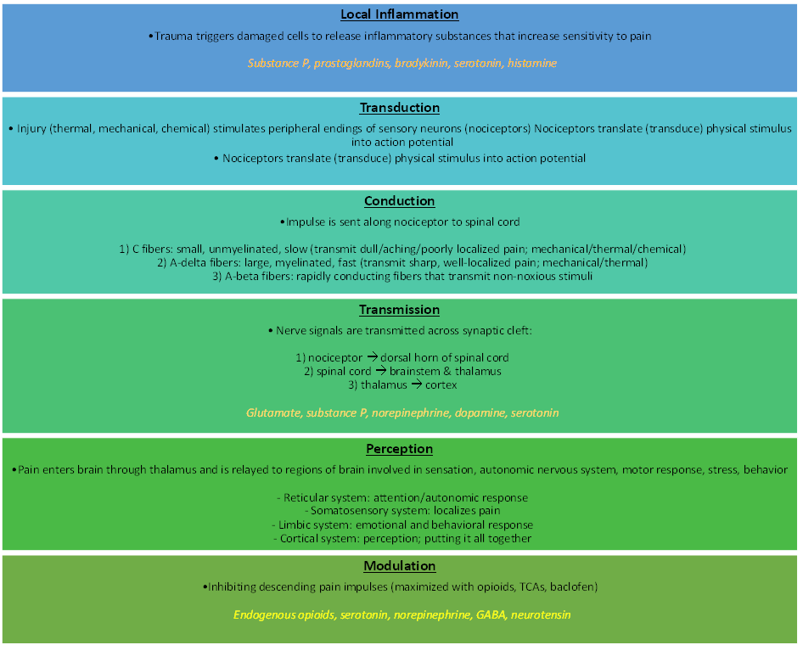
Pain Pathway⁶
Image by authors
Notes:
FACILITATOR
HIGH YIELD FOR THE BOARDS!

Slide 11
Non-Cancer Pain: Central Phantom Limb Pain⁷
Phantom limb pain = pain perceived as coming from an amputated limb
  Described as burning, tingling, sharp
Risk factors:
  tumor-related amputations, chronic limb pain prior to amputation, and significant pain the day of amputation
Pathophysiology is not well-understood, but likely involves disruption of local peripheral nerve feedback as well as central sensitization
Potential treatments:
  Pharmacotherapy (e.g. neuropathic agents, opioids)
  Non-pharmacologic therapies (biofeedback, massage, peripheral nerve blocks, mirror therapy)

Slide 12
Evaluate various treatment options for cancer-pain and non-cancer pain in serious illness

Slide 13
American Society for Pain and Neuroscience:
Best Practices and Guidelines for Interventional Management of Cancer-Associated Pain⁸
Excellent literature review and statements on current state of evidence
  Opioids
    Methadone
  Ketamine
  Radiation therapy
  Blocks and neurolysis
  Targeted drug delivery/intrathecal pump
  Spinal Cord Stimulation
  Vertebral augmentation and radiofrequency ablation
  Radiofrequency lesioning and nerve block
  Surgical procedures

Slide 14
Opioids for Can9cer Pain
Opioids⁹
95% (19/20) achieve meaningful pain reduction within 14 days
Most patients experience adverse effects
10–20% require a change in therapy due to intolerable side effects

Slide 15
Non-pharmacologic management, opioids, and non-opioid adjuvants:
Other lectures in your outpatient curriculum will cover in detail!

Slide 16
Evaluate interventional options for cancer-pain and non-cancer pain in serious illness

Slide 17
NCCN Guidelines Adult Cancer Pain 2020: General Considerations for interventions¹⁰
Patient prognosis is important to consider when choosing the type of intervention
Financial considerations
Other factors
  Infection
  Coagulopathy
  Distorted anatomy
  Patient unwillingness
  Medications that increase risk of wound healing or bleeding (e.g., antiangiogenesis agents such as bevacizumab)
  Technical expertise availability
Notes:
economy

Slide 18
NCCN Guidelines Adult Cancer Pain:
Major Indications for Interventional Consultation¹⁰
  Pain likely to be relieved with nerve block (pancreas/upper abdomen with celiac plexus block, lower abdomen with superior hypogastric plexus block, intercostal nerve, peripheral/plexus nerve)
  Failure to achieve adequate analgesia and/or the presence of intolerable adverse effects (may be handled with intraspinal agents, blocks, spinal cord stimulation, or destructive neurosurgical procedures)

Slide 19
NCCN Guidelines Adult Cancer Pain 2020: Commonly Used Interventional Procedures¹⁰
Regional Infusions
Neurostimulation procedures
Neurodestructive procedures
Percutaneous vertebral augmentation
Percutaneous ablation techniques for bony lesions

Slide 20
Regional Infusions

Slide 21
Regional infusions¹⁰
Regional plexus
  Brachial plexus, lumbar plexus
  Use beyond several days to a few weeks is limited
    concerns for catheter displacement & infection
Epidural
  Easy to place, requires large volumes;
  Use beyond several days to a few weeks is limited
    concerns for catheter displacement & infection
Intrathecal
  High initial cost(10K)
  Refills require technical expertise

Slide 22
Intrathecal Pump Device Characteristics¹¹
Pump Basics
  All IDDS pumps share core components: reservoir, delivery mechanism, pump housing, and catheter with one/more orifices.
  Pump design, catheter orifice configuration, and delivery mode (continuous/bolus) determine drug spread within the intrathecal space.
Fixed-Rate Pumps
  No longer available in the U.S.
  Gas-propelled; temperature and altitude can increase delivered dose by up to 35%.
Programmable Pumps (current standard)
  Allow adjustable dosing as pain and disease evolve.

Slide 23
Intrathecal Drug Delivery= TARGETED Drug Delivery¹¹
Systemic Analgesia
•Distributes drug via blood stream
•High blood levels of drug
•Brain receives highest proportion of drug
•High dose of drug required – High elimination load
•Increase in systemic side effects
Spinal analgesia
•Intrathecal drug distribution
•Low blood levels of drug
•Most drug binds to TARGET (spinal cord pain receptors)
•Low dose of drug is effective – Low elimination load
•Reduced systemic effect on brain and gut

Slide 24
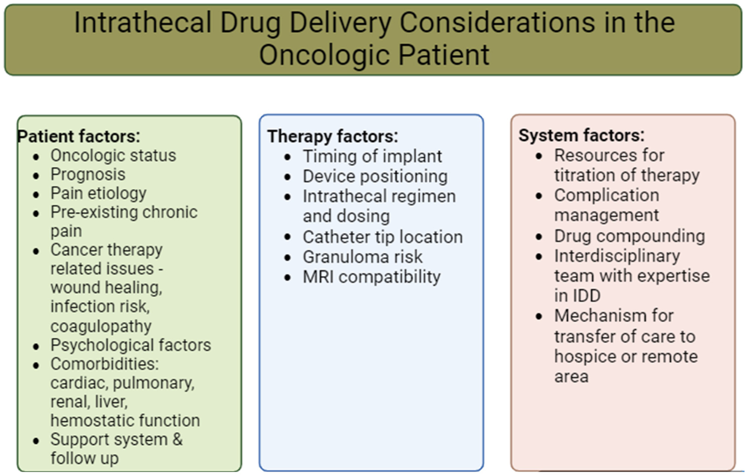
Notes:
⬥ An estimate of prognosis is a vital consideration; when it is clear a patient will live months to years a completely implantable pump is appropriate.
Secondary factors, such as psychosocial situation, home environment, distance from the hospital, language or communication barriers, insurance coverage, and the availability of domiciliary services, Refill/reprogram needs;
Placement of an implanted drug delivery system is minor surgery. In a fragile and complicated patient with limited reserve, and an unknown velocity of tumor progression, it still cannot be
undertaken lightly.
Pulmonary disease can increase the risk of respiratory depression with IT morphine; ziconotide is safer in this context.
Cardiac conditions may lead to dose-related cardiovascular adverse events with ziconotide; careful titration is recommended.
Diabetes management is critical before IDD implantation due to risks of poor wound healing and surgical site infections.
Attention to renal and hepatic function is necessary to avoid complications from drug metabolism and excretion

Slide 25
Intrathecal Drug Delivery Systems for Cancer-Related Pain: Systematic Review and Meta-Analysis¹²
Pain levels
  4 to 5 weeks: −4.34 (95% CI [−4.93 to −3.75], p < 0.001)
  6 to 12 weeks: −4.34 (95% CI [−5.07 to −3.62], p < 0.001)
  >6 months: −3.32 (95% CI [−4.60 to −2.04], p < 0.001)
Systemic opioid consumption by >50% on average after IDD
  Weighted mean OME consumption reduced by 308.24 (SE = 22.72) mg/d
Infection rates were comparable with other indications
  Weighted mean infection rates were ∼3% for external and implanted pumps
Notes:
l
https://pubmed.ncbi.nlm.nih.gov/35088743/
https://scholar.google.com/scholar?q=intrathecal+therapy+cancer+related+pain&hl=en&as_sdt=0&as_vis=1&oi=scholart

Slide 26
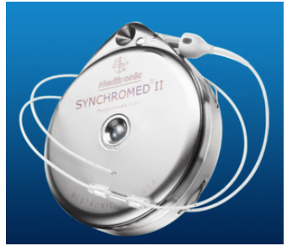
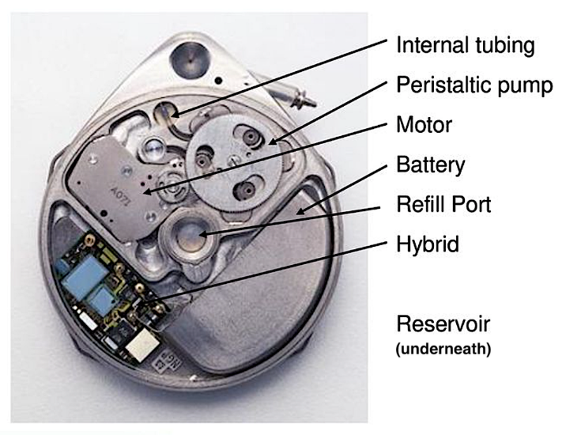
Images from https://mriquestions.com/implanted-infusion-pumps.html

Slide 27
Device related Complications¹¹
Infection/meningitis
Spinal cord injury
Post-dural puncture headaches/CSF leak
Catheter tip granuloma formation
IT catheter and pump malfunctions
Pocket site seroma formation, bleeding, pain and discomfort

Slide 28
IT PUMP MEDS¹³
Only morphine, ziconotide and baclofen are FDA approved
  Ziconotide: blocks N-type calcium channels in dorsal horn → inhibits neurotransmitter release from primary nociceptive fibers
Other medication options:
  Opioids are the mainstay (no definitive evidence of conversion factor)
  Local anesthetics (e.g., bupivacaine): block voltage-gated sodiumchannels → inhibit dorsal horn transmission and reduce systemic opioidneeds
  Clonidine (α2-agonist): enhances analgesia (especially neuropathicpain); risks include hypotension and rebound hypertension
Polyanalgesia is common in cancer pain—synergistic, opioid-sparingapproach targeting multiple nociceptive pathways
  Reduces tolerance, stabilizes opioid dosing, limits escalation

Slide 29
IT Meds-Possible side effects¹³
Opioids
  Nausea, vomiting, itching, respiratory depression, constipation, hormonal imbalance, sedation, hyperalgesia, tolerance
  Peripheral edema
Bupivacaine
  Urinary retention, hypotension, numbness, motor weakness
Clonidine
  Hypotension
Ziconotide
  Hallucinations, confusion, psychosis, suicidality, GI upset

Slide 30
Nerve Blocks

Slide 31
Nerve Block Procedure¹⁴
Needle positioned using fluoroscopy
Patient has to be able to tolerate procedure (move onto bed, lie flat vs sit upright)
Often initial block done with local anesthetic/steroid. If this is effective, can do a longer-lasting block with neurolytic agent.

Slide 32
Methods of Nerve Destruction: Neurolytic Agents¹⁵
Chemical
  Alcohol
  Phenol
  Glycerol
  Chlorocresol
  Ammonium Compounds
  Aminoglycosides
  Hypertonic Saline
  Iced Saline
Physical
  Cryoablation
  Radio Frequency Ablation (RFA)
    Thermocoagulation/Conventional
    Pulsed
  High Intensity Focused Ultrasound(HIFU)
Notes:
Is preferred for procedures that must disrupt diffuse neural networks like celiac plexus
Commonly used agent- Alcohol and phenol;
Glycerol for gasserian ganglion
Alcohol (50-100%)
Causes cellular dehydration, vascular thrombosis and ischemia
Wallerian degeneration
Marked pain on injection; tendency to produce neuritis
More intense nerve destruction and sensory blockade
Phenol (3-12% commonly used- 5 to 10%)
Diffuses into axon and denatures protein- Wallerian degeneration.
Water soluble, diffuses poorly, especially when mixed with glycerin
Local anesthetic properties
not painful on injection,
pain is relieved immediately. Block fades in intensity over the first 24 hours, leaving a neurolytic effect of lesser intensity.

Slide 33
Peripheral Nerve Blocks¹⁶
Targeting peripheral nerves:
  Paravertebral
  Head/neck
  Plexus
  Intercostals
  Others
Most cases report good pain control and minimal side effects

Slide 34
Sympathetic blocks- Sites & Relevant Structures¹⁴
Nervous system location | Corresponding anatomic structures
Stellate ganglion | Head, meninges, arm, eye, ear, tongue, neck, larynx, pharynx
Gasserian ganglion | Face/mouth, typically associated with trigeminal neuralgia
Celiac plexus (splanchnic nerves) | Pancreas, abdominal vessels, esophagus to transverse colon, liver, adrenals, ureters
Lumbar sympathetic chain | Lower extremity vessels and skin, ureters, kidney, testes
Hypogastric plexus | Uterus, ovaries, vagina, bladder, prostate, testes, descending and sigmoid colon, seminal vesicles
Ganglion impar/ganglion of Walther) | Perineum, rectum, anus, vagina, distal urethra, vulva
Notes:
FACILITATOR
HIGH YIELD FOR THE BOARDS!

Slide 35
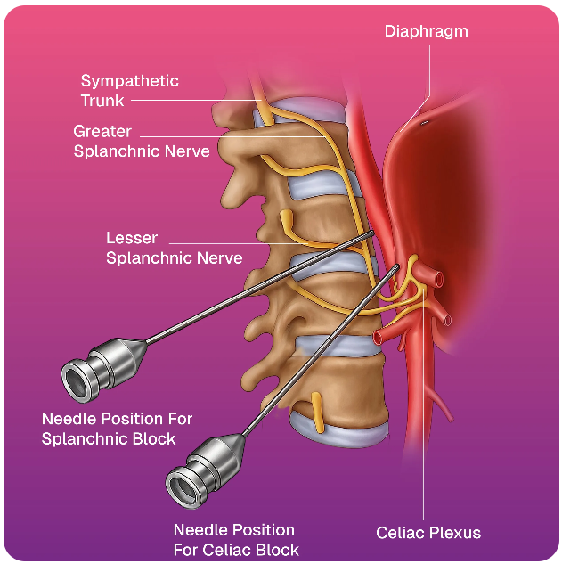
Celiac Plexus: Area of Effect¹⁴
Pancreas, abdominal vessels, esophagus to transverse colon, liver, adrenals, ureters
Image from: https://irclinicindia.com/procedures/celiac-plexus-nerve-block

Slide 36
Side Effects-Celiac Neurolysis^{17,18}
Side effect | # of RCT included for metanalysis | Risk ratio after percutaneous CPN vs Systemic Analgesia | 95% CI
Hypotension | 4 | 7.43 (P=0.0003) | 2.53, 21.79
Diarrhea | 5 | 5.88 (P = 0.0003) | 2.24, 15.44
Constipation | 4 | 0.34 (P<0.00001 | 0.24, 0.48
Nausea/vomiting | 4 | 0.44 (P<0.0001) | 0.29, 0.64
Back pain
  5% to 60%; Spontaneous and fast recovery
Pneumothorax
  1.5% to 2%
Notes:
A meta-analysis was performed for hypotension, constipation, diarrhea, and nausea and vomiting for the percutaneous CPN

Slide 37
Neurological complications¹⁸
Due to direct trauma to spinal cord or nerves by neurolytic agent or needle
Injury to artery of Adamkiewicz may cause paraplegia
Notes:
Neurological adverse events are the most devastating complications after CPN. They may be the result of a direct trauma to the spinal cord or nerves by either the neurolytic agent or needle. An injury or spasm of the artery of Adamkiewicz may be the main mechanism for the development of paraplegia. It may be assumed that percutaneous CPN may be more likely to cause neurological injuries than the EUS technique due to the proximity of the needles to the spinal cord and nerve roots.

Slide 38
Superior Hypogastric Plexus¹⁴
Retroperitoneal structure situated in front of the lower third of L5 and upper third of the S1 vertebrae
Mediates nociceptive visceral stimuli from the pelvic organs including
  Prostate, Bladder, Uterus, Ovaries, Vagina, Rectum
Potential complications
  Infection, Intravascular injection, Neuraxial injection, Discitis, Neuritis, and Bladder/bowel incontinence

Slide 39
Ganglion Impar¹⁴
Single midline ganglion at sacrococcygeal junction
Key relay for perineal and pelvic floor pain.
Indications: refractory pain from rectal, anal, vulvar, penile, and perineal tumors; radiation-induced pain.
Benefits: significant reductions in perineal burning, tenesmus, dyschezia, dyspareunia.
  Associated with pain reduction at 3 months, as well as decreased opioid use¹⁹
Risks: rare—rectal puncture, infection, neuritis, autonomic dysfunction

Slide 40
Neurodestructive Procedures²⁰
IDDS (intrathecal drug delivery system) is typically preferred over these
Can be considered in patients with really short life expectancy or who may not be candidate for IDDS for other reasons
Intrathecal neurolysis²¹
  Alcohol is hypobaric to CSF
  Phenol is hyperbaric
Neurosurgical procedures
  Cordotomy
  Midline myelotomy
  Cingulotomy

Slide 41
  Cordotomy²⁰
For unilateral localized pain
Disruption of spinothalamic pathway
  Loss of pain and temperature sensation

Slide 42
More Invasive Neurosurgical Procedures²⁰
Midline Myelotomy
  Visceral abdominal or pelvic pain
  Disruption of visceral pathways running in the middle
  Open procedure
  Requires laminectomy
Cingulotomy
  For diffuse pain
  Lesioning of brain pain centers-> affective portion of pain is removed
  Requires burr hole

Slide 43
Percutaneous Ablation Techniques for Bony Lesions

Slide 44
Percutaneous ablation techniques of painful bone lesions²²
Chemical
Physical- preferred
  Laser
  Radiofrequency
  Microwave
  Cryoablation
  Radiofrequency inonisation
  MR-guided HIFU
Relative contraindications
  tumors that are less than 1 cm away from the spinal cord, major motor nerves, and arteries supplying the central nervous system, bladder, or bowel.

Slide 45
Neurostimulation Procedures

Slide 46
Spinal Cord Stimulator: Cancer pain²³
Now mostly MRI compatible-
  ASPN practice guidelines
  See manufacturer recommendations
For stable disease
Pain in limb, visceral pain
Neuropathic pain
  CIPN, treatment induced neuropathies
Cochrane review- not enough good quality evidence, more trials needed
  4 case series, total n = 92, small studies, quality-low
  SCS group used fewer drugs than the standard treatment

Slide 47
SCS for Cancer Pain – Series of case series^{24,25}
Population:
  15 patients with cancer treatment (surgery/radiation)–related low back pain, in remission.
  10 patients with post-thoracotomy chest wall pain after lung cancer treatment, in remission.
Intervention:
  SCS trial then implant.
  Lead placement: T8–T10 (low back pain) or T3–T5 (chest wall pain).
  Settings: pulse width 400–450 μs, rate 50–60 Hz, amplitude 1.5–2.3 V.
  Stimulation provided 100% coverage of painful areas.
Outcomes (12-month follow-up):
  >50% pain relief reported in all patients.
Opioid reduction/discontinuation:
  13/15 (86.7%) in the low back group.
  10/10 (100%) in the chest wall group.

Slide 48
Case Example: SCS for Refractory Cancer-Related Back Pain
44 yo M, metastatic renal cell carcinoma
  Spine mets-T12-L5, sacrum, ilium; L2 pathologic fracture.
Refractory axial low back pain
Failed multiple procedures: kyphoplasty, targeted radiation therapy, MB RFA, epidural steroid injections, celiac plexus neurolysis, and an intrathecal pump trial
SCS trial and implant →Drastic improvements in pain, mood, reduced opioids, and increased physical activity.

Slide 49
Peripheral Nerve Stimulator (PNS)²⁶
Implants small stimulator next to nerve to disrupt nerve impulse
Multiple options with external pulse generator available, allowing for percutaneous approach with minimal incisions
Temporary 60-day option
Consider if nerve blocks provide temporary relief and neurolysis may not be an option
PNS may be preferable to SCS due to less invasive nature/ lower risk
Ensure patient can reach or has a caretaker that can reach the area for external pulse generator/battery
Understand MRI restrictions
Notes:
FACILITATOR:
SCS may not be an option due to
Spine anatomy
Anticoagulation needs

Slide 50
General considerations- PNS²⁶
Consider for intractable pain in 1-2 peripheral nerve distribution
Relying on afferent signals: area of pain should have some sensation
Accessibility: Patient can reach or has a caretaker that can reach the external pulse generator/area of stimulation.
Risks: Biggest risk is lead migration
  Lead fracture, Erosion, Infection, Bleeding, Lack of pain relief
MRI considerations: follow manufacturer recs

Slide 51
Use of Temporary PNS for Cancer Pain²⁶
Retrospective review, 15 patients receiving temporary PNS
Key Findings
  10 successful cases: robust pain relief for tumor-related, cancer-associated, and cancer-independent pain.
  Least benefit: patients with treatment-related pain.
  6 cases showed inadequate relief.
Conclusion
  PNS is a promising neuromodulation strategy for focal nerve-distribution pain in cancer patients.

Slide 52
Percutaneous Vertebral Augmentation

Slide 53
Vertebral Compression Fractures²⁷
Pathologic compression fractures (malignancy-related fractures) occur in up to 30% of patients with bone metastases
Can cause acute and long-term pain and decreased functional status

Slide 54
Interventions for Vertebral Compression Fractures²⁷
Vertebroplasty:
  Percutaneous injection of cement (polymethylmethacrylate – PMMA) into a fractured vertebral body
Balloon Kyphoplasty:
  A balloon is inserted into vertebral body in attempt to elevate vertebral end plates prior to injecting cement

Slide 55
Indications, Outcomes, and Complications²⁷
Indications:
  Patient with painful compression fracture, pain located at site of lesion
  Contraindications: neurologic deficits related to the fracture, burst fracture, systemic or local infection
Outcomes:
  Pain improvement in >2/3 of patients, often with a five-point drop in pain scores²⁸
Complications (rare):
  Infections
  Pulmonary or neurologic emboli
  Cement extravasation

Slide 56
Understand sample cancer-pain treatment algorithms

Slide 57
Case study #2
66 year old with multiple myeloma with upper back pain, worse with any activity and better with rest.
On Morphine 30 mg TID, Baclofen 10 mg TID, Pregabalin 50 mg BID, Tylenol 1000 mg TID and Lidocaine patch.
Pain Generator-T5 vertebral body lesion & fracture
Water cooled RF ablation and kyphoplasty done
Back pain completely resolved
Notes:
T4- 40% height loss, changed to 25% height loss s/p kypho

Slide 58
Pain in cancer patient
Due to non-malignant pain such as aging and arthritic changes
Pain due to cancer or cancer treatment
TPI, Medial branch blocks and RF, various joint injections- SI, hip, shoulder, AC; ESI
Visceral Nociceptive pain
Somatic Nociceptive pain
Neuropathic pain
From- vertebral body compression fracture-Kyphoplasty/vertebroplasty; From bone lesion: IR ablation procedures
Within specific dermatomes or 1-2 nerve distribution-Selective nerve block +/- neurolysis
From upper abdomen- celiac/ splanchnic block/neurolysis
From rectum and anal canal-ganglion impar block/neurolysis
Diffuse head and neck or upper extremities- stellate ganglion block/neurolysis
If pain persists consider peripheral neuromodulation- PNS
From pelvis-hypogastric block/neurolysis
If pain persists consider central neuromodulation-SCS
Diffuse lower extremities- lumbar sympathetic block/neurolysis
If pain persists consider intrathecal pump (IDDS)
If IDDS not an option, consider neurosurgical procedures
Figure by author.

Slide 59
Algorithm for Chemo-induced Peripheral Neuropathy (Developed by Author)
Exercise
  Home exercise regimen- strength/endurance, individual exercises​
  OT/PT
Medications
  Start with Duloxetine 20 mg titrate to 60; ALA; topicals (OTC- lido, capsaicin)​
  If no success, other anti-neuropathic agents, muscle relaxants​
  If not success, Qutenza (if approved by insurance), LDN (self-pay, compounding pharmacy), Buprenorphine
Non-Invasive Interventions
  Cutaneous electrical stimulation: TENS, Scrambler​
Invasive Interventions
  Nerve Blocks​
  PNS
    60 day temporary (esp if symptoms within 1 year)​
    Trial/perm (MRI compatible option only)
  Central neuromodulation
    IT pump (ziconotide, bupivacaine)- trial first​
    SCS (esp. if either lower or upper extremity is worse)​
    DRG- generally not due to lack of MRI compatibility

Slide 60
Bonus!
Intro to Interventional Pain @ Emory

Slide 61
Cancer Pain Program at Emory Pain Center: What do we do?
Multimodal pain treatment, focusing on minimizing opioids using techniques such as
  Complementary therapies including acupuncture, physical therapy
  Interventions including
    nerve blocks and neurolysis/nerve ablation,
    joint injections, epidural steroid injections,
    neuromodulation (spinal cord stimulator, peripheral nerve stimulator),
    vertebroplasty,
    intrathecal pump, etc.
  Maximize non-opioid pain medications
  Opioid medications when necessary

Slide 62
Conclusion
Medications can treat 70% of cancer related pain
Variety of interventions available for intractable cancer pain
Good understanding of anatomic pain generator for is key for determining the type of intervention
Strong evidence for sympathetic neurolysis for visceral cancer related pain
IDDS can palliate symptoms in most cases of refractory cancer pain

Slide 63
Questions?
X- @VinitaSinghMD
Linkedin-VinitaSinghMD
Vinita.Singh@emory.edu

Slide 64
References
van den Beuken-van Everdingen MH, Hochstenbach LM, Joosten EA, Tjan-Heijnen VC, Janssen DJ. Update on Prevalence of Pain in Patients With Cancer: Systematic Review and Meta-Analysis. J Pain Symptom Manage. 2016;51(6):1070-1090.e9. doi:10.1016/j.jpainsymman.2015.12.340
Paice JA, Portenoy R, Lacchetti C, et al. Management of Chronic Pain in Survivors of Adult Cancers: American Society of Clinical Oncology Clinical Practice Guideline. Journal of Clinical Oncology. 2016;34(27):3325-3345. doi:https://doi.org/10.1200/jco.2016.68.5206
CDC. United States Cancer Statistics (USCS). United States Cancer Statistics. Published June 5, 2024. https://www.cdc.gov/united-states-cancer-statistics/index.html
Macrae WA. Chronic post-surgical pain: 10 years on. British Journal of Anaesthesia. 2008;101(1):77-86. doi:https://doi.org/10.1093/bja/aen099
National Cancer Institute. Cancer Pain. National Cancer Institute. Published 2018. https://www.cancer.gov/about-cancer/treatment/side-effects/pain/pain-hp-pdq
Osterweis M, Kleinman A, Mechanic D. The Anatomy and Physiology of Pain. National Library of Medicine. Published 1987. https://www.ncbi.nlm.nih.gov/books/NBK219252/
Ramchandran K, Hauser J. FF #212 Phantom Limb Pain | Palliative Care Network of Wisconsin. Palliative Care Network of Wisconsin. Published November 11, 2024. Accessed May 15, 2025. https://www.mypcnow.org/fast-fact/phantom-limb-pain/
Aman MM, Mahmoud A, Deer T, et al. The American Society of Pain and Neuroscience (ASPN) Best Practices and Guidelines for the Interventional Management of Cancer-Associated Pain. Journal of Pain Research. 2021;Volume 14:2139-2164. doi:https://doi.org/10.2147/jpr.s315585
Wiffen PJ, Wee B, Derry S, Bell RF, Moore RA. Opioids for Cancer Pain - an Overview of Cochrane Reviews. Cochrane Database of Systematic Reviews. 2017;7(7). doi:https://doi.org/10.1002/14651858.cd012592.pub2
Swarm RA, Youngwerth JM, Agne JL, Anitescu M, Are M, Buga S, Butler T, Chwistek M, Cleary J, Copenhaver D, Coyne C. Adult cancer pain, version 2.2025, NCCN clinical practice guidelines in oncology. Journal of the National Comprehensive Cancer Network. 2025.
Deer TR, Hayek SM, Grider JS, et al. The Polyanalgesic Consensus Conference (PACC)®: Intrathecal Drug Delivery Guidance on Safety and Therapy Optimization When Treating Chronic Noncancer Pain. Neuromodulation Technology at the Neural Interface. Published online May 1, 2024. doi:https://doi.org/10.1016/j.neurom.2024.03.003
Perruchoud C, Dupoiron D, Papi B, Calabrese A, Brogan SE. Management of Cancer-Related Pain With Intrathecal Drug Delivery: A Systematic Review and Meta-Analysis of Clinical Studies. Neuromodulation. 2023;26(6):1142-1152. doi:10.1016/j.neurom.2021.12.004
Stearns L, Boortz-Marx R, Du Pen S, et al. Intrathecal drug delivery for the management of cancer pain: a multidisciplinary consensus of best clinical practices. J Support Oncol. 2005;3(6):399-408.
Reisfield G, Yu V, Debrosse M, Wilson G. FF #97 Blocks of the Sympathetic Axis for Visceral Pain | Palliative Care Network of Wisconsin. Palliative Care Network of Wisconsin. Published November 11, 2024. https://www.mypcnow.org/fast-fact/blocks-of-the-sympathetic-axis-for-visceral-pain/

Slide 65
References Cont.
15. Wu R, Majdalany BS, Lilly M, J. David Prologo, Nima Kokabi. Agents Used for Nerve Blocks and Neurolysis. Seminars in Interventional Radiology. 2022;39(04):387-393. doi:https://doi.org/10.1055/s-0042-1757315
16. Klepstad P, Kurita GP, Mercadante S, Sjøgren P. Evidence of peripheral nerve blocks for cancer-related pain: a systematic review. Minerva Anestesiol. 2015 Jul;81(7):789-93. Epub 2014 Nov 11. PMID: 25384692.
17. Davies DD. Incidence of major complications of neurolytic coeliac plexus block. Journal of the Royal Society of Medicine. 1993;86(5):264-266. doi:https://doi.org/10.1177/014107689308600507
18. Nagels W, Pease N, Bekkering G, Cools F, Dobbels P. Celiac Plexus Neurolysis for Abdominal Cancer Pain: A Systematic Review. Pain Medicine. 2013;14(8):1140-1163. doi:https://doi.org/10.1111/pme.12176
19. Sousa Correia J, Silva M, Castro C, Miranda L, Agrelo A. The efficacy of the ganglion impar block in perineal and pelvic cancer pain. Supportive care in cancer : official journal of the Multinational Association of Supportive Care in Cancer. 2019;27(11):4327-4330. doi:https://doi.org/10.1007/s00520-019-04738-9
20. Hines K, Shah H, Misra S. Neuroablative Interventions for Refractory Pain | Palliative Care Network of Wisconsin. Palliative Care Network of Wisconsin. Published September 16, 2025. Accessed March 10, 2026. https://www.mypcnow.org/fast-fact/neuroablative-interventions-for-refractory-pain/
21. Rangel Jaimes GW, Ortega Agón KA, Cediel Carrillo XJ. Intrathecal Neurolysis for the Management of Refractory Pain in a Patient with Terminal Oncological Disease: Case Report. Pain Management. 2022;12(5):569-577. doi:https://doi.org/10.2217/pmt-2021-0097
22. Foster R, Stavas J. Bone and Soft Tissue Ablation. Seminars in Interventional Radiology. 2014;31(02):167-179. doi:https://doi.org/10.1055/s-0034-1373791
23. Peng L, Min S, Zejun Z, Wei K, Bennett MI. Spinal cord stimulation for cancer-related pain in adults. Cochrane Database of Systematic Reviews. Published online June 29, 2015. doi:https://doi.org/10.1002/14651858.cd009389.pub3
24. Yakovlev AE, Resch BE. Spinal cord stimulation for cancer-related low back pain. Am J Hosp Palliat Care. 2012;29(2):93-97. doi:10.1177/1049909111410414
25. Yakovlev AE, Resch BE, Karasev SA. Treatment of cancer-related chest wall pain using spinal cord stimulation. Am J Hosp Palliat Care. 2010;27(8):552-556. doi:10.1177/1049909110373240
26. Sudek EW, Mach S, Huh B, Javed S. Use of Temporary Percutaneous Peripheral Nerve Stimulation in an Oncologic Population: A Retrospective Review. Neuromodulation. 2024;27(1):118-125. doi:10.1016/j.neurom.2023.06.009
27. Chwistek M, Mehta R. Vertebroplasty and Kyphoplasty for Vertebral Compression Fractures | Palliative Care Network of Wisconsin. Palliative Care Network of Wisconsin. Published July 7, 2025. Accessed March 10, 2026. https://www.mypcnow.org/fast-fact/vertebroplasty-
28. Sorensen ST, Kirkegaard AO, Carreon L, et al. Vertebroplasty or kyphoplasty as palliative treatment for cancer-related vertebral compression fractures: a systematic review. The Spine Journal 2019; 19(6):1067-75.

