Slide 1
Introduction to Outpatient Palliative Care: Part One
Victoria Sweetnam MD
Angelika Golebiowska MD
No Disclosures
Notes:
Presenter: VS

Slide 2
Learning Objectives
Understand the shift of focus for outpatient vs inpatient palliative care
Understand the organization of palliative care in various settings
Understand outpatient IDT roles
Master outpatient documentation standards for regulatory compliance, quality reporting, and efficient clinical operations
Evaluate best telehealth practices in outpatient palliative care
Notes:
Presenter:VS

Slide 3
Learning Objective
Understand the shift of focus for outpatient vs inpatient care
Notes:
Presenter:AG

Slide 4
Two Distinct Care Models
Clinic vs Inpatient Overview
Hospital setting:
Acute interventions:
initiated during a crisis / hospitalization
Consolidated specialists:
all specialist “under one roof”
Crisis Alignment:
GOC in response to acute changes
Clinic Setting:
Upstream integration:
ideally engage with the pt BEFORE a crisis
System navigation:
guiding patient through complex/fractured medical system
Relational focus:
build rapport (often occurs through symptom management)
Notes:
Presenter:AG

Slide 5
Clinic: Medical Decision Making in a “Data-light Zone”
Hospital setting:
Excellent access to data on medication use
Dose, time delivery and interactions are well documented.
You can return to see the patient multiple times a day to check you intervention
Medication regimens are delivered as written in a monitored environment
Clinic Setting:
Varied access to data on medication use
Relay on patient report
Objective data comes from pharmacy refills /pill counts/ iSTOP
Medication regimens may be complicated by use of ETOH, illicit drugs, herbal remedies, poor nutrition, cognitive impairment.
Usually, extra effort and investigation are needed to safely prescribe.
Notes:
Presenter:AG

Slide 6
Clinic: Advanced Care Planning
Hospital setting
Code Status and EOL preferences are dictated by emergent clinical issues.
Patient participation in ACP may be varied due to acute crisis.
Typically, less time to build relationships and gain trust.
Clinic Setting
Typically, you have time to build rapport and relationships
ACP planning can be stepwise based on trust. Clinical changes overtime can be utilized to adjust the care plan.
Ideally, these long-term conversations yield outcomes for patients most closely aligned to their goals.
Notes:
Presenter:AG

Slide 7

Outpatient Operational Gaps & Barriers
30-60
MINUTES PER VISIT
Temporal and Systemic Demands
Time Limitations: Clinics typically template only 45-60 minutes for a new patient and 30 minutes for return visits, requiring tight efficiency.
Operational : Staffing, infrastructure and space
Financial: IDT time and other work is often under-reimbursed or not reimbursed by insurance providers.
Severe Wait Times: Due to a shortage of dedicated PC clinics, referred patients routinely may have to wait months to see an outpatient provider.
Delayed Referrals: Patients are often referred far too late, arriving at their first visit already carrying a very high, unmanaged symptom burden or even death
Continuity: transitions of care, real-time monitoring and access to appointments.
Notes:
Presenter:AG

Slide 8
Learning Objective
Understand the organization of palliative care in various settings
Notes:
Presenter:VS

Slide 9
OVERVIEW
Taxonomy of Palliative Care Delivery
Foundation
Subsidized vs. non-subsidized
Inpatient
Acute crisis stabilization
Outpatient
Longitudinal support
Ambulatory
Community-based
Clinics
Home-based
Facility-based
Embedded clinics
Insurance programs
Company-based program
Longterm care
Notes:
Presenter:VS

Slide 10
SUBSIDIZED PATHWAY
Taxonomy of Palliative Care Delivery
Foundation
Subsidized & non-subsidized
Subsidized = Government covers a portion of costs to expand access
(i.e VA, public hospitals, Medicaid)
Inpatient
Acute crisis stabilization
Outpatient
Longitudinal support
Ambulatory
Community-based
Clinics
Home-based
Facility-based
Embedded clinics
Insurance programs
Company-based program
Longterm care
Notes:
Presenter:VS

Slide 11
AMBULATORY PATHWAY
Taxonomy of Palliative Care Delivery
Foundation
Subsidized vs. non-subsidized
Inpatient
Acute crisis stabilization
Outpatient
Longitudinal support
Ambulatory
Community-based
AMBULATORY PC:
Based in outpatient clinics
Oncology = commonly embedded clinics
Clinics
Home-based
Facility-based
Embedded clinics
Insurance programs
Company-based program
Longterm care
Notes:
Presenter:VS

Slide 12
COMPLETE FRAMEWORK
Taxonomy of Palliative Care Delivery
Foundation
Subsidized vs. non-subsidized
Care is in the home or facility based
Inpatient
Acute crisis stabilization
Outpatient
Longitudinal support
Ambulatory
Community-based
Clinics
Home-based
Facility-based
Embedded clinics
Insurance programs
Company-based program
Longterm care
Notes:
Presenter:VS

Slide 13
Indications for Referral to Outpatient Palliative Care
Patients with serious or life-threatening/life-limiting illnesses who need specialist-level help with:
  Complex symptom management
  Complex medical decision-making and care coordination
  Psychosocial support
  Advanced care planning support
Notes:
Presenter:VS

Slide 14
Facility-based Palliative Care:
Types of Longterm Care
Type of Care & Environment | Staff Training / Profile | Core Services & Facilities
Assisted Living | Non-medical Staff | Meal preparation inside, professional housekeeping, scheduled social calendars, and transport services. Add-on care available for activities of daily living
Memory Care Highly secured neighborhood | Trained in cognitive decline | Significantly elevated supervision and visual check-ins. Specialized, highly structured activities matching the unique needs of memory loss patients (low privacy, high safety).
Skilled Nursing / "Rehab" | Medically Trained | 24/7 immediate clinical support.). Intensive, highly goal-focused recovery cycles designed specifically to support a safe, sustainable return home.
Nursing Home | Medically Trained | Comprehensive 24/7 nursing oversight paired with continuous, hands-on care for eating, bathing, and mobility needs.
CCRC (Continuing Care) Expansive multi-facility neighborhood supporting all life phases. | Hybrid Teams | Houses all care models on a single campus
Image by https://geriatricresourceservices.com/2020/01/types-of-long-term-care/¹
Notes:
Presenter :VS

Slide 15
Learning Objective
Understanding outpatient IDT roles (co-visits, individual visits, visit pacing, best practices)
Notes:
Presenter: VS

Slide 16




The Outpatient IDT Framework
Understand that not all outpatient practices will be fully equipped with a full IDT
Direct Clinical
Psychosocial Care
Operations & Support
Notes:
Presenter:VS

Slide 17



Outpatient IDT Visit Architectures
Integrated Co-Visits
Individual Visits & Pacing
Joint consultations—bringing an outpatient Social Worker and Clinical Pharmacist directly into the loop—are highly effective before, during, or after a medical visit
Titrated Frequency: Sub-specialty visit frequency is dynamic, depending on the clinical follow-up needs established during the referral process
Primary Indications:
The "Warm Welcome" Standard: Clinical best practice is typically such that IDT members try and meet new patients at their initial intake appointment to forge early, trust-filled alignment
•
High-burden psychiatric or spiritual distress
•
Complex polypharmacy or pain medication titration
•
Interpersonal barriers, safety, or compliance concerns
Clinical Visit Best Practices
Slide 8 of 10
Notes:
Presenter:VS

Slide 18
The Roles of Outpatient IDT Roles:
Spiritual Health
Provide emotional and spiritual support to patients, care partners, and staff
A neutral, compassionate person outside family/friend relationships
Intent is to allow their whole self into the space
Therapeutic listening
Integrate care with SW, pharm, etc. to enhance care
Notes:
Presenter:VS

Slide 19
The Roles of Outpatient IDT Roles:
Spiritual Health
How/when helpful to incorporate outpatient spiritual health?
  Emotional, spiritual, or religious distress
  Anticipatory grief / Disenfranchised grief
  Bereavement
  Support for care partner
  Support staff: join in your joy and be there for your challenges
Notes:
Presenter:VS

Slide 20
The Roles of Outpatient IDT Roles:
Social Work
How/when helpful to incorporate outpatient Social Work?
Identify home needs and support
Provide caregiver support resources
Provide community resources
Help mitigate mental health outpatient crises
Identify psychosocial barriers to care
May assist with advanced care planning
Notes:
Presenter:VS

Slide 21
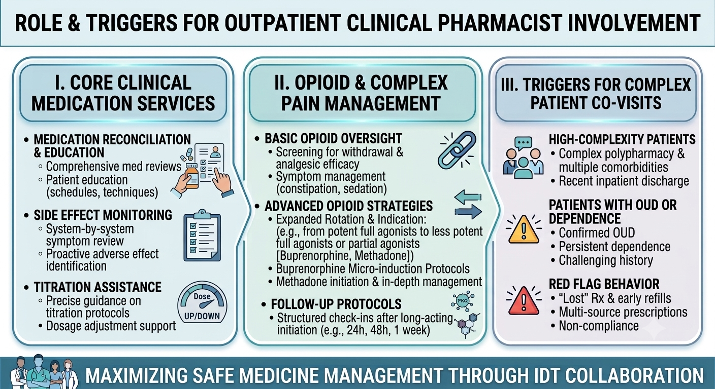
The Roles of Outpatient IDT Roles
Clinical Pharmacist
Notes:
Presenter:VS

Slide 22
Learning Objective
Master outpatient documentation standards for regulatory compliance, quality reporting, and efficient clinical operations
Notes:
Presenter:VS

Slide 23
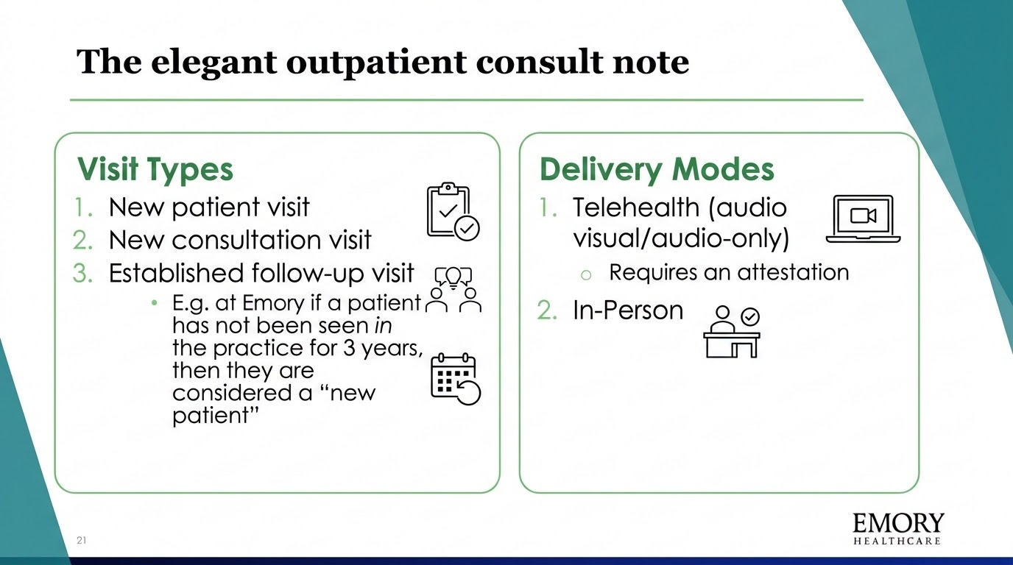
Notes:
Presenter:VS

Slide 24
Documentation Pearls
Consider documentation of significant events:
  Medication or plan changes--> handoff cross-covering and co-management
  Concerning patient behavior
Recognize that patients can read their notes
  The 2016 21st Century Cures Act (the "Open Notes" rule)
Elements: billing requirements + communication to colleagues—nothing else!
Notes:
Presenter:VS
FACILITATOR:Can be a plain "documentation encounter/note" or a "significant event" note

Slide 25
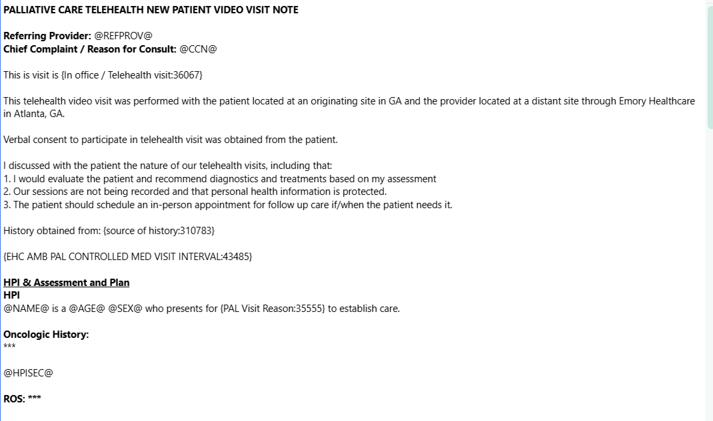
Telehealth Visit
Documentation
Telehealth attestation
Can add statement about if on controlled medications and frequency of visits needed/how often need to be seen in person
HPI:
"presents to palliative care office visit as referred by X for Y, Z, and to establish care/for follow-up.
I often will keep a brief history here: recent treatments the patient has been on, what I have primarily been managing (e.g., condition, medications/treatments).
Often, this will be a place to leave important historical points (e.g.,medications tried/failed table)
Interval HPI: "I introduced palliative care," "I conducted life review," "we discussed symptom management/GOC"...
Bulleted vs paragraph form
Brief Serious illness history here​
Image created by author
Notes:
Presenter:VS

Slide 26
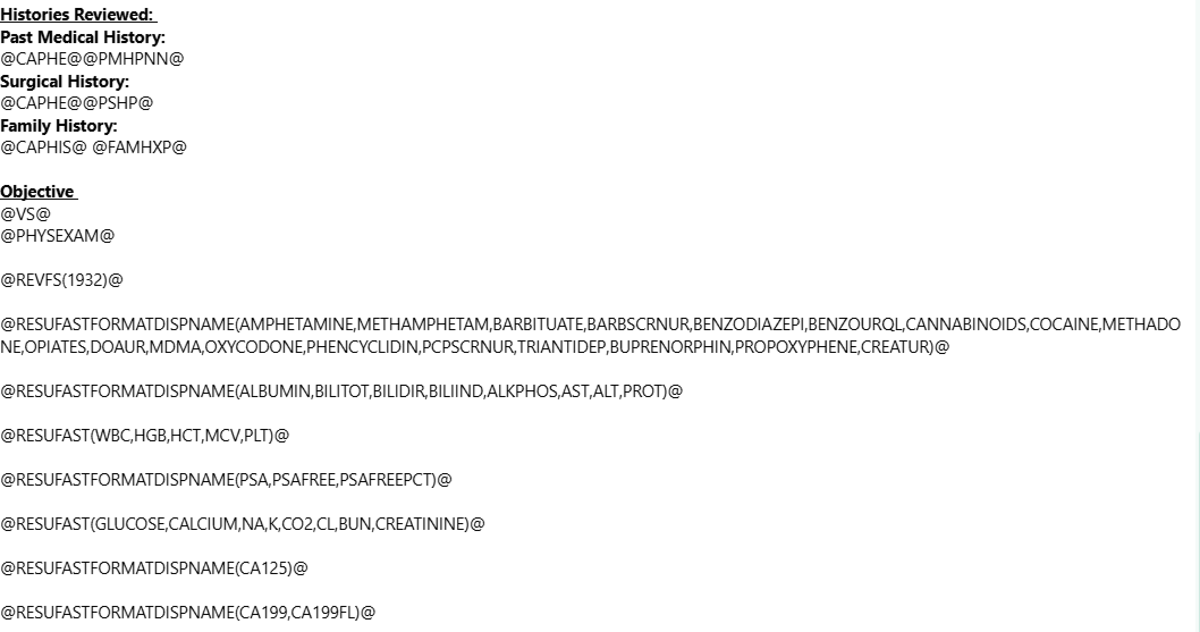
PERTINENT physical examination
PERTINENT labs
Image created by author
Notes:
Presenter:VS

Slide 27
I like breaking up the A/P into:
Symptom Management
Goals of Care/ACP/The Palliative Assessment
Psychosocial Support
A/P
@NAME@ is a @AGE@ @SEX@ with *** severe chronic illness *** who presents for {PAL Visit Reason:35555} to establish care *** uncontrolled*** exacerbation of *** pain *** and side effects from illness *** treatment*** including ***
-Symptom Management:
#Malignant pain***: Continue current regimen
- Multimodal regimen: scheduled Tylenol, duloxetine 60mg every day, gabapentin 300mg TID, lidocaine patch ***
- Long acting: ***, continued*** initiated*** titrated*** today, plan to follow up closely as below for close monitoring given high risk medication use***
- Short acting: ***, continued*** initiated*** titrated*** today, plan to follow up closely as below for close monitoring given high risk medication use ***
- Bowel regimen discussed :***
- PDMP reviewed and appropriate: @PDMPREVMSG@
- Reviewed chart and recent palliative care notes
- E-Substance agreement @CERMSGREFRESH(746841:;746622:,1)@
- Has Narcan on profile ***
- I reviewed the most recent ***note
- I reviewed the most recent labs including CBC and CMP revealing Scr which is *** and LFTS which are ***, ok for *** treatment***.
- Ordered UDS ***
- I personally interpreted the *** imaging which demonstrates *** progression *** stable disease consistent with patient's reported history of pain ***
- I communicated with the patient's *** provider regarding ***
Note, in your A/P billing, requirements should be easily identified
If documenting regarding controlledmedications, consider including:
Reviewing PDMP
ECSA
Last UDS/history of abberant UDS and whether results are as expected
Image created by author
Notes:
Presenter:VS

Slide 28
-Palliative Assessment:
Functional assessment:
ECOG: {ECOG performance status:20027} (last: ***)
PPS: *** (last: ***)
- Social: ***
- Spiritual Assessment: ***
-GOC, complex medical decision making: ***
Advanced Care Planning
Patient's understanding of illness: ***
Decisional capacity: {Palliative Care Decisional Capacity:21405}
Advanced Directive: {NO/YES WITH COMMENTS:31485}
Health Care Directive on file? {yes no:314532}
Health care agent and phone number: ***
Comments:
POLST forms: {POLST Documentation Options:21423}
@CODESTATUS@ today discussed code status confirming DNR***full code***. See separate ACP note.
@HEALTHCAREAGENTSLPG@
-Focused on acute symptoms today and not ACP - at appears that these conversations happened in the hospital and did not need to be acutely addressed today ***
Psychosocial Support:
***
Palliative care clinic IDT following.
Psychosocial needs were addressed and supported today including:***
Palliative Care SW met with and supported the patient today ***
Palliative Care Spiritual Care Clinician met with and supported the patient today ***
Follow up: ***
Visit Diagnoses: ***
CC: ***
Billing Time: *** (if applicable)
I like breaking up the A/P into
Symptom Management
Goals of Care/ACP/The Palliative Assessment
Psychosocial Support
Track functional status with a date: ECOG/PPS/KPS
Track functional status with a date: ECOG/PPS/KPS
Track functional status with dates: ECOG/PPS/KPS
Spiritual Assessment
Track Advanced Care Planning with dates and contact info
Track capacity with dates
Co-visit with IDT today?
Visit diagnoses should pull in. Need them to be specific and in order of importance. The #1 dx should have the most significance
Who you should "loop in"
Image created by author
Notes:
Presenter:VS

Slide 29
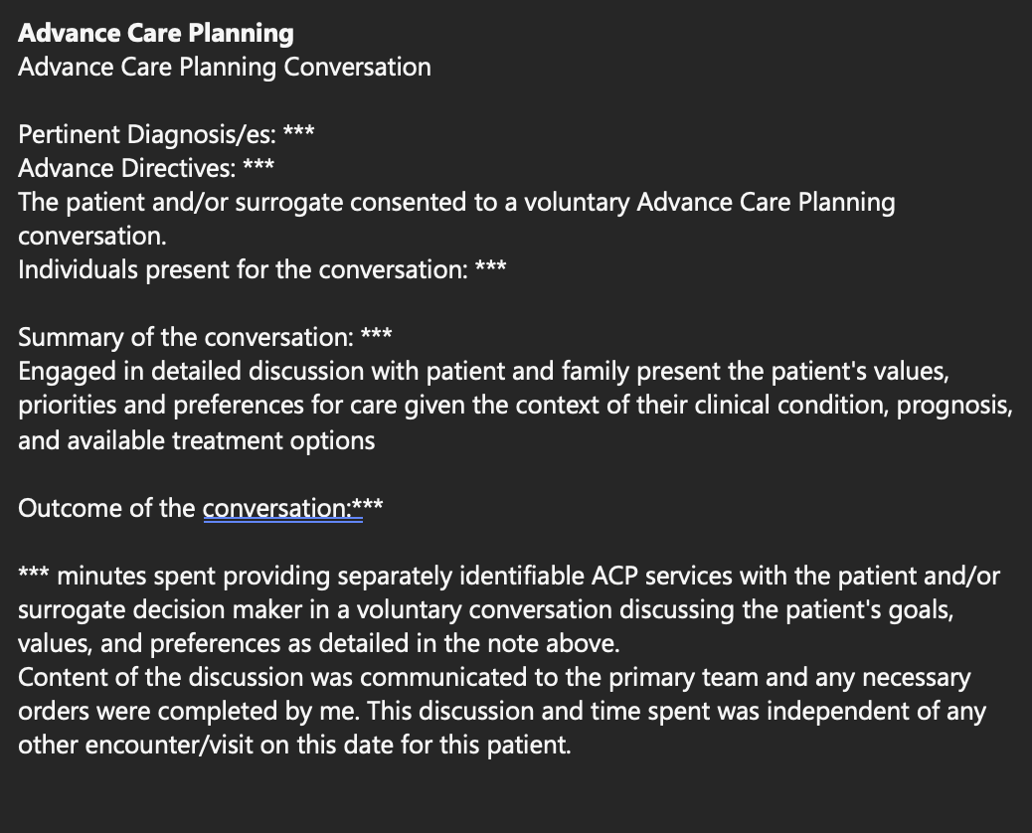
NEW ACP
Note
This must be a NEW ACP conversation that has NOT been had by any provider during the same year. Cannot bill twice in the same year for a NEW ACP conversation
Need to create a new note entirely for this conversation or make it VERY CLEAR within the same note that this was separate time accounted for and billed for
Image created by author as adapted from
Emory Supportive Care Center EPIC Note template
Notes:
Presenter:VS

Slide 30
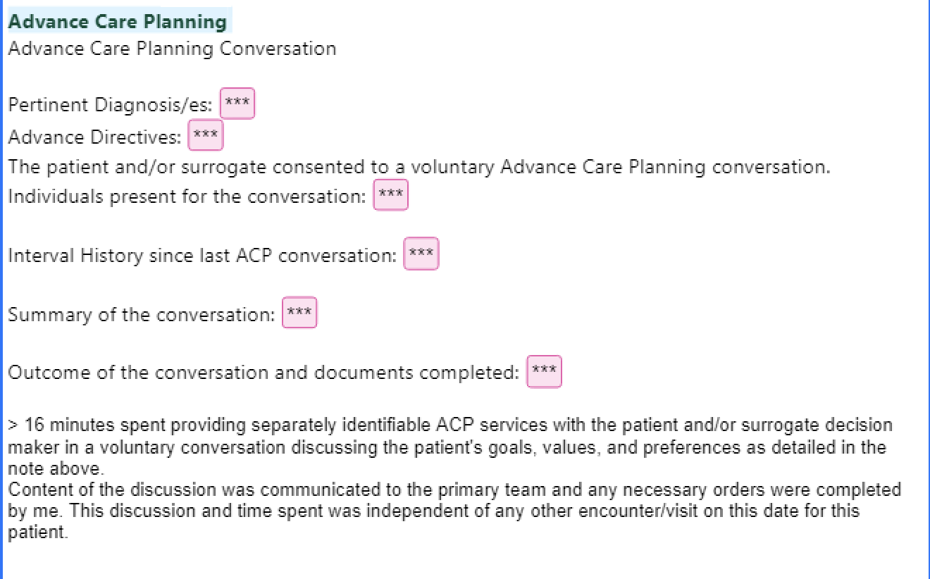
Follow-Up
ACP Note
Since this is a follow-up ACP conversation, you must document what has clinically CHANGED in the patient since last ACP conversation was documented.
Image created by author
Notes:
Presenter:VS

Slide 31
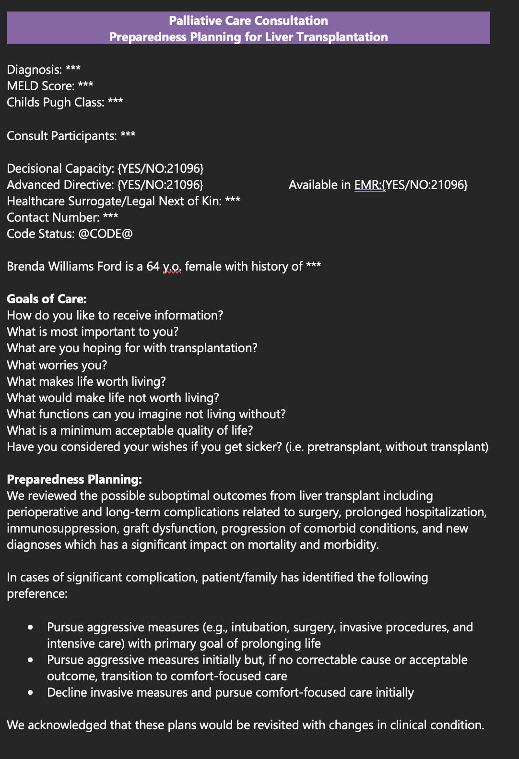
Transplant Evaluation
Image created by author as adapted from Emory Supportive Care Center EPIC Note template
Notes:
Presenter:VS

Slide 32
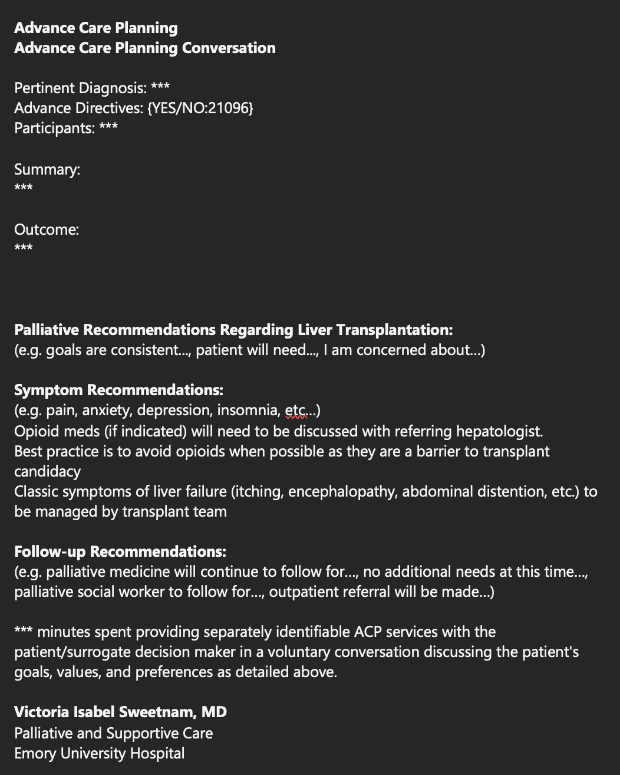
Need to create a new note entirely for this conversation or make it VERY CLEAR within the same note that this was separate time accounted for and billed for
Image created by author as adapted from
Emory Supportive Care Center EPIC Note template
Notes:
Presenter:VS

Slide 33
Controlled medication refill request note
Allows for ease of cross-coverage among multiple providers
Incorporates universal opioid precautions
Identifies aberrant/concerning controlled medication use
PALLIATIVE CARE MEDICATION REFILL REQUEST NOTE
*** refilled for ***date; Last fill on *** per PDMP
PDMP reviewed and appropriate: Not reviewed.
Reviewed Blue Sticky/additional comments ***
Reviewed chart and recent palliative care notes ***, last palliative care note on ***
E-Substance agreement Signed on 11/6/2023
Signed on 10/15/2024
Most recent UDS reviewed: Navis lab result on file - 7/15/2024 & {UDS response:45062}
Narcan has been previously prescribed
@RECENTFUTUREVISITS@
Have you seen this patient within the last X months? Do they have an appointment scheduled in clinic within the next Y months? What are your clinic policies regarding this?
Image created by author
Notes:
Presenter:VS

Slide 34
Learning Objective
Evaluate best telehealth practices
Notes:
Presenter:VS

Slide 35
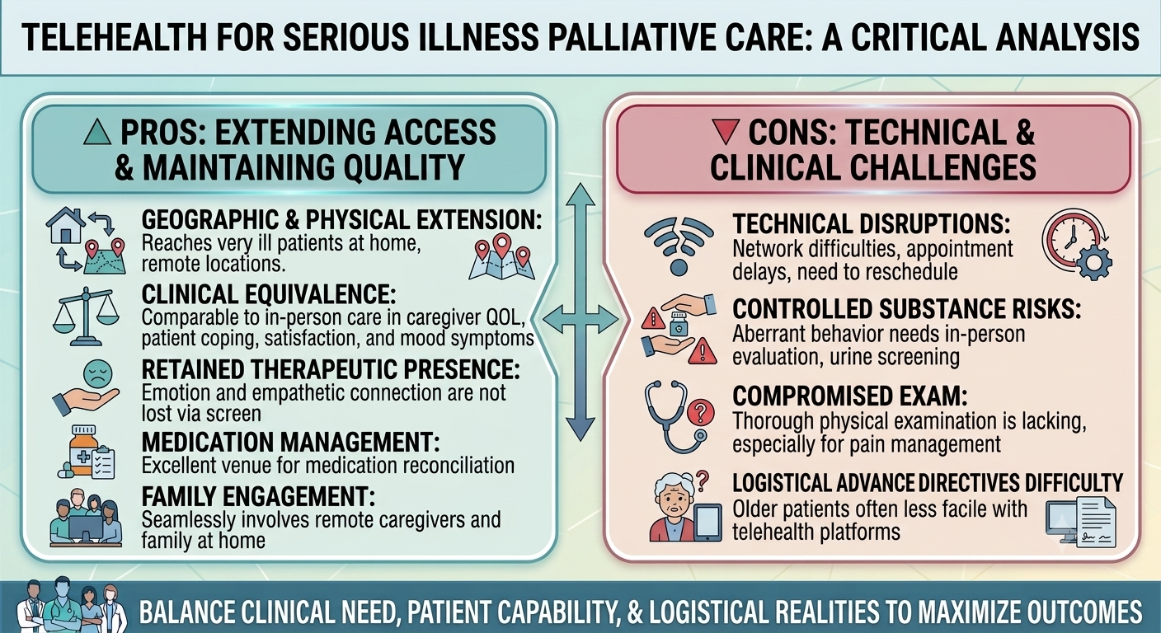
Notes:
Presenter:VS

Slide 36
Best Practices in Telehealth
  A telehealth attestation is required
  Specific billing codes are needed to specify telehealth
    95 modifier for telehealth audio and visual
    93 modifier for audio only
    New specific telehealth codes
      Brief check-in code 98016 (first 5- 10 minutes, audio only or audio/visual); patient initiated; cannot lead to an immediate visit in the next 24 hours or be a follow-up on a recent visit in the last 7 days
        e.g., better way to handle Mychart messages
Notes:
Presenter:VS

Slide 37
Best Practices in Telehealth
  Prescription of controlled medications:
    DEA, state, and clinic level policies all may have different requirements about in person vs telehealth prescribing
    E.g., Currently DEA and GA medical board allows for telehealth extension regarding controlled medication prescribing. However, SCC at Emory requires patients to be seen twice yearly in person and telehealth may be used in between
Notes:
Presenter:VS

Slide 38
Best Practices in Telehealth
  Both parties should find a quiet, private space for all visits to respect patient confidentiality.
  Maintain professionalism
  Use HIPAA-compliant technology
  Have a back-up for technological issues
  Utilize interpreters when needed
  Prepare accessible resources
    Send resources via Mychart, patient instructions
  Utilize the "share screen" function if available
    E.g., I often do this for low dose THC consultations to navigate the Georgia DPH website
  Ensure there is a reliable follow-up plan as there is no in person "check-out"
Notes:
Presenter:VS

Slide 39
Best Practices in Telehealth
  Utilize clinical judgement for when telehealth is not appropriate:
    Vitals needed
    A thorough physical exam needed
    Aberrant patient behavior surrounding controlled medications
    Have not been seen in clinic for X amount of time (as per clinic policies)
  Utilization of electronic consent forms (e.g., E-Controlled Substance Agreements) when possible
Notes:
Presenter:VS

Slide 40
References
Geriatric Resource Services. Types of long-term care. Published January 2020. Accessed March 25, 2026. https://geriatricresourceservices.com/2020/01/types-of-long-term-care/
Greer JA, Temel JS, El-Jawahri A, et al. Telehealth vs in-person early palliative care for patients with advanced lung cancer: a multisite randomized clinical trial. JAMA. 2024;332(14):1153-1164. doi:10.1001/jama.2024.13964
Centers for Medicare & Medicaid Services. Medicare Claims Processing Manual, Chapter 12: Physicians/Nonphysician Practitioners. Updated 2024. Accessed March 25, 2026. https://www.cms.gov/regulations-and-guidance/guidance/manuals/downloads/clm104c12.pdf
Notes:
https://geriatricresourceservices.com/2020/01/types-of-long-term-care/
https://www.capc.org/palliative-care-community/
https://jamanetwork.com/journals/jama/fullarticle/2823624

Slide 41
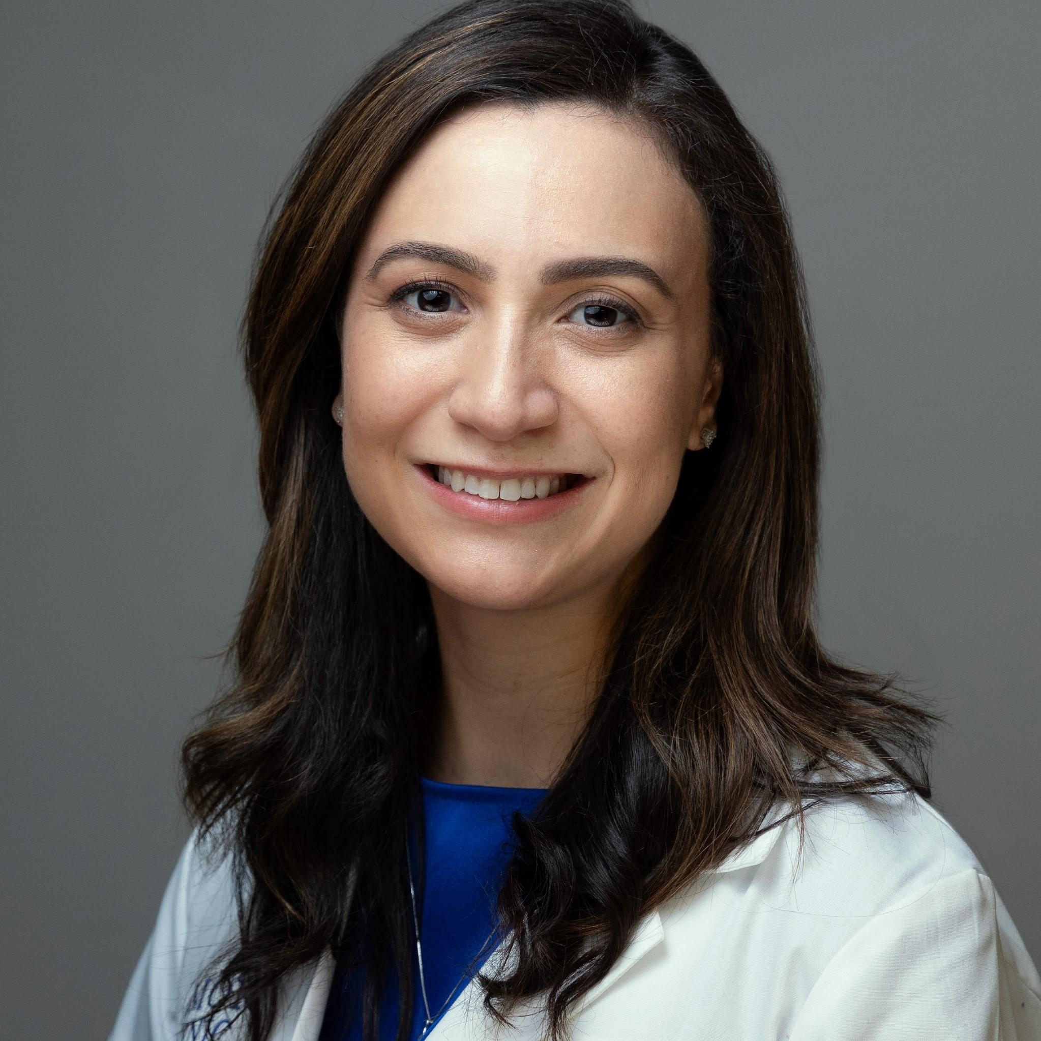

Thank you
Vsweetn@emory.edu
Angelika.golebiowska@nyulangone.org

