Slide 1
Introduction to Outpatient Palliative Care
Part Two
Victoria Sweetnam MD
Angelika Golebiowska MD
Tonya Hershman PharmD
Stephanie Choate LCSW
No Disclosures
Notes:
Presenter:VS

Slide 2
Learning Objectives
Navigate medication access issues (shortages, cost, prior authorizations)
Navigate financial distress and social determinants of health in the outpatient palliative care setting
Understand outpatient psychosocial barriers to care
Understand caring for un-represented and/or socially isolated patients with serious illness outpatient
Notes:
Presenter:VS

Slide 3
Learning Objectives
Navigate medication access issues
  Shortages
  Cost
  Prior authorizations
  Outpatient psychosocial barriers to care
Notes:
Presenter:VS

Slide 4
Barriers to Medication Access
1. Cost
2. Communication with pharmacies
3. Medication availability/shortages
4. Insurance coverage
Notes:
Presenter:VS

Slide 5
Barriers to Medication Access
Our Supportive Care Pharmacist (calls from Emory number): “I’m calling from Emory Healthcare on behalf of Dr. _____.Are you able to order in OxyContin 20mg #60 for a patient of ours with metastatic cancer?
Pharmacy: “No.” Click.
Tip: Many pharmacies want to see a prescription FIRST before divulging stock information
Notes:
Presenter:VS

Slide 6
The Opioid Epidemic has caused Medication Access Issues for Patients with Serious Illness
In the US in 2017 per CDC ~72k people died of drug overdose (47k involving opioids)¹
Results in a decrease in access to prescribed opioids
Cancer pain is undertreated and difficult to treat²
Notes:
Presenter:VS

Slide 7
The Predicament: Opioids Remain a Mainstay in the Treatment of Pain in Cancer and Other Serious Illness
Notes:
Presenter:VS

Slide 8
Opioids Remain a Mainstay in the Treatment of Cancer-related Pain and in Other Serious Illness
43% of cancer patients and 10% of survivors use opioids, with 2/3 of patients with cancer surviving >5 years³
55% cancer patients and 40% of survivors experience chronic cancer-related pain⁴
Since 2016, one-third of cancer patients report difficulty getting their prescribed opioids³
Notes:
Presenter:VS

Slide 9
The Opioid Epidemic has caused Medication Access Issues for Patients with Serious Illness
National and state policy changes
  Prescription fill limits
  PDMP review mandates
  Overdose medication co-prescribing
  Codification of opioids prescribing guidelines
Notes:
Presenter:VS

Slide 10
The Opioid Epidemic has caused Medication Access Issues for Patients with Serious Illness
Major pharmacies have changed their practices
The US Department of Justce’s lawsuit against CVS
CVS has since put out a statement:⁵ https://www.cvshealth.com/impact/healthy-community/our-opioid-response.html
“Pharmacists are held to vague, undefined, and ever-changing standards of practice”
CVS voluntarily blocked dispensing controlled prescriptions written by certain doctors, created algorithms to identify forged prescriptions, increased opioid training for pharmacists
Notes:
Presenter:VS

Slide 11
The Opioid Epidemic has caused Medication Access Issues for Patients with Serious Illness
“Even after taking these actions, we've been met with state investigations and lawsuits for allegedly second-guessing doctors’ medical judgment and refusing to fill opioid prescriptions. Whatever decision pharmacists make, it will not be good enough for some interest group.
This after-the-fact scrutiny places our pharmacists in an unenviable position. Our past efforts to work with the DEA to improve this situation have been routinely and flatly rebuked by bureaucrats that have no interest in disrupting the status quo.” –CVS⁵
Notes:
Presenter:VS

Slide 12
Medication Access Issues: Medication Shortages
Controlled medications are many times on national and local shortages
Why are there national shortages?
Manufacturing issues, supply chain disruptions, increased regulation on opioids
Local pharmacies do not want to carry opioids given safety concerns
Medication shortages affects patient-centered medication choices
E.g., Dronabinol, Morphine
initiating a lesser potent opioid, like morphine, may not be possible
Notes:
Presenter:VS

Slide 13
Medication Access Issues: Medication Shortages
Not in stock, but can order
Shortages:
  ASHP Drug Shortages Database: https://www.ashp.org/drug-shortages?loginreturnUrl=SSOCheckOnly
Notes:
Presenter:VS

Slide 14
Medication Access Issues: Pharmacies Are Declining to Fill Prescriptions
“High” Morphine Equivalent Daily Dose
Filling prescriptions “too early”
If a provider verbally tells a patient to take their IR opioid more frequently with existing prescription/supply → they “run out” earlier than expected and unable to fill new prescription
Note: dose changes to the prescription matching the way the patient needs to actually be taking the medication and a note to the pharmacist in the comments section is imperative to mitigate this problem
The PDMP may not be thoroughly reviewed by the pharmacist
Notes:
Presenter:VS

Slide 15
Medication Access Issues: Medication Shortages
Safer alternatives like buprenorphine in all formulations are not readily available or covered adequately by insurance
Buprenorphine may need to be ordered or not carried at a local pharmacy
Example: Insurance may only cover 3 tabs of Subutex daily but the patient may need 2mg/1mg/2mg dosing; Subutex only comes in 2mg and 8mg tabs
Prior authorizations needed → delay in prescriptions
Notes:
Presenter:VS

Slide 16
Medication Access Issues: Medication Shortages
Medication shortages cause delays in receiving prescription fills⁶
Case series by Heung et al. JPSM 2023⁶
50 y/o with GU cancer presents to pall care clinic with ongoing cancer-related pain. Patient was taking oxyER 15mg q12h and hydrocodone/acetaminophen 10/325mg q4h prn around the clock with only moderate relief. Given uncontrolled pain, the patient was instructed to discontinue oxyER and start methadone 5mg q12h an continue hydrocodone/acetaminophen 10/325mg for breakthrough. The opioid prescriptions were sent to the patient’s pharmacy. A few days later the patient reported that the pharmacy did not carry methadone and that it would need to be ordered. The clinic then had to locate another pharmacy that had it in stock. A new prescription was sent but that new pharmacy would not fill as it looked like the patient had tried filling at another pharmacy, labeling the patient as “high risk for abberancy.” Then the clinic needed to call several other pharmacies to re-route the prescription to another willing pharmacy, allowing four days to pass before the patient could get their medication. Meanwhile patient suffered from uncontrolled pain.
Notes:
Presenter:VS

Slide 17
Medication Access Issues
Patients with cancer-related pain report difficulty with filling their opioids due to stigma at their local pharmacies⁶
Notes:
Presenter:VS

Slide 18
Consequences of Limiting Opioid Prescriptions
Undertreated pain
Opioid withdrawal
Emotional distress⁶
Notes:
Presenter:VS

Slide 19
Consequences of Limiting Opioid Prescriptions
Can you think of others as you recall situations you have encountered in clinic?
Please spend a moment sharing with the group a time when medication access was an issue for a palliative care patient in clinic.
Notes:
Presenter:VS

Slide 20
Medication Access Issues: Formularies
Formulary: a list of covered medications by a health plan⁷
Formulary Types: what are the differences?
  Open
  Closed
  Tiered
Tiering exception: a tool to help make a plan decide to charge lower for a drug that is on its non-preferred drug tier. Must be requested by the patient and doctor who must provided a supporting statement explaining the medical reason for exception.
Plans can change their formulary at any time and must notify patients if their drug is affected.
Notes:
Presenter:VS
FACILITATOR:
Open: health plan covers part of the cost for all meds, regardless of whether they are on a formulary or not⁵
Closed: health plan covers only meds listed on the formulary. If not, prior authorization (and possibly appeal) is required.
Tiered: health plan offers financial incentives (i.e., different copay) to encourage patients to use preferred medications.

Slide 21
Medication Access Issues: Formularies
Example of a Medicare tiered formulary
  Tier 1 – lowest co-payment (most generic drugs)
  Tier 2 – medium co-payment (preferred brand name drugs)
  Tier 3 –higher co-payment (non-preferred brand name drugs)
  Tier 4 –highest co-payment (very high-cost drugs)
Notes:
Presenter:VS

Slide 22
Medication Access Issues:
What Other Restrictions Do Insurance Companies Put in Place on Prescription Drugs?
Notes:
Presenter:VS

Slide 23
Medication Access Issues: Why Do Prescriptions Get Rejected?
Drug
Not on formulary
On formulary, but not preferred
Quantity
Medications (especially opioids) have 30-day quantity limits
Documentation
Missing diagnosis code
Clinical rationale not in notes (applies primarily if PA already complete)
Notes:
Presenter:VS
FACILITATOR:
A medication can be rejected if on formulary but “non-preferred”
Insurance requires Step Up therapy: must try cheaper similar preferred drugs first
Non-preferred drug is high-cost/brand-name with a generic alternative
Non-preferred drug has safety concerns
The manufacturer didn't offer rebates
The above then often triggering a PA or Formulary Exception Request from provider to prove medical necessity

Slide 24
Medication Access Issues: Prior Authorizations Impose a Barrier to Prescription Drug Coverage
Prior authorization
  Aka: pre-authorization, precertification, prior notification, prospective review, prior review
  Another tool used to get a service or medication approved for a patient to qualify for financial coverage
  For services, a referral may be required
To avoid need for a PA:
  Check the formulary FIRST
  Be thoughtful about the BEST medication for the patient? Are there 1-2 similar medication that would also work well that may have fewer barriers?
  Send the prescription and associate the diagnosis code on the prescription
Notes:
Presenter:VS

Slide 25
Medication Access Issues: Prior Authorizations
Most providers submit PAs retrospectively
The pharmacy or patient notifies the clinic of the need for a PA
Movement towards Prospective PA
At time of prescription
More efficient but there is lack of consistency b/w health plans.
Electronic prescribing
CoverMyMeds (free!), Epic
Request PAs on behalf of multiple providers
Push for Automation – have this information at the time of prescribing, so patients/ providers have easier decision making
Notes:
Presenter:VS

Slide 26
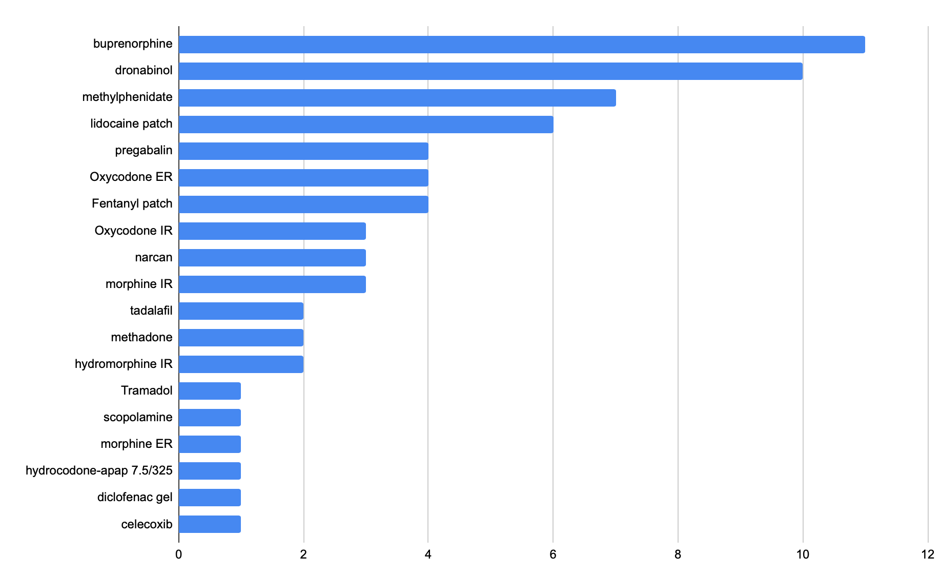
Prior Authorizations in the Emory SCC
-All PAs for Oct 2021, total = 67
-Roughly 3000 patients total in our practice
Figure by SCC staff
Notes:
Presenter:VS

Slide 27
Medication Access Issues: Other Restrictions Placed by Insurance Companies
Prior authorization
Step up therapy
  A type of prior authorization
  Prescribe lower priced medications before stepping up to other more costly medications
Quantity Limits
Age requirements
Notes:
Presenter:VS

Slide 28
Medication Access Issues
A team is helpful in navigating these challenges and processes
A specialty pharmacist and pharmacy technician
A prior-authorization specialist
Nursing staff
Our LPN is trained to initiating the PA process and submitting letters of appeal
Notes:
Presenter:VS

Slide 29
Medication Access Issues: Steps after Prior Authorizations
May need a formulary alternative
Rejection letter may have alternatives and lists reasons for rejection
    “Subject: PA Oxycontin 40mg – Denied
    The PA for oxycontin 40mg has been Denied by the insurance company. Their criteria is that the patient must have tried and failed 3 of the formulary options: Morphine ER, Hydrocodone ER, Hydromorphone ER, methadone and Fentanyl transdermal”
* Clinical Documentation can help make your case: a progress note stating that you’ve tried step up therapy already or preferred formulary alternatives
Notes:
Presenter:VS

Slide 30
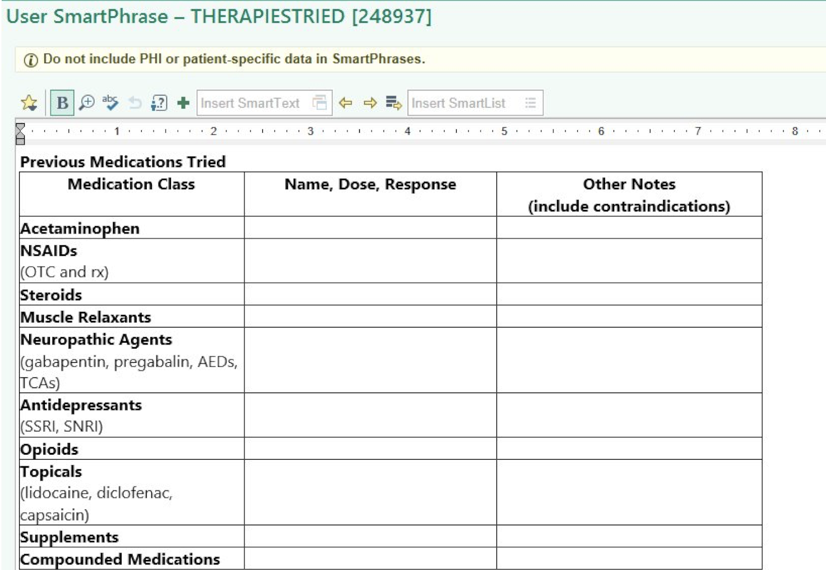
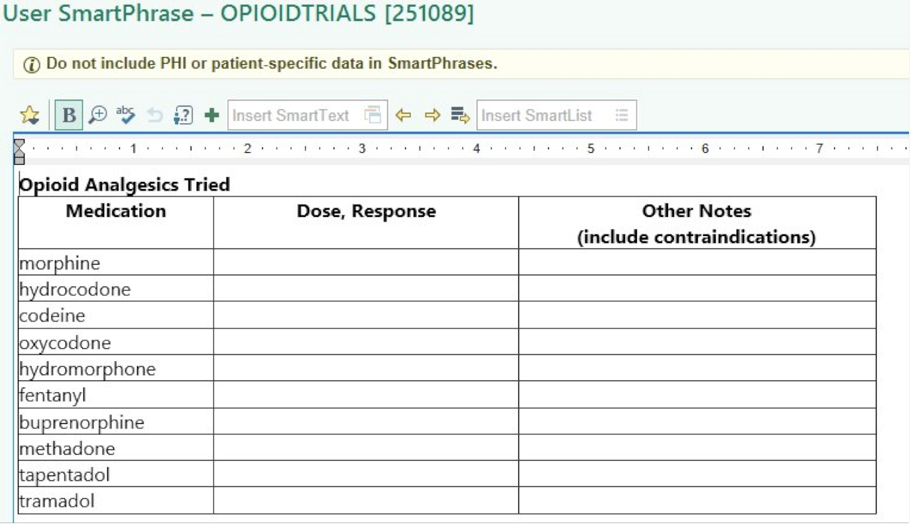
Clinical Documentation
Helpful Dot-phrases
  .THERAPIESTRIED
  .OPIOIDTRIALS
Images created by author
Notes:
Presenter:VS

Slide 31
Medication Access Issues: Formularies
Formulary Exercise
  Cancer patient has refractory nausea and you want to know if Gransietron (Sancuso) patches or Dronabinol (Marinol) would be covered under their insurance plan (Florida Blue Cross Blue Shield, Blue Select).
Notes:
Presenter:VS

Slide 32
Medication Access Issues: Formulary Exercise
Formulary Exercise
  Cancer patient has refractory nausea, and you want to know if Gransietron patches or Dronabinol would be covered under their insurance plan (Florida Blue Cross Blue Shield, Blue Select).
  https://member.myhealthtoolkitfl.com/web/public/brands/fl/prescription-drugs/
    OUTCOME:
      Gransietron is Tier 1, non-preferred, no PA/Step therapy/quantity limit/Specialty medication required
      Sancuso is Tier 3, non-preferred, no PA/Step therapy/quantity limit/Specialty medication required
      Dronabinol is Tier 1, generic, no PA/Step therapy/quantity limit/Specialty medication required
      Marinol is Tier 3, non-preferred, no PA/Step therapy/quantity limit/Specialty medication required
Notes:
Presenter:VS

Slide 33
Medication Access Issue Pearls
Formularies
  Available online
  Find the plan that most closely matches your patient’s insurance
  If you don’t see a product name, look at generic AND brand name
Send a ”test script” and the pharmacy can tell you if a PA is required
Notes:
Presenter:VS

Slide 34
Learning Objective
Navigate financial distress and social determinants of health in the outpatient palliative care setting

Slide 35
Navigating Financial Distress
Example:
  The Emory Supportive Care Clinic (SCC) has created a general resource packet to send patients information based on need and area of residence (United Way, Salvation Army, Georgia Rental Assistance, Buckhead Christian Ministry, St Vincent de Paul Society, County Co-op, etc.).
Send the local Area Agency on Aging if applicable for resources
Notes:
Presenter:AG

Slide 36
Navigating Social Determinants of Health
Engage your social worker and explore :
Access to food and stable housing
Transportation
Financial situation in setting of illness
Ability to navigate the "system" (literacy and access to insurance)
Support system
Role in the family, dependents
Notes:
Presenter:AG
In my practice at an urban safety net hospital – Social determinants are often the most important factor in outcomes – beyond tumor biology and beyond access to gold-standard treatments. Most patients will have a need in some domain regardless of socioeconomic status. For example I had a very well resourced older women in clinic and she needed to go to the ER, however she had 2 cats at home (depndents) and no one to feed/care for them. She declined escalation of care to teh ER and ultimately delayed treatment for her PE. Truly no one is spared.
In the ideal setting you and your social worker can discuss these issues with the patient, however not all clinics are staffed for this approach. You must rely on your inner Sherlock Holms and look for clues as you explore – there are usually places of need.
Asking about access to reliable food source – can they maintain nutritional status during treatment?
Housing – do they live in an enviroment where they can saftely store medications you provide? Are they in the shelter systems, if so what does that look like? Shared bathrooms (infection) or lockers, opioid storage
How do they get to appointments? Is this sustainable?
How do they pay their rent/morgage/ other bills if working is not feasiable (were they hourly wage earners)
You should inquire about basic literacy this will help you understand how much of the system the patient can navigate and ultimacy how complex your medication regimen should be... " I will ask, Are you comfortable reading in any language?"
Who is their support? Where are they?
What is their role in the family? Who are the dependents? (look for pet hair on clothing) his question can actually take you to some important places in terms of patient identity, total pain and trully help build rapport too.

Slide 37
Learning Objective
Understand caring for un-represented and/or socially isolate patients with serious illness outpatient
Notes:
Presenter:AG

Slide 38
Caring for the Un-befriended and isolated with serious illness in the outpatient setting
Unbefriend patients are greater risk for poor outcome and getting discordant EOL care
Rapport building and engaging with other team members (social work/IDT) is often helpful in providing additional patient support.
Consider assessing for victimization potential, screen to see if the patient has been the victim of human trafficking, sexual exploitation. Is their domestic partner abusive?
Explore if they are undomiciled or marginally domiciled? Would offering shelter services make things better (i.e family shelters).
Assessing for mental health issues is important as well, is there a history of trauma, PTSD, substance abuse or abandonment that may be important to address.
Notes:
Presenter:AG

Slide 39
Caring for the Un-befriended and isolated with serious illness in the outpatient setting
If no HCP can be identified, then I make extra efforts to complete a MOLST form with the patient so that their voice is documented.
Many patients may be hesitant to "sign anything" in which case I over time provide a detailed narrative of their goals, hopes and important abilities to better guide future conversations and providers.

Slide 40
References
Wilson N, Kariisa M, Seth P, Smith H IV, Davis NL. Drug and opioid-involved overdose deaths—United States, 2017–2018. MMWR Morb Mortal Wkly Rep. 2020;69. doi:10.15585/mmwr.mm6911a4
Page R, Blanchard E. Opioids and cancer pain: patients’ needs and access challenges. J Oncol Pract. 2019;15(5):229-231. doi:10.1200/JOP.19.00081
van den Beuken-van Everdingen MHJ, Hochstenbach LMJ, Joosten EAJ, Tjan-Heijnen VCG, Janssen DJA. Update on prevalence of pain in patients with cancer: systematic review and meta-analysis. J Pain Symptom Manage.2016;51(6):1070-1090.e9. doi:10.1016/j.jpainsymman.2015.12.340
American Cancer Society Cancer Action Network. Key findings summary: opioid access research project. Published 2018. Accessed January 9, 2026. https://www.fightcancer.org/sites/default/files/ACS%20CAN%20PQLC%20Opioid%20Research%20Project%20Key%20Findings%20Summary%20Memo%20FINAL.pdf
CVS Health. Our response to opioid litigation. Accessed January 9, 2026. https://www.cvshealth.com/impact/healthy-community/our-opioid-response.html
Heung Y, Clark M, Tschanz J, Bruera E. Opioid prescription denials by community pharmacies for cancer-related pain: a case series. J Pain Symptom Manage. 2023;66(3):e431-e435. doi:10.1016/j.jpainsymman.2023.06.027
Medicare.gov. How do drug plans work? Accessed January 9, 2026. https://www.medicare.gov/health-drug-plans/part-d/what-drug-plans-cover/how-drug-plans-work

Slide 41


Questions?
vsweetn@emory.edu
Angelika.golebiowska@nyulangone.org
Notes:
Alternative first slide option

Slide 42
Thank you

