Slide 1
Introduction to Outpatient Palliative Care
Part Three
Victoria Sweetnam MD

Slide 2
No Disclosures

Slide 3
Learning Objectives
Develop a strategy to manage inter-visit patient care (inbox, appointment triage, phone calls, crises/emergencies, medication access, psychosocial barriers to care)
Apply caregiver/decision-makers assessment and engagement in outpatient settings
Understand best practices in developing your referral practices & defining your role on the care team
Navigate transitions of care and survivorship or "graduating" patients (negotiating the transition back to primary care provider or primary specialists)

Slide 4
Learning Objective
Inter-visit patient care (inbox, appointment triage, phone calls, crises/emergencies, medication access, psychosocial barriers to care)

Slide 5

Inter-visit Patient Care
Figure from Mulligan et al. MedEd Portal, 2024¹

Slide 6
Inter-visit care is a skill and takes practice!¹
Notes:
Facilitator:
- It is important to recognize that intervisit care is its own unique skill and takes practice! This is not well taught in medical education.

Slide 7
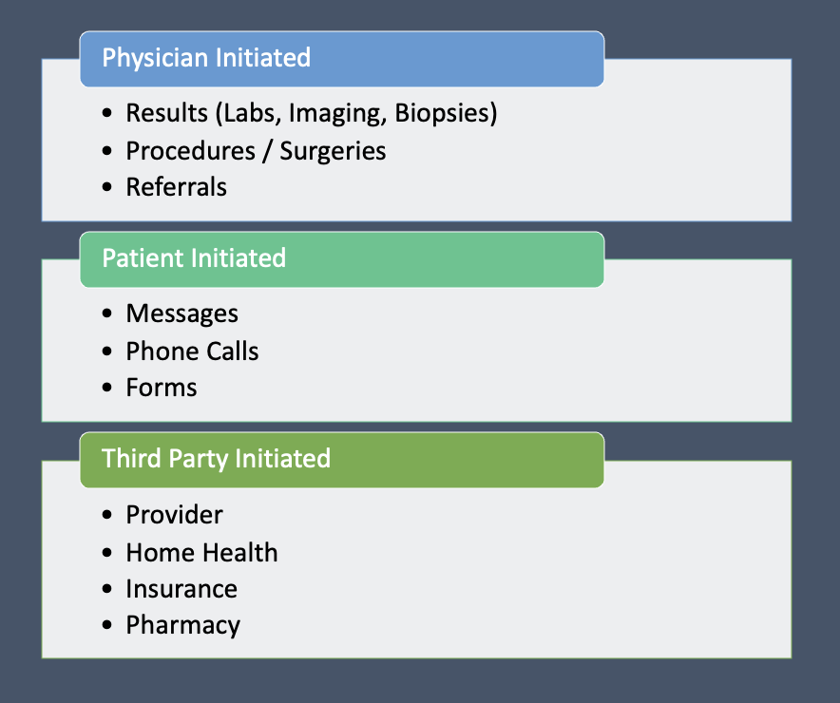
What Does Inter-visit Care Consist of?
Figure from Mulligan et al. MedEd Portal, 2024¹
Notes:
Facilitator:
Can you think of some examples of things in outpatient palliative care that come up under each of these categories?
Commonly UDS, CMP, CBC, XR, CT, MR results
When to use a phone call vs portal response to communicate interpretation of that result is important. Imaging generally warrants a phone call. Abnormal results also generally warrant phone calls. If you cannot get a hold of a patient by phone, portal response should be made
Documentation of result notes and next steps of a plan is helpful
Copying specialists on result notes helps with communication

Slide 8
Common portal message requests in outpatient palliative care
Refill requests
  Controlled vs. non-controlled medication refills.
    How do you think we treat these requests differently?
    When was this last filled?
    Are there refills already on this?
    Are we the primary prescriber of this medication?
Questions
  Is it ok to adjust medication regimen? Is it ok to take more or less of a medication?

Slide 9
Common portal message requests in outpatient palliative care
Concerns
  Uncontrolled symptoms
    i.e., Pain, nausea/vomiting
  Side effects from a medication
Referrals to home health and signing home health orders, hospice referrals, home palliative care referrals
Insurance
  “My insurance won’t cover this medication, is there an alternative”
  ”My insurance will only cover X number of tablets/ X days of this medication”

Slide 10
Common portal message requests in outpatient palliative care
Pharmacy
  ”My pharmacy does not have this medication in stock, Can you send the medicine to another pharmacy?”
Forms
  Can you please write a letter to stating medical necessity of X accommodations for work or school?
Patient ”check-ins” with updates on progress of a treatment plan

Slide 11
What are some thoughts that you have about the PC inbox as fellows?
Notes:
FACILITATOR:
Have you had the opportunity to go through some portal messages as fellows? How about as residents?
What emotions are raised as you think about the inbox? Dread? Confusion? Feeling like you have nowhere to turn? You are not alone!
Historically we do not do a great job teaching management of intervisit care to medical trainees.
Hoping that today helps you feel more comfortable with the PC inbox and intervisit management

Slide 12
What are some intervisit care examples that you have encountered so far in palliative care clinic that you have struggled with?

Slide 13
One of the most important take aways regarding intervisit: Don’t be afraid to ask for help!¹
Notes:
FACILITATOR:
Don’t be afraid to turn to an attending, a colleague, or an administrator for help
Delegate tasks when appropriate
Don’t make things up!
There is often NO right answer and multiple ways to address things

Slide 14
Wherein lies the Difficulty in Managing Inter-visit care?
Time
  In outpatient PC, inter-visit phone conversations can be complex
    GOC conversations, hospice conversations and referrals, psychiatric emergencies
    Medication safety with opioids
    Should these urgent needs become visits? For safety? For fair compensation of your time? To demonstrate productivity?
      “The Brief Check-in” = Virtual check in w/medicare service code 98016
Burnout¹
  1 hour of direct clinical face time --> 2 hours of EMR/desk work²
  Highest message volume correlated with 4x the burnout³
Notes:
FACILITATOR
The virtual check in/ Brief Check-in is reimbursed service that can help you find out if more extensive discussion with a patient needs to be had at an appointment. It is audio-only. It has to be patient-initiated with an established patient. It cannot originate from a service in the last 7 days and cannot result in an E/M service within the next 24 hours. It must be documented in the chart. It must be between 5-10 minutes.
If longer than 10 minutes you can consider an audio-only virtual visit.
Regarding burnout: A study showed that among 57 U.S. physicians in family medicine, internal medicine, cardiology, and orthopedics who were observed for 430 hours, 21 of whom also completed after-hours diaries showed this correlation of 1 hour of direct clinical face time created approximately 2 hours of EMR/desk work. ²

Slide 15
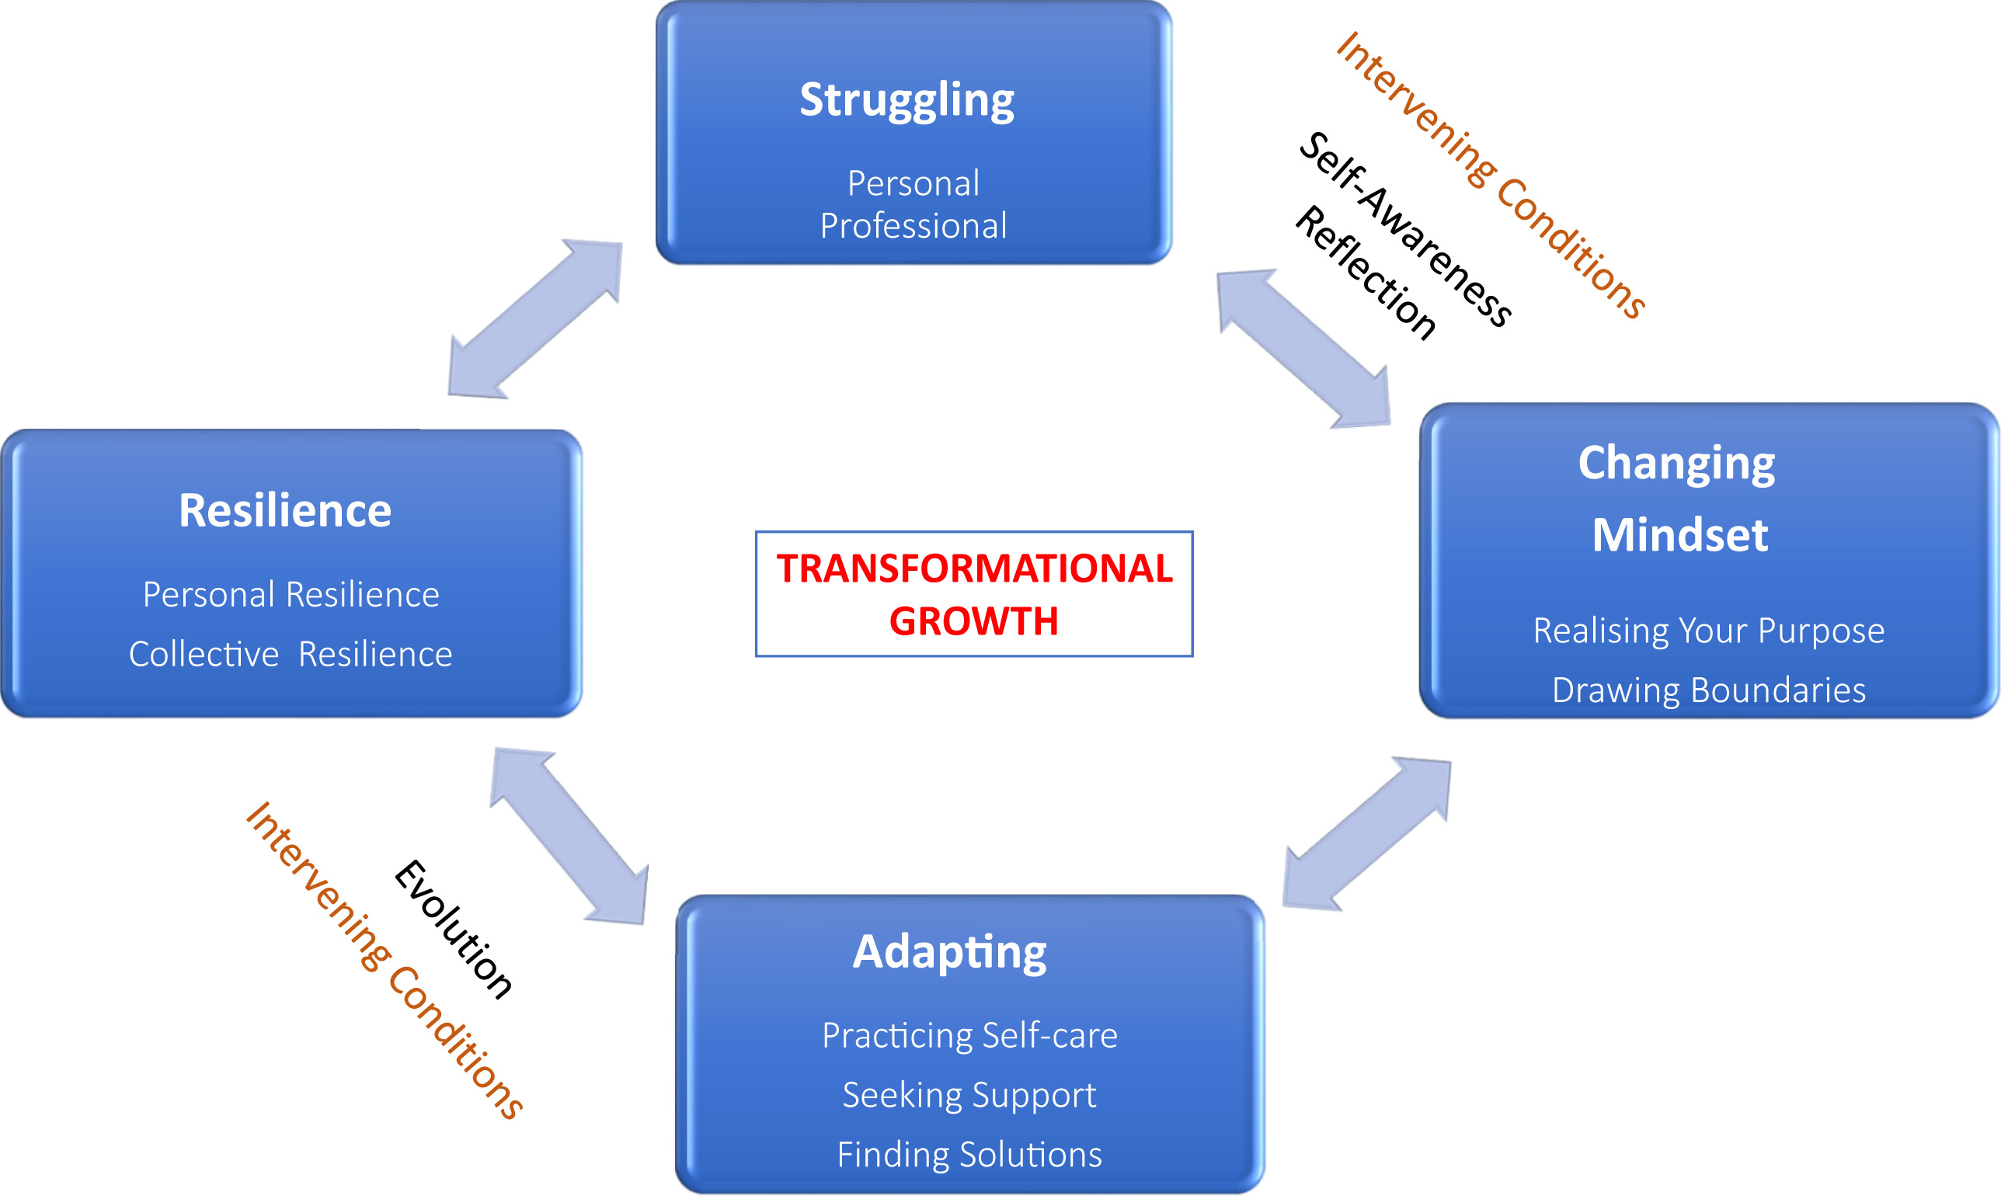
Taking a Moment to Recognize Burnout as it Pertains to Palliative Care in General. . .
PC providers with 10+ years of experience must "undergo a process of struggling, changing mindset, adapting, and resilience resulting in a model of transformational growth before achieving personal and team resilience." ⁴
Remember: medicine is just A PART of your life! Make space for the other things that fill your cup.
Figure from Koh et al. 2020 JPSM⁴
Notes:
FACILITATOR
This study in Singapore aimed to study PCCs with 10+ years of experience “to better understand their views on burnout, resilience, and their use of coping strategies” via 1:1 semi-structured interviews. They found that 4 themes emerged: struggling, changing mindset, adapting, and resilience with “transformational growth” being the connecting theme, “presenting an overall sequence of the PCCs from burnout/struggling toward a path of resilience.”⁴

Slide 16
“4 themes emerged: struggling, changing mindset, adapting, and resilience with “transformational growth” being the connecting theme, “presenting an overall sequence of the PCCs from burnout/struggling toward a path of resilience.”
  Struggling
    Personal relationships: complete exhaustion (being emotionally attached to patients that die and crying to sleep, feeling exhausted), maintaining a work-life balance (“pajama time”, raising a family, being ”on-call” )
    Professional relationships: differences in medical opinions between, for example, the oncologist and the PCC on goals of care and continuing chemotherapy
    Having multiple roles
  Changing Mindset
    Finding meaning & finding strength in difficulties: “There is meaning and purpose behind why you are being placed in this field.”
    Differentiating work vs personal life balance
    Creating personal space and a boundary with work and personal life

Slide 17
“4 themes emerged: struggling, changing mindset, adapting, and resilience with “transformational growth” being the connecting theme, “presenting an overall sequence of the PCCs from burnout/struggling toward a path of resilience.”
  Adapting
    Practicing self-care
    Learning to love yourself
    Seeking help from colleagues
    Taking personal responsibility
    Formal multidisciplinary rounds
    Finding solutions
  Resilience
    Rising again: “We are bound to be affected by what we are facing.”
    Growth from challenges
    Collective resilience: “We are good individually, but we are better as a team. We are always better as a team. We are never better as individuals. Having this culture helps us to build resilience. ”

Slide 18
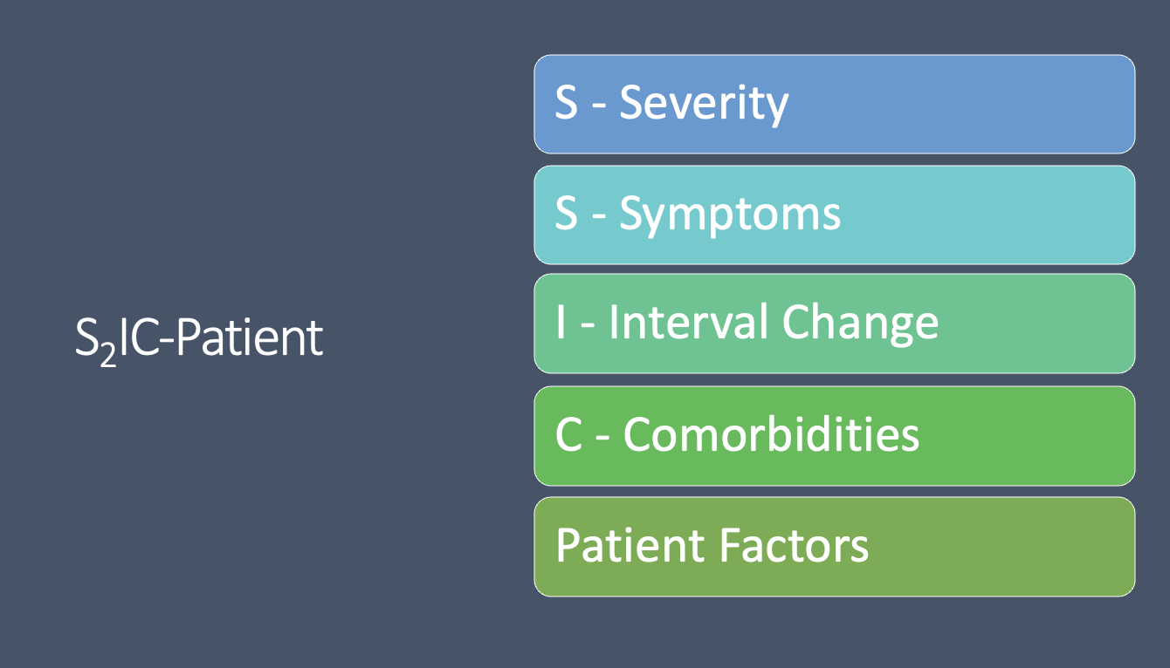
Intervisit Care: Let’s Work with a Framework to Help Us Manage!
Mulligan et al. 2024¹
Notes:
FACILITATOR:
- This framework “encourages you to think about severity, symptoms, interval change, comorbidities, and patient factors, and can be applied to each intervisit care situation.” ¹

Slide 19
A Case to Help Us Work Through The Framework
SEVERITY
A 80 year-old female with metastatic breast cancer portal messages you about worsening right hip and groin pain, an 8/10, for the last few days. She is currently on a Butrans 5 mcg/h patch q weekly.
What if this was 3/ 4 pain?
What if this was 10/ 10 pain?
What if this occurred over several months vs a few days vs a few hours?
Figure from Mulligan et al. MedEd Portal, 2024¹
Notes:
FACILITATOR
- The goal is to follow up on the pain but that the sense of urgency changes with change in reported pain level or more acute timeframe

Slide 20
A Case to Help Us Work Through The Framework
SYMPTOMS
A 80 year-old female with metastatic breast cancer portal messages you about worsening right hip and groin pain, an 8/10, for the last few days. She now has difficulty bearing weight. She is currently on a Butrans 5 mcg/h patch q weekly.
You call her and she reports that she has difficulty bearing weight. No changes in bowels or bladder.
Figure from Mulligan et al. MedEd Portal, 2024¹
Notes:
FACILITATOR
Symptoms of difficulty with weight bearing should alarm urgent symptoms concerning for pathologic fracture and need for urgent imaging and non-weight bearing status until imaging confirms and orthopedist is potentially able to evaluate. You should recommend being see at an urgent care or emergency room for urgent in person evaluation.
When do they go? Now? Tomorrow?
Where do they go? The local ED vs Emory ED vs urgent care?
Do they need ambulance transport?

Slide 21
A Case to Help Us Work Through The Framework
INTERVAL CHANGE
Opposite Case
A 80 year-old female with metastatic breast cancer portal messages you about slow worsening right hip and groin pain, a 3/10 persistent right hip pain for the last 3 months since your last appointment. She is currently on a Butrans 5 mcg/h patch q weekly and taking oxycodone immediate release 5mg q4h as needed for breakthrough pain that controls her pain but she is having to take breakthrough oxycodone 5 times a day. She had an MRI ordered by oncology of her right hip a month ago showing degenerative osteoarthritic changes of the hip.
Does the lower pain score, chronicity over 3 months, and recent imaging change your management?
Figure from Mulligan et al. MedEd Portal, 2024¹
Notes:
FACILITATOR
-This is the opposite symptoms presentation; how does the lower pain score, chronicity over 3 months since your last appointment with her and recent imaging change your management?
Where does this need to be worked up? Can you see her at a visit in person to perform a physical exam and avoid the emergency room? How urgently would you want to follow-up with this patient? What type of anticipatory guidance would you provide this patient? It sounds like an appointment to discuss and adjust her pain regimen might be helpful.

Slide 22
A Case to Help Us Work Through The Framework
COMORBIDITIES
The initial patient
A 80 year-old female with metastatic breast cancer and a history of recent substance use disorder with last urine screening + Cocaine, butrans, and oxycodone (not prescribed). The patient portal messages you about worsening right hip and groin pain, an 8/10, for the last few days. She is currently on a Butrans 5 mcg/h patch q weekly and is requesting to increase and change her pain medications.
What are the comorbidities that may make you change your management?
Figure from Mulligan et al. MedEd Portal, 2024¹
Notes:
FACILITATOR
What are her comorbidities?
Older at higher fracture risk
Cancer history at higher risk for pathologic fracture
History of substance use disorder
Recent abnormal urine screen concerning for active substance abuse
What are some concerns that you have?
Does she need a visit to investigate further and discuss how to safely manage her opioids /pain regimen and evaluate etiology of her pain? Does she need the emergency room?

Slide 23
A Case to Help Us Work Through The Framework
PATIENT FACTORS
The initial patient
A 80 year-old female with metastatic breast cancer portal messages you about worsening right hip and groin pain, an 8/10, for the last few days. She is currently on a Butrans 5 mcg/h patch q weekly.
You call her and she tells you that she does not know what medication she is on and relies on her daughter for transportation and to give her medications. She lives 3 hours from Emory.
Figure from Mulligan et al. MedEd Portal, 2024¹
Notes:
FACILITATOR
Are there patient centered factors to consider here?
Transportation to the emergency room may be difficult
May have poor health literacy and it may be most helpful to loop in her daughter on the call
Geography may be a limiting factor, and it is often best to tell patients to go to their local emergency room for urgent evaluation that will not be delayed.
What are some other patient factors that you can think of?
E.g., finances, caregiver support, does the patient regularly come to their clinic visits or often no show (i.e., what is the probability that they will follow-up? Do you need to loop in SW)?

Slide 24
Unique to PC, Use Your IDT in Intervisit Care.
For spiritual or existential distress, it is best practice to refer your patient to outpatient PC spiritual health clinician if you have one
For psychiatric emergencies, loop in your SW
  To engage your state’s crisis line, local PD, mental health resources

Slide 25
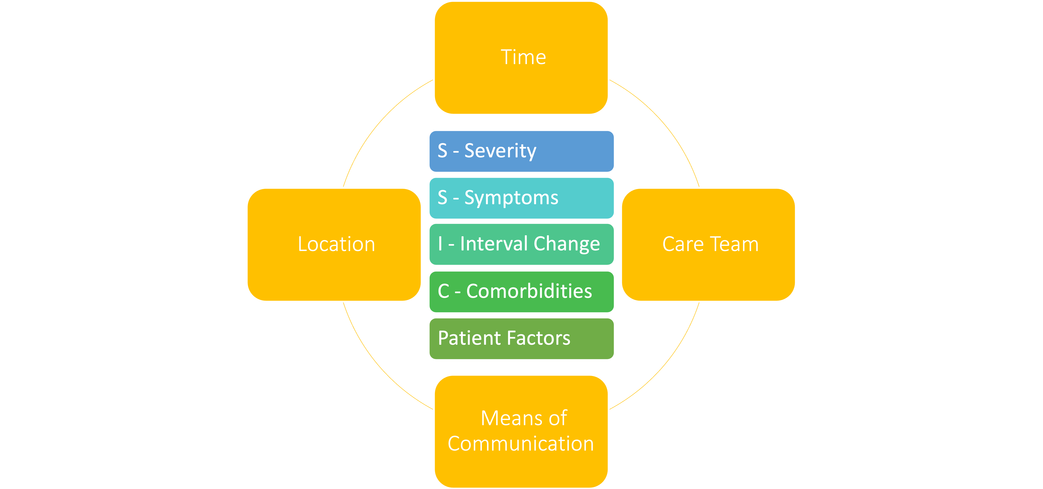
Figure from Mulligan et al. MedEd Portal, 2024¹

Slide 26
Don’t Be Afraid to Defer to an Appointment to Discuss Further. It is Often Best Practice
"Response: It sounds like you have a lot of questions. Please schedule an appointment so we can address them together."
Quote & figure from Mulligan et al. MedEd Portal, 2024¹
Figure from Mulligan et al. MedEd Portal, 2024¹

Slide 27
Other Outpatient PC Inter-visit Care Examples
Results
  Urine Drug Screening Results
  Imaging results for new pain, new symptoms
    Comment on the result and leave a result note in the chart
    Copy applicable specialists/providers on the results
    Include plan/next steps
  Comment on ALL lab results with a result note in the chart
    Helpful to include the plan/next steps
    Route to applicable specialists/providers

Slide 28
Outpatient PC Inter-visit Care Examples
Patient initiated: ”I have run out of my OxyIR early. Can I get an early refill?”
  Why is the patient out early?
    Worsening pain?
      Importance of matching the prescription to the way the patient is actually taking the medication will avoid this dilemma
    Opioid misuse or NMOU?
    Low health literacy? Confused on how to take the medication?
    Was the medication lost or stolen? Do they need a police report filed before refilling?
  How is the patient currently taking the medication? Differently than prescribed?
    Does a new prescription need to be written matching?
  Check the PDMP
  Do they need an appointment to discuss in detail for safety or better understanding/best practice?

Slide 29
Controlled medication refill request note
Allows for ease of cross-coverage among multiple providers
Incorporates universal opioid precautions
Identifies aberrant/concerning controlled medication use
PALLIATIVE CARE MEDICATION
REFILL REQUEST NOTE
*** refilled for ***date; Last fill on *** per PDMP
PDMP reviewed and appropriate: Not reviewed.
Reviewed Blue Sticky/additional comments ***
Reviewed chart and recent palliative care notes ***, last palliative care note on ***
E-Substance agreement Signed on 11/6/2023
Signed on 10/15/2024
Most recent UDS reviewed: Navis lab result on file - 7/15/2024 & {UDS response:45062}
Narcan has been previously prescribed
@RECENTFUTUREVISITS@
Have you seen this patient within the last X months? Do they have an appointment scheduled in clinic within the next Y months? What are your clinic policies regarding this?
Notes:
FACILITATOR:
- Our practice has developed this standardized template for refill requests to be documented in the chart for controlled substances.

Slide 30
Outpatient PC Inter-visit Care Examples
Patient initiated: “I am having worsening pain”
    On controlled medications?→ does the patient need an appointment to discuss altering regimen?
    Can you or a colleague see this patient for an urgent appointment? Even if by video for convenience? Can you see them in person to lay hands and examine?
    Does the patient need to go to the ED for urgent evaluation?
      Acute pain?
      Pain unresponsive to current regimen?
      Other symptoms?
    Is new imaging required?
    Do you need to loop in other specialists?
      Oncologist, radiation oncologist, interventional radiology or interventional pain?

Slide 31
Outpatient PC Inter-visit Care Examples
Third party initiated
  Another provider wants to provide background on a referral
  Maintaining strong relationships with your collaborative specialists is key
    Much of a good outpatient pall care provider depends on the communication with their specialists

Slide 32
Learning Objective
Respond to symptom crises at home or in the office as well as outpatient palliative care emergencies

Slide 33
Palliative Care Emergencies #1
Patient Vignette: A 64 y/o M with history of metastatic prostate cancer reports worsening pain over the past several weeks. A couple of days ago, he started developing weakness in his legs. This afternoon, the weakness was so severe that he was unable to walk to the bathroom on his own. He also has had two episodes of urinary incontinence, which is new for him.
What are we worried about?
  Malignant Spinal Cord Compression
What to do next?
  Send urgently to ER for imaging (CT), steroids, and evaluation for surgery/radiation
Notes:
Mehta R, Arnold R. Management of Spinal Cord Compression. Palliative Care Network of Wisconsin. Accessed June 16, 2022. https://www.mypcnow.org/fast-fact/management-of-spinal-cord-compression/

Slide 34
Palliative Care Emergencies #2
Patient Vignette: A 50 y/o F with a history of non-small cell lung cancer reports hypoxia and SOB when she arrives at clinic. She has a cough, a hoarse voice, and swelling in her face and neck.
What are we worried about?
  Superior Vena Cava syndrome
What to do next?
  Send to ED for urgent imaging (CT, MRI). Patient may need respiratory support (e.g. ventilator, BIPAP) or stenting while awaiting more definitive treatment with cancer-directed therapy.
Notes:
Kinnard E. Superior vena cava syndrome in the cancer patient: a case study. J Adv Pract Oncol. 2012;3(6):385-387. doi:10.6004/jadpro.2012.3.6.4

Slide 35
Palliative Care Emergencies #3
Patient Vignette: A 63 y/o M with history of metastatic colorectal cancer presents to clinic. You notice that he is short of breath with even brief conversation. You check his O2 saturation and it is 84% on RA. He does not wear oxygen at baseline.
What is our differential for acute hypoxemia?
  Pulmonary: embolism, effusion, pneumonia, metastatic lung lesions, asthma/COPD exacerbation, mucous plug, pneumothorax, ARDS
  Cardiac: HF exacerbation
  Hematologic: anemia
  Nervous System/MSK: obesity hypoventilation, myasthenia gravis, c-spine injury
  Etc.
What to do next?
  Detailed physical exam
  Add supplemental O2
  ER for further evaluation
Notes:
Bhutta B, Alghoula F, Berim I. Hypoxia. National Library of Medicine. Published 2024. https://www.ncbi.nlm.nih.gov/books/NBK482316/

Slide 36
Palliative Care Emergencies #4
Patient Vignette: A 32 y/o M with h/o metastatic colorectal cancer calls clinic and reports that he has not had a bowel movement in about a week. He also reports severe nausea, vomiting, and abdominal pain that started the day prior.
What are we worried about?
  Bowel Obstruction
What to do next?
  ED for urgent imaging (CT, will show dilated loops of bowel)
  Treatment to include pain control (IV opioids), nausea control (IV haloperidol, avoid metoclopromide), NGT placement, possibly octreotide
Notes:
von Gunten C, Muir C, Marks S. Medical Management of Bowel Obstructions. Palliative Care Network of Wisconsin. https://www.mypcnow.org/fast-fact/medical-management-of-bowel-obstructions/

Slide 37
Palliative Care Emergencies #5
Patient Vignette: 40 y/o F with multiple myeloma comes to clinic with severe, new-onset back pain. The pain started suddenly the day prior when she stepped out of her car. On exam, you notice exquisite midline tenderness over her lumbar spine.
What are we worried about?
  Malignant compression fracture
What to do next?
  Send to ER for urgent imaging (CT, MRI). IR consult for evaluation for vertebroplasty/kyphoplasty.
Notes:
Giorgi PD, Schirò GR, Capitani D, D'Aliberti G, Gallazzi E. Vertebral compression fractures in multiple myeloma: redefining the priorities during the COVID-19 pandemic. Aging Clin Exp Res. 2020 Jul;32(7):1203-1206. doi: 10.1007/s40520-020-01590-4. Epub 2020 May 14. PMID: 32410167; PMCID: PMC7224162.

Slide 38
Palliative Care Emergencies #6
Patient Vignette: 64 y/o M with lung cancer metastatic to bones. His partner calls the clinic and states that the patient has been "not himself" for the past few days. He has been confused, constipated, and nauseated. He has vomited several times and urinating more than usual. Today, he seems very tired and is difficult to wake up.
What are we worried about?
  Hypercalcemia
What to do next?
  Send patient to ED for urgent BMP. Treatment for hypercalcemia will involve fluids +/- loop diuretics and bisphosphonates, and evaluation for cancer-directed therapies.
Notes:
Siddiqui F, Weissman D. Hypercalcemia of Malignancy. Palliative Care Network of Wisconsin. https://www.mypcnow.org/fast-fact/hypercalcemia-of-malignancy/

Slide 39
Palliative Care Emergencies #7
Patient Vignette: 45 y/o patient with newly-diagnosed GBM. Their sister calls clinic and states that patient has had worsening headache, confusion, and sleepiness over the past couple of days.
What are we worried about?
  Increased intracranial pressure
What to do next?
  Send to ER for urgent imaging (head CT) and lumbar puncture. Treatment includes close observation in neuro ICU, osmotic therapy with mannitol or hypertonic saline, steroids if caused by intracranial tumor/absces, elevating head of bed.
Notes:
Pinto VL, Tadi P, Adeyinka A. Increased intracranial pressure. National Library of Medicine. Published 2023. https://www.ncbi.nlm.nih.gov/books/NBK482119/

Slide 40
Palliative Care Emergencies #8
Patient Vignette: A 49 y/o F with a history of breast cancer presents to clinic. She reports that the day prior, she had an episode of unresponsiveness, during which her family reports she had rhythmic shaking of her right upper extremity. She was confused and fatigued for several hours after the event, though she feels fine now.
What are we worried about?
  Seizure
What to do next?
  Immediate treatment of seizure includes benzos: IV if in hospital; families can be provided with rectal diazepam if patient having seizures at home.
  After immediate stabilization, patient should have head imaging to evaluate for metastatic disease or other acute causes of seizure, BNP to rule out electrolyte abnormalities or hypoglycemia, and neurology evaluation for seizure-controlling medication
Notes:
Tradounsky G. Seizures in palliative care. Can Fam Physician. 2013 Sep;59(9):951-5, e401-5. PMID: 24029509; PMCID: PMC3771721.

Slide 41
High Yield Summarizing Pearls: Outpatient Palliative Care Emergencies:
Psychological Emergencies
  Active suicidality with a plan
    Communicate with the primary palliative care provider/team in real time
    Crisis Line
    Local Police Department for a wellness check
  Passive suicidality
    Close surveillance
    At least monthly PHQ-9s (collab care rule of thumb)
    Home safety concerns
  Assess need for DFCS or APS referrals

Slide 42
High Yield Summarizing Pearls: Outpatient Palliative Care Emergencies:
Symptom management
  Documentation! Documentation! Documentation!
  Severe Pain
    Refer and coordinate ED evaluation / Urgent Care (Winship ICC)
      Pathologic fractures necessitating imaging and in person evaluation
    Plan for opioids in case the patient is discharged
    Close clinic follow-up
Notes:
FACILITATOR:
-Important to document everything in the electronic medical record!

Slide 43
High Yield Summarizing Pearls: Outpatient Palliative Care Emergencies:
Dyspnea
Superior Vena Cava Syndrome
  Obstruction of SVC by tumors, clots/catheter-related thrombosis→ upper body swelling (face/arms), vein distension, cerebral edema (confusion/coma), laryngeal edema (stridor).
  Worse with laying flat/leaning forward
  Dx: CT chest
  Tx: elevate head, consider steroids (lymphoma), endovascular therapy like stenting
Malignant Spinal Cord compression
  Bowel and bladder changes, motor/sensory loss, back pain, gait changes
  MRI spine with contrast
  Steroids, radiotherapy, surgery, pain control

Slide 44
High Yield Summarizing Pearls: Outpatient Palliative Care Emergencies:
Seizures
Sepsis
  Watch for Hypotension, fever, confusion, tachypnea, tachycardia
Major bleeding
Hypercalcemia
  Nausea, vomiting, muscle weakness, constipation, increased thirst, increased urination, bone pain, broken bones, renal stones, lethargy, loss of appetite
Severe Agitation
  ?Hospice discussions vs preparing families for distress in the ED

Slide 45
High Yield Summarizing Pearls: Outpatient Palliative Care Emergencies:
Malignant bowel obstruction⁵
  Associated with prognosis of 3-8 months (operable) or 4-8 weeks (inoperable)
  Nausea/vomiting/abdominal pain
  Surgery, venting G tube, stenting across the obstruction, medical management (opioids, anti-emetics, antimuscarinics/anticholinergics (Scop/Atropine), H2 blockers/PPIs to reduce acid, somatostatin inhibitors (Octreotide/Sandostatin), corticosteroids, reglan (if partial MBO), olanzapine for nausea
  Fluid restriction with medication titration, NGT to decompress
  If venting G is in place, PO can take place
  Consider TPN if longer prognosis

Slide 46
High Yield Summarizing Pearls: Outpatient Palliative Care Emergencies:
Don’t ever forget to forget your vitals in clinic and a good physical exam!
E.g., hypotension, vasogenic edema with worsening mid-line shift and new neurologic symptoms, unstable Afib with RVR with new onset acute CHF
Rapid response in clinic may be needed to obtain care
  Hypoglycemia, chest pain, SOB

Slide 47
Open Discussion: After seeing these examples, do you have any other intervisit care situations that you have encountered so far in palliative care clinic that you have struggled with?

Slide 48
Learning Objective
Caregiver/decision makers assessment and engagement in outpatient settings

Slide 49
Caregiver Assessment & Engagement
Does the caregiver play an active role in the day-to-day? Do they live with the patient? Can they provide reliable, collateral information.
Does the caregiver need support? Engage spiritual health and SW IDT
Does the caregiver help with medication management or medical decision making?
I often find that in important medical decision making enlisting the caregiver is invaluable
  Enforcing medication changes
  Understanding patient’s desires for GOC/ACP
Provide anticipatory guidance to the caregiver. Prepare them for what is to come.
Caregivers are the “extra set of listening ears”
In ACP, engage the caregiver
  Place on speakerphone, invite to appointments in person/video.
  Caregivers are likely to be the ones listed on ACP documents. They should know what these documents contain if patient gives permission

Slide 50
Learning Objective
Develop best practices in your referral practices & define your role on the care team

Slide 51
Developing Your Referral Practice
  Referring internally within a system is generally preferred
    Usually encouraged to do this by your institution because of institutional financial incentive
    Being able to be on the same platform for note & result visibility
  Provider/specialty availability
    i.e., neurology may take months at Emory to see, thus an external expedient evaluation may be necessary
  Geography
    Patients may live far away. Some may value geography>staying within the system
  No matter how you refer, maintaining relationships among referral partners is important
    Copy them on notes, results on EPIC

Slide 52
Defining Your Role on the Care Team
Sometimes patients don’t need to see the MD or APP. Often what a patient you to do is see a specific IDT member!
Spiritual health clinician
Social work
Clinical pharmacist
Counselor/psychologist
Clinic staff (Schedulers/staff/clinic manager/nursing manager/financial)
Referring partner/specialist
Home health, PT, OT

Slide 53
Defining Your Role on the Care Team
Physicians are often seen as leaders on the outpatient PC team
Managers
Organize clinic structures and schedule, often run clinic team huddles to help run an effective team
We delegate responsibilities
Final care decisions and ultimate responsibility often comes down to the physician
It is important to maintain professionalism
Remember that you are looked to as the team leader and set the standard of behavior and clinic culture
Remember to not speak ill of other team members or patients

Slide 54
Who is the Outpatient Palliative Care Team in An Ideal World?
Physicians
Advanced practice providers
Spiritual Health Clinician
Therapist, psychologist, and/or psychiatrist
Social worker
Administrative staff (RN, LPN, MA, nurse manager, clinic manager, clinic medical director)
Clinical pharmacist and/or pharmacy technician
Dieticians
Physical and occupational therapists
Extra Support Teams
  i.e., MD Anderson has a team to help patients at high risk for NMOU

Slide 55
Learning Objective
Navigate transitions of care and survivorship or "graduating" patients (negotiating the transition back to primary care provider or primary specialists)

Slide 56
Navigating transitions of care and graduating patients from palliative care is difficult and complex
Often this is patient specific. There are no clear guidelines. Create open discussion among you clinic providers about who you will see.
Examples
  Pain – a sticking point because of controlled medications!
    Treating chronic pain in the setting of no current life-limiting illness
      Especially if on high OME unable to wean or rotate to safer alternative
  Patients who do not have current life limiting illness
    Patient specific exceptions
      H/N cancer patients completely disfigured and co-morbid that do not have active cancer but terrible pain sequela that will last likely lifelong.

Slide 57
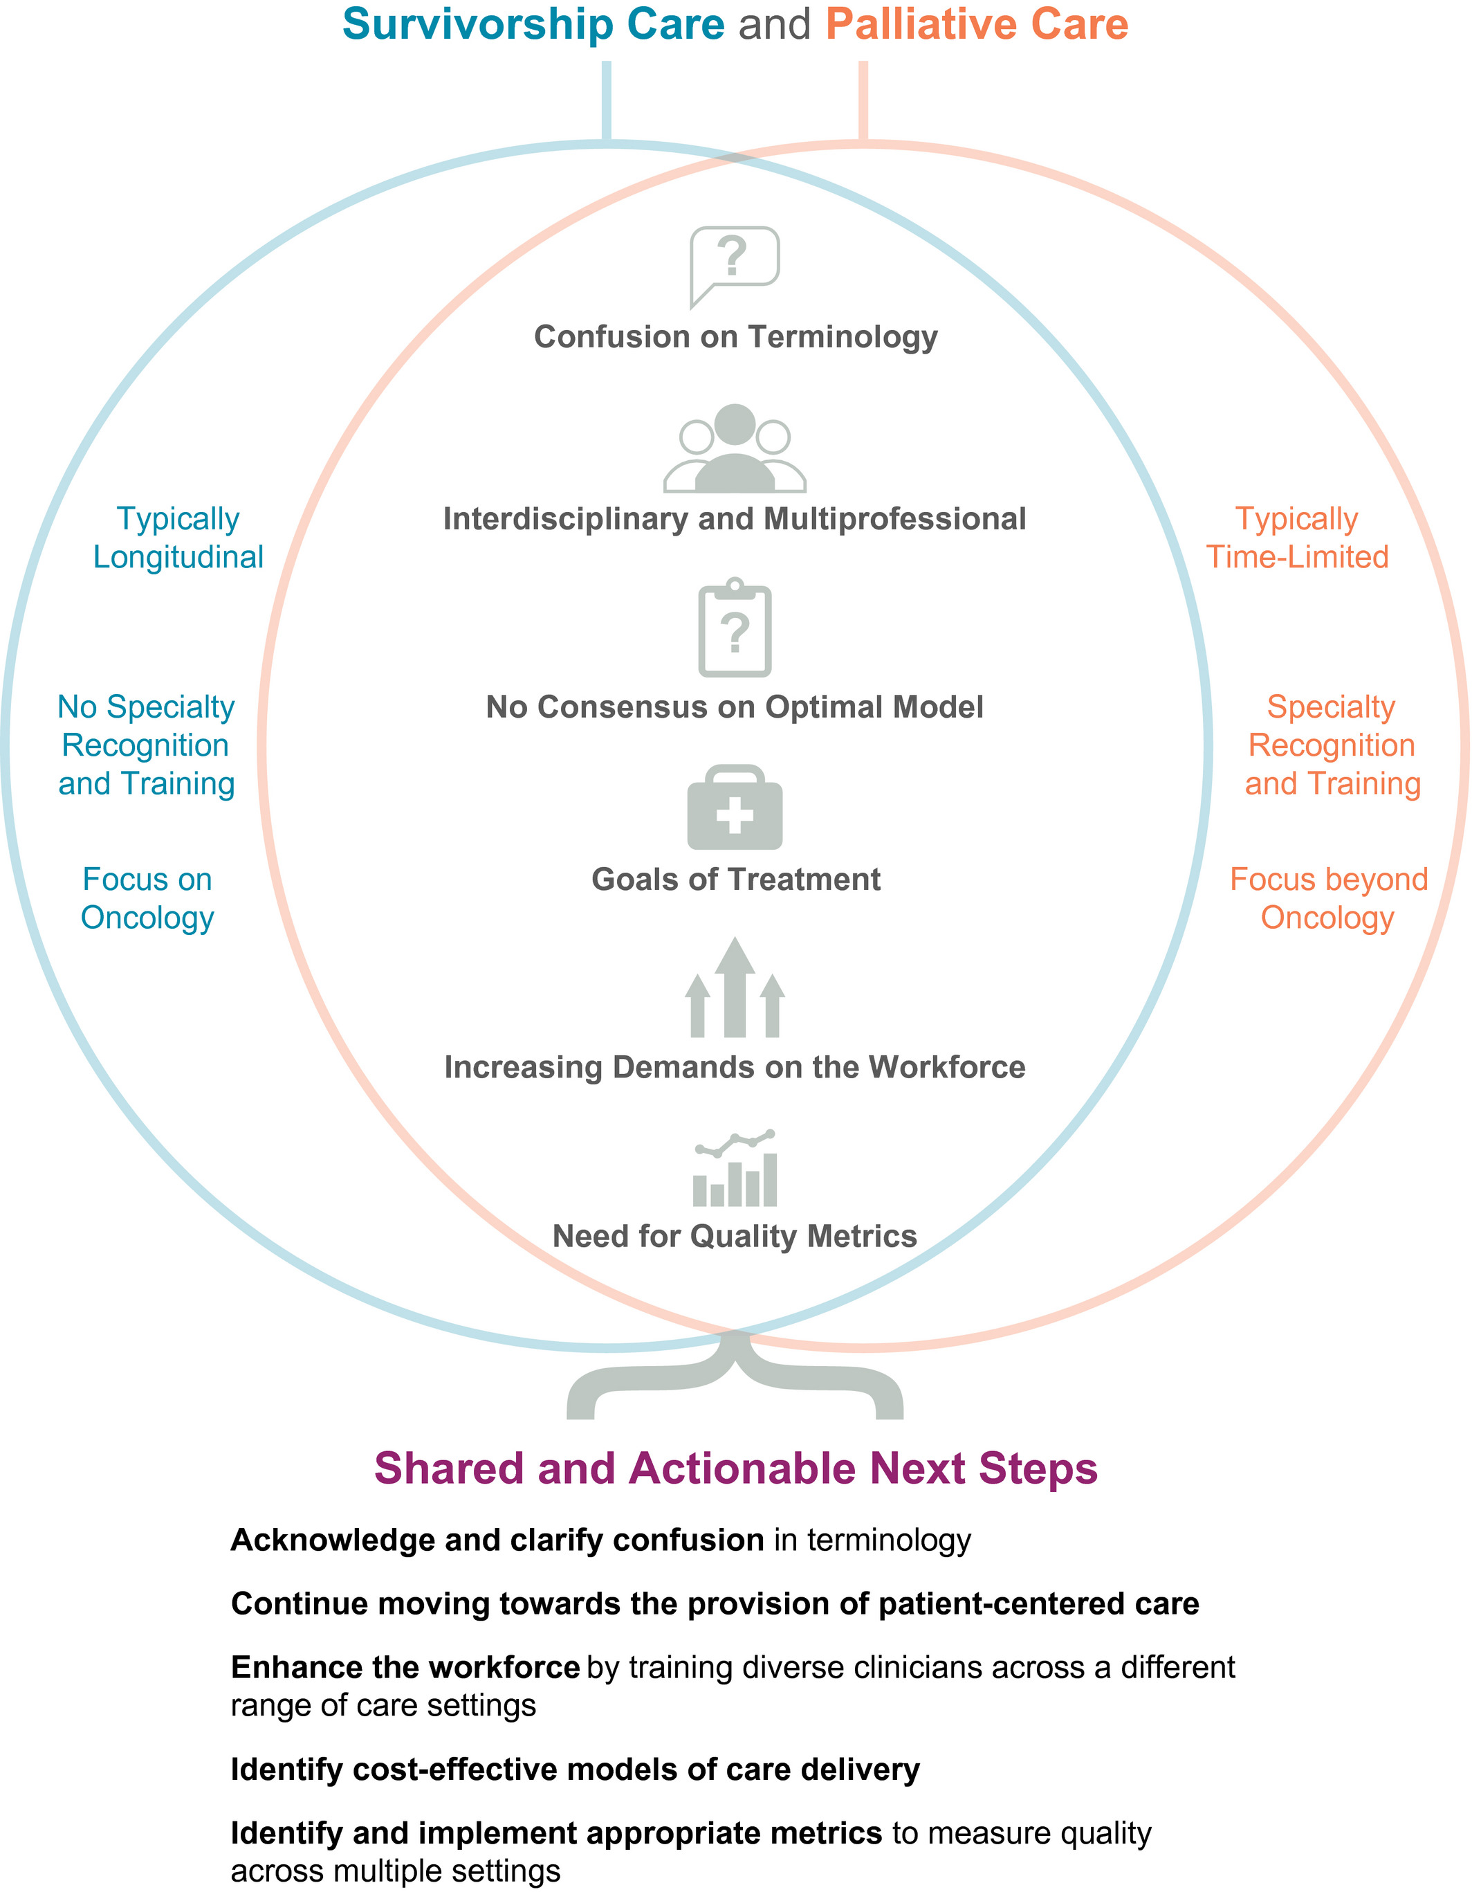
Gheerse et al. IInterdisciplinary International Journal of the American Cancer Society. 2018⁶

Slide 58
References
1. Mulligan MJ, Breviu AB, Hall SK, Stenehjem KE, Cioletti AC. Beyond the Exam Room: Teaching Intervisit Care to Internal Medicine Residents. MedEdPORTAL. 20:11479. doi:10.15766/mep_2374-8265.11479
2. Sinsky C, Colligan L, Li L, et al. Allocation of Physician Time in Ambulatory Practice: A Time and Motion Study in 4 Specialties. Ann Intern Med. 2016;165(11):753-760. doi:10.7326/M16-0961
3. Hilliard RW, Haskell J, Gardner RL. Are specific elements of electronic health record use associated with clinician burnout more than others? J Am Med Inform Assoc. 2020;27(9):1401-1410. doi:10.1093/jamia/ocaa092
4. Koh MYH, Hum AYM, Khoo HS, et al. Burnout and Resilience After a Decade in Palliative Care: What Survivors Have to Teach Us. A Qualitative Study of Palliative Care Clinicians With More Than 10 Years of Experience. Journal of Pain and Symptom Management. 2020;59(1):105-115. doi:10.1016/j.jpainsymman.2019.08.008
5. Palliative Care Network of Wisconsin. Medical management of bowel obstructions. Accessed January 12, 2026. https://www.mypcnow.org/fast-fact/medical-management-of-bowel-obstructions/
6. Geerse OP, Lakin JR, Berendsen AJ, Alfano CM, Nekhlyudov L. Cancer survivorship and palliative care: Shared progress, challenges, and opportunities. Cancer. 2018;124(23):4435-4441. doi:10.1002/cncr.31723

Slide 59
Thank you

