Slide 1
Medical Marijuana
"POTpourri"
Emily Pinto Taylor, MD
Divisions of General IM and Hospice/Palliative Medicine
Emily james, md
Hospice and palliative medicine fellow
Emory University School of Medicine

Slide 2
Disclosures
​
Disclosure Statement​
The authors have nothing to disclose and there are no conflicts of interest.

Slide 3
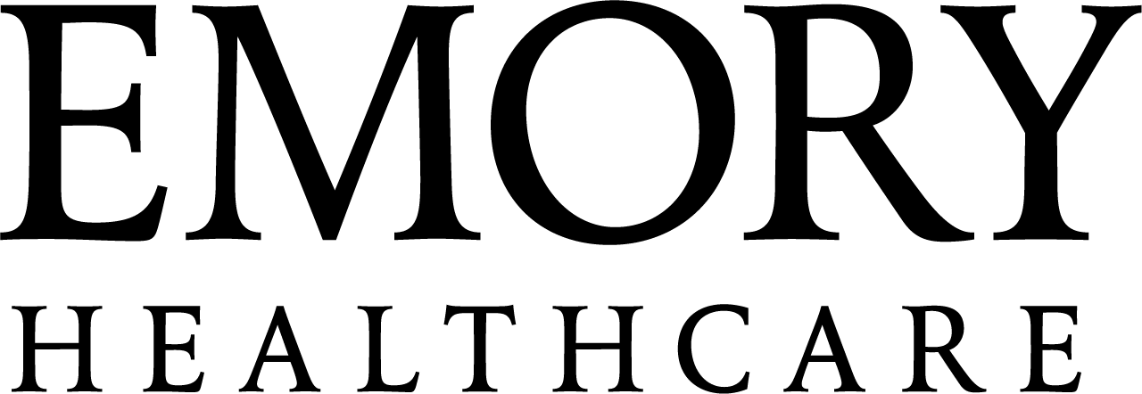
Learning Objectives
Review the pharmacology and mechanisms of action for cannabis
Evaluate indications and evidence for medical cannabis among palliative and hospice patients in adult and pediatric patients
Discuss risks and benefits of medical cannabis
Discuss patient assessment and cannabis dosing
Review considerations for safety and monitoring of medical cannabis

Slide 4
In the clinic
39 y.o. female with metastatic breast cancer with bone mets who presents for initial supportive care office visit. S/p bilateral mastectomy, and currently on tx with Verzenio and tamoxifen. She was referred to palliative care by med onc for symptom management, consideration of THC use, and support.
C/o "severe" pain in bilateral shoulders and base of neck. Described as aching and constant. Pain started before cancer diagnosis, but has gotten worse after bilateral mastectomy.
Reports “extreme anxiety” at work, related to her son’s health, and living with stage IV cancer.
Reports sleep difficulty for 1 yr due to her partner disrupting her sleep and recently started having hot flashes with tamoxifen.
Patient is inquiring about medical cannabis for these concerns.

Slide 5
Big questions
What is the data on cannabis?
Should we even be offering this?
How does it help?
What is the data on patients?
Do they want this and why?
How do we dose cannabis products?
What about safety and monitoring?

Slide 6
Cannabis Basics

Slide 7
Cannabinoids¹
Cannabis = Cannabis sativa or C. indica, the “marijuana” plant
“Cannabinoids” – any one of several molecules which interact with cannabinoid receptors in animals
  CB1 – mainly in nervous system
  CB2 – mainly in immune cells
  Implicated in pain, appetite, aversive memory extinction, HPA axis modulation, mood, immune function, inflammation

Slide 8
Cannabinoids¹
Cannabis has dozens of cannabinoids, and other molecules which may contribute to its clinical effects (terpenoids, flavonoids)
As far as we know, the most clinically important cannabinoids in cannabis are:
  Delta-9-tetrahydrocannabinol (THC)
  Cannabidiol (CBD)

Slide 9
THC²
Major psychoactive molecule in cannabis
Euphoria, dysphoria, analgesic, antiemetic, anti-inflammatory effects
Most “recreational” cannabis has a high THC:CBD ratio –
it’s bred for this

Slide 10
CBD²
Does not seem to cause euphoria but may have anxiolytic effects.
  There is a widespread clinical belief it antagonizes euphoric effects of THC
Suspected analgesic effects - ?antiepileptic properties vs antinociceptive
  Really, really unclear

Slide 11
Indications &
Evidence
Notes:
Let's talk about some of the potential indications and evidence for medical cannabis

Slide 12
A note on the cannabinoids in the studies
Synthetic cannabinoids
Dronabinol
(Marinol and Syndros) ³
Nabilone (Cesamet)³
Cannabidiol
(CBD; Epidiolex)³
Nabiximols (Sativex)³
A cannabis-derived extract that contains 1:1ratio of THC to CBD
Administered as an oromucosal spray
Not FDA approved in the US
Approved in many European countries and Canada for MS-related spasticity and pain
Synthetic THC
FDA indications
  Anorexia in AIDS
  Refractory CINV
Synthetic analog of THC
FDA indications:
  Refractory CINV
Epidiolex is the only CBD formulation approved in the US
FDA indications:
  Rare pediatric seizure disorders
Notes:
FACILITATOR:
But before we go too far, I'd like to talk about the cannabinoids most often used in the studies
Studies often look at synthetic cannabinoids, such as dronabinol or nabilone, or nabiximols which is a 1:1 THC:CBD cannabis-derived extract that is often administered as an oromucosal spray
Some studies also look at CBD, THC oral capsules or THC oromucosal sprays
The important point that I noticed right away when I started looking at the literature, is that these studies are NOT looking at low THC oil or products from the dispensaries that our patients are getting
So the outcomes in the literature may signal a likelihood that our patients could experience the same outcomes with the products they are using, but we can't say that we know for sure
Ped seizure disorders with indications include: Lennox-Gastaut syndrome, Dravet syndrome, and tuberous sclerosis complex

Slide 13
Pain
There is some evidence for improvement in chronic non-cancer pain with cannabinoids^{3,4}
There is not good evidence for improvement of specifically cancer-related pain^{4,5}
There has been some evidence for improvement in neuropathic pain with cannabis-based medications, however, not when specifically looking at chemotherapy-induced peripheral neuropathy⁶
Anecdotally – patients tend to rate the effect as real, but mild (not going to resolve pain fully)
Notes:
FACILITATOR:
Let's start with pain, which is obviously a commonly encountered palliative care symptom:
The evidence has been mixed:
1. 2021 meta-analysis of 23 RCTs looking at chronic non-cancer pain showed a small, but statistically-significant improvement in patient-reported pain⁴
2022 meta-analysis demonstrated dronabinol and nabiximols were associated with significant improvements in chronic pain when compared to placebo³
2. 2020 meta-analysis of 5 RCTs showed that the addition of cannabinoids to opioids did not reduce cancer pain in adults with advanced cancer⁵
2021 meta-analysis of 4 RCTs comparing nabiximols to placebo in cancer pain did not show a statistically significant improvement in pain⁴
3. 2025 systematic review of cannabis-based medications for neuropathic pain demonstrated reduced pain intensity for 15 of 22 RCTs, however, the studies looking at chemotherapy-induced peripheral neuropathy (with nabiximols and topical CBD) did not show significance⁶
Small amount of evidence for improvement in chronic, non-cancer pain

Slide 14
Nausea and vomiting
2024 ASCO guidelines suggest adults who receive moderate and highly emetogenic chemo regimens and experience refractory n/v despite guideline-consistent antiemetic prophylaxis may augment their regimen with dronabinol, nabilone, or an oral 1:1 THC:CBD extract¹
Far fewer studies on radiation-induced n/v, but have not shown benefit¹
Notes:
Nausea and vomiting is another very commonly encountered symptom that we see, and the evidence here is a bit better.
More studies have shown the benefits of cannabinoids for CINV, which can be summarized by the 2024 ASCO guidelines which suggest adults who receive moderate and highly emetogenic chemo regimens and experience refractory n/v despite guideline-consistent antiemetic prophylaxis may augment their regimen with dronabinol, nabilone, or an oral 1:1 THC:CBD extract
Supporting evidence:
2015 Cochrane review of nabilone and dronabinol in relation to CINV reported benefits in some measures of nausea and/ or vomiting¹
2024 Phase II/III RCT showed that oral 1:1 THC:CBD extract is an effective adjunct for CINV in patients already taking guideline-consistent antiemetic prophylaxis⁷
2022 MASCC guidelines suggest cannabinoids may be considered for refractory CINV in adults with cancer who are not on checkpoint inhibitors¹
ASCO = American Society of Clinical Oncology
MASCC = Multinational Association of Supportive Care in Cancer

Slide 15
Appetite
Across studies, cannabinoids have not shown a consistent benefit for anorexia, cachexia, weight gain, or appetite in patients with cancer and evidence is generally considered low or very low^{1,3,8,9}
Low quality evidence that cannabinoids increase body weight in HIV patients⁹
Some studies have shown that megestrol acetate is more effective than dronabinol for weight gain in HIV/AIDS and in advanced cancer⁹
Notes:
FACILITATOR:
A bit surprisingly, cannanbinoids have not shown a consistent benefit for anorexia, cachexia, weight gain or appetite in patient with cancer, though the evidence is generally considered low or very low
- There is some low quality evidence that cannabinoids increase body weight in HIV patients, and Dronabinol is FDA-approved for AIDS-related anorexia and weight loss, though the evidence is mixed⁹
- Some studies have even shown that Megace is more effective than dronabinol for weight gain in HIV/ AIDS and advanced cancer
I think this symptom in particular begs the question, "why are we not seeing this pan out in the evidence?"
Culturally, it's a relatively commonly accepted association that cannabis increases appetite. People generally expect that cannabis products make them more hungry. Everyone has heard of the munchies.
So why does the evidence not show this?
I'm certainly not an expert in this area, but I do think the answer is likely multifactorial.
For one, cannabis has been classified federally as a schedule I drug, which significantly limits ability to conduct research on cannabis.
Additionally, I wonder if the incentive exists for individuals, or institutions, or importantly drug companies to study this. Why would big pharma be incentivized to study cannabis, unless they're planning to make money off of it?
So, with barriers to conducting research and a lack of incentive to do research, it leaves us with either an absence of data or low quality data on a topic that seems obvious, but hasn't been born out in the literature.
So, just some food for thought...
2022 systematic review and meta-analysis found that cannabinoids did not have a statistically significant effect on appetite or weight gain in patients with cancer¹²

Slide 16
Insomnia
2022 meta-analysis of 5 RCTs showed cannabinoids were associated with a very small improvement in sleep in adults with cancer pain¹⁰
  Larger benefit observed in patients with non-cancer pain
Notes:
FACILITATOR:
Insomnia is another common symptom that people think of using cannabis for and there was a 2022 meta-analysis that found cannabinoids were associated with a very small improvement in sleep in adults with cancer related pain, though a larger benefit was observed in patients with non-cancer pain

Slide 17
Anxiety and Mood
There is not good evidence to support the use of cannabinoids for depression, anxiety, or quality of life improvement in patients with cancer^{11,12}
2023 MASCC guidelines: no high-quality evidence to recommend the use of cannabis as an intervention for psychological symptoms in patients with cancer¹³
Notes:
FACILITATOR:
Finally, for anxiety and mood, there has not been good evidence to support the use of cannabinoids for depression, anxiety, or quality of life improvement in patients with cancer
For example, there was a 2023 RCT of patients with advanced cancer receiving palliative care which did not show an effect of CBD oil on ESAS total symptom distress score, quality of life, depression, or anxiety scores¹²
In fact, the 2023 Multinational Association of Supportive Care in Cancer guidelines state that there is no high-quality evidence to recommend the use of cannabis as an intervention for psychological sx in patients with cancer
Well established that high THC can exacerbate anxiety
2024 systematic review and meta-analysis found insufficient evidence to determine the efficacy and safety of medicinal cannabis as a therapeutic intervention for depression, anxiety, or stress in people with active cancer¹¹

Slide 18
Pediatrics
It is well established that CBD results in a decreased seizure frequency among patients with rare seizure disorders Dravet syndrome, Lennox-Gastaut, and tuberous sclerosis complex^{14, 15, 16}
In a 2021 systematic review: Two small, crossover RCTs (total n= 48) found nabilone to improve CINV compared to conventional tx (prochlorperazine or domperidone). Quality of both studies assessed as poor¹⁴
Notes:
FACILITATOR:
A note about pediatrics, it is well established that CBD results in a decreased seizure frequency among patients with rare seizure disorders Dravet syndrome, Lennox-Gastaut, and tuberous sclerosis complex
Regarding chemo-induced n/v, a 2021 systematic review looked at two small crossover RCTs with a total of 48 patients and found that nabilone improved outcomes compared to conventional tx for chemo-induced N/V. Unfortunately the quality of evidence was low.
However, given the efficacy of cannabinoids for this indication in adults and this small amount of evidence in kids, it could certainly be a signal for an area for future research
Supporting studies:
2021 systematic review and meta-analysis of medical cannabinoids in children found that CBD likely results in a 50% reduction in seizure rate from baseline in Dravet syndrome¹⁴
2018 RCT of use of CBD in adults and children with Lennox-Gastaut syndrome showed decreased frequency of drop seizures when added to conventional AEDs¹⁵
2023 systematic review and meta-analysis showed ≥50% reduction in seizures with CBD in patients with Dravet syndrome, Lennox-Gastaut, and tuberous sclerosis complex¹⁶
Potential adverse events of CBD: decreased appetite and adverse mental events¹⁴, elevations in liver aminotransferase¹⁵, diarrhea, somnolence, sedation, and any serious adverse event¹

Slide 19
Clinical Takeaways
Small improvements in chronic pain, but less certain in cancer-related pain
Beneficial in peripheral neuropathy, but less certain in CIPN
Beneficial for refractory CINV
Limited evidence of sleep improvement in patients with cancer pain
Lack of evidence for improvement of appetite/ weight gain in patients with cancer
No evidence for benefit in anxiety/ depression; high THC can exacerbate anxiety
CBD is beneficial in rare pediatric seizure disorders
Importantly, the THC products your patients are using from the dispensary (or down the street) are not reflected in the literature
A lot more research is needed, but is it coming?
Notes:
FACILITATOR:
Some clinical takeaways…
Looking into all of this research left me a bit disappointed. It was obvious to me that a lot more research is needed. But is it coming?
One study I looked at suggested that some reasons why the level of evidence is low include: limited availability of investigational products due to legal status, lack of standardization of cannabis products, lack of standardization of product administration, and over-emphasis on pain scores to define efficacy
I also think the question of who is going to conduct the research and why is another factor in the lack of data

Slide 20
Back to the clinic
39 y.o. female with metastatic breast ca inquiring about medical cannabis for pain, anxiety, and insomnia.
Pain was primarily musculoskeletal and chronic
Anxiety consistent with GAD and has not been on any first-line treatments (i.e. SSRI or SNRI)
Multifactorial insomnia with some behavioral components
Notes:
Let's come back to case #1.
Now that we've examined the existing evidence, I'd like for you all to think about what would you do in this situation given what we know?
This is a 39 y.o. female with metastatic breast ca inquiring about medical cannabis for pain, anxiety, and insomnia
Her pain was primarily MSK and chronic, for which there is some evidence that cannabis can help in chronic pain. However, our first recommendation was to continue NSAIDs PRN and we referred her to PT
For her anxiety, which was c/w GAD, given that she had not yet been on any first-line therapies, we recommended starting an SNRI, hoping that this may also help treat her hot flashes, which were also contributing to her insomnia.
For her insomnia, we counseled on sleep hygiene and encouraged her to talk to her partner about the sleep environment and were hoping to target her anxiety and hot flashes with the SNRI.
Since we were starting a new medication during this visit, we made a plan to discuss medical cannabis more at follow up.
We did not suggest using cannabis as a first-line intervention for these concerns
In this case, I don't think cannabis was the answer to all of her concerns that this patient was hoping for, however, there are plenty of patients for whom medical cannabis is very helpful for their symptoms, and I'd like to take a look at one of those patients now.

Slide 21
In the clinic
76 y.o. male with h/o multiple myeloma s/p chemotherapy and stem cell transplant who is following with anesthesia pain management for chronic CIPN. Currently taking low dose naltrexone for neuropathy. He was referred to palliative care clinic for evaluation of low THC oil use.
Sx started a few years ago with chemotherapy before transplant. Sx started in bilateral hands and feet and radiate up his thighs into his abdomen.
Did not tolerate duloxetine due to dizziness and balance issues. Also failed gabapentin and alpha lipoic acid.

Slide 22
When the evidence is lacking...
We are taught from the very beginning that evidence-based medicine is the gold standard, and for good reason!
But what about if the evidence isn't there? And it isn't coming anytime soon?
We still have patients who are relying on us to help them feel better.
When the goal is to help patients feel better, like it often is in palliative care, what about the patient's perception of improvement? What about safety?
Notes:
FACILITATOR:
All of this got me thinking a lot about evidence-based medicine vs anecdote
And I recalled my first lecture on evidence-based medicine in medical school. I don't remember exactly what was said, but I do know it was during first year orientation, which I think highlights what a cornerstone evidence-based medicine is in our medical education and culture.
And for good reason! It should be the gold standard.
But I started to wonder: what do we do if the evidence isn't there? And if we aren't sure it's coming any time soon?
And we still have patients who are relying on us to help them feel better?
I think palliative medicine is uniquely positioned with symptom management, because symptom management is inherently subjective. If someone tells us their pain or nausea is better or worse, we believe them.
So, if a patient feels like they are improving, is that enough to say a treatment is working?
If we think it is, what do we do about safety?

Slide 23
Perceptions of Benefits and Harms of Medical Cannabis among Seriously Ill Patients in an Outpatient Palliative Care Practice ¹⁷
Notes:
And fortunately for us, Dr. Zarrabi and colleagues have looked at this question in our own Emory Supportive Care Clinic.
So I want to talk about this paper that they published in 2020 about the perceptions of benefits and harms of medical cannabis among seriously ill patients

Slide 24
Patient Demographics¹⁷
101 patients invited to participate
100% response rate
55.7% male
64% ≥ 50 y.o.
82.6% with high school degree or equivalent
61.2% married
56.7% on disability and unable to work
15.5% full or part-time employment

Slide 25
Qualifying Diagnosis¹⁷
75.5% Cancer
17% Severe peripheral neuropathy
5.3% Other: ALS/ MS, GvHD, HIV, seizures/ epilepsy, Crohn's disease
Notes:
FACILITATOR:
Qualifying diagnosis for state-issued card

Slide 26
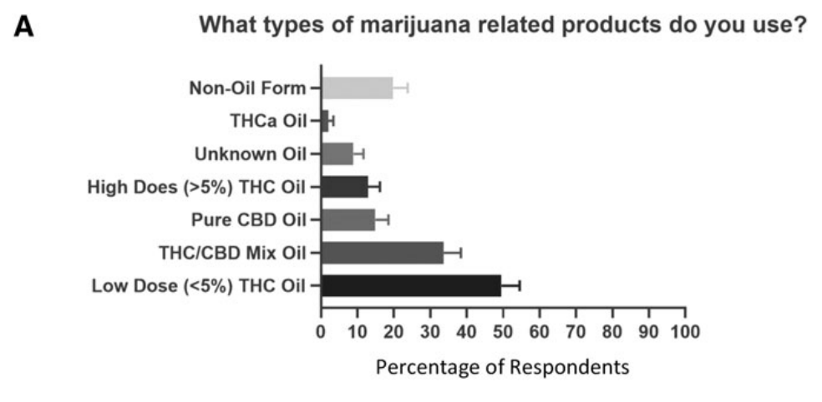
Table from Zarrabi et al., retrieved from: doi:10.1089/jpm.2019.0211 on March 25, 2026¹⁷​
​
Notes:
FACILITATOR:
About 50% were using low THC oil and about 1/3 were using mixed THC/CBD oil
20% were using a non-oil form
14.9% pure CBD oil​
12.9% >5% THC oil​
2.0% THCa oil​
8.9% unsure

Slide 27
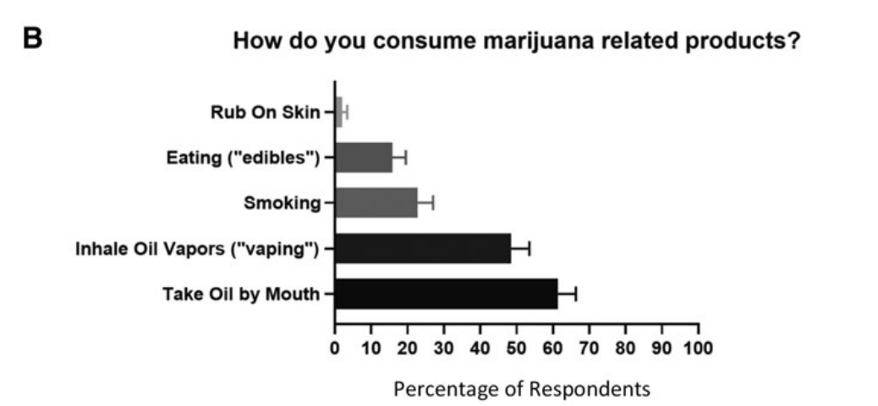
Table from Zarrabi et al., retrieved from: doi:10.1089/jpm.2019.0211 on March 25, 2026¹⁷​
​
Notes:
FACILITATOR:
B. Among patients who used cannabis oil:
61% consumed orally
49% vaped​
23% smoked plant-based cannabis​
16% edibles​
2% topical product

Slide 28
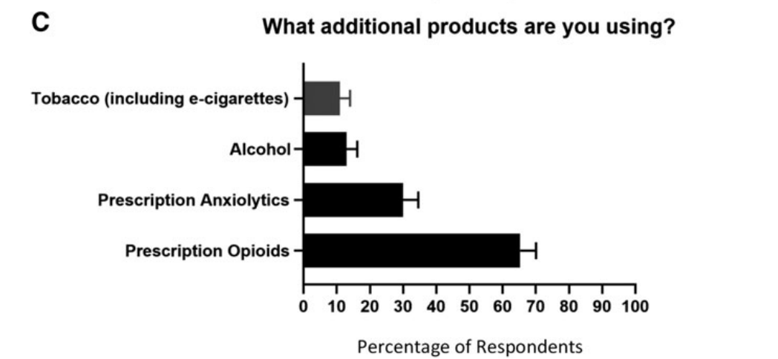
Table from Zarrabi et al., retrieved from: doi:10.1089/jpm.2019.0211 on March 25, 2026¹⁷​
​
Notes:
FACILITATOR:
C. 65.3% concurrent opioid therapy​
29.7% anxiolytics/ sedatives​
12.9% alcohol​
10.8% tobacco

Slide 29
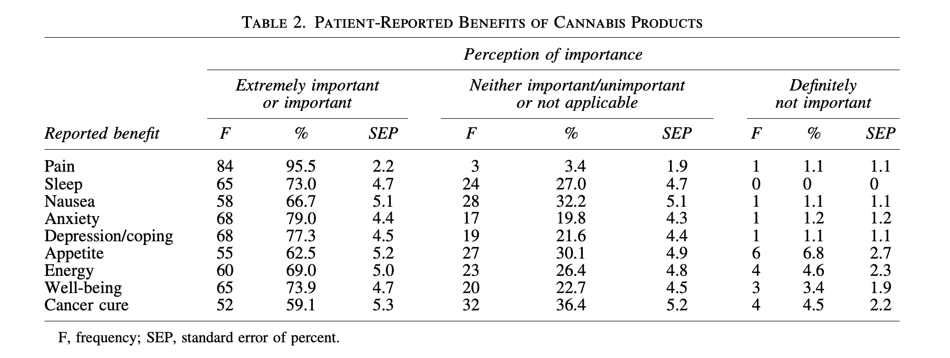
Table from Zarrabi et al., retrieved from: doi:10.1089/jpm.2019.0211 on March 25, 2026¹⁷​
​
Notes:
FACILITATOR:
What this table looks at is the patient-reported benefits of cannabis products
And the vast majority report cannabis is important or extremely important for pain, sleep, nausea, anxiety, depression/ coping, appetite, energy, well-being​
What this tells me is that patients believe their medical cannabis is very important for their symptom management​
We may not have a lot of data to back up their subjective reporting, but I believe this is where the intersection of the art and science of medicine lies ​
If seriously ill patients in our palliative care clinic feel better with medical cannabis, why should we not support them in using this treatment?​
​
It is also interesting to note that 59% report cannabis is important or extremely important for cancer cure—indicates need for further exploration​
I think this is where a "Tell me more" statement can be really helpful when exploring why a patient is interested in using cannabis

Slide 30
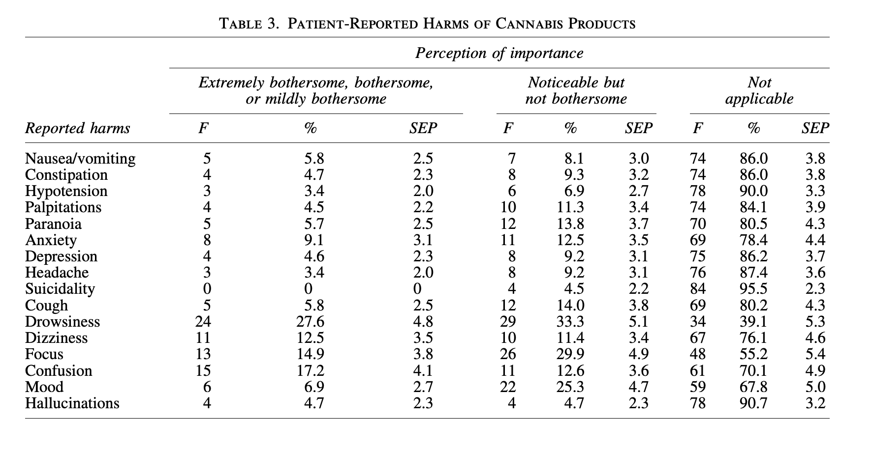
Table from Zarrabi et al., retrieved from: doi:10.1089/jpm.2019.0211 on March 25, 2026¹⁷
Notes:
FACILITATOR:
Table 3 looks at the patient-reported harms of cannabis
Some of the more commonly reported side effects include drowsiness, dizziness, problems with focus, or confusion
Anxiety was reported by 9% and problems with mood around 7%
All other adverse effects were reported by < 6%​ of participants
It's also notable that almost 1 in 5 reported unpleasant physical or emotional sx suggestive of withdrawal including irritable mood, changes in sleep, and pain when stopping​
And 13.5% reported a perception of mental or physical dependence on cannabis​
While only 3 pts were concerned about "becoming addicted"

Slide 31
Back to the clinic
On follow up 2 years later, now 78 y.o. man takes low THC oil 4-6 drops sublingually in the evening after dinner. It takes 30-45 min to take effect and provides 5-6 hours of relief from peripheral neuropathy, allowing him to sleep well.
No hangover effects the following morning. He finds it extremely helpful and can tell a difference if he doesn't take it.
He says “I have no life without it!” He has been offered opioids by his oncologist, but he prefers THC oil as it involves “less chemicals” and lasts longer.​
Notes:
Back to case #2. This patient was certified for the state low THC oil registry and…

Slide 32
DOSING

Slide 33
Dosing
I often counsel patient to return for a separate visit to discuss this, as it's hard to remember when there's a 6-8 week delay before you receive your card

Slide 34
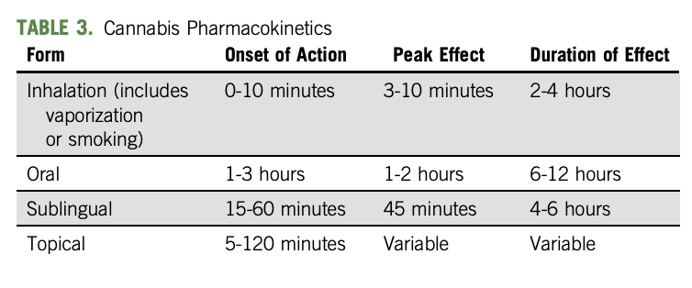
Cannabis Pharmacokinetics¹⁸
Table from Worster et al., retrieved from: doi:10.1200/OP.22.00080 on March 25, 2026.¹⁸

Slide 35
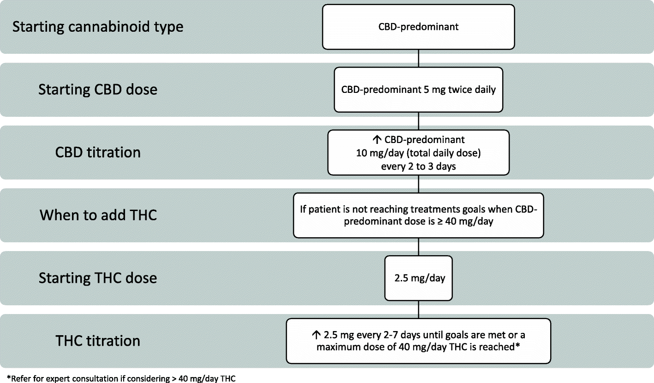
Routine protocol for medical cannabis dosing and administration
Figure from Bhaskar et al., retrieved from doi:10.1186/s42238-021-00073-1 on March 25,2026.¹⁹​
Notes:
FACILITATOR:
The lack of RCT evidence combined with the practical reality that patients are receiving a pharmaceutically active drug creates an atypical clinical scenario that necessitates expert guidance from experienced clinicians on how to safely and, perhaps, effectively dose and administer medical cannabis.​
Routine protocol recommended for most patients​
Initiate with 5 mg BID with CBD predominant strain and uptitrate by 10 mg/ day (5 mg CBD BID) q2-3 days up to 40 mg CBD per day​
Chose to start with CBD predominant variety to prioritize safety as CBD is high tolerable, does not induce euphoria, and has low risk for adverse effects​
If 40 mg/ day of CBD doesn't reach tx goals, consider adding THC 2.5 mg per day and titrate up by 2.5 mg THC q2-7 days up to 40 mg/ day while maintaining CBD dose​
Titrate to effects desired by each pt, as opposed to a particular dose

Slide 36
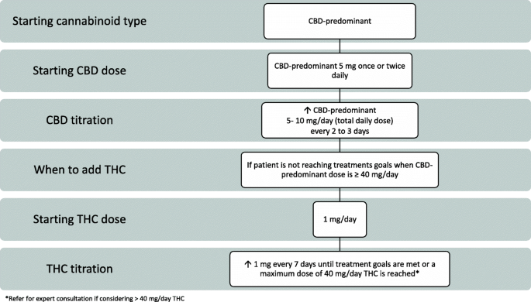
Conservative protocol for medical cannabis dosing and administration
Figure from Bhaskar et al., retrieved from doi:10.1186/s42238-021-00073-1 on March 25,2026.¹⁹​
Notes:
FACILITATOR: Conservative protocol for patients who may be more sensitive- frail, complex comorbidities, polypharmacy, mental health disorders

Slide 37
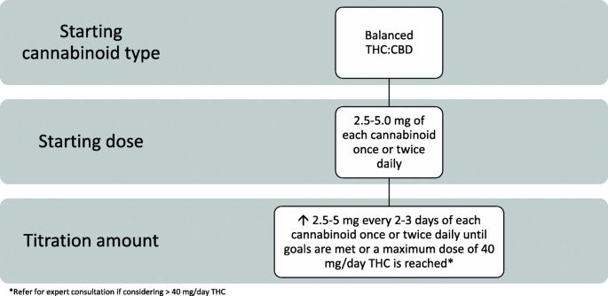
Rapid protocol for medical cannabis dosing and administration
Figure from Bhaskar et al., retrieved from doi:10.1186/s42238-021-00073-1 on March 25,2026.¹⁹
Notes:
FACILITATOR: Rapid protocol may be considered for pts requiring urgent management of severe pain, palliation, and those with prior cannabis use​
Start with balanced THC:CBD product of 2.5 to 5 mg once or twice daily and uptitrate q2-3 days by 2.5-5 mg/ day until goals are met or up to 40 mg THC​
When considering patients with neuropathic pain, products containing THC may be more suitable

Slide 38
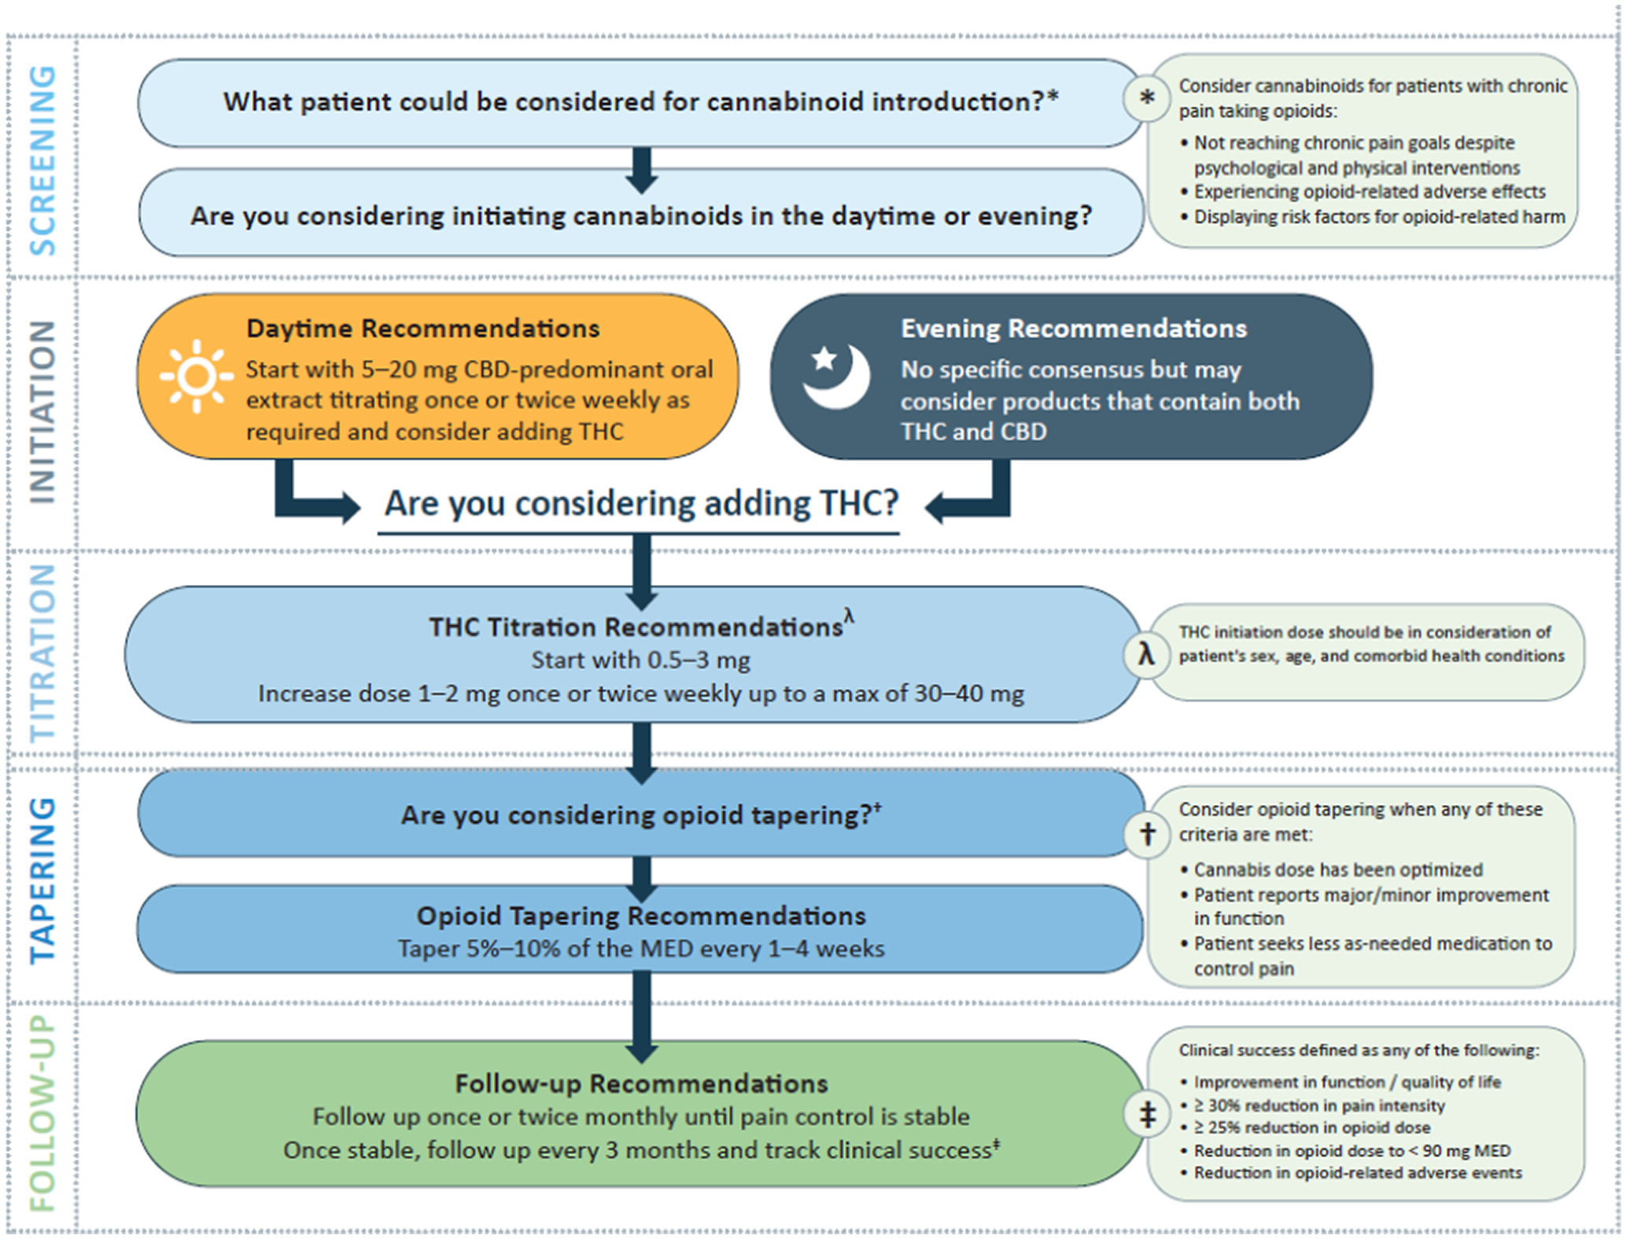
Consensus‐based recommendations for titrating cannabinoids and tapering opioids for chronic pain control
Figure from Shiota et al., retrieved from: doi:10.1111/ijcp.13871 on March 25, 2026²⁰

Slide 39
CLINICAL APPLICATION

Slide 40
Clinical Application
First – explore why are they asking
Cure my cancer. I heard it on the news. It helps my husband sleep. Helps with my pain. My neighbor used it while on chemotherapy and she said it helped with nausea, etc.

Slide 41
Clinical Application
Can you register the patient and monitor them?

Slide 42
Clinical Application
If yes…
Be mindful to counsel*, informed consent (?), UDS, practical matters**
Filling out the paperwork is annoying (notary, confirm address, annual re-cert)
Must maintain relationship with the patient
Navigating the system is time consuming – be prepared for A LOT of portal messages!
*Driving on cannabis, safe storage, side effects
**Federal employee, workers comp, federal contract, pistol permit?

Slide 43
Clinical Application
If no…
Consider Dronabinol (Marinol)* +/- CBD (<0.3% THC)
Refer out! → CBD is legal to obtain without card, if pt wants THC (or you think they would be a good candidate for THC):
CBD only website example: lazarusnaturals.org
THC/CBD website example: kingharvest.org
*Likely PA,
Should still monitor pt
Notes:
FACILITATOR:
"In georgia … "

Slide 44
Dronabinol dosing
Start at 2.5mg capsule BID with meals, increase to 5mg BID as tolerated
Note: capsules must be refrigerated (not ideal for housing instability)

Slide 45
Clinical Application – Adverse Effect Monitoring
Monitor for cannabis use disorder (CUD) (DSM-V)
A systematic review and meta-analysis from 2024 estimated prevalence of CUDs to be 25% in people who have used medicinal cannabis²¹
CUDIT-R
  Cannabis Use Disorder Identification Test-Revised
    Only validated in recreational users²²
Notes:
Potential RF for developing CUDs: daily use, younger age, depression, using medicinal cannabis for chronic pain²¹
We don’t have evidence for cannabis dependence/use disorder in patients using medicinal cannabis! (HUGE area for research)
How do we approach/define addiction, dependence, abuse, and substance use disorder in this emerging population?
Little is known about tolerance of medical cannabis effects
Withdrawal is common (with THC, not associated with CBD)
Cannabis hyperemesis syndrome

Slide 46
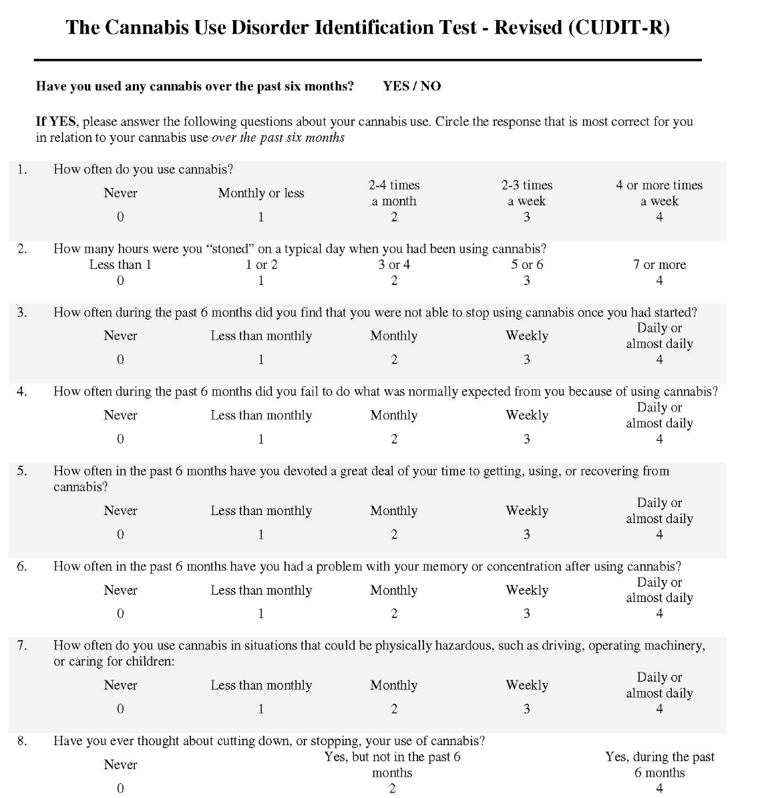
Figure from Adamson et al., retrieved from: doi:10.1016/j.drugalcdep.2010.02.017 on March 25, 2026²³
Notes:
FACILITATOR:
Designed for self-administration​
Scoring:​
≥ 8 indicates hazardous use​​
≥12 indicates the need to assess for cannabis use disorder​
Validated in recreational cannabis use
Has been evaluated in 2 studies of Veterans using medicinal cannabis, but more research is needed for medicinal cannabis users

Slide 47
Common Side Effects²⁴
Nausea
Effects on cognitive function
Deficits in motor function
Drowsiness/ fatigue
Dizziness
Dry mouth
Anxiety

Slide 48
Drug Interactions²⁴
CYP 3A4
  Inducers: may decrease THC and/or CBD
  Inhibitors: may increase THC and/or CBD
  Substrates: CBD is potential inhibitor of CYP3A4 and could increase 3A4 substrates. Caution with medications with smaller therapeutic index (e.g. tacrolimus)
  Carbamazepine, phenobarbital, phenytoin, rifampin, St. John’s wort, azole antifungals, clarithromycin, diltiazem, erythromycin, grapefruit, HIV protease inhibitors, macrolides, mifepristone, verapamil, Alprazolam, clobazam, cyclosporine, buprenorphine, tacrolimus, cyclosporine, phenytoin, sildenafil, statins, sirolimus, zopiclone
Summary: can have drug-drug interactions, caution with tacrolimus or HIV ART
Notes:
Generally, it is believed cannabis can be safely used with the majority of medications. Clinically, significant drug interactions are rare​
Screen for concominant use of other depressant medications that may worsen sedation and cognitive impairment​
CBD may increase toxicity of calcineurin inhibitors such as tacrolimus​
Can increase levels of clobazam​
May increase effect of warfarin (CYP 2C9 substrate)

Slide 49
Precautions²⁴
No reported deaths due to overdose
The strongest evidence for the negative impact of cannabis use on mental health is within recreational populations and is associated with an early age of initiation (< 25 yo) and exposure to large doses of THC
Vaping/ EVALI (E-cigarette or Vaping Associated Lung Injury)
Smoking tobacco and cannabis may increase risk of cardiovascular and respiratory disorders
Severe liver dysfunction may affect metabolism of cannabis
Recommended patients using THC should not drive or engage in safety-sensitive activities for at least 4 hours after inhalation, 6 hours after oral ingestion, or 8 hours, if euphoria is experienced
Screen for potential problematic use with risk assessment tools. Careful consideration if pt has an active or h/o SUD or is at risk of cannabis use disorder (CUD)

Slide 50
Precautions with Malignancy¹
Prolonged cannabis consumption could possibly interfere with immunotherapy
Cannabis consumption was associated with reduce response rates to nivolumab in one study
Cannabis consumption was correlated with a significant decrease in time to tumor progression and decreased overall survival in another study
Notes:
There is no high-quality evidence of cannabis/ cannabinoids being effective as antineoplastic therapy, but there is widespread information online about using cannabis/ cannabinoids as cancer-directed therapy

Slide 51
Considerations for Cardiovascular Disease²⁵
2025 systematic review and meta-analysis looking at CV risk associated with use of cannabis. All studies (n =24) looked at recreational marijuana use, other than one which looked at medical cannabis use
  Four different subgroups of MACE were considered: acute coronary syndrome (ACS), stroke, composite outcome of ACS or stroke and cardiovascular mortality
  The estimated risk ratio (RR) was 1.29 (95% CI 1.05 to 1.59) for ACS
  RR was 1.20 (1.13 to 1.26) for stroke
  RR was 2.10 (1.29 to 3.42) for cardiovascular death
  Composite outcome of ACS or stroke (2 studies) was not statistically significant
Notes:
CB1 activation in the cardiovascular system has been associated with oxidative stress, tissue injury, cell death, proatherogenic, profibrotic, proinflammatory effects and vasodilation/vasoconstriction via the sympathetic nervous system.​
THC-mediated sympathetic stimulation can cause tachycardia, increased oxygen cardiac demand and vasoconstriction, which can be transient and triggered by underlying pathological conditions, potentially leading to ischemia in the heart, brain or periphery.​
CB2 activation, conversely, has been linked to anti-inflammatory effects and reduced oxidative stress and could have antiatherogenic and antifibrotic functions.​
The one study that looked at medical cannabis was in Canada where whole leaf MJ or oil can be used as medical cannabis

Slide 52
Contraindications²⁴
Unstable cardiovascular disease
Avoid smoking cannabis in respiratory disease
Psychosis or bipolar disorder
Pregnancy and breastfeeding

Slide 53
Summary
Evidence is mixed for cannabinoids in patients with serious illnesses
Best evidence for chronic pain, neuropathy, and CINV
Palliative care patients perceive a large benefit of medical cannabis, with relatively low harms
Oral/ sublingual formulation is preferred to avoid harms of smoking
Start low and go slow with dose titration

Slide 54
References
Braun IM, Bohlke K, Abrams DI, et al. Cannabis and cannabinoids in adults with cancer: ASCO guideline. J Clin Oncol. 2024;42(13):1575-1593. doi:10.1200/JCO.23.02596
U.S. Department of Veterans Affairs, Health Services Research & Development Service. Cannabis Provider Education Packet. Published 2020. Accessed 3/17/26
Bilbao A, Spanagel R. Medical cannabinoids: a pharmacology-based systematic review and meta-analysis for all relevant medical indications. BMC Med. 2022;20(1):259. doi:10.1186/s12916-022-02459-1
Wang L, Hong PJ, May C, et al. Medical cannabis or cannabinoids for chronic non-cancer and cancer-related pain: a systematic review and meta-analysis of randomized clinical trials. BMJ. 2021;374:n1034. doi:10.1136/bmj.n1034
Boland EG, Bennett MI, Allgar V, Boland JW. Cannabinoids for adult cancer-related pain: systematic review and meta-analysis. BMJ Support Palliat Care. 2020;10(1):14-24. doi:10.1136/bmjspcare-2019-002032
Almuntashiri N, El Sharazly BM, Carter WG. Are cannabis-based medicines a useful treatment for neuropathic pain? A systematic review. Biomolecules. 2025;15(6):816. doi:10.3390/biom15060816
Grimison P, Mersiades A, Kirby A, et al. Oral Cannabis Extract for Secondary Prevention of Chemotherapy-Induced Nausea and Vomiting: Final Results of a Randomized, Placebo-Controlled, Phase II/III Trial. J Clin Oncol. 2024;42(34):4040-4050. doi:10.1200/JCO.23.01836
Simon L, Baldwin C, Kalea AZ, Slee A. Cannabinoid interventions for improving cachexia outcomes in cancer: a systematic review and meta-analysis. J Cachexia Sarcopenia Muscle. 2022;13(1):23-41. doi:10.1002/jcsm.12861
Mücke M, Weier M, Carter C, et al. Systematic review and meta-analysis of cannabinoids in palliative medicine. J Cachexia Sarcopenia Muscle. 2018;9(2):220-234. doi:10.1002/jcsm.12273
AminiLari M, Wang L, Neumark S, et al. Medical cannabis and cannabinoids for impaired sleep: a systematic review and meta-analysis of randomized clinical trials. Sleep. 2022;45(2):zsab234. doi:10.1093/sleep/zsab234
Crichton M, Dissanayaka T, Marx W, et al. Does medicinal cannabis affect depression, anxiety, and stress in people with cancer? A systematic review and meta-analysis of intervention studies. Maturitas. 2024;184:107941. doi:10.1016/j.maturitas.2024.107941
Hardy J, Greer R, Huggett G, Kearney A, Gurgenci T, Good P. Phase IIb Randomized, Placebo-Controlled, Dose-Escalating, Double-Blind Study of Cannabidiol Oil for the Relief of Symptoms in Advanced Cancer (MedCan1-CBD). J Clin Oncol. 2023;41(7):1444-1452. doi:10.1200/JCO.22.01632
De Feo G, Case AA, Crawford GB, et al. Multinational Association of Supportive Care in Cancer (MASCC) guidelines: cannabis for psychological symptoms including insomnia, anxiety, and depression. Support Care Cancer. 2023;31(3):176. Published 2023 Feb 21. doi:10.1007/s00520-023-07628-3

Slide 55
References
Treves N, Mor N, Allegaert K, et al. Efficacy and safety of medical cannabinoids in children: a systematic review and meta-analysis. Sci Rep. 2021;11(1):23462. Published 2021 Dec 6. doi:10.1038/s41598-021-02770-6
Devinsky O, Patel AD, Cross JH, et al. Effect of Cannabidiol on Drop Seizures in the Lennox-Gastaut Syndrome. N Engl J Med. 2018;378(20):1888-1897. doi:10.1056/NEJMoa1714631
Talwar A, Estes E, Aparasu R, Reddy DS. Clinical efficacy and safety of cannabidiol for pediatric refractory epilepsy indications: A systematic review and meta-analysis. Exp Neurol. 2023;359:114238. doi:10.1016/j.expneurol.2022.114238
Zarrabi AJ, Welsh JW, Sniecinski R, et al. Perception of Benefits and Harms of Medical Cannabis among Seriously Ill Patients in an Outpatient Palliative Care Practice. J Palliat Med. 2020;23(4):558-562. doi:10.1089/jpm.2019.0211
Worster B, Hajjar ER, Handley N. Cannabis Use in Patients With Cancer: A Clinical Review. JCO Oncol Pract. 2022;18(11):743-749. doi:10.1200/OP.22.00080
Bhaskar A, Bell A, Boivin M, et al. Consensus recommendations on dosing and administration of medical cannabis to treat chronic pain: results of a modified Delphi process. J Cannabis Res. 2021;3(1):22. Published 2021 Jul 2. doi:10.1186/s42238-021-00073-1
Sihota A, Smith BK, Ahmed SA, et al. Consensus-based recommendations for titrating cannabinoids and tapering opioids for chronic pain control. Int J Clin Pract. 2021;75(8):e13871. doi:10.1111/ijcp.13871
Dawson D, Stjepanović D, Lorenzetti V, Cheung C, Hall W, Leung J. The prevalence of cannabis use disorders in people who use medicinal cannabis: A systematic review and meta-analysis. Drug Alcohol Depend. 2024;257:111263. doi:10.1016/j.drugalcdep.2024.111263
Schlag AK, Hindocha C, Zafar R, Nutt DJ, Curran HV. Cannabis based medicines and cannabis dependence: A critical review of issues and evidence. J Psychopharmacol. 2021;35(7):773-785. doi:10.1177/0269881120986393
Adamson SJ, Kay-Lambkin FJ, Baker AL, Lewin TJ, Thornton L, Kelly BJ, Sellman JD. An improved brief measure of cannabis misuse: the Cannabis Use Disorders Identification Test–Revised (CUDIT-R). Drug Alcohol Depend. 2010;110(1-2):137-143. doi:10.1016/j.drugalcdep.2010.02.017
MacCallum CA, Lo LA, Boivin M. "Is medical cannabis safe for my patients?" A practical review of cannabis safety considerations. Eur J Intern Med. 2021;89:10-18. doi:10.1016/j.ejim.2021.05.002
Storck W, Elbaz M, Vindis C, Déguilhem A, Lapeyre-Mestre M, Jouanjus E. Cardiovascular risk associated with the use of cannabis and cannabinoids: a systematic review and meta-analysis. Heart. 2025;111(22):1047-1056. Published 2025 Oct 29. doi:10.1136/heartjnl-2024-325429

Slide 56
Thank you

