Slide 1
Buprenorphine and Methadone in
Serious Illness
Tonya Hershman, PharmD
Ali John Zarrabi, MD FAAHPM
Victoria Sweetnam, MD
Notes:
Presenter: AZ

Slide 2
Disclosures
Tonya Hershman, PharmD – none
Victoria Sweetnam, MD – none
Ali John Zarrabi, MD, FAAHPM
  Industry sponsored research (not relevant to this talk): Compass Pathways, Cybin, Reunion Neuroscience, Usona
Notes:
Presenter: AZ

Slide 3
Learning Objectives
Compare pharmacology of both buprenorphine and methadone
Differentiate between buprenorphine products and select an appropriate product for a patient in the outpatient palliative care setting
Initiate and manage buprenorphine in the outpatient palliative care setting
Initiate and manage methadone in the outpatient palliative care setting
Notes:
Presenter: AZ

Slide 4
Buprenorphine
Notes:
Presenter: AZ

Slide 5
Case 1: Buprenorphine
Mrs. S. is an 84-year-old woman with history of ESRD on HD, metabolic dysfunction-associated steatotic liver disease (MASLD), mild cognitive impairment, sarcopenia, mechanical falls, and chronic pain (mixed neuropathic pain from diabetes, chronic nociceptive pain of diffuse arthralgias from osteoarthritis) who reports intolerable pain causing suicidal ideation and demoralization (no active plan).
She was prescribed hydromorphone 2 mg TID which caused dysphoria and severe constipation requiring ED visit for fecal disimpaction.
Previously, NSAIDs helped with pain but are now contraindicated.
Notes:
Presenter: AZ

Slide 6
Buprenorphine Mechanism of Action^{1,2}
Partial agonist with high binding affinity at μ-OR
  Potent analgesia, ceiling on respiratory depression and euphoria, decreased adverse events (AEs)
Antagonist with high binding affinity at δ-OR and κ-OR
  Decreased OIC, respiratory depression, dysphoria, rewarding effects
Agonist w/ low binding affinity at ORL-1
  Spinal analgesia, & limited substance abuse and tolerance
Notes:
Presenter: AZ
FACILITATOR: ORL-1 - GPCR

Slide 7
Advantages vs Full-Opioid Agonists
Receptor Activity | Effects
Mu Opioid Receptor: Partial Agonist | Potent analgesia Ceiling effect (dose-related) on respiratory depression, euphoria ↓ tolerance, addiction, withdrawal ↓ constipation, immunosuppression, HPA axis suppression
Table adapted from Case et al., retrieved from doi:10.1007/s11864-021-00910-8 on April 30,2026²
Notes:
Presenter: AZ

Slide 8
Advantages vs Full-Opioid Agonists (cont.)
Receptor Activity | Effects
Kappa Opioid Receptor: Antagonist | ↓ anxiety, depression, dysphoria, hostility, SI ↓ tolerance, addiction ↓ sedation, hyperalgesia, immunosuppression
Delta Opioid Receptor: Antagonist | Anti-opioid effects Myocardial protection ↓ respiratory depression, constipation
Opioid-like Receptor 1 (ORL-1): Reduced Affinity | ↑ spinal analgesia ↓ opioid reward effects, tolerance
Figure adapted by Gudin et al., reetrieved from doi:10.1007/s40122-019-00143-6 on April 30,2026¹
Notes:
Presenter: AZ

Slide 9
Advantages vs Full-Opioid Agonists²
In the elderly, when compared to full agonist opioids, associated with less:
  Cognitive impairment
  Constipation
    Less binding effect on GI MOR
  Falls
  Sexual dysfunction
    Less central hypogonadism
  Sarcopenia in males
Notes:
Presenter: AZ

Slide 10
Advantages vs Full-Opioid Agonists²
Favorable metabolic pathways for certain populations
  Safe for use in renal impairment
    Not dialyzed
    Undergoes phase II glucuronidation; mostly excreted in feces
      Small amount in urine --> OK for anuric pts
  Safe to use in mild to moderate hepatic impairment
    But not in severe (requires careful monitoring)
Notes:
Presenter: AZ

Slide 11
Advantages vs Full-Opioid Agonists
Good for central sensitization^{1,3-4}
  CS = “Increased responsiveness of nociceptive neurons in the central nervous system to their normal or subthreshold afferent input” (IASP)
    Patients have diffuse pain that spreads outside the segmental area of primary nociception.
    Associated with fatigue, insomnia, poor concentration, general hypersensitivity to light, sound, touch
Notes:
Presenter: AZ

Slide 12
Advantages vs Full-Opioid Agonists
Good for Central Sensitization (CS)⁵
  Full agonists, like morphine, upregulate dynorphin
    An endogenous kappa agonist --> CS
  Bup blocks kappa receptors, reducing CS and opioid tolerance
    Also via opioid receptor-like 1 (ORL-1 receptors)
      Blocks analgesic tolerance
      Blunts rewarding aspect of full agonists in animal models
Notes:
Presenter: AZ

Slide 13
Advantages vs Full-Opioid Agonists
Depression²
  Bup is an inverse agonist of kappa opioid receptor (KOR)
    KOR agonism associated with craving, depression, and stress-like effects
  Thus, bup is associated with less depression and anxiety
    Bup is currently being studied for treatment-resistant depression
Notes:
Presenter: AZ

Slide 14
Advantages vs Full-Opioid Agonists
Works well with full agonists (at certain doses)²
  Bup occupies the majority (but not all) of the mu opioid receptors (MORs)
  Thus, other opioids (esp. high affinity ones like HDM) have room to bind to MORs
  Over time, bup increases MOR expression, increasing surface for other opioids to potentially bind
Notes:
Presenter: AZ

Slide 15
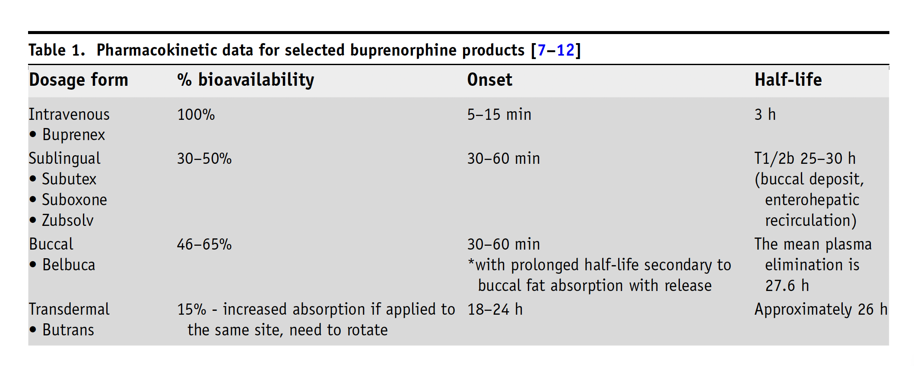
Buprenorphine Products
Table adapted from Case et al., retrieved from doi:10.1007/s11864-021-00910-8 on April 30,2026²
Notes:
Presenter: TH
FACILITATOR:
Absorption of the SL/buccal patches assumes perfect technique

Slide 16
Buprenorphine Products
Product | Formulation | Dosing | Indication
Butrans® (buprenorphine) | Transdermal patch | 5, 7.5, 10, 15, 20 mcg/hr q7d | Pain
Belbuca® (buprenorphine) | Buccal film | 75, 150, 300, 450, 600, 750, 900 mcg q12h | Pain
Subutex® (buprenorphine) | Sublingual tablet | 2, 8 mg | OUD Off-label for pain
Suboxone® (buprenorphine/ naloxone) | Sublingual tablet or film | 2/0.5, 4/1, 8/2, 12/3 | OUD Off-label for pain
Table created by author
Notes:
Presenter: TH

Slide 17
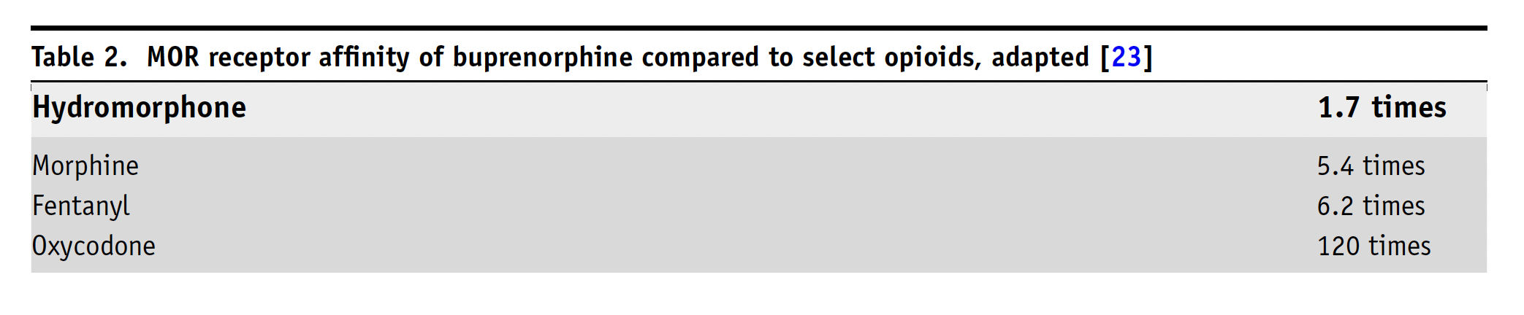
Pharmacodynamics
Table adapted from Case et al., retrieved from doi:10.1007/s11864-021-00910-8 on April 30,2026²
Primarily eliminated in feces (less in urine so may affect results of UDS)
Notes:
Presenter: TH

Slide 18
Buprenorphine Dosing
 | Oral Morphine Equivalent (OME)/24 Hours
 | 7 | 15 | 30 | 48 | 60 | 80 | 100 | 120 | 300
Butrans q7 days | 5 mcg/hr |  | 10 mcg/hr | 20 mcg/hr
Belbuca | 75 mcg daily | 150 mcg q12h | 300 mcg q12h | 450 mcg q12h | 600 mcg q12h | 750 mcg q12h |  | 900 mcg q12h
Suboxone or Subutex |  |  |  |  |  | 1 mg BID (split tabs or cut film) |  | 1 mg TID | 2 mg TID
Table adapted from Case et al., retrieved from doi:10.1007/s11864-021-00910-8 on April 30,2026²
1 mg bup = 30 OME (approximate)
Notes:
Presenter: TH

Slide 19
Buprenorphine Microinduction
What?
  'Sneaking' BUP onto receptors so it gradually overtakes full agonist (vs all at once)
Why?
  Risk of inducing withdrawal if patient on >120 OME
How?
  Overlap full agonist and BUP until target dose reached, then discontinue full agonist
  Use 1:30 BUP:OME to estimate a target dose
  Ask for help and follow up with your patient frequently (at least 2-3 times a week until on a stable dose)
Table: Sample microinduction schedule
Day | Bup Dose | Full Agonist Opioid
1 | 0.5 mg SL daily | Full dose
2 | 0.5 mg SL BID | Full dose
3 | 1 mg SL BID | Full dose
4 | 2 mg BID | Full dose
5 | 3 mg BID | Full dose
6 | 4 mg BID | Discontinue or start taper
Table created by author
Notes:
Presenter: TH

Slide 20
Breakthrough Pain on Buprenorphine¹
  BUP occupies the majority (but not all) of mu-opioid receptors (dose-dependent)
  Can give other opioids to bind to available MORs
    Choose opioids with higher binding affinity that can compete with BUP
      More favorable: hydromorphone (preferred); morphine
      Less favorable: oxycodone, hydrocodone
  Can also give BUP PRN
Notes:
Presenter: TH

Slide 21
Prescribing Considerations
Chronic (non-malignant) pain
Non-adherence (BUP patch qweek)
Side effects with full agonists
Complex persistent opioid dependence
Difficult PO access or poor GI absorption
Cancer in remission
Renal or liver impairment*
Harm/risk reduction
Elderly
Notes:
Presenter: TH
FACILITATOR: In the elderly --> less sedating, less cognitive impairment and risk of falls vs traditional opioids; lower risk of constipation

Slide 22
Naloxone: Is it really inactive?^{6,7}
AVOID bup-naloxone products (Suboxone) in patients with
severe hepatic impairment
  Naloxone insufficiently metabolized --> prevents BUP from providing analgesia
Low SL bioavailability
Included to prevent misuse by injection
Patients with pain seem to do better with buprenorphine alone products (eg, Subutex)
Notes:
Presenter: TH

Slide 23
Prescribing Cautions & Side Effects⁸
Nausea: reported 10%, likely higher
CNS: fatigue, headache, dizziness, insomnia (should improve)
Dental issues (SL/transmucosal products): tooth decay, cavities, tooth loss with OR without history of dental disease at varying doses and durations of therapy
  Keep up with dental checkups and home hygiene
  Swish water around after dissolved
Severe liver impairment (careful w/ naloxone-containing products; reduce starting doses)
Notes:
Presenter: TH

Slide 24
Patient Education & Practical Tips
What will you find when you Google? Educate in advance!
You may not "feel" the same way on bup as with other opioids.
Films (SL, buccal) can take up to 10 min to dissolve.
Patch pearls:
  Onset: 3 days
  To help with adhesion --> medical tape, Tegaderm
  Rotate patch sites
  Local irritation --> OTC fluticasone spray prior to patch application
Notes:
Presenter: TH

Slide 25
Buprenorphine for All?
Cancer pain – yes⁹
  Elderly patients, renal failure, SUD, complex persistent opioid dependence, nonadherence, concomitant CNS depressants, severe respiratory illness, poor GI absorption or inability to swallow, difficult-to-treat pain phenotypes
  Longer-term pain control needed with increased survival time (survivorship)
Non-cancer pain – yes¹⁰⁻¹³
  Buccal (Belbuca) and transdermal (Butrans) formulations studied in patients with chronic pain (low back, osteoarthritis)
  Long-term use – jury's still out
First-line – yes¹⁴
  Can be used in opioid-naïve patients
  Experts agree on use as first-line in cancer-related pain
Notes:
Presenter: AZ + TH

Slide 26
Guidelines and Consensus
US Dept of Health and Human Services Guideline (2019) recommend the use of buprenorphine as a first-line opioid for chronic pain if an opioid is needed¹⁵
Consensus paper recommending buprenorphine as a first-line opioid in the elderly¹⁶
NCCN also recommended bup as a first-line opioid for cancer pain¹⁷
Notes:
Presenter: AZ

Slide 27
Case 1: Buprenorphine
Mrs. S. is an 84-year-old woman with history of ESRD on HD, metabolic dysfunction-associated steatotic liver disease (MASLD), mild cognitive impairment, sarcopenia, mechanical falls, and chronic pain (mixed neuropathic pain from diabetes, diffuse arthralgias from osteoarthritis) who reports intolerable pain causing suicidal ideation and demoralization (no active plan).
She was prescribed hydromorphone 2 mg TID which caused dysphoria and severe constipation requiring ED visit for dis-impaction.
Previously, NSAIDs helped with pain but are now contraindicated.
Notes:
Presenter: AZ

Slide 28
Case 1: Buprenorphine Management
Start with TD bup
  5 mcg/hr q7d
  Titrate weekly
  Can go up to at least TD 40 mcg/hr, maybe higher
Notes:
Presenter: AZ

Slide 29
Buprenorphine Dosing
 | Oral Morphine Equivalent (OME)/24 Hours
 | 7 | 15 | 30 | 48 | 60 | 80 | 100 | 120 | 300
Butrans q7 days | 5 mcg/hr |  | 10 mcg/hr | 20 mcg/hr
Belbuca | 75 mcg daily | 150 mcg q12h | 300 mcg q12h | 450 mcg q12h | 600 mcg q12h | 750 mcg q12h |  | 900 mcg q12h
Suboxone or Subutex |  |  |  |  |  | 1 mg BID (split tabs or cut film) |  | 1 mg TID | 2 mg TID
Table adapted from Case et al., retrieved from doi:10.1007/s11864-021-00910-8 on April 30,2026²
1 mg bup = 30 OME (approximate)
Notes:
Presenter: AZ

Slide 30
QT prolongation?
Should you check an EKG?¹⁸
  TD bup currently goes up to 20 mcg/hr patches
    (in Europe goes up substantially higher)
  Purported risk of QT prolongation
  We know bup increases QT by <=15ms
  However, does not bind to K channel blockers associated with torsades de pointes
Notes:
Presenter: AZ

Slide 31
QT prolongation?
Should you check an EKG?¹⁸⁻¹⁹
  FDA AE database has not shown disproportionate signal for ventricular arrhythmias or torsades de pointes (unlike methadone)
  So, probably check an EKG, be mindful of other QT prolonging agents, through it's okay, in general, to go up on the patch
Notes:
Presenter: AZ

Slide 32
Diurnal Pain
Her pain is worse at night and significantly less worse during the day
Rotated to buccal bup (q12hr regimen)
  Worked better for her
  Dental care needed
Notes:
Presenter: AZ

Slide 33
Drug Interactions
Bup primarily metabolized by CYP3A4 (substrate)
Example: Patient develops thrush not resolved with troches, magic mouthwash with nystatin
  Prescribed ketoconazole (CYP3A4 inhibitor)
    Also QT-prolonging
  Be vigilant!
    Reduce doses, regular check ins
Notes:
Presenter: TH

Slide 34
Buprenorphine for MOUD²⁰⁻²⁶
Higher dose formulations are FDA approved for MOUD (sublingual or subcutaneous)
Sufficient dose to treat opioid withdrawal (requires understanding of opioid deficit)
Sufficient dose to suppress cravings (requires elucidation of "reward" from opioid effect)
Opioid agonist treatment decreases all-cause mortality
Buprenorphine impact on lower mortality is associated with longer durations of treatment
Higher retention and lower rate of overdose compared to XR-naltrexone
Lower retention in treatment compared to methadone
Notes:
Presenter: TH

Slide 35
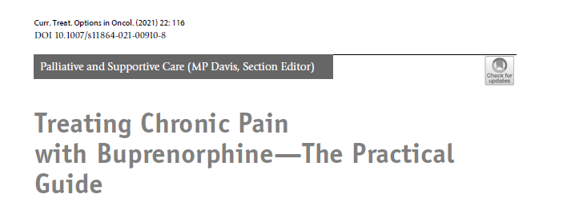
Key Buprenorphine References
Image from Case et al., retrieved from doi:10.1007/s11864-021-00910-8 on April 30,2026.²
Notes:
Presenter: TH

Slide 36
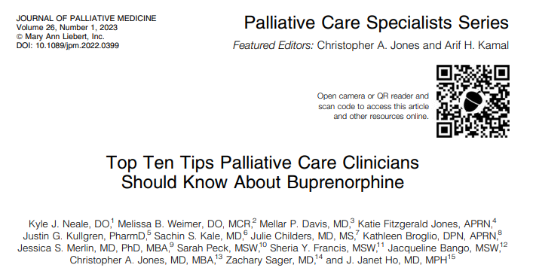
Key Buprenorphine References
Image by Neale et al., retrieved from doi:10.1089/jpm.2022.0399 on April 30, 2026. ²⁷
Notes:
Presenter: TH

Slide 37
Methadone
Notes:
Presenter: VS

Slide 38
Case 2: Methadone
A 40- year-old female with a history of advanced stage IV cervical cancer presents to your palliative care clinic with poorly controlled pain. The pain has been progressively worsening for the last few months, and she lives at a daily 6/10 pain. She describes it as a persistent dull aching pain in the pelvis and back that at times is stabbing and shoots into her legs bilaterally. Pain has not responded to recent nerve blocks by her interventional pain doctor, acupuncture, THC oil, acetaminophen, NSAID, gabapentin, and duloxetine. She is additionally taking extended-release oxycodone 60 mg BID and breakthrough short-acting oxycodone 15 mg q4h prn (taking this around the clock, six doses in 24 hours). Each dose of short-acting oxycodone is lasting the expected 4 hours. Her recent scans taken just this week reveal progression of disease.
Notes:
Presenter: VS

Slide 39
What's so great about methadone?²⁸
Inexpensive
Multiple dosage forms (tab, PO solution, concentrated PO solution, IV)
High oral bioavailability
No dosage adjustment in renal failure
Long duration of action with sustained analgesia
No dose adjustment in renal failure
No pharmacologically active metabolites
Benefit in difficult pain syndromes, including neuropathic pain
"Salvage opioid" when others fail, especially if OME high
Notes:
Presenter: TH

Slide 40
Methadone Mechanism of Action²⁹⁻³⁰
R-methadone
Mu-opioid receptor agonism
S-methadone
NMDA antagonism (prevents opioid tolerance, decrease central sensitization, neuropathic analgesia)
Serotonin and norepinephrine reuptake inhibition
Responsible for most of methadone's analgesic action
Notes:
Presenter: TH
FACILITATOR: Methadone is a mu-opioid receptor agonist (like morphine, oxycodone, and hydromorphone), and it also binds to the kappa- and delta-opioid receptors. Additional mechanisms of action include inhibiting the reuptake of serotonin and norepinephrine (which is how antidepressants act to treat pain). Additionally, methadone works as an antagonist at the N-methyl-D-aspartate (NMDA) receptor, thought to prevent central sensitization and reduce opioid tolerance, and possibly increase its effectiveness in treating neuropathic pain as compared to other opioids. Methadone is a racemic mixture of R- and S-methadone. R-methadone has a 10-fold affinity at the mu receptor, is up to 50 times more potent than S-methadone, and is responsible for most of its action.2 S-methadone is responsible for serotonin and norepinephrine reuptake inhibition, and NMDA antagonism.

Slide 41
Methadone Challenges²⁸
PK/PD
QTc prolongation
Drug interactions
McPherson ML et al. J Pain Symptom Manage 2019; 57:635-645.
Notes:
Presenter: TH

Slide 42
PK/PD^{28,30}
Oral bioavailability high --> ~80%
Lipophilic; widely distributed; retained in tissue and slowlyreleased back into plasma --> contributes to long half-life
Onset: PO, 15-45 minutes
  Peaks in 2.5-4 hours
Half-life: 5-130 hours; average 24 hours
  Takes 4-10 days to reach steady-state
Time to steady-state doubled in liver disease
No active metabolites; biotransformation to active drug not required
Notes:
Presenter: TH

Slide 43
Steady-State (assuming 24 hr t_{1/2})
96.875%
93.75%
87.5%
75%
50%
Day 0
Day 1
Day 2
Day 3
Day 4
Day 5
Figure adapted from McPherson ML, retrieved from https://cme.painweek.org/content/methadone-madness-part-1 on April 30, 2026 ³¹
Notes:
Presenter: TH

Slide 44
Drug Interactions²⁸
Many CYP450 enzymes involved in methadone metabolism
  CYP2B6, 2C19, 3A4, 2D6
  Can increase or decrease methadone concentrations with significant clinical implications
Think about 3 big categories of medications:
  Anti-infectives
  Antidepressants
  Amiodarone
Resources to check drug interactions:
  Online databases (Micromedex, UpToDate Lexidrug)
  McPherson ML, et al. White Paper, Supp. Table 1
  Ask a pharmacist for help
Notes:
Presenter: TH
FACILITATOR:
Many CYP450 enzymes involved in methadone metabolism
2B6, 2C19, 3A4, 2D6
Pearl: cigarette smoking can induce 2B6 --> lower methadoneconcentrations; cessation can therefore INCREASE methadone conc.
Think about 3 big categories of medications:
Anti-infectives
Antidepressants
Amiodarone
Resources:
Drug interaction checker (Micromedex, UpToDate Lexidrug)
Refer to methadone white paper Supp Table 1 (McPherson, et al)
Ask a pharmacist for help

Slide 45
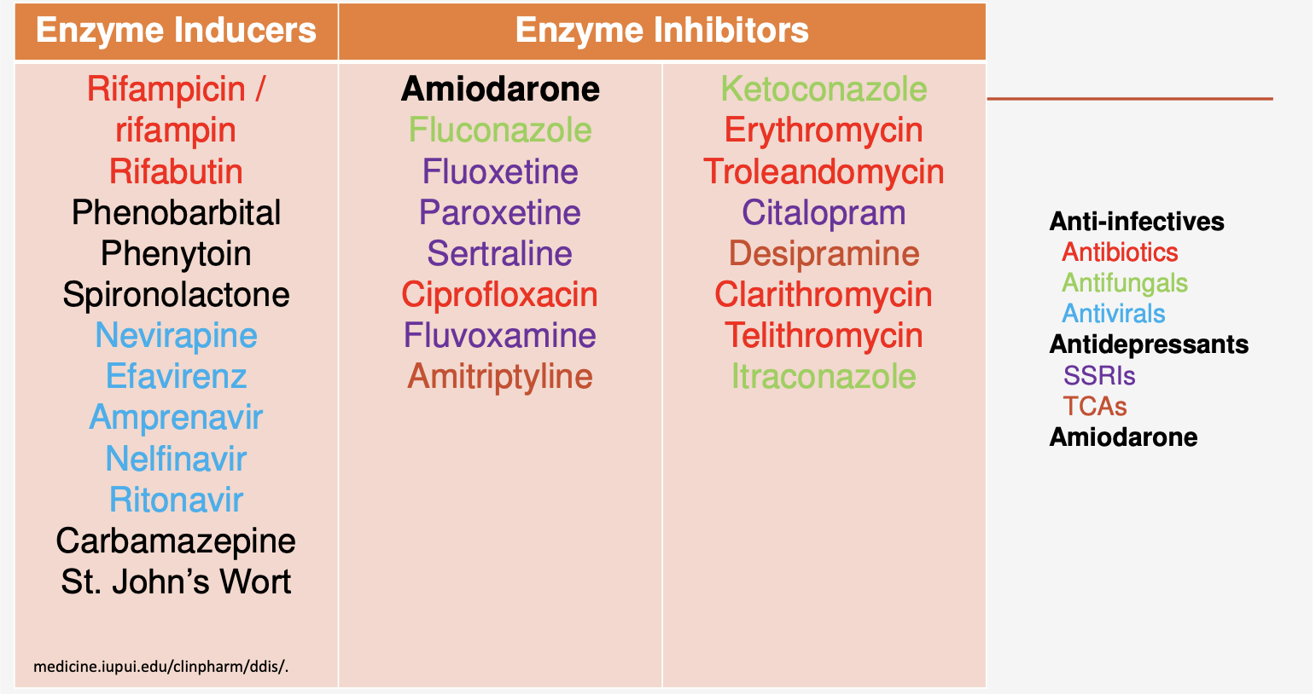
Note: Duloxetine is a P450 inhibiting medication that can raise levels of both duloxetine and methadone!
Figure from McPherson ML, retrieved from https://cme.painweek.org/content/methadone-madness-part-1 on April 30, 2026 ³¹
Notes:
Presenter: TH
FACILITATOR:

Slide 46
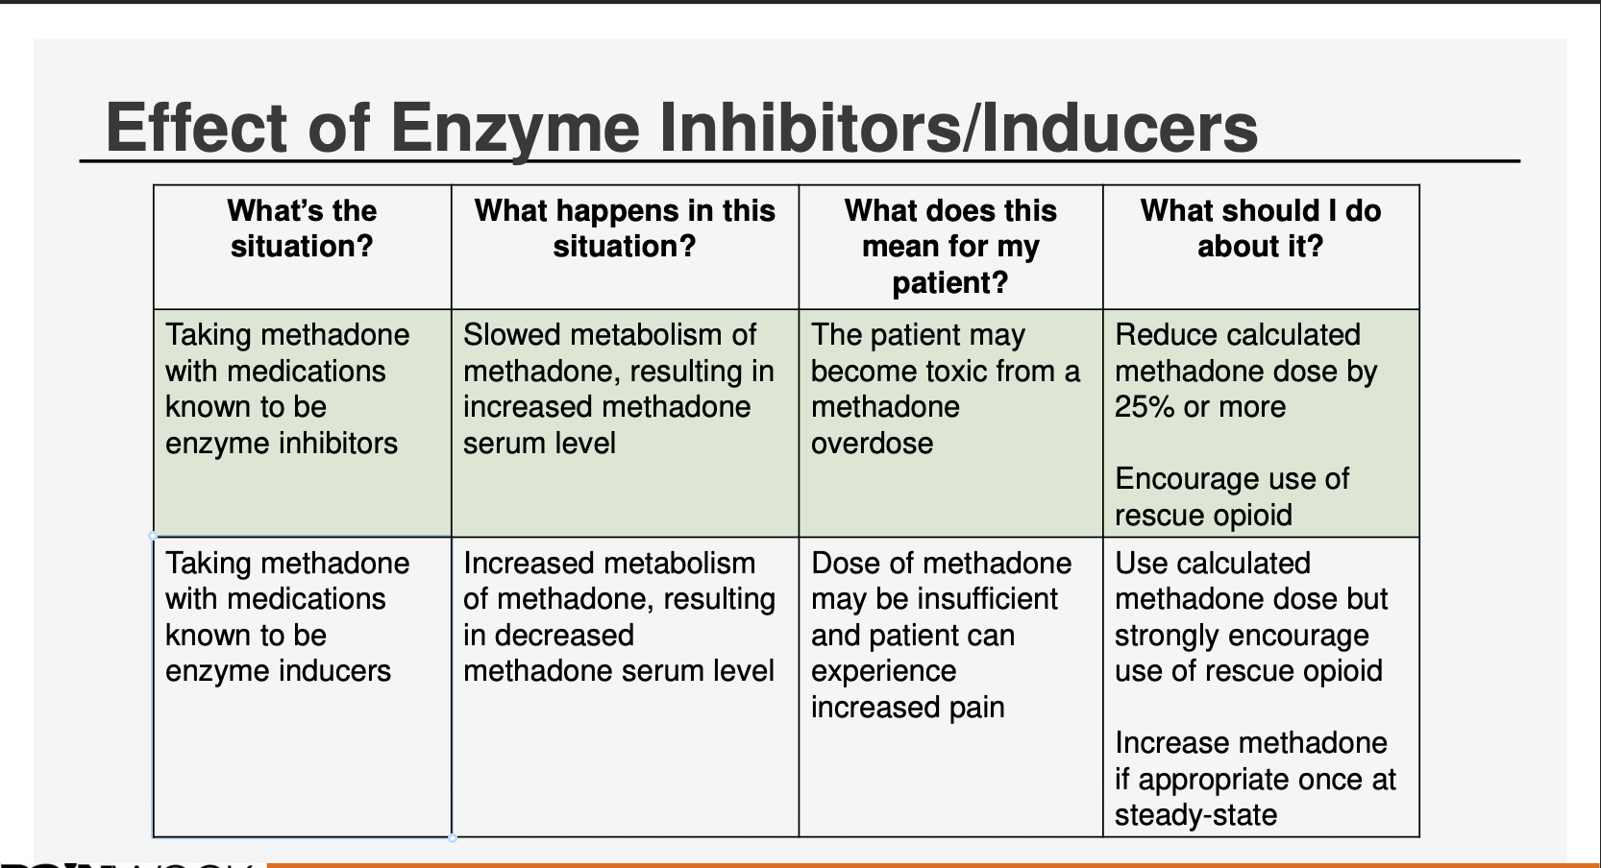
Figure adapted from McPherson ML, retrieved from https://cme.painweek.org/content/methadone-madness-part-1 on April 30, 2026 ³¹
Notes:
Presenter: TH

Slide 47
Methadone and QTc Prolongation^{28,31}
Risks and Management
Resources
Clinically significant implications
QTc 450-500 msec: consider alternative to methadone; evaluate and correct causes of QTc prolongation
QTc >500 msec: use not recommended
Frequency of monitoring depends on goals of care, baseline QTc
ML McPherson, et al. Methadone White Paper, Table 3
CredibleMeds®
  Online resource, free to use
  Categorizes QTc risk by Known, Possible, or Conditional
Notes:
Presenter: TH
FACILITATOR:
Methadone is known to prolong the QTc interval and EKG monitoring needed
You can consider prognosis to inform monitoring

Slide 48
Methadone Dosing²⁸
Opioid naïve: 2.5-7.5 mg/day (in divided dose q8 or q12h)
Low dose adjunct: 1 mg q12h
Opioid tolerant: next slide
Adjustments: no sooner than every 5-7 days(or longer in elderly or liver impairment)
Addiction: qday dosing to block cravings (vs analgesia – divided doses)
Typical to use methadone as long-acting with a breakthrough opioid
McPherson ML et al. J Pain Symptom Manage 2019; 57:635-645.
Notes:
Presenter: TH

Slide 49
Conversion To/From Methadone^{28,32}
FROM Methadone
TO Methadone
Conversion factor of 1:4.7 OME (or 1:5 for ease)
Many methods in the literature
3-day switch from other opioid to methadone (simultaneous reduction of opioid and increase of methadone)
MAX starting dose of 30-40 mg/day regardless of previous OME
Conversion factors from McPherson, et al:
  <60 OME: 2-7.5 mg/day
  60-199 OME and <65 y/o: 10:1
  200+ OME and/or >65 y/o: 20:1
Notes:
Presenter: TH

Slide 50
Methadone for MOUD
Treats pain AND OUD
No ceiling effect (given that it's a full agonist) unlike buprenorphine
Consider if buprenorphine transition is not feasible
Dosing for OUD is typically once daily
Consider methadone clinic or addiction psychiatry referral for management/co-management
Notes:
Presenter: TH

Slide 51
Who gets methadone?^{28,33}
Potentially Appropriate Candidates for Methadone in HPC | Potentially Inappropriate Candidates for Methadone in HPC
Moderate to severe pain (especially as a second-line opioid choice) Pain refractory to other opioids True phenanthrene (e.g., morphine) allergy Significant renal impairment Need for a long-acting opioid (particularly as an oral concentrate solution) High opioid tolerance Poorly controlled opioid-induced adverse effects with other opioids History of dysphagia, inability to swallow, or feeding tube placement | Patient lives alone, or poor cognitive functioning, without a responsible caregiver Lack of knowledgeable practitioner on transfer History of opioid/medication nonadherence History of substance misuse or SUD (patient or family) Multiple risk factors for methadone toxicity (e.g., clinical instability, multiple transitions in care, history of transplant) History of QTc prolongation or at high risk for such Prognosis less than projected time to methadone steady state (i.e., five to seven days) Obstructive or central sleep apnea Determined to be medically inappropriate after risk assessment (see next section)
Notes:
Presenter: TH

Slide 52
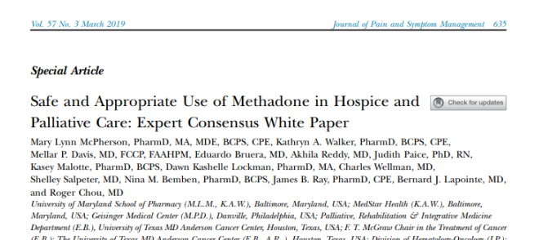
Key Methadone Reference
Image by McPherson et al., retrieved from doi:10.1016/j.jpainsymman.2018.12.001 on April 30, 2026. ²⁸
Notes:
Presenter: TH

Slide 53
Case 2: Methadone
A 40-year-old female with a history of advanced stage IV cervical cancer presents to your palliative care clinic with poorly controlled pain. The pain has been progressively worsening for the last few months, and she lives at a daily 6/10 pain. She describes it as a persistent dull aching pain in the pelvis and back that at times is stabbing and shoots into her legs bilaterally. Pain has not responded to recent nerve blocks by her interventional pain doctor, acupuncture, THC oil, acetaminophen, NSAID, gabapentin, and duloxetine. She is additionally taking extended-release oxycodone 60 mg BID and breakthrough short-acting oxycodone 15 mg q4h prn (taking this around the clock, six doses in 24 hours). Each dose of short-acting oxycodone is lasting the expected 4 hours. Her recent scans taken just this week reveal progression of disease.
Notes:
Presenter: VS

Slide 54
Case 2: Methadone
What opioid rotation could you consider? What is she a candidate for?
If you choose to rotate to methadone, how would you rotate?
  What do you need to check?
  What dose of methadone? What dose adjustment (if any) may need to be made?
  What dose of rescue opioid?
  How would you monitor?
Notes:
Presenter: VS
FACILITATOR:
What opioid rotation could you consider? What is she a candidate for?
I would consider a rotation to methadone as her long-acting agent from oxycodone extended-release. She may benefit from methadone's high potency for difficult to manage complex cancer pain. Additionally, methadone has neuropathic analgesic properties which in cervical cancer makes this an excellent choice, given the highly innervated area that this cancer often affects in the pelvis, causing pain. If she shows that she can safely and reliably take this medication and a good baseline QTc less than 450ms, that also would make her an ideal candidate.
If you choose to rotate to methadone, how would you rotate? What dose adjustment (if any) may need to be made?
What do you need to check? Check most recent EKG and look at Qtc. See Methadone White Paper for guidance. Generally, we would want the Qtc to be less than 450ms.
What dose of methadone? She is taking oxyER 60 x2 + short-acting oxyIR 15mg x6 doses in 24 hours--> 210mg oxycodone daily--> ~262.5 OME TDD (using conversion factor of 20mg of oxycodone is 25mg of morphine)--> By looking at McPherson's Methadone White Paper, I am able to look at my conversion guidance. The patient is opioid tolerant and TDD is between >200mg OME. Therefore, I will use the recommended 20:1 conversion (20mg OME:1mg oral methadone). Remember, no greater than 30-40mg per day of methadone regardless of the previous opioid dose and the dose should not be increased before 5-7 days (with no more than 5mg/day up to 30-40mg/day, then can be increased by 10 mg/day) after 5-7 days--> so, this converts to TDD of 13mg oral methadone. Given that she is on duloxetine, I would want to conservatively dose reduce by at least 25% (duloxetine is a P450 enzyme inhibiting medication that could raise both methadone and duloxetine levels). I would not otherwise dose reduce to account for cross-tolerance of opioid rotation given poorly controlled pain--> Thus TDD is reduced to ~10mg methadone--> divide this into two or three doses--> 5mg PO methadone BID.
What dose of rescue opioid?
I would continue her breakthrough oxyIR 15mg q4h prn for now as it seems to be at the right dose, lasting for at least 3-4 hours—although this may need to be rotated in the future to another breakthrough opioid type.
How would you monitor? I would monitor for side effects like sedation for a minimum of 5-7 days (10-14 days in older adults) after initiation. I would also repeat an EKG 2-4 weeks after initiating methadone and ensure no further significant increase in QTC or other aberrancies in EKG that would be a contraindication for methadone.

Slide 55
Key Points: Methadone
Unique pharmacology:
  Long half-life (need for slow titration, delayed respiratory depression risk)
  Highly potent full agonist opioid
  NMDA antagonist (neuropathic analgesic)
  Great for complex pain, opioid tolerance/hyperalgesia, neuropathic pain, refractory cancer pain/"salvage" therapy
  Helpful in opioid rotation
Can be crushed if patient has a feeding tube (liquid also available)
Nonlinear equianalgesic conversion from other opioids
Watch for QTc prolongation and drug interactions
Safer in renal dysfunction
Low cost
Notes:
Presenter: VS

Slide 56
Key Points: Buprenorphine
Unique pharmacology:
  Partial µ-opioid agonist
  Safer safety profile: ceiling on respiratory depression/risk of OD, less sedation, constipation, cognitive impairment
Helpful in elderly, at risk for opioid toxicity, moderate-severe pain, chronic cancer pain, neuropathic pain
  May be less helpful in high opioid tolerance
  Receptor affinity can make adding full agonists harder (must overcome)
First-line for MOUD
Less QTc risk than methadone
May need a micro-induction for OME >120 or may precipitate withdrawal
Notes:
Presenter: VS

Slide 57
Final Thoughts?

Slide 58
References
1.Gudin J, FudinGudin J, FudinGudin J, Fudin J. A narrative pharmacological review of buprenorphine: a unique opioid for the treatment of chronic pain. Pain Ther. 2020;9(1):41-54. doi:10.1007/s40122-019-00143-6
2.Case AA, Kullgren J, Anwar S, Pedraza S, Davis MP. Treating chronic pain with buprenorphine: the practical guide. Curr Treat Options Oncol. 2021;22(12):116. doi:10.1007/s11864-021-00910-8
3.Nishigami T, Manfuku M, Lahousse A. Central sensitization in cancer survivors and its clinical implications: state of the art. J Clin Med. 2023;12(14):4606. doi:10.3390/jcm12144606
4.Nijs J, Lahousse A, Kapreli E, et al. Nociplastic pain criteria or recognition of central sensitization? Pain phenotyping in the past, present and future. J Clin Med. 2021;10(15):3203. doi:10.3390/jcm10153203
5.Davis MP. Twelve reasons for considering buprenorphine as a frontline analgesic in the management of pain. J Support Oncol. 2012;10(6):209-219. doi:10.1016/j.suponc.2012.05.002
6.Tylleskär I, Skarra S, Skulberg AK, Dale O. The pharmacokinetic interaction between nasally administered naloxone and the opioid remifentanil in human volunteers. Eur J Clin Pharmacol. 2021;77(12):1901-1908. doi:10.1007/s00228-021-03190-1
7.Buprenorphine. StatPearls. National Library of Medicine. Accessed April 2026. https://www.ncbi.nlm.nih.gov/books/NBK459126/
8.Buprenorphine. In: Lexi-Drugs. UpToDate Lexidrug. UpToDate Inc; Updated April 20, 2026. Accessed April 30, 2026. http://online.lexi.com
9.Chwistek M, Sherry D, Kinczewski L, et al. Should buprenorphine be considered a first-line opioid for the treatment of moderate to severe cancer pain? J Pain Symptom Manage. 2023;66:e638-e643. doi:10.1016/j.jpainsymman.2023.09.014.
10.Dalal S, Chitneni A, Berger AA, et al. Buprenorphine for Chronic Pain: A Safer Alternative to Traditional Opioids. Health Psychol Res. 2021;9(1):27241. Published 2021 Aug 6. doi:10.52965/001c.27241

Slide 59
References
11.Wong SSC, Chan TH, Wang F, Chan TCW, Ho HC, Cheung CW. Analgesic Effect of Buprenorphine for Chronic Noncancer Pain: A Systematic Review and Meta-analysis of Randomized Controlled Trials. Anesth Analg. 2023;137(1):59-71. doi:10.1213/ANE.0000000000006467
12.Khanna IK, Pillarisetti S. Buprenorphine—an attractive opioid with underutilized potential in treatment of chronic pain. J Pain Res. 2015;8:859-870. doi:10.2147/JPR.S85951
13.U.S. Department of Veterans Affairs, Pharmacy Benefits Management Services, Medical Advisory Panel, and VISN Pharmacist Executives. Buprenorphine for the management of chronic pain. March 2024. https://www.va.gov/formularyadvisor/DOC_PDF/CRE_Buprenorphine_for_Chronic_Pain_MAR_2024.pdf
14.Schmidt-Hansen M, Bromham N, Taubert M, Arnold S, Hilgart JS. Buprenorphine for treating cancer pain. Cochrane Database Syst Rev. 2015;2015(3):CD009596. Published 2015 Mar 31. doi:10.1002/14651858.CD009596.pub4
15.U.S. Department of Health and Human Services. Pain management best practices inter-agency task force report: updates, gaps, inconsistencies, and recommendations. 2019. https://www.hhs.gov/ash/advisory-committees/pain/reports/index.htm
16.Pergolizzi J, Böger RH, Budd K, et al. Opioids and the management of chronic severe pain in the elderly: consensus statement of an international expert panel. Pain Pract. 2008;8(4):287-313. doi:10.1111/j.1533-2500.2008.00204.x
17.Swarm RA, Youngwerth JM, Agne JL, et al. Adult cancer pain, version 2.2025, NCCN clinical practice guidelines in oncology. J Natl ComprCanc Netw. 2025;23(7):e250032.
18.Davis M. Buprenorphine in palliative care. BMJ Support Palliat Care. 2025. doi:10.1136/spcare-2025-005984
19.Schmith VD, Curd L, Lohmer LRL, et al. Evaluation of the effects of a monthly buprenorphine depot subcutaneous injection on QT interval during treatment for opioid use disorder. Clin Pharmacol Ther. 2019;106:576-584
20.Enns B, Guerra-Alejos BC, Min JE, Carter A, Siebert U, Nosyk B. Population-Level Health Benefits and Harms Associated With Buprenorphine/Naloxone vs Methadone. JAMA Netw Open. 2025;8(12):e2551337. doi:10.1001/jamanetworkopen.2025.51337

Slide 60
References
21.Weimer MB, Herring AA, Kawasaki SS, et al. ASAM clinical considerations: buprenorphine treatment of opioid use disorder for individuals using high-potency synthetic opioids. J Addict Med. 2023;17(6):632-639. doi:10.1097/ADM.0000000000001202
22.Rockhill KM, Bau GE, DeVeaugh-Geiss A, et al. Buprenorphine, oxycodone, hydrocodone, and methadone mortality in the United States (2010–2017). J Am Coll Emerg Physicians Open. 2024;5(5):e13338. doi:10.1002/emp2.13338
23.Ajazi EM, Dasgupta N, Marshall SW, et al. Revisiting the X:BOT naltrexone clinical trial using a comprehensive survival analysis. J Addict Med. 2022;16(4):440-446. doi:10.1097/ADM.0000000000000931
24.Glanz JM, Binswanger IA, Clarke CL, et al. The association between buprenorphine treatment duration and mortality. Addiction. 2023;118(1):97-107. doi:10.1111/add.15998
25.Santo T Jr, Clark B, Hickman M, et al. Association of opioid agonist treatment with all-cause mortality. JAMA Psychiatry.2021;78(9):979-993. doi:10.1001/jamapsychiatry.2021.0976
26.Lee JD, Nunes EV, Novo P, et al. Comparative effectiveness of extended-release naltrexone versus buprenorphine-naloxone for opioid relapse prevention (X:BOT). Lancet. 2018;391:309-318
27.Neale KJ, Weimer MB, Davis MP, et al. Top ten tips palliative care clinicians should know about buprenorphine. J Palliat Med. 2023;26(1):120-130. doi:10.1089/jpm.2022.0399
28.McPherson ML, et al. Safe and appropriate use of methadone in hospice and palliative care: expert consensus white paper. J Pain Symptom Manage. 2019;57(3):635-645.e4. doi:10.1016/j.jpainsymman.2018.12.001
29.McPherson ML. Demystifying Opioid Conversion Calculations. 2nd ed. ASHP; 2018.

Slide 61
References
30.Gazelle G, Fine PG. Methadone for the treatment of pain. Palliative Care Network of Wisconsin Fast Facts #75. Published May 30, 2025. https://www.mypcnow.org/fast-fact/methadone-for-the-treatment-of-pain/
31.McPherson ML. Methadone madness: part 1. PAINWeek; 2022. Accessed April 11, 2026. https://cme.painweek.org/content/methadone-madness-part-1
32.Walker PW, Palla S, Pei BL, et al. Switching from methadone to a different opioid: what is the equianalgesic dose ratio? J Palliat Med. 2008;11(8):1103-1108. doi:10.1089/jpm.2007.0285/
33.Smith HS. Methadone: a review of its pharmacology and use in pain management. J Pain Symptom Manage.2019;57(2):635-645.e2. doi:10.1016/j.jpainsymman.2018.11.014

Slide 62
Thank you
Notes:
Presenter: VS

