Slide 1
Managing Non-Pain Symptoms
Dr. Shaylee Dave DO FACP
Assistant Professor
Division of Palliative Care
Department of Family and Preventative Medicine
Emory University

Slide 2
No Financial Disclosures

Slide 3
Learning Objectives
  Nausea
  Constipation
  Dyspnea
  Cough
  Anorexia and Cachexia
  Depression and adjustment disorder
  Insomnia
  Delirium
  Opioid induced neurotoxicity
  Fatigue
  Hiccups
Evaluate common non-pain symptoms in the outpatient palliative care setting
Manage common non-pain symptoms in the outpatient palliative care setting

Slide 4
41-year-old female presents with a history of Stage III triple negative breast cancer initially diagnosed in 2023. Her treatment was interrupted due to incarceration and housing insecurity. She then re-established care with oncology at Emory University and was found to have progression of disease with metastasis to the lung and bone. She was referred to the Supportive Care Clinic for pain and symptom management.
Case 1
Notes:
FACILITATOR:
What is your approach to learning more about this patient?
What kind of questions are you going to ask to learn more about her and how you can help her?

Slide 5
Case 1: Patient History
Notes:
FACILITATOR:
What else do you want to know about this person?

Slide 6
The Edmonton Symptom Assessment Scale (ESAS)¹
10-point scale; 0= absent/best, 10= worst possible in severity
Pain, fatigue, nausea, depression, anxiety, drowsiness, appetite, feeling of wellbeing, shortness of breath, sleep, financial distress, spiritual pain + “other problems”
Higher scores = higher symptom burden
Notes:
FACILITATOR:
ESAS¹
1991
Psychometrically validated
Translated in 20+ languages
The average cancer patient reports 8-12 symptoms
Most common: fatigue, pain anorexia, dyspnea, anxiety, and depression
Negative impact patient quality of life and function.
Increase caregiver burden⁶
Patient Reported Outcomes (PROs)
Routine symptom assessment and reassessment
Recognize, diagnose, treat, and monitor symptoms longitudinally

Slide 7
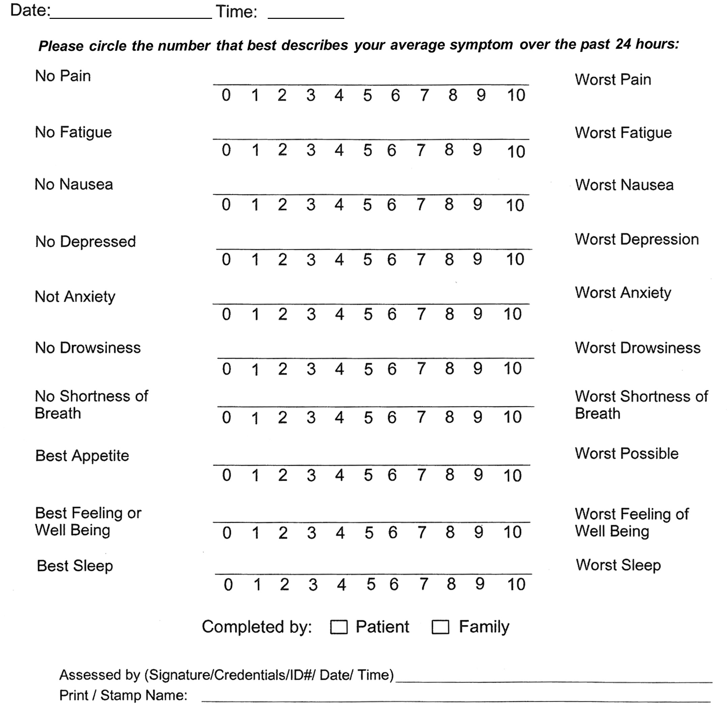
Figure from Hui and Bruera, retrieved from https://doi.org/10.1016/j.jpainsymman.2016.10.370 on March 4, 2026. ²

Slide 8
ESAS for Our Patient
Figure created by author

Slide 9
Key Benefits to Using ESAS on Every Patient
Symptom identification
Symptom Prioritization
Trending the symptom
Research utility

Slide 10
ESAS Score Interpretation
ESAS =0=None, 1-3 mild, 4-6 moderate and 7-10 severe
Oldenmenger et al., JPSM 2013³
  Systematic review of cutoffs for ESAS NRS (18 studies)
  Moderate symptom intensity was ~4 and 5
  Severe symptom intensity was ~7 and 8
Another study found similar cutoffs with ESAS-r (Japanese version): moderate was 3-4 and severe was 5-7.⁴

Slide 11
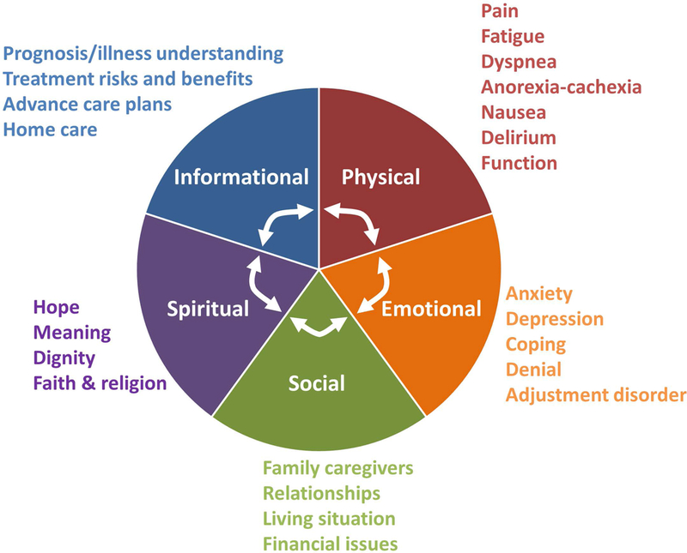
There are Multi-dimensional Needs for the Suffering Patient
Figure by Hui et al., retrieved from doi:10.3322/caac.21490 on March 4, 2026.⁵

Slide 12
Nausea

Slide 13
Nausea Pathophysiology
The “vomiting center” = medulla oblongata⁵
  Neurons are activated by neuronal impulses from
    The Chemoreceptor Trigger Zone (outside the blood brain barrier)
    The GI tract
    Higher cortical areas
    Vestibular apparatus
  Main neurotransmitters: serotonin (5HT3 R’), dopamine (D2 R’), and substance P (NK R’)
  Histamine and muscarinic receptors are involved in motion-related vomiting
Notes:
FACILITATOR:
CTZ is outside the blood brain barrier and is therefore accessible to emetogenic substances in the blood
The main neurotransmitters that transmit emetogenic impulses to the CTZ and the vomiting center include Serotonin, Dopamine, and Substance P
Serotonin acts on the 5HT3 receptors
Dopamine on the D2 Receptors
Substance P on the NK receptors
There are also histamine and muscarinic receptors involved in motion-related vomiting.

Slide 14
Common Causes of Nausea
Drugs ^{6,7}
  Opioids
  Chemotherapy
Increased intracranial pressure
Metabolic abnormalities
Bowel obstruction
  Malignant bowel obstruction
Peptic ulcer disease
Constipation
Radiation therapy
Autonomic dysfunction
Cancer
  Impaired GI motility
  Brain tumor
Notes:
FACILITATOR:
Nausea is chronic if it occurs for more than one week in the palliative care patient population
Nausea is very common at the end of life
Nausea appears to be more prevalent in younger patients, women, and patients with malignancy (gastric, breast or gynecologic)

Slide 15
Common Causes of Nausea | Treatment
Opioid –induced nausea and vomiting | Metoclopramide, Haloperidol, Prochlorperazine
Chemotherapy | 5HT₃ antagonists (such as ondansetron), Dexamethasone, & Aprepitant
Malignant bowel obstruction | Metoclopramide (if partial obstruction), Haloperidol & Dexamethasone Octreotide, Hyoscyamine, NGT, Venting G-tube
Impaired GI tract in advanced cancer | Metoclopramide
Radiation induced nausea and vomiting | 5HT₃ antagonists
Brain tumor | Dexamethasone
Motion-associated | Scopolamine, Diphenhydramine, and promethazine
Table adapted from Wood et al., retrieved from Supportive and Palliative Care Handbook.⁶

Slide 16
Evaluation of a Patient with Nausea
Symptom Assessment
Intensity - ESAS
Quantity of emesis – Large (gastric outflow obstruction); small (gastric stasis)
Bowel movement frequency
Review history
Site of malignancy
Medications, chemotherapy, XRT
Co-morbid conditions
Examine Patient
Onset, duration, frequency, aggravating, alleviating factors
Hydration status
Abdominal exam, CNS involvement, autonomic failure
Diagnostics
Laboratory values – electrolytes, calcium, liver, renal function
Abdominal X-ray
Figure created by author
As adapted from Dr. Tschanz Nausea Board review lecture⁷

Slide 17
Treatment of Nausea^{7,8,9}
Dopamine antagonist
With prokinetic effects
Without prokinetic effects
Haloperidol
5HT3 antagonist
Ondansetron, Granisetron, Dolasetron
H1 Receptor Blocker
Metoclopramide
Prochlorperazine
Chlorpromazine
Promethazine, Meclizine, Diphenhydramine
Other useful Agents
Olanzapine
Dexamethasone
NK Receptor Blockers
Figure created by author
Figure created by author
Notes:
FACILITATOR:
In summary: once you determine the intensity, frequency, and temporal factors affecting nausea→ you can then look at further patient history, tumor type, previous treatments and whether chemo/ radiation therapy RT are involved→ then examine hydration status and whether there are diagnostic evaluations (like metabolic abnormalities, calcium issues, liver or renal issues, or even bowel obstruction)→ after all of this, you can then come up with a treatment plan.

Slide 18
Side Effects of Anti-emetics^{7,8,9}
Dopamine Antagonist
Haldol
Sedation, QT prolongation, Neuroleptic malignant syndrome, movement disorder
5HT3 Antagonist
Odansetron, Granisetron, dolasetron
Constipation*
H1 receptor blocker
Other Agents
Olanzapine
Less EPS effects
Somnolence, weight gain, hyperglycemia, elevated lipids
Improved & insomnia
Metoclopramide
Diarrhea, movement disorder, drowsiness
Prolongation QT
Headache – most common
NK receptor blockers
Dexamethasone
Promethazine
Anticholinergic side effects
Cognitive impairment
Dopamine Antagonist
Prochlorperazine
Lethargy, movement disorder
inducers of CYP3A
Fatigue constipation, headache, hiccups
Insomnia, dyspepsia, hyperglycemia, hiccups
Figure created by author
Figure created by author
Notes:
FACILITATOR:
Olanzapine has greater affinity to 5HT2 receptors compared to D2 receptors therefore less extrapyramidal symptoms

Slide 19
Side Effects of Anti-emetics^{7,8,9,10}
 | D-2 | Ach | H-1 | Alpha-1-Adr | 5-HT3
Narrow Spectrum Haloperidol
 | +++
Broader Spectrum Prochlorperazine Promethazine Chlorpromazine
 | +++ | + | +
 | + | +++ | +++
 | +++ | +++ | +++ | +
Broadest Spectrum Olanzapine
 | ++ | ++ | ++ | + | +++
Figure created by author
As adapted from ***

Slide 20
Case 1
In our patient we started:
  Bowel regimen
  Zofran prn, #1 choice
  Zyprexa 2.5mg po q6h prn, #2 choice
  Compazine prn, #3 choice

Slide 21
Constipation

Slide 22
Evaluation of Constipation¹⁰
Rome III Criteria – standardized functional constipation research
Patient must have at least two or more of the following more than 25% of the time
  Straining
  Lumpy/hard stools
  Sensation of incomplete evacuation
  Sensation of anorectal obstruction/blockage
  Manual maneuvers to facilitate defecation
  Fewer than three defecations per week

Slide 23
Etiology of Constipation¹⁰
Opioids or drugs
Autonomic dysfunction
Dehydration
Immobility
Electrolyte abnormalities
Bowel obstruction
Endocrine abnormalities

Slide 24
Drugs Known to Cause Constipation¹⁰
Opioids
Verapamil
Ondansetron
Iron
Calcium
Anticholinergics
TCA
Scopolamine
Promethazine
Notes:
FACILITATOR:
High yield for the HPM boards!

Slide 25
Treatment for Constipation¹⁰
Senna
Directly irritates the colonic wall to induce fluid secretion. Decreases absorption in the proximal colon and decreases luminal transit time
Onset of action: 6-10 hours
Bisacodyl
Stimulates parasympathetic system – increases colonic motility and decreases absorption
Lactulose/Polyethylene Glycol
Onset of action: 8-48 hours
Magnesium citrate/Magnesium hydroxide
Retains water in the bowel lumen, increased intraluminal pressure and softens stool. Increases CCK release
Onset of action: 6-10 hours
Hyperosmotic agent – retains water in colon and increases colonic peristalsis.
"Musher"
"Pusher"
Onset of action 0.5-6hours
Figure created by author
Notes:
FACILITATOR:
Drugs that work on the colon: Senna. Bisacodyl, and Lactulose
Drugs that work on the small intestine and the colon: Mag citrate and Mag hydroxide

Slide 26
Treatment for Constipation
There is no added benefit for combining docusate with senna¹¹
Systematic review by Rao and Brenner¹²
  Senna (stimulant laxative) has good evidence as a first-line agent for chronic constipation
  Docusate (stool softener) has shown to be no more effective than placebo in preventing or treating constipation
Notes:
Randomized controlled trial By Tarumi et al. in 2013 published in Journal of Pain and Symptom management which demonstrates no added benefit from combining docusate with senna.11
In hospice patients, docusate plus sennosides showed no significant differences compared to placebo plus sennosides in stool frequency, volume, consistency, or patient-reported difficulty with evacuation.

Slide 27
Opioid-Induced Bowel Dysfunction
Mu-opioid antagonist
Peripherally Active (PAMORA)
Methylnaltrexone
Naloxegal
Naldemedine
Alvimopan
Centrally active
Naltrexone
Figure created by author
Notes:
FACILITATOR
Naltrexone:
Low therapeutic index
Reverses GI symptoms and analgesia together
Methylnaltrexone
It does not cross the blood brain barrier and has limited effect on analgesia
Administration is SQ or Oral
Side effects – GI perforation. Abdominal pain, and diarrhea.
Naloxegal and Naldemedine are approved for noncancer pain
Alvimopan has shown to improve constipation and decrease pain scores but is not approved specifically for opioid induced bowel dysfunction.
It has shown to increase risk of MI

Slide 28
Case 1
For Constipation we started
  Miralax 17g po daily
  Senna 2 tabs po twice daily
Provided instructions to titrate the Polyethylene glycol 17g po to twice daily as needed and the Senna from one tab to four tabs twice daily
Goal is to ensure she is having a soft, nonpainful, normal bowel movements daily or every other day

Slide 29
Dyspnea

Slide 30
Dyspnea
Breathlessness, air hunger
“A subjective experience of breathing discomfort that consists of qualitatively distinct sensations that vary in intensity”¹³

Slide 31
Evaluation of Dyspnea
• Onset: How long have you been having these symptoms? Getting worse?¹⁴
• Precipitants: What makes it worse?
• Quality: How it is affecting your daily life?
• How far can you walk before feeling shortness of breath?
• What things are you not able to do now because of shortness of breath?
• Rest: Do you have shortness of breath at rest?
• Episodes: Do you have shortness of breath episodes?
- If so, how frequent?
- How long do they last?
- What are the triggers?
• Treatment: What have you tried so far?

Slide 32
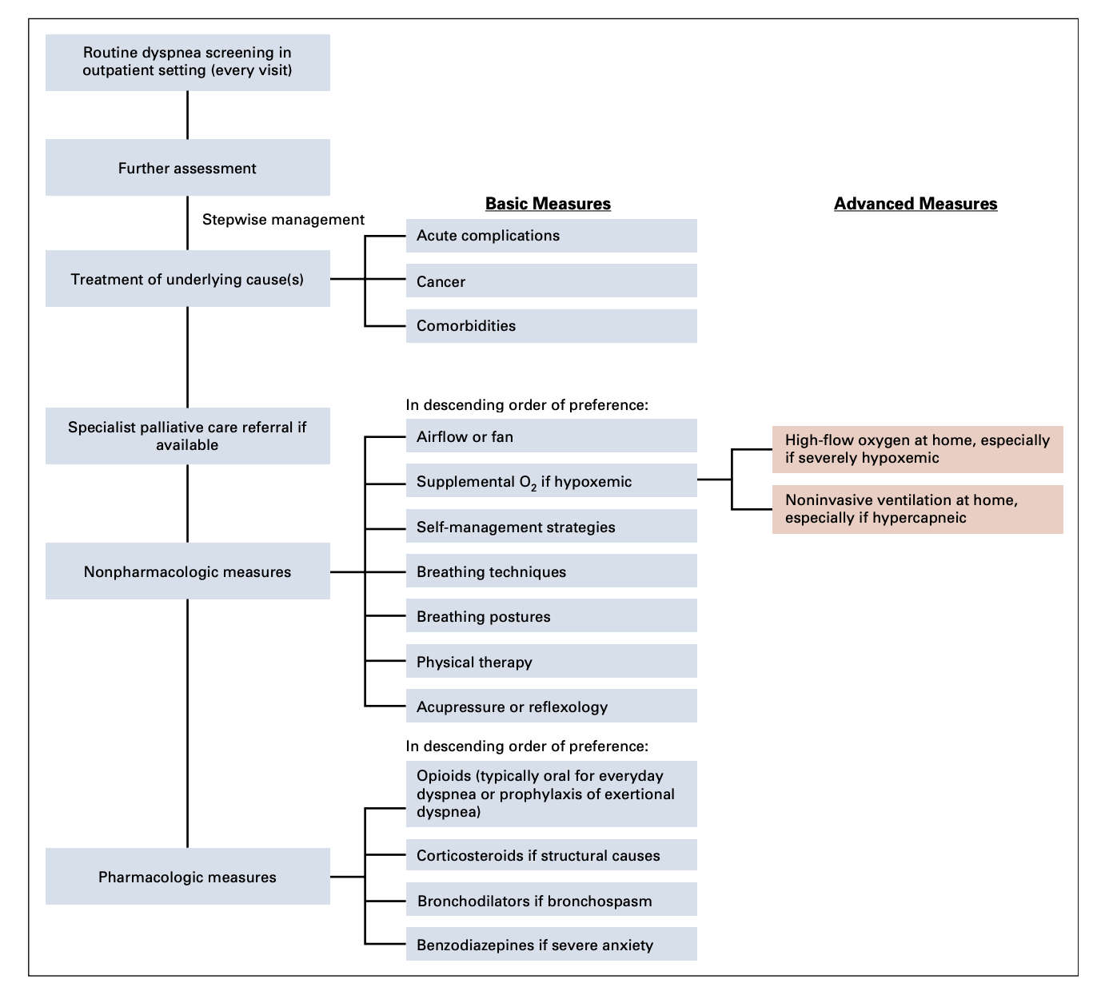
Evaluation and Management of Dyspnea
Figure from from Hui et al., retrieved from: doi:10.1200/JCO.20.03465 on March 8, 2026.¹⁵
Notes:
FACILITATOR:
This image is from the 2021 Management of Dyspnea in Cancer Patients ASCO guidelines
Outpatient management of chronic dyspnea. In the ambulatory setting, patients may present with chronic dyspnea that may limit their daily
activities.
Recommend a stepwise approach to include treatment of reversible causes, nonpharmacologic measures, and pharmacologic measures.
Nonpharmacologic measures listed here have been studied and proven beneficial.
Opioids – could consider Regularly scheduled opioids for everyday dyspnea and prophylactic opioids may be considered
before exertion.
For high flow nasal canula oxygen or non-invasive ventilation support recommendations are to consider a time limited trial—usually up to one hour.
Noninvasive ventilation is most beneficial if severely hypercapnic
High flow nasal cannula oxygen is most beneficial if severely hypoxemic

Slide 33
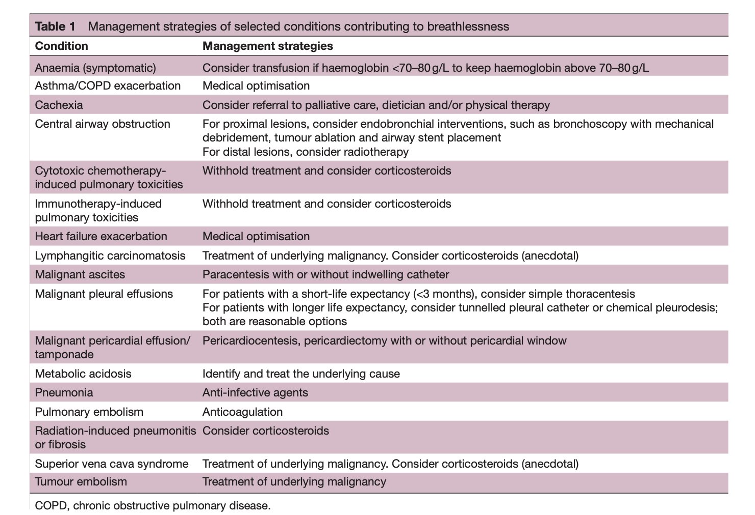
Management of Dyspnea in Cancer
Table from Hui et al., retrieved from doi:10.1136/esmoopen-2020-001038 on March 8, 2026.¹⁶
Notes:
FACILITATOR:
High yield for the boards!

Slide 34
Oxygen Supplementation
Presence of dyspnea or respiratory distress? | Oxygen saturation | Oxygen Indicated | Other Interventions
Present | < 90% | Yes, start low | Yes, treat underlying cause of hypoxemia
Present | >/=90% | No; airflow alone can be beneficial | Yes, treat underlying cause of dyspnea
Absent | <90% | Yes, for oxygenation, unless last days of life | Yes, treat underlying cause of hypoxemia
Absent | >/= 90% | No, consider withdrawal if in use | No
Table adapted from Hui et al., retrieved from: doi:10.1200/JCO.20.03465 on March 8, 2026.¹⁵

Slide 35
Pharmacologic Intervention for Dyspnea¹⁵
Opioids
Steroids
Bronchodilators
Benzodiazepines
As adapted from Hui et al. Journal of Clinical Oncology, 2021¹⁵
Notes:
FACILITATOR:
Opioids:
Offer when nonpharmacological interventions are insufficient
For chronic dyspnea, can schedule morphine 10-30mg/daily
For acute dyspnea related to certain activity, consider taking 5-10 mg of morphine prior to the activity
Consider different formulations of opioids: Immediate release vs extended-release formulations
Opioid naïve vs opioid tolerant?
Steroids:
Consider when airway obstruction or inflammation are a cause of the dyspnea
Benzodiazepines:
Consider when dyspnea is related to anxiety
Bronchodilators:
Consider when bronchospasm or obstruction is an issue

Slide 36
Cough

Slide 37
Physiology of Cough¹⁷
Cough receptors at airway bifurcations in larynx and distal esophagus link to the vagus and superior laryngeal nerves to the cough center and cerebral cortex
coordination of muscles
Cough Response
Figure created by author

Slide 38
Causes of Cough in the Cancer Patient
Pleural disease-effusion, tumor | Micro-embolism
Lung parenchyma infiltration | Transesophageal fistula
Radiation or chemotherapy | Vocal chord paralysis
COPD, chronic bronchitis | Congestive heart failure
Pericardial effusion | Post-infectious cough
Upper airway cough syndrome due to variety of rhinosinus conditions | Eosinophilic bronchitis
Gastroesophageal reflux disease | Angiotensin-converting enzyme inhibitor
Asthma
Lymphangitis carcinomatosis
Chest Infection
Etiology of Cough
Table adapted from Molassiotis et al., retrieved from: doi:10.1016/j.chest.2016.12.028 on March 8, 2026¹⁸
Notes:
Acute < 3 weeks
Chronic > 8 weeks

Slide 39
Treatment
Nonpharmacological
Pharmacological
Centrally acting
Benzonatate
Peripherally acting
Gabapentinoid
Opioids
Amitriptyline
Baclofen
Nebulized lidocaine
Breathing exercises
Avoid triggers
Hydration
Improve oral/vocal hygiene
Endobronchial Brachytherapy
Treatment of Cough
Figure adapted from Molassiotis et al., retrieved from: doi:10.1016/j.chest.2016.12.028 on March 8, 2026¹⁸

Slide 40
Anorexia & Cachexia

Slide 41
Anorexia and Cachexia
Definitions: Anorexia vs Cachexia¹⁹
Clinical significance:
  Decreased survival
  Increased complications of surgery, radiotherapy, and chemotherapy
  Weakness, anorexia, chronic nausea
  Psychological distress in patient and family
Notes:
FACILITATOR:
Anorexia: the loss of appetite for food¹⁹
Cachexia is weakness and wasting of the body from severe chronic illness, loss of skeletal muscle mass and/or fat mass
Cachexia is specifically >5% weight loss over 6 months (in absence of starvation or BMI <20) and weight loss >2%; or appendicular skeletal muscle index consistent with sarcopenia and weight loss >2%

Slide 42



Contributors to Decreased Oral Intake in the Last Days of Life
Primary Anorexia
Inflammatory response, neurohormonal changes, lack of appetite
Refractory Cachexia
Inflammatory response, hypermetabolism, catabolic state with muscle loss
Nutritional Impact Symptoms
Direct effect on PO
Dysphagia, early satiety, xerostomia, taste disturbance, nausea/vomiting, mucositis, constipation, bowel obstruction, dental issue
Indirect effect on PO
Delerium, drowsiness, dyspnea, pain, fatigue/weakness, depression
Decreased PO
Decreased QOL, function. Increase in body image changes and distress
Process map as adapted from Bruera, retrieved from doi:10.1136/bmj.315.7117.1219 on March 10, 2026.¹⁹
Primary Anorexia
Nutritional Impact Symptoms
Refractory Cachexia
Inflammatory response, neurohormonal changes, lack of appetite
Inflammatory response, hypermetabolism, catabolic state with muscle loss
Direct effect on PO
Indirect effect on PO
Dysphagia, early satiety, xerostomia, taste disturbance, nausea/vomiting, mucositis, constipation, bowel obstruction, dental issue
Delerium, drowsiness, dyspnea, pain, fatigue/weakness, depression
Decreased PO
Decreased QOL, function. Increase in body image changes and distress

Slide 43
Management of Cancer Cachexia: ASCO Guideline
Nutritional Recommendations²⁰
  High calorie, nutrient dense food, high protein
  Liberalize diet restrictions
  Encourage small frequent meals
  Consultation with a dietician: assessment, establish goals, safe feeding advice, and advice against fad diets
Outside of clinical trials, no recommendations for enteral or parenteral nutrition²¹

Slide 44
ASCO 2023 Cancer Cachexia guideline update ²²
Recommendation 2.1:
  For advanced cancer, may offer low dose olanzapine once daily to improve weight gain and appetite
Recommendation 2.2:
  For patients who cannot tolerate low-dose olanzapine, may offer a short-term trial of a progesterone analog or a corticosteroid to those experiencing loss of weight and/ or appetite
Per Sandhya et al., those on olanzapine reported improved QOL, nutritional status, and lesser chemotoxicity. Side effects of olanzapine were minimal. ²³

Slide 45
Adjustment Disorder & Depression
Notes:
Alternative first slide option

Slide 46


Normal Adjustment Process to a Life-threatening Illness²⁴
Sadness
Anxiety
Fatalism
Grief
Death Anxiety
Fear of Recurrence
Figure created by author
Notes:
FACILITATOR
Normal adjustment process includes: sadness, anxiety, fatalism and grief to name a few.
However, when these sentiments become pervasive and interfere with function, the risk of depression is high.

Slide 47
Depression
Feeling outcast and alone, feeling of permanence, regret, rumination on irredeemable mistakes, extreme self-loathing, constant, hopeless, enjoys few activities, suicidal thoughts/behavior
Sadness
Still able to feel connected to others, feeling like some day this will end, able to enjoy, sense of self worth is maintained, comes in waves, looks forward to things, will to live
Figure adapted from table in Rayner et al., Eur J Cancer 2011²⁶
Notes:
30 Rayner, L., Price, A., Hotopf, M., & Higginson, I. J. (2011). The development of evidence-based European guidelines on the management of depression in palliative cancer care. European journal of cancer (Oxford, England : 1990), 47(5), 702–712. https://doi.org/10.1016/j.ejca.2010.11.027

Slide 48
Adjustment Disorder
DSM-V
Development of emotional or behavioral symptoms in response to a stressor within 3 months of onset of stressor²⁵
ICD-11
Preoccupation with²⁶
Failure to adapt to stressor
Notes:
FACILITATOR:
Significant behavioral and emotional changes that are out of proportion to the severity or intensity of the stressor and causes significant impairment in functioning.
The symptoms often resolve within a six-month period or once the stressor is removed (not typically apply in the palliative care setting).
It is useful to think of adjustment disorder as symptoms of situational anxiety - these symptoms can include insomnia, worry, irritability, mood swings, tearfulness, poor concentration, transient spells of hopelessness or demoralization.
No real ideal questionnaire to date for diagnosing adjustment disorders in cancer patients.
The Hospital Anxiety and Depression Scale (HADS) is a brief self-reported instrument that can be used – Combined score of 10-11 suggests adjustment disorder vrs score of 19-20 suggests major depression.

Slide 49
Depression
DSM-V
At least two weeks²⁵
At least one core
Loss in interest/pleasure
And at least four of the other symptoms
Depressed mood or
*Note: depression is often under-diagnosed and undertreated in palliative care.
Steifal et al, Support Cancer Care, 2001²⁷ is cited multiple times and supports this

Slide 50
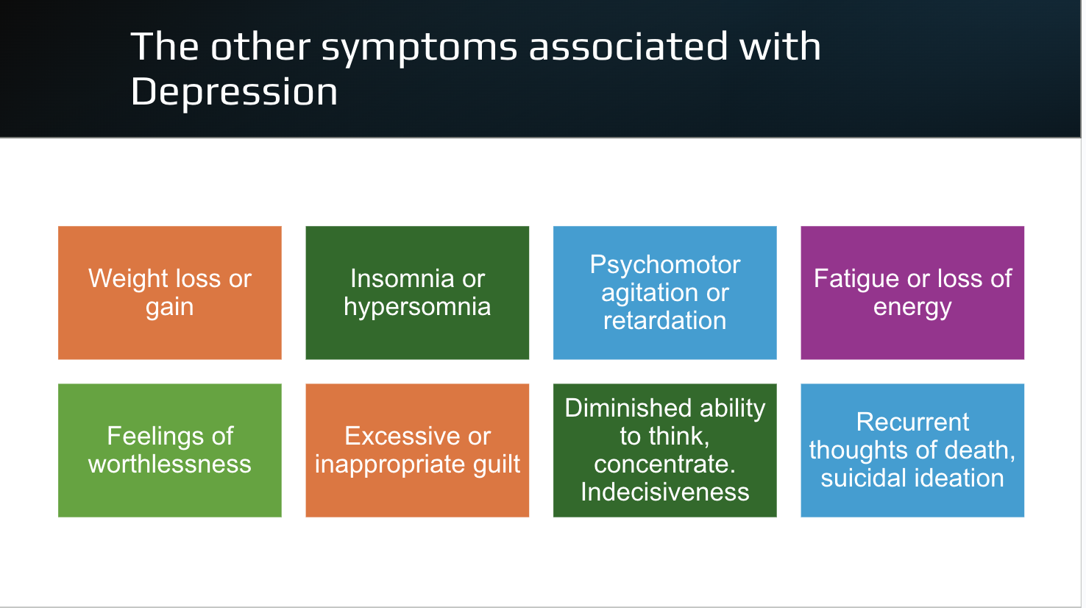
^{28, 29}
Figure by author
Notes:
Each of these symptoms must meet the severity index – most of the day or nearly every day.
Weight loss or gain is defined as more than 5% of body weight in a month
The predicament: almost all our patients undergoing cancer treatment will experience some or all these symptoms.
So, what is depression vs what is the cancer/cancer treatment?

Slide 51
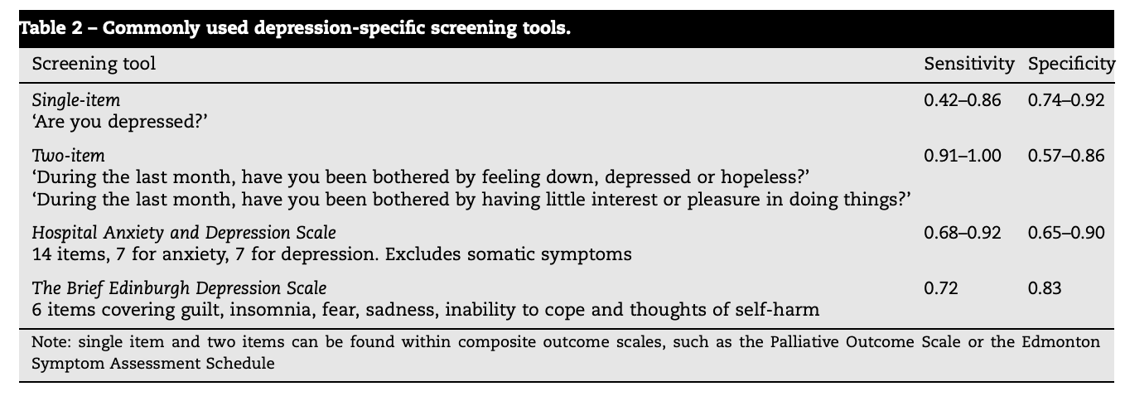
30
Table by Rayner et al., retrieved from doi:10.1016/j.ejca.2010.11.027 on March 11, 2026.³⁰
*Clinical pearl: A good rule of thumb is to repeat these screening tools in a depressed patient monthly to track progress if possible. Often will ask PHQ9 at every visit while titrating medications for mood.
Notes:
FACILITATOR
This table is from: Rayner L, Price A, Hotopf M, et al. The development of evidence-based European guidelines on the management of depression in palliative cancer care. Eur J Cancer. 2011;47(5):702-712. doi:10.1016/j.ejca.2010.11.027.³⁰
The 2-item screening approach has been endorsed by the US Preventative Health Task Force for use in primary care settings.
Studies have concluded that the simple one question survey is good at excluding depression in nondepressed patient but is poor at confirming depression.
The two question is significantly more accurate than the single question.

Slide 52
Using the ESAS as a Screening Tool for Depression
Valentine et al. in (Psycho-Oncology, 2022)³¹
  A retrospective chart review on 1221 cancer patients in the psychiatric oncology center between 2014-2017
  Found that when compared to the PHQ9 scale and ESAS, cut off greater than equal to 3 had a 0.84 sensitivity for depression with a relatively low number of false positives
  Further they found that ESAS-D of greater than equal to 4 provided an excellent sensitivity for severe depression with a relatively low number of false positives
  They proposed that an ESAS of greater than equal to 3 for depression should prompt a more in-depth secondary assessment and or direct referral to psychiatry teams
Note: They use the word depression and not sadness as part of the ESAS survey

Slide 53
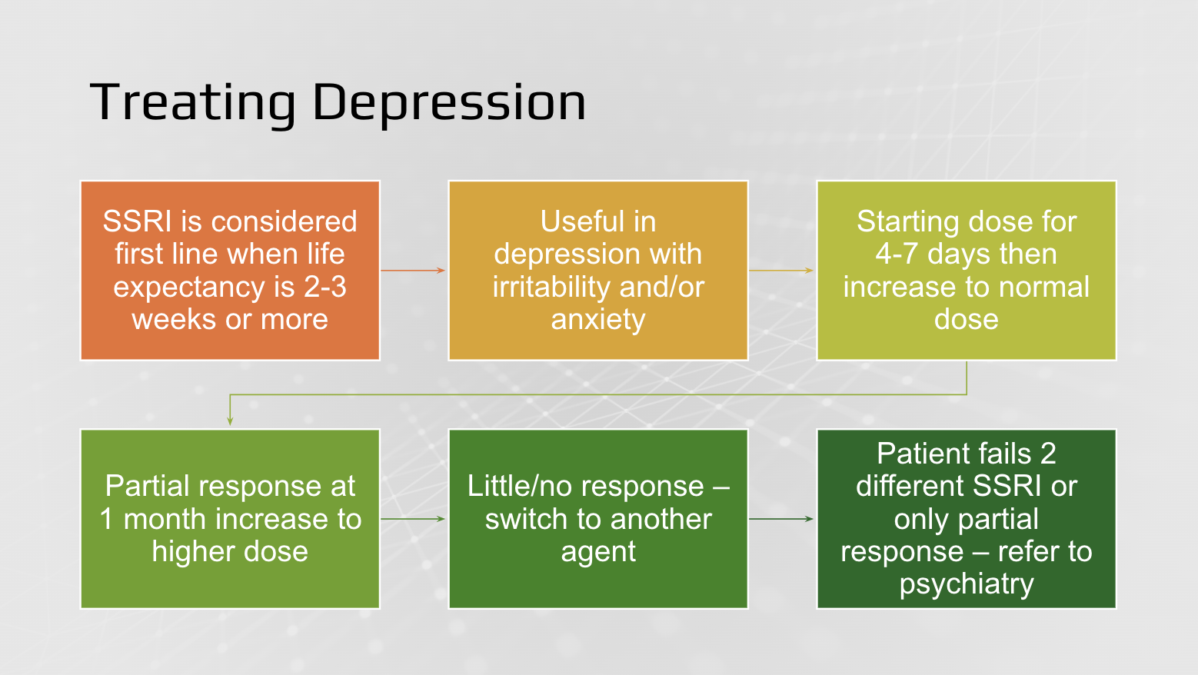
32
Figure by author
Notes:
FACILITATOR
For “real deal” major depression in a setting where end-of-life is not an immediate concern, the patient and clinician are committing themselves to at least 4-6 months on medication, and ideally that much time doing well, before stopping. Often patients tend to pull off the drug too soon.
Sertraline, citalopram, escitalopram – are weak inhibitors of the cyp450 and thus fewer interactions with oncological drugs
High yield slide!

Slide 54
Remember the ESAS in Our Patient!
Figure by author

Slide 55
Case 1
Started our patient on olanzapine 2.5mg po nightly → ESAS improved!
  Olanzapine (mean 8.7mg daily) is more helpful for refractory generalized anxiety disorder than placebo when added to GAD therapy if refractory to fluoxetine³³
  Olanzapine has been shown to improve sleep efficiency and quality when combined with an SSRI in depressed patients—even with starting as little as 2.5mg³⁴
  Olanzapine has also shown to improve weight gain and appetite (2.5-5mg qhs).

Slide 56
Insomnia
Notes:
Alternative first slide option

Slide 57
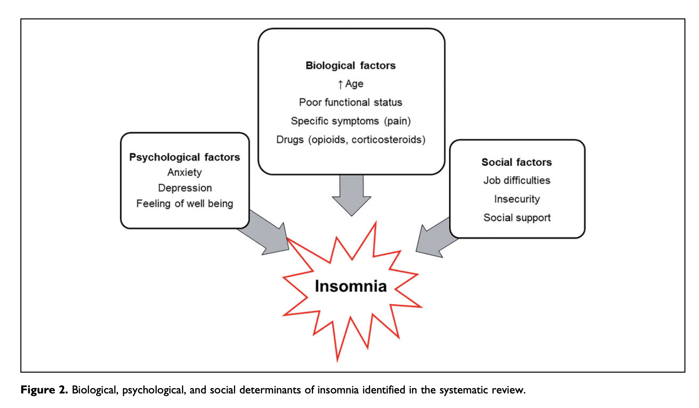
Insomnia
Prevalence of insomnia is high among palliative care patients ³⁵
Interventions for sleep among palliative care patients are very limited but can consider:
  melatonin, cannabinoids, benzodiazepines, antidepressants, antipsychotics
Affected by social factors, psychologic factors, biological factors
Figure from Nzwalo et al., retrieved from:doi:10.1177/1049909120907021. on march 11,2026.³⁵
Notes:
Literature review done by Nzwala et al, atleast one in 3 patients were affected with insomnia in most studies reviewed.
about the prevalence, predictors, and treatment options of insomnia in palliative care patients. Primary sources of investigation were identified and selected through Pubmed and Scopus databases. The research was complemented by reference search in identified articles and selected reviews. OpenGrey and Google Scholar were used for searching grey literature. Study quality analysis was based on the Newcastle-Ottawa Scale. Results: A total of 65 studies were included in the review. Most studies had acceptable /good quality. The prevalence of insomnia in the included studies ranged from 2.1% to 100%, with a median overall prevalence of 49.5%. Sociodemographic factors such as age; clinical characteristics such as functional status, disease stage, pain, and use of specific drugs, including opioids; psychological factors such as anxiety/depression; and spiritual factors such as feelings of well-being were identified as predictors. The treatment options identified were biological (pharmacological and nonpharmacological), psychological (visualization, relaxation), and spiritual (prayer). Conclusions: The systematic review showed that the prevalence of insomnia is high, with at least one in 3 patients affected in most studies. Insomnia’s risk factors and treatment in palliative care are both associated to physical, psychological, social, and spiritual factors, reflecting its true holistic nature.

Slide 58
Delirium
Notes:
Alternative first slide option

Slide 59
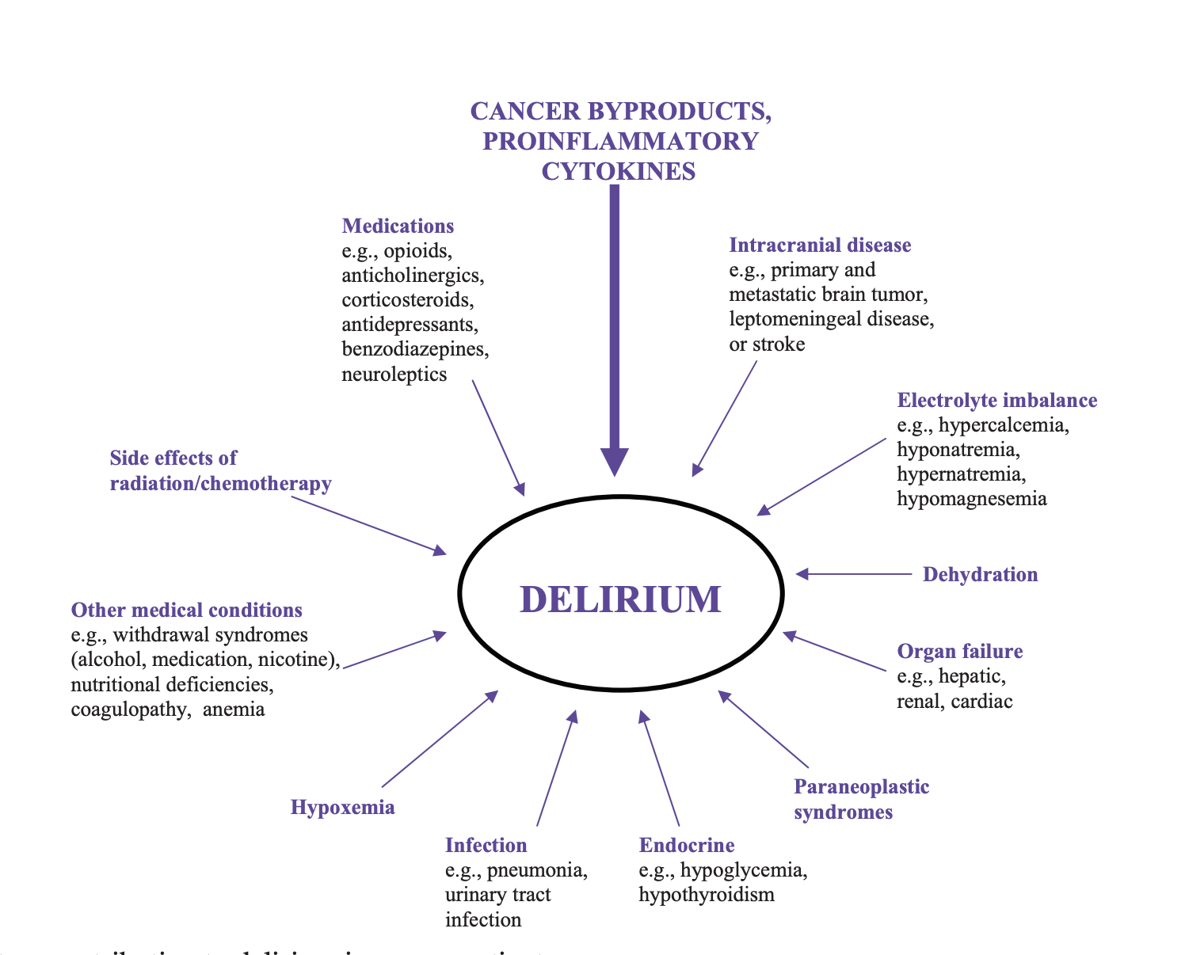
Figure from Bush and Bruera, retrieved from: doi:10.1634/theoncologist.2009-0122 on March 11,2026.³⁶

Slide 60
Delerium
A disturbance in attention (i.e. reduced ability to direct, focus, sustain, and shift attention) AND awareness (reduced orientation to the environment) (DSM-5).
“Global brain failure”
Retrospective study by De la Cruz et al in 2017, showed that delirium was diagnosed in ~one-third of patients referred to the palliative care inpatient consult service ³⁷
  ~61 % of these patients had been missed by the primary referring team!
Hypoactive delirium
  Often a missed diagnosis; can be misinterpreted as fatigue, depression, or dementia
Screening tools: MDS, CAM, DRS
Correct underlying metabolic disturbances
  E.g., hypercalcemia (Delgado-Guay et al., JPSM 2008)³⁸
Notes:
Delirium is a common neuropsychiatric condition in pa-
tients with advanced illness and is a significant cause of increased morbidity and mortality.
In this retrospective study done by Maxine De La Cruz et al in 2015, 771 consecutive palliative care inpatient consults from August 1, 2009 to January 31, 2010.
Delirium was diagnosed in about one third of patients referred to the palliative care inpatient consult service and about 61 % of these patients had been missed by the primary referring team.
Several authors have described that high expression of symptoms in patients with delirium can be misinterpreted by both
family and medical staff [10, 19] resulting in unnecesary medical interventions and delay in appropriate treatment.
Hypoactive delirium is most often missed because their psychomotor presentation is often misinterpreted as fatigue,
depression, and in older patients, part of the symptomatology of dementia
DELIRIUM IS ESSENTIALLY GLOBAL BRAIN FAILURE. IT IS THE WAY MOST OF US WILL DIE.

Slide 61
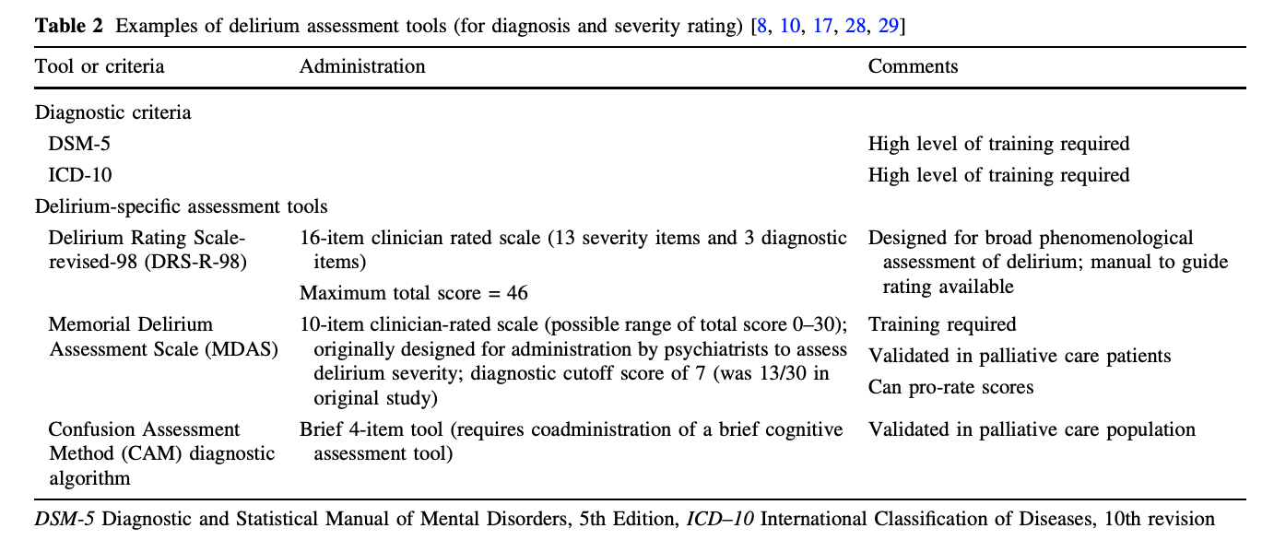
Diagnosing Delirium
Screening tools such as MDAS, CAM, DRS³⁹
Table from Bush et al., retrieved from: doi:10.1007/s40265-017-0804-3 on March 11,2026.³⁶
Notes:
Screening tools are high yield for boards!
Note: the CAM is based on the DSM-III-R criteria

Slide 62
Impacts of Delirium
Very distressing to caregivers
Associated with poor prognosis
Negative Impacts
  Symptom expression
  Communication
    e.g. Counseling
  Decision making

Slide 63
Non-Pharmacologic Treatment of Delirium³⁹
Optimize sleep-wake pattern
Patient orientation
Communication
Encourage mobility
Monitor hydration/nutrition
Monitor bowel/bladder function
Provide support and education
Notes:
Ref: Bush, S. H., Tierney, S., & Lawlor, P. G. (2017). Clinical Assessment and Management of Delirium in the Palliative Care Setting. Drugs (New York, N.Y.), 77(15), 1623–1643. https://doi.org/10.1007/s40265-017-0804-3

Slide 64
Pharmacologic Treatment of Delirium
Indication: hyperactive or mixed delirium⁴⁰
First line – Antipsychotic
Severe agitation – consider Benzodiazepine
Refractory Agitated Delirium – Palliative Sedation

Slide 65
Opioid-induced Neurotoxicity (OIN)

Slide 66
Opioid induced Neurotoxicity (OIN)³⁶
Severe sedation
Hallucinations- Do not forget Tactile hallucinations
Cognitive impairment /Delirium
Myoclonus
Seizures
Hyperalgesia
Allodynia
Figure from Bush and Bruera, retrieved from: doi:10.1634/theoncologist.2009-0122 on March 11,2026.³⁶
Notes:
FACILITATOR:
Clinical signs of OIN--> High yield for the boards!
Cognitive impairment
Perceptual disturbances, reduced levels of consciousness, confusion, disorientation, visual and tactile hallucinations, and delirium
Visual hallucinations occurring in almost half of hospice inpatients
Myoclonus: uncontrollable twitching and jerking of muscles or muscle groups (myoclonus; especially in the extremities); rarely progresses to seizure
Pain hyperexpression without evidence of a worsening pain due to a recognized cause
Generalized body pain of an unknown source with an increase in opioid dose or allodynia
Severe sedation
Allodynia: Painful response to a stimulus that is normally not painful (such as light touch)
HYPERALGESIA: Severe pain response to a stimulus that normally produces only mild pain response; pain to any kind of touch

Slide 67
Factors Predisposing to OIN
Opioid factors (high OME, long time treated on opioids, rapid escalation reduced nociceptive input)
Dehydration Renal failure
Infection
Borderline cognitive impairment/delirium
Using other psychoactive drugs (benzos, non-benzo hypnotics, TCAs)
Older
Prior OIN
Table adapted from Bush and Bruera, retrieved from: doi:10.1634/theoncologist.2009-0122 on March 11,2026.³⁶

Slide 68
Management of OIN
Initial opioid selection (i.e. avoid opioid with active metabolites in renal failure patients)
Hydration
Opioid rotation (equianalgesic dose of new opioid should be reduced by 30-50%
Opioid dose reduction
Discontinue other contributing drugs (i.e., hypnotics)
psychostimulants
Treat symptoms with neuroleptics (e.g., haloperidol)
Consider benzodiazepine for myoclonus(e.g., clonazepam)
Reassurance
Table adapted from Bush and Bruera, retrieved from: doi:10.1634/theoncologist.2009-0122 on March 11,2026.³⁶
*75-80% of drug-induced delirium resolve with rotation and discontinuation of other drugs

Slide 69
Fatigue
Notes:
FACILITATOR:
Fatigue is the physical, mental, psychological exhaustion resulting from exertion.
Patients may experience fatigue early in the disease or could be related to treatment.
Fatigue can impact other symptoms and other symptoms can impact fatigue

Slide 70
Causes of Cancer related Fatigue
Direct effects from cancer and/or treatments
Deconditioning
Nutritional imbalance/impairment
Medications: opioids, benzodiazepines, antihistamines, hypnotics
Psychiatric co-morbidities (e.g., depression, anxiety)
Hypoxemia, or severe anemia (e.g., Hb ≤7 g/dL)
Systemic infection and/or or significant organ dysfunction (e.g., heart, liver, kidney, lung)
Electrolyte abnormalities (e.g., ↓Na⁺, ↓K⁺, ↓Mg⁺⁺, ↑Ca⁺⁺)
Sleep disturbances such as insomnia or sleep apnea
Uncontrolled pain

Slide 71
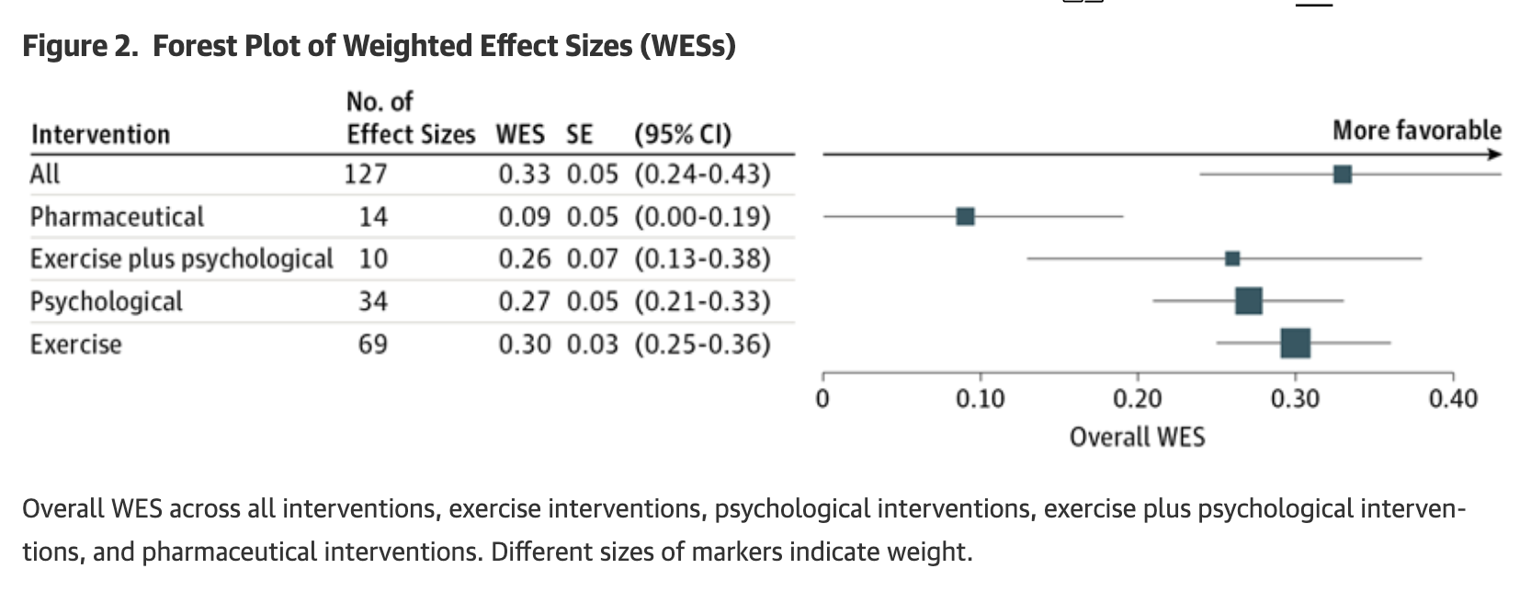
Exercise and psychological interventions and the combination of both decrease neoplasm fatigue significantly more than drug interventions (Mustian et al.) ⁴¹
Figure from Mustian et al., retrieved from: doi:10.1001/jamaoncol.2016.6914 on March 11, 2026⁴¹
Notes:
FACILITATOR:
Meta-analysis of 113 unique studies 11,525 unique participants
Reduction in neoplasm fatigue was not due to time, attention, or education and pharmaceutical interventions and do not improve cancer-related fatigue

Slide 72
Pharmacologic treatment of Cancer related Fatigue
Corticosteroids
Psychostimulants
  Methylphenidate

Slide 73
Hiccups

Slide 74
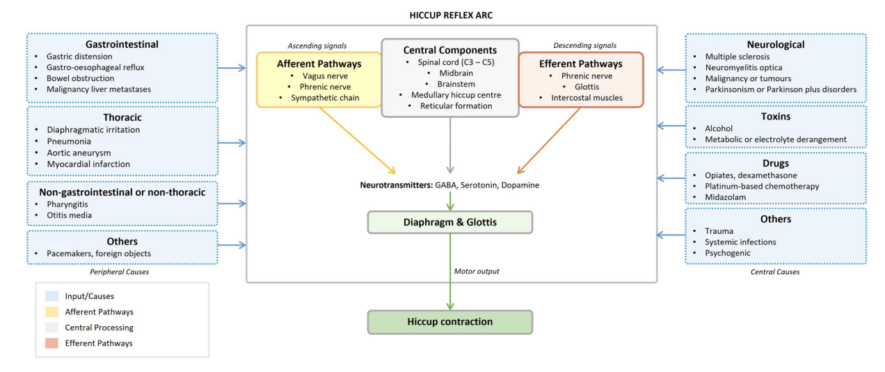
Figure from Das et al., retrieved from: doi:10.1016/j.jpainsymman.2025.11.010 on March 11, 2026⁴²

Slide 75
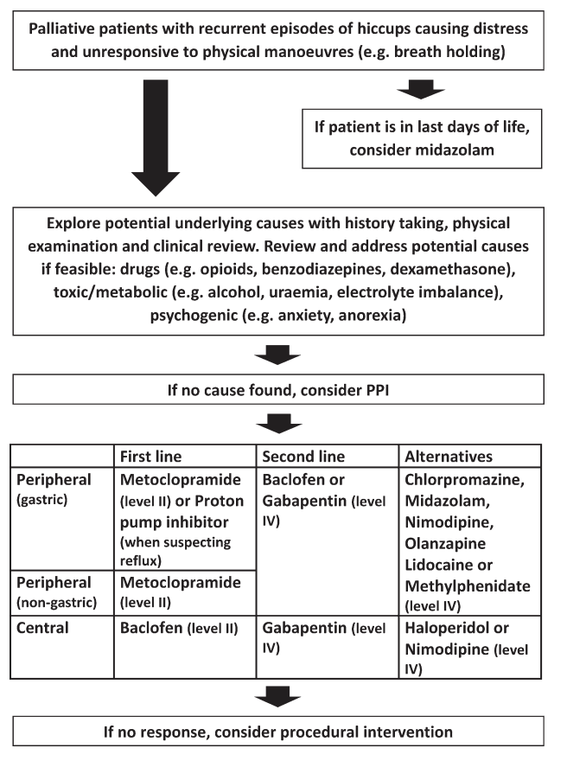
Treatment of Hiccups
Figure from Jeon et al., retrieved from: doi:10.1136/bmjspcare‑2016‑001264 on March 11, 2026⁴³

Slide 76
There are Multi-dimensional Needs for the Suffering Patient
Figure by Hui et al., retrieved from doi:10.3322/caac.21490 on March 4, 2026.⁵

Slide 77
Questions

Slide 78
References
Bruera E, Kuehn N, Miller MJ, Selmser P, Macmillan K. The Edmonton Symptom Assessment System (ESAS): a simple method for the assessment of palliative care patients. J Palliat Care. 1991;7(2):6-9.
Hui D, Bruera E. The Edmonton Symptom Assessment System 25 Years Later: Past, Present, and Future Developments. Journal of Pain and Symptom Management. 2017;53(3):630-643. doi:10.1016/j.jpainsymman.2016.10.370
Oldenmenger WH, Raaf PJ de, Klerk C de, Rijt CCD van der. Cut Points on 0–10 Numeric Rating Scales for Symptoms Included in the Edmonton Symptom Assessment Scale in Cancer Patients: A Systematic Review. Journal of Pain and Symptom Management. 2013;45(6):1083-1093. doi:10.1016/j.jpainsymman.2012.06.007
Yamaguchi T, Morita T, Nitto A, et al. Establishing Cutoff Points for Defining Symptom Severity Using the Edmonton Symptom Assessment System-Revised Japanese Version. Journal of Pain and Symptom Management. 2016;51(2):292-297. doi:10.1016/j.jpainsymman.2015.09.011
Hui D, Hannon BL, Zimmermann C, Bruera E. Improving patient and caregiver outcomes in oncology: Team-based, timely, and targeted palliative care. CA: A Cancer Journal for Clinicians. 2018;68(5):356-376. doi:10.3322/caac.21490
nauseous all of the time . . . nothing was working.” JAMA. 2007;298(10):1196-1207. doi:10Wood GJ, Shega JW, Lynch B, Von Roenn JH. Management of intractable nausea and vomiting in patients at the end of life: “I was feeling .1001/jama.298.10.1196
Madden K, Bruera E, Hui D, et al. The MD Anderson Supportive and Palliative Care Handbook: 2023. UT MD Anderson Cancer Center; 2023:42-50.
DailyMed - PROCHLORPERAZINE EDISYLATE injection. Accessed January 19, 2026. https://dailymed.nlm.nih.gov/dailymed/drugInfo.cfm?setid=b3c5c1b7-310a-4658-bd01-b88b7334b591
Choi J, Lee J, Kim K, Choi HK, Lee SA, Lee HJ. Effects of Ginger Intake on Chemotherapy-Induced Nausea and Vomiting: A Systematic Review of Randomized Clinical Trials. Nutrients. 2022;14(23):4982. doi:10.3390/nu14234982
Tchanz. Board Review Lecture on Nausea and constipation. Lecture presented at: MD Anderson; 2025; Houston, TX.

Slide 79
References
Tarumi Y, Wilson MP, Szafran O, Spooner GR. Randomized, Double-Blind, Placebo-Controlled Trial of Oral Docusate in the Management of Constipation in Hospice Patients. Journal of Pain and Symptom Management. 2013;45(1):2-13. doi:10.1016/j.jpainsymman.2012.02.008
Rao SSC, Brenner DM. Efficacy and Safety of Over-the-Counter Therapies for Chronic Constipation: An Updated Systematic Review. Official journal of the American College of Gastroenterology | ACG. 2021;116(6):1156. doi:10.14309/ajg.0000000000001222
Parshall MB, Schwartzstein RM, Adams L, et al. An Official American Thoracic Society Statement: Update on the Mechanisms, Assessment, and Management of Dyspnea. Am J Respir Crit Care Med. 2012;185(4):435-452. doi:10.1164/rccm.201111-2042ST
Hui D, Hannon BL, Zimmermann C, Bruera E. Improving patient and caregiver outcomes in oncology: Team-based, timely, and targeted palliative care. CA: A Cancer Journal for Clinicians. 2018;68(5):356-376. doi:10.3322/caac.21490
15. Hui D, Bohlke K, Bao T, et al. Management of dyspnea in advanced cancer: ASCO guideline. J Clin Oncol. 2021;39(12):1389-1411. doi:10.1200/JCO.20.03465.
Hui D, Maddocks M, Johnson MJ, et al. Management of breathlessness in patients with cancer: ESMO Clinical Practice Guidelines. ESMO Open. 2020;5(6):e001038. doi:10.1136/esmoopen-2020-001038
Chung KF, Pavord ID. Prevalence, pathogenesis, and causes of chronic cough. Lancet. 2008;371(9621):1364-1374. doi:10.1016/S0140-6736(08)60595-4
Molassiotis A, Smith JA, Clemens KE, Callister ME, Currow DC. Symptomatic treatment of cough among adult patients with lung cancer: CHEST guideline and expert panel report. Chest. 2017;151(4):861-874. doi:10.1016/j.chest.2016.12.028
Bruera E. ABC of palliative care: Anorexia, cachexia, and nutrition. BMJ. 1997;315(7117):1219-1222. doi:10.1136/bmj.315.7117.1219
Roeland EJ, Bohlke K, Baracos VE, et al. Management of cancer cachexia: ASCO guideline. J Clin Oncol. 2020;38(21):2438-2461. doi:10.1200/JCO.20.00611
Jozwiak R, Recka K. Fast Fact #386: the anorexia-cachexia syndrome: definitions, evaluation, and non-pharmacologic management. Palliative Care Network of Wisconsin. Published October 16, 2025. Accessed March 10, 2026. https://www.mypcnow.org/fast-fact/the-anorexia-cachexia-syndrome-definitions-evaluation-and-non-pharmacologic-management/

Slide 80
References
Schneider BJ, Naidoo J, Santomasso BD, et al. Management of immune-related adverse events in patients treated with immune checkpoint inhibitor therapy: ASCO guideline update. Journal of Clinical Oncology. 2021;39(36):4073-4126. doi:10.1200/JCO.21.01440.
Sandhya L, Sreenivasan ND, Goenka L, et al. Randomized double-blind placebo-controlled study of olanzapine for chemotherapy-related anorexia in patients with locally advanced or metastatic gastric, hepatopancreaticobiliary, and lung cancer. J Clin Oncol. 2023;41(14):2617-2627. doi:10.1200/JCO.22.01997
Wilson KG, Chochinov HM, de Faye BJ, Breitbart W. Diagnosis and management of depression in palliative care. In: Chochinov HM, Breitbart W, eds. Handbook of Psychiatry in Palliative Medicine. Oxford University Press; 2000:25-49.
American Psychiatric Association. Major depressive disorder. In: Diagnostic and Statistical Manual of Mental Disorders. 5th ed. American Psychiatric Association; 2013.
World Health Organization. Depressive episode. International Classification of Diseases 11th Revision (ICD-11). World Health Organization. Accessed March 10, 2026. https://icd.who.int/browse/2024-01/mms/en#/http://id.who.int/icd/entity/894521262
Stiefel F, Die Trill M, Berney A, Olarte JM, Razavi D. Depression in palliative care: a pragmatic report from the Expert Working Group of the European Association for Palliative Care. Support Care Cancer. 2001;9(7):477-488. doi:10.1007/s005200100263
Handbook of Psychiatry in Palliative Medicine. New York, NY: Oxford University Press; 2000.
Chochinov HM. Depression in cancer patients. Lancet Oncol. 2001;2(8):499-505. doi:10.1016/S1470-2045(01)00456-9.
Rayner L, Price A, Hotopf M, et al. The development of evidence-based European guidelines on the management of depression in palliative cancer care. Eur J Cancer. 2011;47(5):702-712. doi:10.1016/j.ejca.2010.11.027.
Valentine A, Brown J, Lacourt T, Chen M, De La Garza R II, Bruera E. Frequency of anxiety and depression and screening performance of the Edmonton Symptom Assessment Scale in a psycho-oncology clinic. Psychooncology. 2022;31(2):290-297. doi:10.1002/pon.5813.

Slide 81
References
Miovic M, Block S. Psychiatric disorders in advanced cancer. Cancer. 2007;110(8):1665-1676. doi:10.1002/cncr.22980.
33. Felton M, Weinberg R, Pruskowski J. Olanzapine for nausea, delirium, anxiety, insomnia and cachexia. Fast Fact #315. Palliative Care Network of Wisconsin. Accessed March 11, 2026. https://www.mypcnow.org/fast-fact/olanzapine-for-nausea-delirium-anxiety-insomnia-and-cachexia/
Lindberg N, Wirkkunen M, Tani P, et al. Effect of a single-dose of olanzapine on sleep in healthy females and males. Int Clin Psychopharmacol. 2002;17(4):177-184.
Nzwalo I, Aboim MA, Joaquim N, Marreiros A, Nzwalo H. Systematic review of the prevalence, predictors, and treatment of insomnia in palliative care. Am J Hosp Palliat Care. 2020;37(11):957-969. doi:10.1177/1049909120907021.
Bush SH, Bruera E. The assessment and management of delirium in cancer patients. Oncologist. 2009;14(10):1039-1049. doi:10.1634/theoncologist.2009-0122.
De La Cruz M, Hui D, Parsons HA, et al. Insomnia in patients with advanced cancer referred to a palliative care clinic. Am J Hosp Palliat Care. 2015;32(5):545-550. doi:10.1177/1049909114527450.
38. Delgado-Guay MO, Yennurajalingam S, Bruera E. Delirium with severe symptom expression related to hypercalcemia in a patient with advanced cancer: an interdisciplinary approach to treatment. J Pain Symptom Manage. 2008;36(4):442-449. doi:10.1016/j.jpainsymman.2007.11.004
Bush SH, Tierney S, Lawlor PG. Clinical assessment and management of delirium in the palliative care setting. Drugs (NY). 2017;77(15):1623-1643. doi:10.1007/s40265-017-0804-3.
Bramati P, Bruera E. Delirium in palliative care. Cancers (Basel). 2021;13(23):5893. doi:10.3390/cancers13235893.
41. Mustian KM, Alfano CM, Heckler C, et al. Comparison of pharmaceutical, psychological, and exercise treatments for cancer-related fatigue: a meta-analysis. JAMA Oncol. 2017;3(7):961-968. doi:10.1001/jamaoncol.2016.6914.
Das A, Halpin S, Kondasinghe JS. Pharmacotherapy for chronic & intractable hiccups in palliative care: a mixed methods systematic & umbrella review. J Pain Symptom Manage. 2025 Nov 20:S0885‑3924(25)00937‑6. doi:10.1016/j.jpainsymman.2025.11.010.
Jeon YS, Kearney AM, Baker PG. Management of hiccups in palliative care patients. BMJ Support Palliat Care. 2018;8(1):1‑6. doi:10.1136/bmjspcare‑2016‑001264.

Slide 82
Thank you

