Slide 1
Managing Opioid Use from Dependence through Disorder in Serious Illness Care
Tonya Hershman, PharmD
Ali John Zarrabi, MD FAAHPM
Victoria Sweetnam, MD
Katrina Nickels, MD
Notes:
Presenter: KN

Slide 2
Disclosures
Ali John Zarrabi MD
  Industry sponsored research (not relevant to this talk): Compass Pathways, Cybin, Reunion Neuroscience, Usona
Victoria Sweetnam MD, Tonya Hershman PharmD, and Katrina Nickels MD – none
Notes:
Presenter: KN

Slide 3
Learning Objectives
Review definitions and epidemiology of substance use from dependence through disorder
Utilize screening tools and deliberate risk mitigation strategies against development of OUD
Utilize a framework for clinical decisions about opioid and other controlled medication regimens and monitoring in patients at risk for or with SUDs
Evaluate urine toxicology monitoring
Integrate opioid rotation, opioid tapering, and medications for OUD treatment to improve quality of life of patients in palliative care
Notes:
Presenter: KN

Slide 4
Learning Objectives
Review definitions and epidemiology of substance use from dependence through disorder
Utilize screening tools and deliberate risk mitigation strategies against development of OUD
Utilize a framework for clinical decisions about opioid and other controlled medication regimens and monitoring in patients at risk for or with SUDs
Evaluate urine toxicology monitoring
Integrate medications, opioid rotation, and opioid tapering for SUD treatment to improve quality of life of patients in palliative care
Notes:
Presenter: KN

Slide 5
Important to Know Up Front
This is hard!
Treat pain while mitigating risk.
  Practice compassion, empathetic listening
  Focus on harm reduction vs abstinence
What does SUD mean in the context of palliative care? We don't know. But recognition that SUD can be either a chronic condition or a life-threatening serious illness is a place to start.
Notes:
Presenter: KN

Slide 6
Relevance of SUD in palliative care
Direct cause of death
The underlying chronic serious illness
Impact on care retention
Co-occurring mental health condition
Chronic medical condition
Notes:
Presenter: KN
FACILIATOR:
In looking up literature of "addiction as a terminal illness" or "addiction in palliative care," all I could find was that the majority of articles were about opioid pain management in patients with addiction, about caution, about compassion, and most of information is usually through narratives in case reports.
However, there is not much about how to contextualize substance use disorders, which are illnesses, in patients with serious illness.
This is very interesting, because we have not yet incorporated looking this contextualization into our train of thought that the same way we do other medical conditions that do not confound us.
For example, take the patient with a blood clot and also a history of bleeding ulcers – we can look at factors around those and can weigh risks and benefits of different approaches without much wringing of the hands-->This is my attempt to conceptualize SUD in the context of palliative care.

Slide 7
SUD as Terminal Diagnosis??
"An irreversible or incurable disease condition from which death is expected in the foreseeable future" ¹
Medicare coverage of hospice depends on a physician's certification that an individual's prognosis is a life expectancy of 6 months or less if the terminal illness runs its normal course²
  Recurrent infections
  Significant loss of muscle mass, not reversible
  Increase symptom burden
  Hypotension, edema, ascites, weakness, decreased mentation, progressive stage 3-4 pressure ulcers despite optimal care
  Decrease performance status due to illness, dependence for 2+ ADLs
  Decrease cognitive status due to illness, FAST 7a or greater
  Increase ED visits
  Co-morbidities
Notes:
Presenter: KN

Slide 8
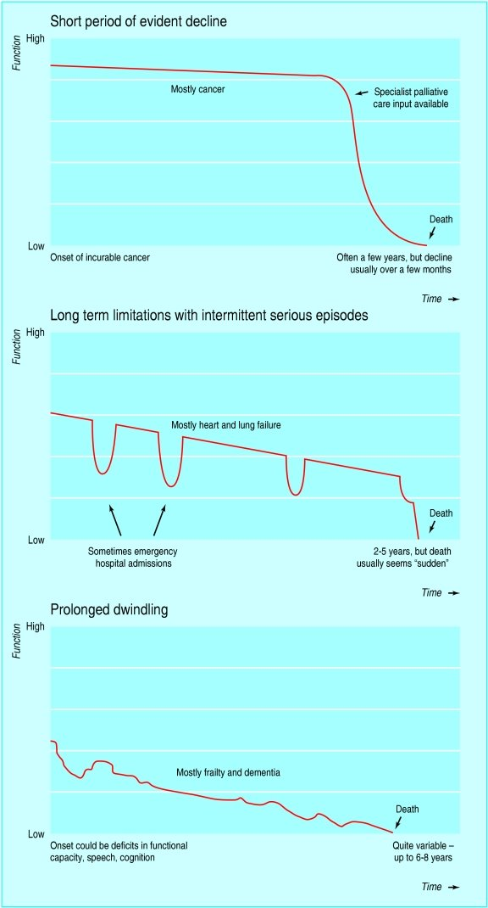
SUD as the underlying serious illness³
Blood-borne infections
  HIV
  Hep C
  IV use related infective endocarditis (IVU-IE)
  Skin & Soft Tissue Infections
Cirrhosis
End stage renal disease (ESRD, needs dialysis)
Cardiomyopathies
Dementia
Figure by Murray et al., retrieved from doi:10.1136/bmj.331.7529.152 on May 1,2026.⁴
Notes:
Presenter: KN
FACILIATOR:
In the following study: Sun J, Mehta SH, Astemborski J, et al., mortality among people who inject drugs: a prospective cohort followed over three decades in Baltimore, MD, USA. Addiction. 2022;117(3):646-655. doi:10.1111/add.15659
Baltimore 1988-2018 data from the AIDS Linked to the Intravenous Experience (ALIVE) - 5506 adult PWID
43.9% were deceased by 2018
24.4% drug-related deaths (overdose)
30.5% were HIV/ID deaths
33.3% chronic disease deaths

Slide 9
Epidemiology of SUD as co-occurring or other chronic condition⁵⁻⁷
Prevalence unknown but likely reflects general population
<5% of patients
Cancer survivors (cross -sectional study of ~6100 adult cancer survivors)
  Active SUD (past 12 months) --> 4%
    Higher prevalence in head and neck and gastric cancers (9%)
  Alcohol most common substance
    OUD <1% (1.4% in H&N)
Notes:
Presenter: KN

Slide 10
Why Is This Important?
Many of our patients with serious illness...
  Come to us on opioids (many times for many years)
  10%–26% of patients on chronic opioid therapy (COT) for chronic noncancer pain (CNCP) may develop OUD
  Have chronic pain requiring opioids
  Patient with serious illness and OUD still need their pain managed
    E.g., stage IV cancer patient with progressive disease and OUD
      Palliative care specialists are experts in cancer-related pain management
      Group Question: How would local pain management likely treat these patients?
Notes:
Presenter: KN

Slide 11
Why This Matters – OUD⁸⁻¹⁰
OUD may negatively affect relationships with clinical teams, adherence to chronic disease management
Managing OUD-related suffering aligns with the aims of palliative care
Notes:
Presenter: KN

Slide 12
Epidemiology of OUD and pain¹¹⁻¹⁶
Iatrogenic OUD from prescribed opioids is rare but significant
45% of patients with OUD report chronic pain
2/3 report pain not well managed through Opioid Treatment Programs (methadone clinic)
Reasons for prescription opioid misuse
Pain (70%)
“Feel good or get high” (9.1%)
“Relax or relieve tension” (7.5%)
Varies from <1 to 6%, NNH 16.7
Dose correlation exists
Chronic pain and OUD frequently coexist
Duration correlation is stronger than dose
Notes:
Presenter: KN
FACILITATOR:
Why is pain and addiction so important?
#1 – we are wary to cause harm. Long term opioids can cause harm, which led to the 2016 CDC Guidelines on Chronic Pain¹⁶
“At 35%, incident opioid use was not uncommon among individuals with new onset of a CNCP episode. But among the 35% who received opioids, only 5% proceeded to chronic use (1.7% of total CNCP patients), and only 3% of these (0.1% of total CNCP patients) proceed to chronic use of high daily doses. This is a steep selection process for patients achieving chronic high-dose therapy…. Evidence to date suggests that this is largely a self-selection process by the patients, where most patients started on opioid therapy choose not to continue on to chronic use.³⁶ An earlier study found that US veterans receiving high-dose opioid therapy were characterized by multiple pain problems and high levels of medical and psychiatric comorbidity.³⁷ We have shown in a separate sample that high daily dose and opioid misuse predict continued use of opioid therapy after 90 days of daily use.³⁸ Together, these past studies demonstrate that the patients selected for chronic high-dose opioid therapy have characteristics beyond the nature and intensity of their pain that may increase their risk of adverse outcomes.”
Which brings us to #2 – Comorbid OUD frequently coexists with chronic pain. In a study of patients on opioid agonist MOUD, including methadone, which is a potent full agonist opioid with a long half-life, half to the majority of patients report unmanaged chronic pain. Not surprisingly, pain is the #1 self-reported cause for misusing prescription opioids.
What does all of this mean??? There is a lot more going on with patients with pain with opioid use disorder and with patients who tend to experience a need for higher doses of prescription opioids, usually being patients with risk factors for developing opioids use disorder.
Therefore, you need to have expertise in the fundamentals of the pain diagnosis regarding opioid responsiveness. Nociplastic chronic pain syndromes, if they be primary chronic pain like fibromyalgia or chronic low back pain or secondary chronic pain like post-surgical pain or chronic pain after cancer treatment, are not indications for starting or adding opioids. Nociceptive and neuropathic pain can respond to opioid titrations or initiations. However, without this foundational understanding, you will be at a loss for a patient with complex severe pain and a substance use disorder. Pain diagnoses are not the focus of this lecture, but be sure you have expertise in pain before managing a person with both an opioid use disorder and pain

Slide 13
Barriers to care of patients with OUD and pain in palliative care¹⁷⁻²²
Low reported levels of knowledge and comfort caring for patients with OUD and cancer
Access to SUD continuing education, IDT members with SUD expertise, addiction specialists or programs
Stigma and misconceptions related to OUD diagnosis
Insufficient services available nationwide for patients with cancer+ OUD
Under-recognition of need to treat SUD in patients themselves
Notes:
Presenter: KN

Slide 14
BASICS - Definitions
Substance Use Disorder
Cluster of cognitive, behavioral, physiological symptoms indicating that the individual continues to use alcohol, nicotine, and/or other drugs despite significant related problems.
4 C's²³
  Craving – intense, overwhelming desire that is difficult to resist
  Compulsion – urge or need to take/use medication
  Control – loss of ability to control how much or how often substance used
  Consequences – negative outcomes and continued use despite harm
Notes:
Presenter: KN

Slide 15
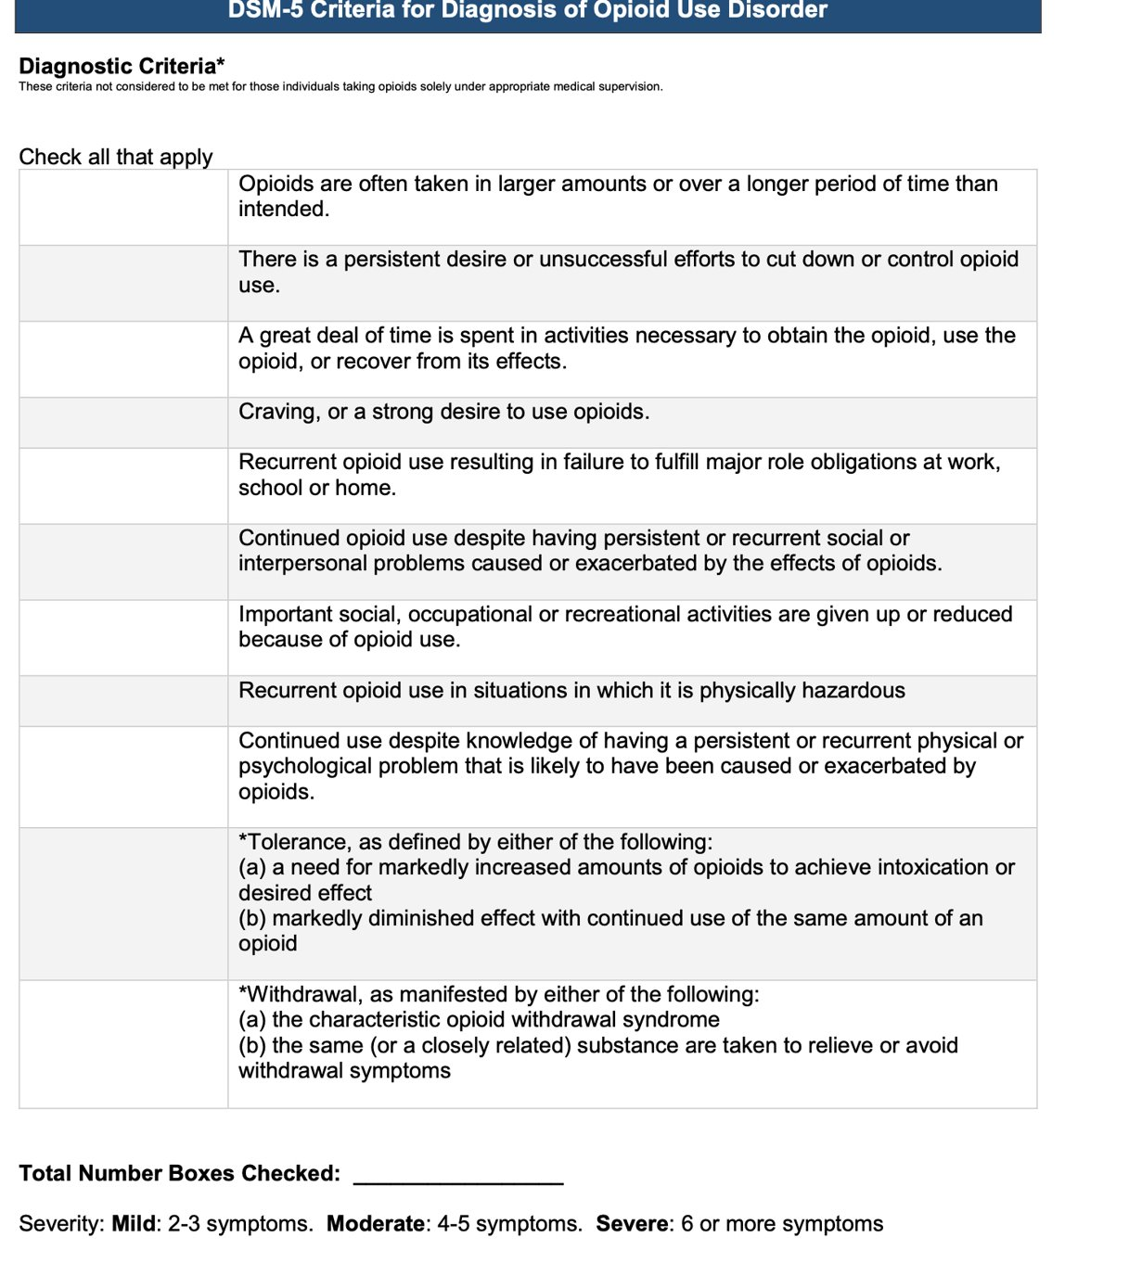
Definitions
DSM-V Criteria for Opioid Use Disorder²⁴
Figure from the American Psychological Association, retrieved from Diagnostic and Statistical Manual of Mental Disorders. 5th ed. 2013.²³
Notes:
Presenter: KN

Slide 16
"Is it pain or is it addiction?"
Or is it both?²⁵
Think about this when patient displays red flag/worrisome behaviors
Escalating opioid requirements/self-escalation could mean worsening pain AND progression of disease.
  In cancer, think about progression of disease FIRST and not opioid tolerance necessarily.
    When other sources eliminated, think about tolerance (Collin et al., 1993)--> need for imaging and looping in oncology.
  OUD is a behavioral syndrome
The DSM-5 criteria specifically note--> do NOT use the development of tolerance or physical dependence or high opioid dose as criteria for deciding if a patient has an OUD.
Notes:
Presenter: KN

Slide 17
"Is it pain or is it addiction?" Or is it both?²⁵
This is complicated
  Self-escalation could mean worsening, uncontrolled pain and not OUD
  Self-escalation represents risky behavior --> clinicians should intensify opioid safety discussions and monitoring
  Ongoing pattern of self-escalation should prompt suspicion of OUD, even if they also accept patient has poorly controlled pain
  OUD and pain commonly co-exist
Notes:
Presenter: KN

Slide 18
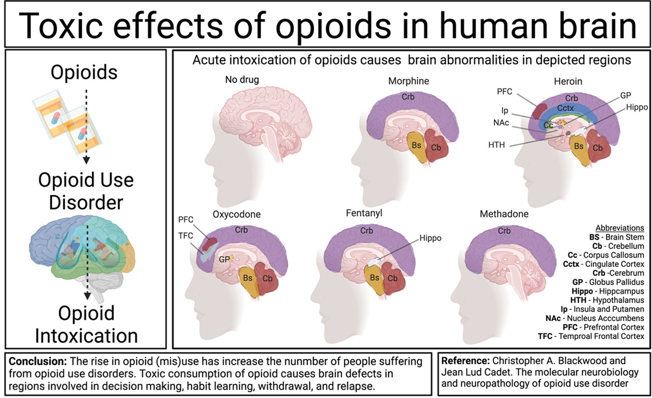
This is NOT patient's fault. This is what these medications do to the brain over time.
Figure by Blackwood et al., retrieved from doi:10.1016/j.crneur.2021.100023 on May 1,2026. ²⁶
Notes:
Presenter: KN
FACILITATOR:
Abbreviations:
Bs, Brain Stem; Cb, Cerebellum; Crb, Cerebrum; Cctx, Cingulate cortex; Cc, Corpus Callosum; GP, Globus Pallidus; Hippo, Hippocampus; HTH, Hypothalamus; Ip, Insula and putamen; NAc, Nucleus Accumbens; PFC, Prefrontal Cortex.
Oxycodone: Leukoencephalopathy, cerebellar and GP lesions. cerebellar edema, cerebellar hypoattenuation
This is a figure illustrating the long-term chronic effects of various opioid intoxication on the brain over time causing degeneration of these brain structures. You can see that partial agonist opioids like methadone affect the brain less than full agonist opioids.
I often find that explaining to patients that LTOT changes the brain and that this is not their fault. This is unfortunately a side effect. This is why we should try using all of the other tools in our tool belt to build a comprehensive and multi-modal pain management strategy. However, if we need to use opioids, that is ok. Sometimes we have to—especially in cancer-related pain that is very difficult to treat and very dynamic. I often find that setting expectations BEFORE initiating opioid therapy is important. Covering questions like:
How long do I anticipate a patient will need to be on opioids for?
Completing screening questions (ORT, CAGEAID) and being intentional about choosing a specific opioid (partial agonist opioid vs full agonist opioid initially)
Continually reassessing the need for opioid therapy is important to mitigate LTOT risks

Slide 19
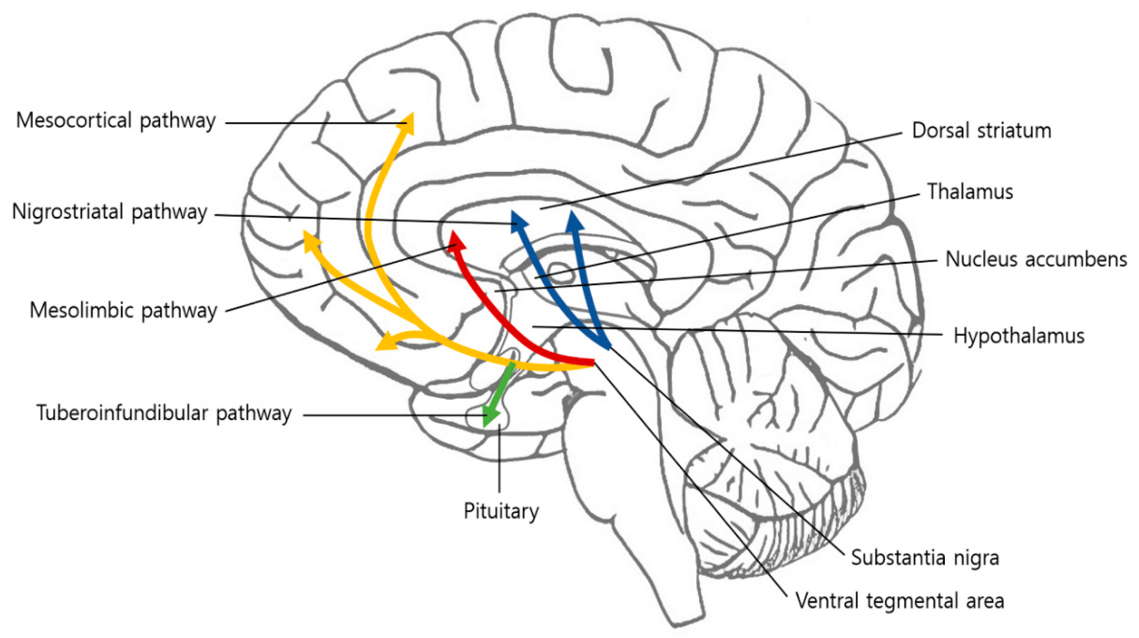
Chronic Pain & Opioid Effect on Neurocircuitry
Potential negative outcomes:²⁸
Prescription opioid dependence syndrome (Complex persistent opioid dependence)
Prescription opioid use disorder
Figure by Yang et al., retrieved from doi:10.3390/brainsci10100701 on May 2,2027 ²⁷
Notes:
Presenter: KN

Slide 20
Chronic opioid neurobiology
With repeated opioid administration, tolerance occurs -->analgesia, reward require higher doses to achieve similar effects (Williams et al., 2013).²⁹
Chronic use of opioids also leads to long-lasting alteration of other transmitter systems (e.g., dopamine [DA], glutamate, and GABA) --> altered synaptic plasticity.
Opioid activation of MORs reduces the release of GABA, an inhibitory neurotransmitter--> disinhibiting VTA DA neurons--> excitation and increased DA levels in the NAc --> acute rewarding effects of opioids (Johnson and North, 1992).30
Notes:
Presenter: KN

Slide 21
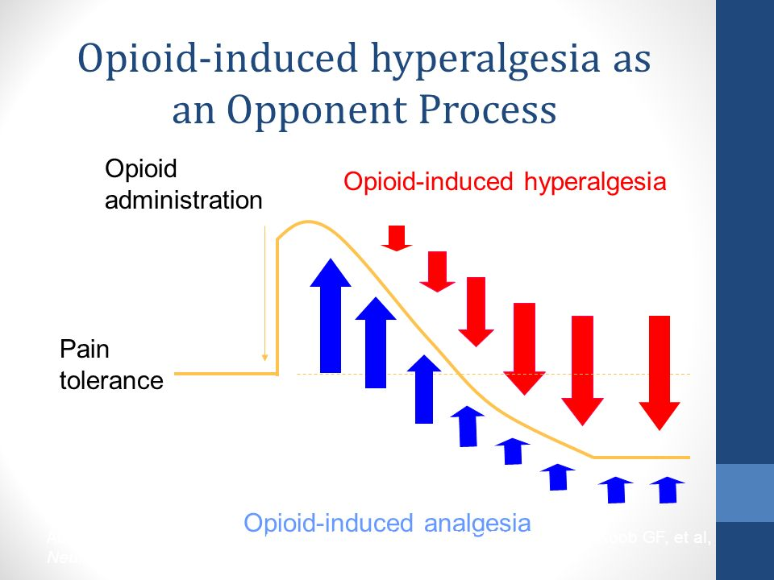
Cellular neuroadaptation
Adapted from Peggy Compton's lecture Neurobiology of Pain and Addiction: Implications for Patients with Chronic Pain and Addictive Disorders [educational material]. Lecture presented May 2, 2026. Retrieved on May 2, 2026.³¹
Notes:
Presenter: KN
FACILITATOR: However, the caution with opioid for chronic pain after tissue injury already occurred is that the allostatic response, or adaptation to exogenous opioid administration intended to decrease pain, is that too much blunting of pain can cause the body to reset the pain threshold and we will develop tolerance and at worse, hyperalgesia.

Slide 22
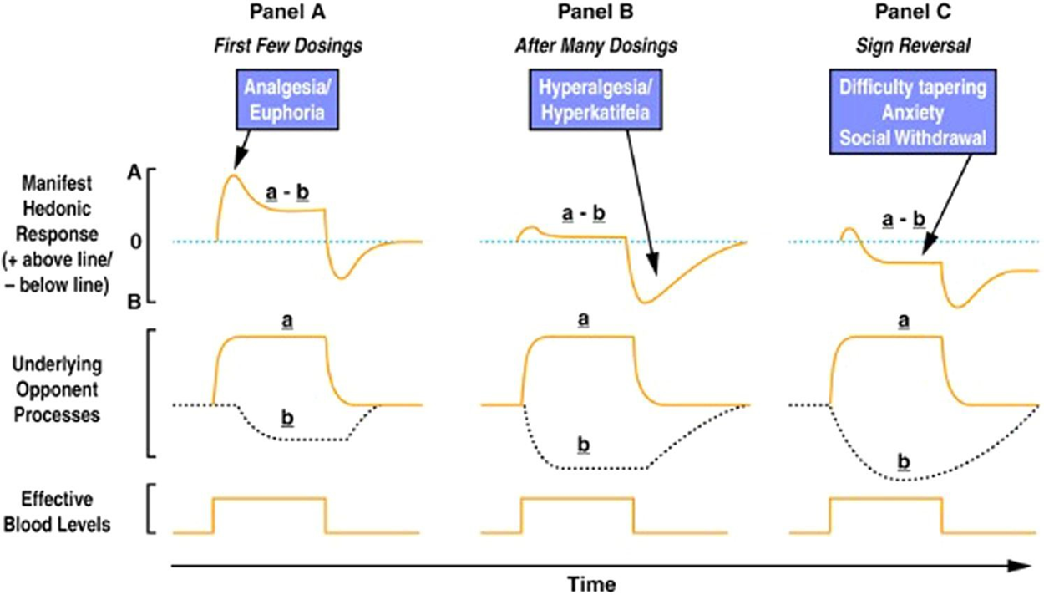
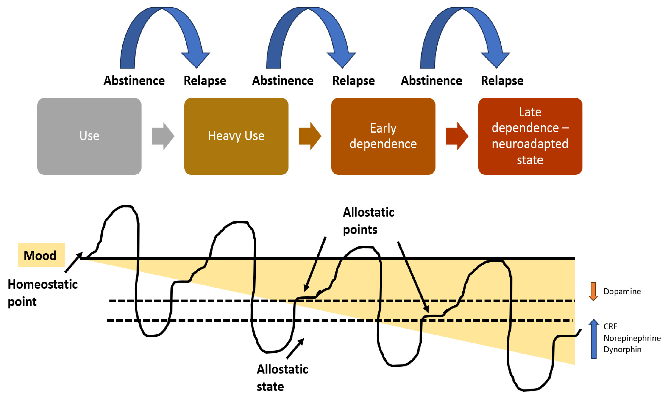
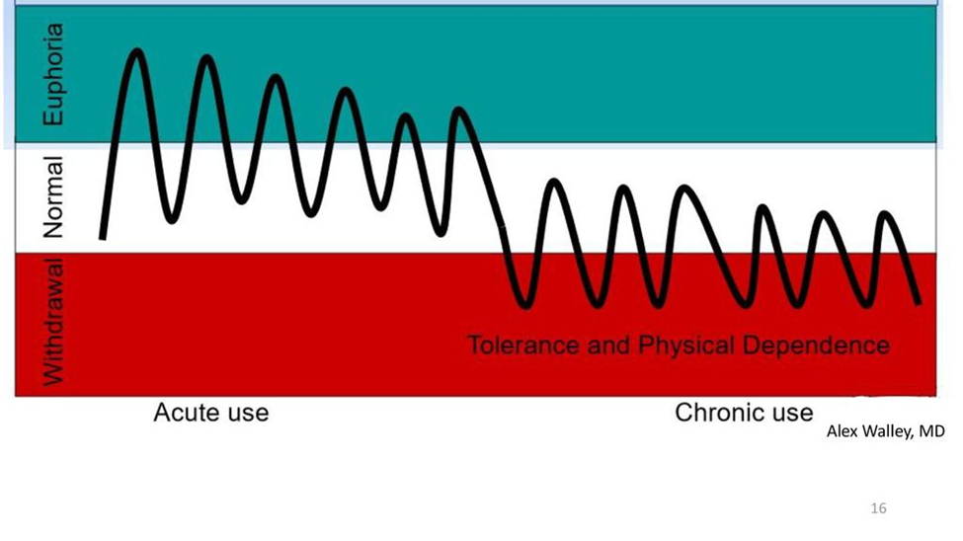
Figure by Ballantyne et al., retrieved from doi:10.1097/ADM.0000000000001526 on May 2, 2026.³²
Figure by Ferrer-Pérez et al., retrieved from doi:10.3390/psychoactives3010003 on May 2, 2026.³⁴
This is NOT patient's fault. This is what these medications do to the brain over time.
Image by Alex Walley retrieved on May 2, 2026.³³
Notes:
Presenter: KN
FACILITATOR:
The top right figure by Ferrer-Perez et al. Is a diagram of the progression of drug-consumption motivation from a state of positive reinforcement to the maintenance of consumption for relief of discomfort (negative reinforcement).

Slide 23
Complex persistent opioid Dependence (CPOD)
AKA Prescription opioid dependence syndrome (PODS)³⁵⁻³⁶
This is an emerging concept that is estimated to occur in about five percent of patients on long term opioid therapy (LTOT)
Characterized by progressively poor pain control in patients on LTOT who are not exhibiting signs of progression of the underlying disease as a cause of the pain
Notes:
Presenter: KN

Slide 24
Complex persistent opioid Dependence
Clinical presentation:³⁶
  Declining physical function and psychiatric instability
  Manifested by depressive symptoms, insomnia, and aberrant behaviors not sufficient to label as OUD
  Poor pain tolerance and low mood
    Versus in patients with OUD, the focus is on drug acquisition and experience (drug use and craving)
  Patients desire to continue, increase dose, or resist weaning LTOT
  Those susceptible to CPOD can develop an alteration in their baseline sense of well-being from LTOT
Notes:
Presenter: KN
FACILITATOR: High yield concept for clinical practice!

Slide 25
CPOD / PODS pathophysiology^{32,37}
Presence of chronic pain syndrome: nociplastic pain which can be a chronic primary pain or a chronic secondary pain syndrome (more common in palliative care eg: chronic post-surgical pain or chronic cancer pain
Allostatic Opponent Process (same as for OUD risk) from prolonged opioid exposure in LTOT
Cognitive dissonance related to impaired reward processing from the interaction of pain relief with opioid reward such that opioids are the only solution despite no improvement in function with LTOT
Notes:
Presenter: KN

Slide 26
OPIOIDS FOR MOOD MODIFICATION²⁵
If shorter prognosis at EOL
  E.g., patient is prescribed opioids for painful metastatic cancer, but the patient is also using it for sedative effects to get to sleep or mild euphoric effects to decrease anxiety
  Most clinicians accept these uses when patients are close to death
  Goals are solely focused on relieving suffering
  It is clinically challenging to tell the difference between physical and emotional pain
  At EOL benefits of opioids outweigh risks
If Longer prognosis
    Education about avoiding opioids for mood modification & offer safer alternatives.
    Consider OUD as a diagnosis if patient continues to misuse opioids despite negative consequences in social functioning and adequate education about CPOD/PODS
Notes:
Presenter: KN

Slide 27
Learning Objectives
Review definitions and epidemiology of substance use from dependence through disorder
Utilize screening tools and deliberate risk mitigation strategies against development of OUD
Utilize a framework for clinical decisions about opioid and other controlled medication regimens and monitoring in patients at risk for or with SUDs
Evaluate urine toxicology monitoring
Integrate medications, opioid rotation, and opioid tapering for SUD treatment to improve quality of life of patients in palliative care
Notes:
Presenter: VS

Slide 28
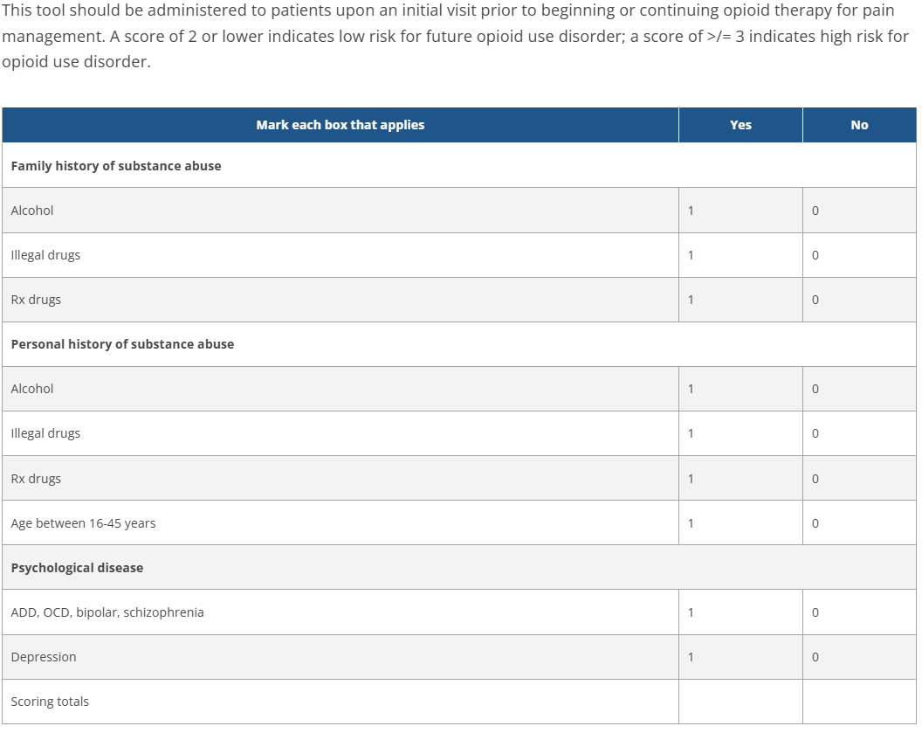
Risk factors for OUD³⁸⁻³⁹
Prior history of substance use disorder
Younger age
More severe pain
Co-occurring mental disorders
History of childhood maltreatment
Revised ORT
Figure by Cheatle et al., retrieved from doi:10.1016/j.jpain.2019.01.011 on May 3,2026.³⁹
Notes:
Presenter: VS

Slide 29
RED FLAG Behavior patterns in OUD from CAPC⁴⁰
Decreased physical or psychological functioning
Compromised relationships with family, friends, or clinicians
Loss of job
Motor vehicle infractions or other problems involving law enforcement
Not bringing unused medications to appointments when asked to do so
Appearing at clinic without appointment & in distress
Frequent visits to ED to request medications
Family reports of overuse or intoxication
Escalating doses without consulting the physician
Requests for early prescription renewals
Reports of 'lost' or 'stolen' prescriptions
Patient does not participate in non-pharmacologic pain
therapies
Patient does not keep appointments
Interest in relief of symptoms, not rehabilitation
Reports no effect of non-opioid interventions
Evidence of multiple providers
Notes:
Presenter: VS

Slide 30
Risk Mitigation⁴¹⁻⁴²
With EVERY patient!
Naloxone prescribing
Limit quantities
Urine drug testing
Harm reduction counseling
Increased touch points and frequency of visits (q3 months or more)
Consider buprenorphine as first-line analgesic
Shared decision making on benefits/risks of PRN opioid use
Engagement with addiction med/psych
Universal precautions
Notes:
Presenter: VS

Slide 31
Universal Precautions
Naloxone prescribing
Obtain a comprehensive medical, psychiatric, and substance use history
Counsel and obtain informed consent prior to opioid initiation
Education to patient and caregivers on administration, storage and disposal
Review PDMP
Regular urine screening
Continue to reassess opioid risks and benefits
Interdisciplinary team care
Notes:
Presenter: VS
FACILIATATOR:
High yield for the boards!

Slide 32
Universal Precautions in Opioid Prescribing
Med Counts
ORT-OUD is a risk tool for INITIATION. Use other tools or assessments during monitoring.​
No screening tools validated in cancer pain population.
ORT-OUD
Refill Request History
PDMP
Misuse & Diversion Concern
Drug Testing
Structure as Risk Mitigation Prevention AND as Therapeutic Intervention
Tiered Refill & Visit Workflow
Figure by author
Notes:
Presenter: VS

Slide 33
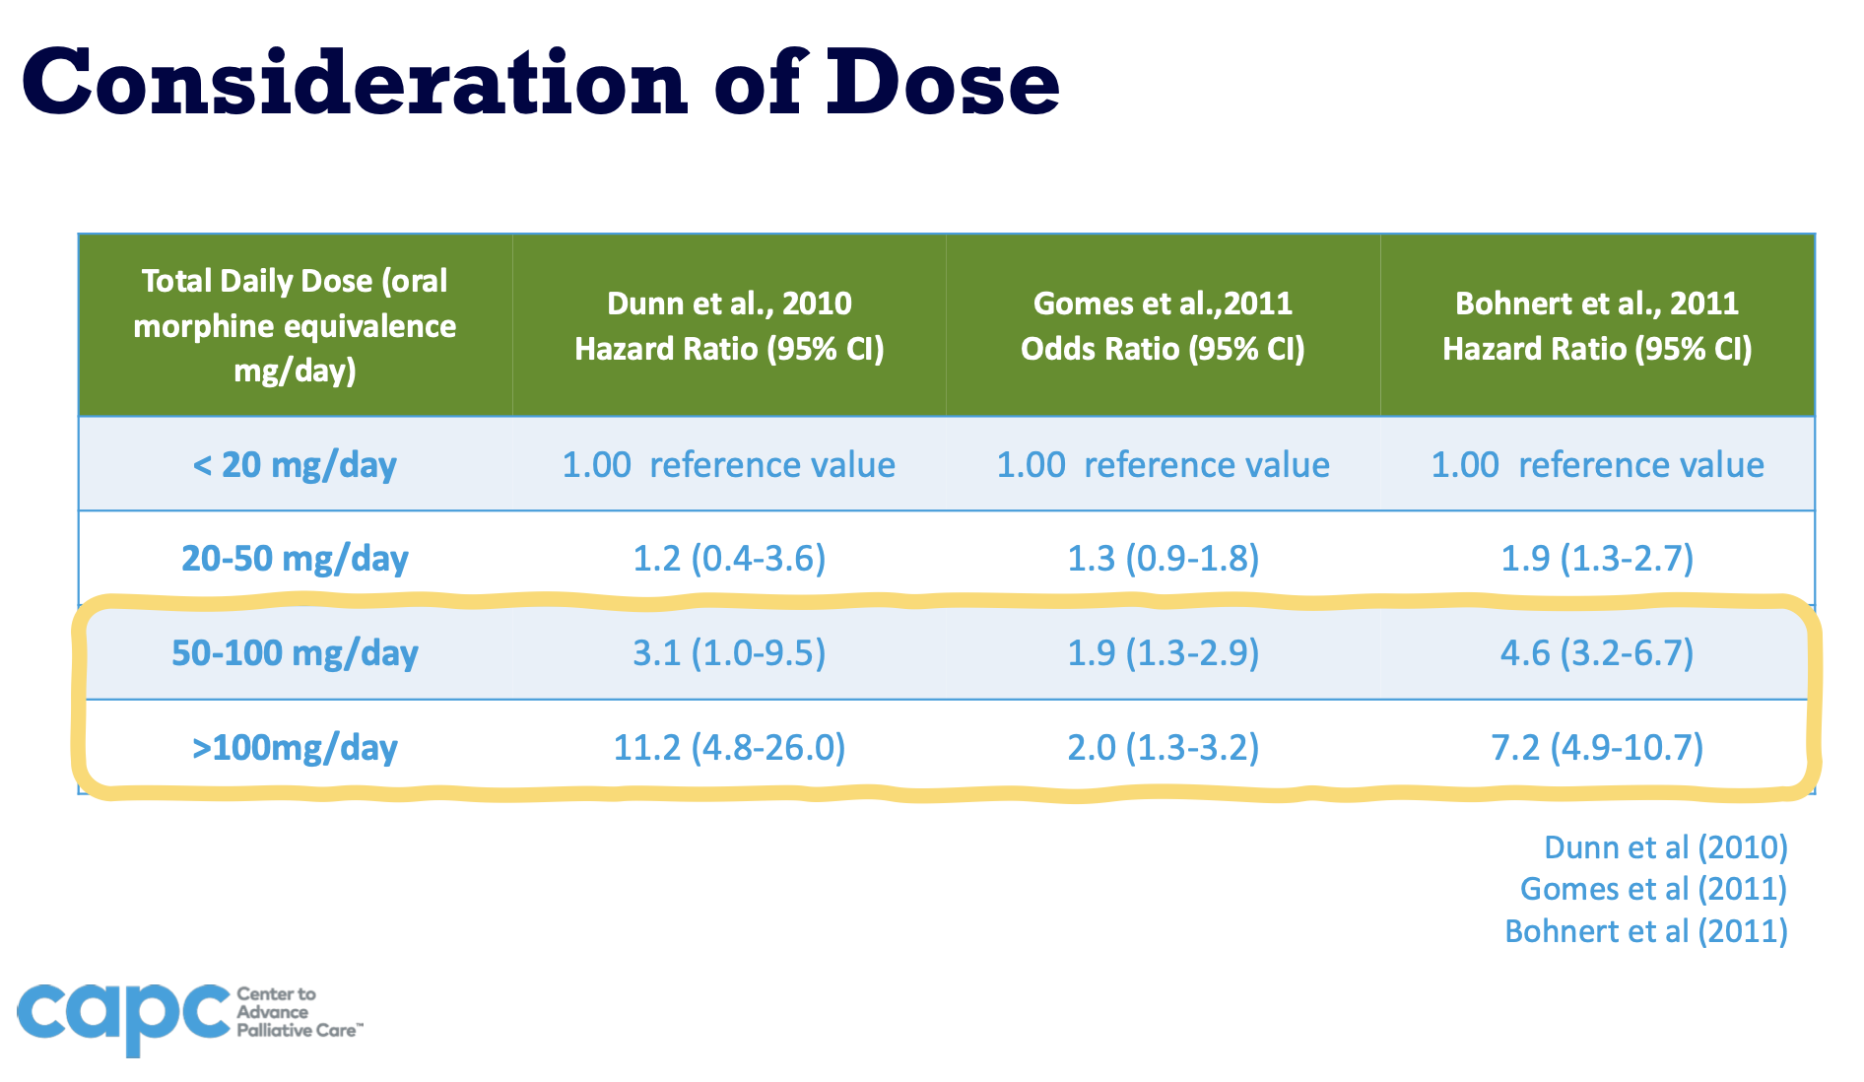
Figure by Center to Advance Palliative Care. Retrieved from https://media.capc.org/on-demand/slides/CAPC_COPY_Master_Session.pdf.. Accessed on April 10, 2026.
Notes:
Presenter: VS
Higher risk of overdose at OME >50

Slide 34
Screening Tools⁴³
Not all are validated in palliative care
There is still a need for complex decision making that is personalized, considers health equity, and utilizes clinical judgement and evidence-based medicine
We need to still complete a thorough substance use history
We do not police or punish patients
Use opioid screening for OUD prior to initiation of therapy and at random intervals while on opioid therapy
Notes:
Presenter: VS

Slide 35
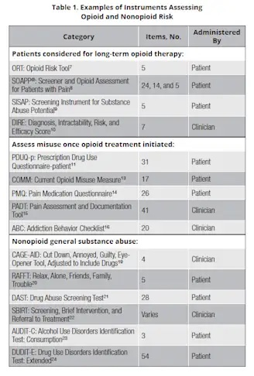
Screening: How to Identify Opioid Use Disorder Behaviors
Table by Chou et al., retrieved from doi:10.1016/j.jpain.2008.10.008 on May 3,2026.⁴⁴

Slide 36
Revised ORT
Note: the revised ORT removes preadolescent sexual abuse and all sex-based weighting on the basis of new evidence from original ORT
Figure by Cheatle et al., retrieved from doi:10.1016/j.jpain.2019.01.011 on May 3,2026.³⁹
Notes:
Presenter: VS
FACILITATOR:
The ORT is meant to supplement other risk assessments or to diagnose a substance use disorder. It is not meant to predict abuse or addiction but to provide the clinician a sense of the probability the patient will display aberrant drug related behavior within a year if prescribed an opioid. Sometimes patients will not be honest and can provide incomplete or wrong answers. However, if they provide false information, it usually becomes apparent after a few visits and getting to know the patient.
Note newer ORT-OUD-- This revision of the ORT removes the preadolescent sexual abuse item and all sex-based weighting on the basis of new evidence.

Slide 37
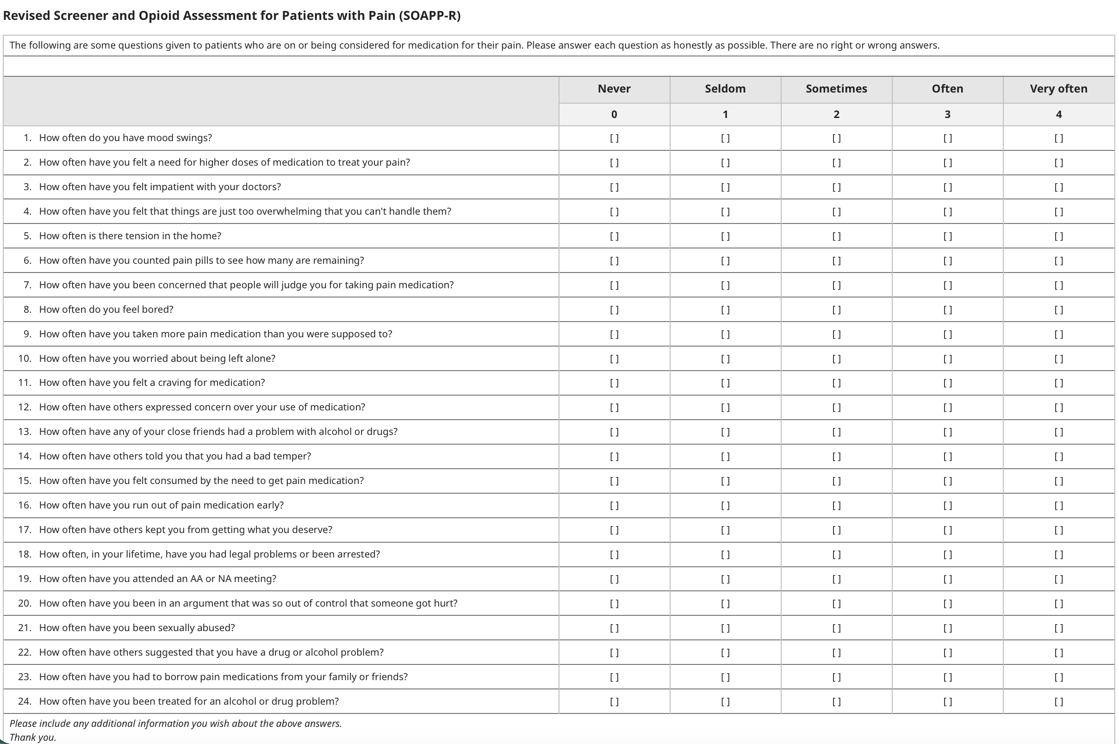
Figure by Butler et al., retrieved from doi:10.1016/j.jpain.20 on May 3,2026.07.11.014
Notes:
Presenter: VS
FACILITATOR:
SOAPP-R is a Screener and Opioid Assessment for Patients with Pain-Revised, a tool used to assess a patient's risk for opioid misuse and to determine the appropriate level of monitoring for long-term opioid therapy. It's a 24-item self-report instrument.
Original: proprietary 14-item form, captures primary determinants of aberrant drug-related behaviors

Slide 38
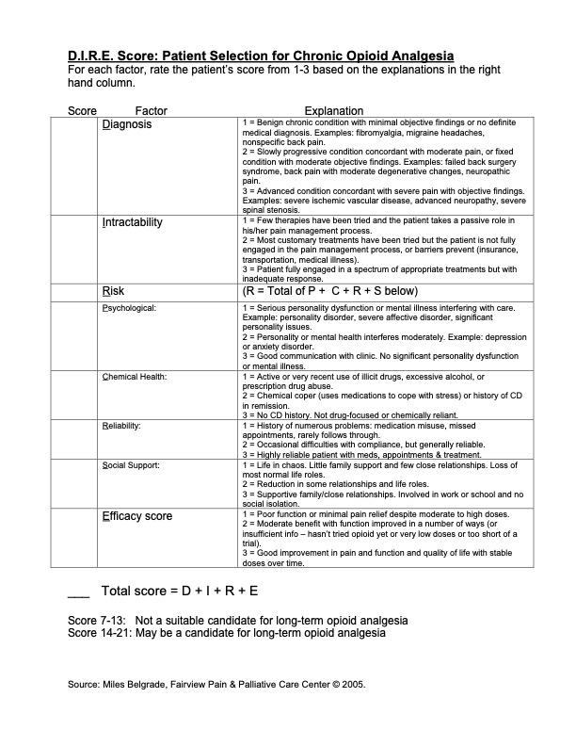
Figure by Webster et al., retrieved from doi:10.1111/j.1526-4637.2005.00072.x on May 3,2026. ⁴⁶
Notes:
Presenter: VS
FACILITATOR:
Predicts which chronic noncancer pain patients will have effective analgesia and be compliant with long-term opioid maintenance treatment.
The DIRE Score is meant to be applied to patients with chronic noncancer pain who either are already using opioid analgesics or who are being considered for such therapy. It consists of four factors that are rated separately and then added up to form the DIRE Score: Diagnosis, Intractability, Risk, and Efficacy. The Risk factor is further broken down into four subcategories that are individually rated and added together to arrive at the Risk score. The Risk subcategories are: Psychological Health, Chemical Health, Reliability, and Social Support.
Sensitivity and specificity of the DIRE Score for predicting patient compliance were 94% and 87%, respectively. For efficacy, sensitivity and specificity were 81% and 76%. For disposition, the sensitivity and specificity were 86% and 73%. Intraclass correlation was 0.94 for interrater reliability and 0.95 for intrarater reliability.

Slide 39
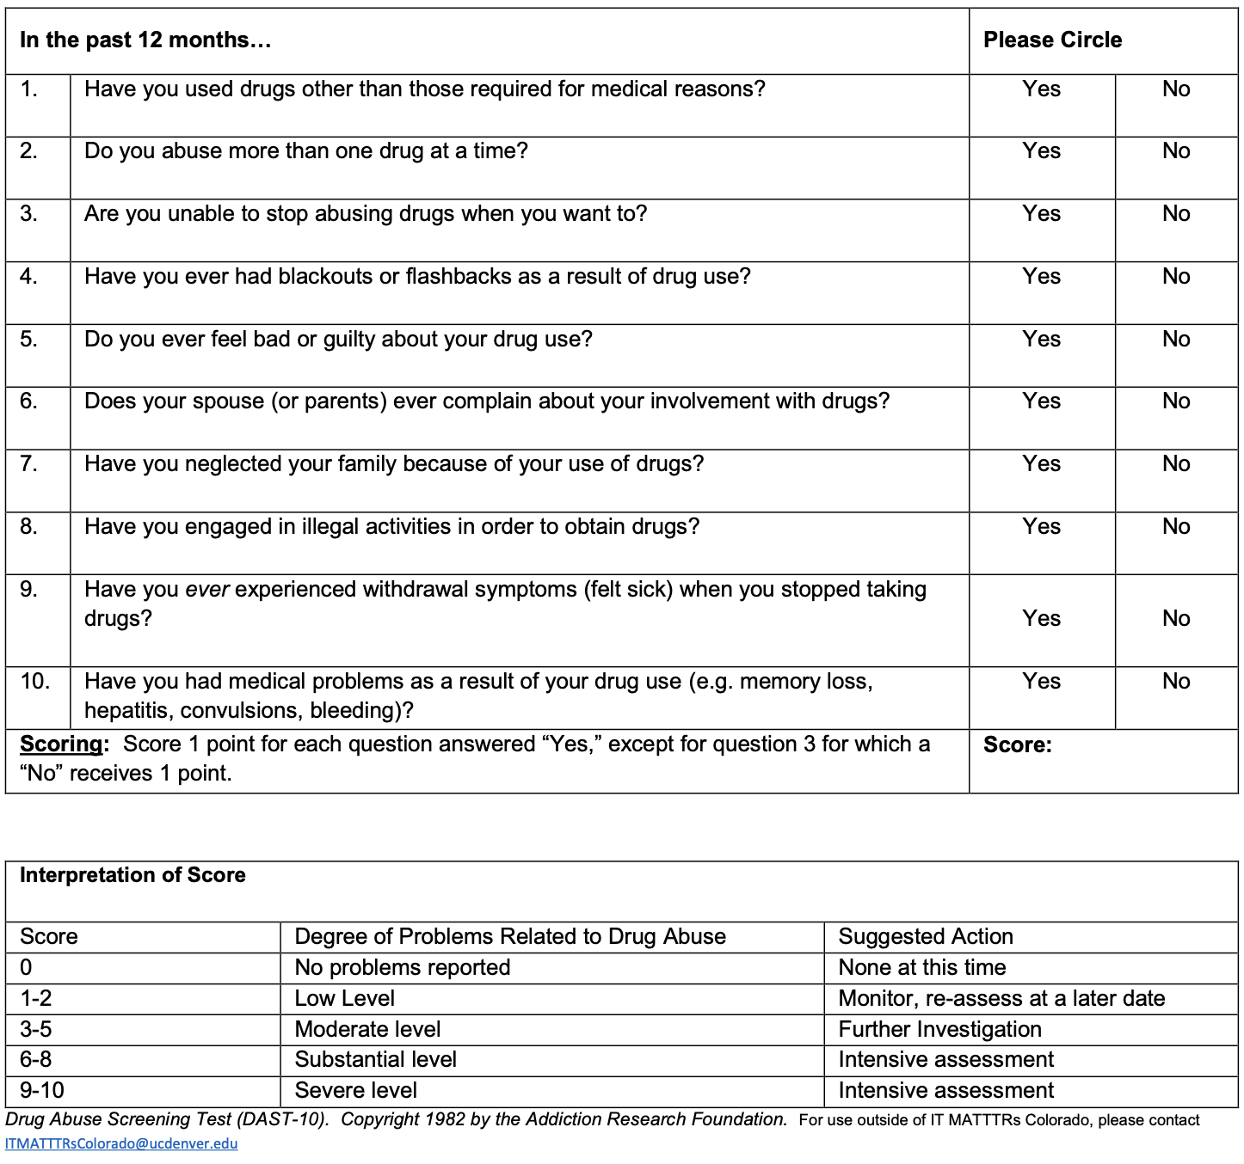
DAST-10: From Screening to Assessment
Figure by American Society of Addiction Medicine, retrieved from https://www.asam.org/quality-care/clinical-guidelines/screening-assessment-for-addiction on May 3,2026. ⁴⁷
Notes:
Presenter: VS

Slide 40
Learning Objectives
Review definitions and epidemiology of substance use from dependence through disorder
Utilize screening tools and deliberate risk mitigation strategies against development of OUD
Utilize a framework for clinical decisions about opioid and other controlled medication regimens and monitoring in patients at risk for or with SUDs
Evaluate urine toxicology monitoring
Integrate medications, opioid rotation, and opioid tapering for SUD treatment to improve quality of life of patients in palliative care
Notes:
Presenter: KN

Slide 41
Proposed Setting of Opioid Therapy
Generalist/Solo Prescriber
Specialty Team
Pain Etiology | Clear, straightforward | Uncertain etiology, but suggestive of physiologic cause | Etiology unknown
Psychiatric | No history | Stable, compensated psychiatric disorder | Psychiatric instability
Addiction | No history of unhealthy use nor SUD | In recovery or history of heavy unhealthy use | Current substance use, active SUD
Social Support | Good | Some or challenges | Isolated, major distress
Activity Engagement | Good | Some meaningful activities | No satisfying activities
Figure adapted from Kampman et al. From Principles of Addiction Medicine, 6th ed., Section 12.⁴⁸
Notes:
Presenter: KN

Slide 42
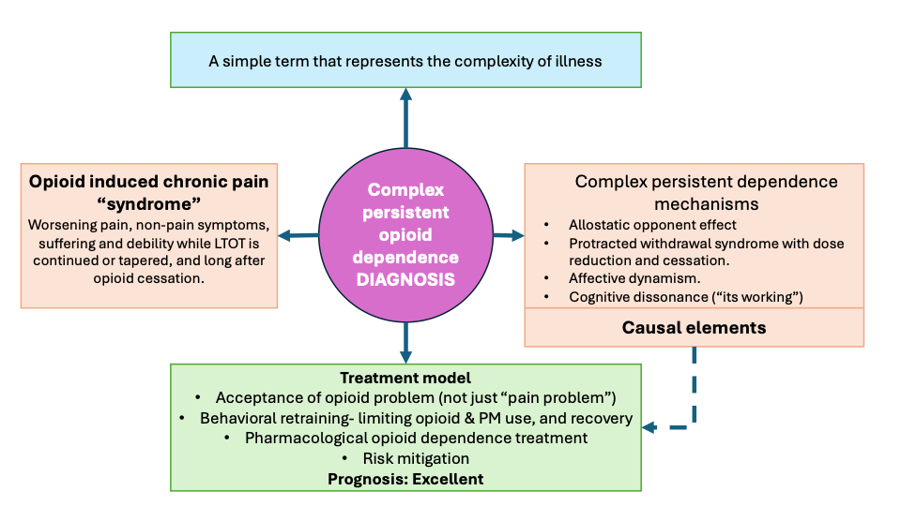
CPOD: COGNITIVE VS BEHAVIORAL MODIFICATION
Image by Ajay Manhapra MD, used with permission
Notes:
Presenter KN:
FACILITATOR: So, in the opioid pain management context, naming the error of thinking that chronic pain is a "pain problem" and correcting it to an "opioid problem" is key. The neurobiology in the brain is the same, but the approach is different. It is not "relapse prevention planning" and "people, places, and things" we talk about to maintain recovery from OUD, it is the acceptance of pain and physical rehabilitation efforts to recovery from chronic pain.

Slide 43
Engaging with Patients
Don't assume
Be curious
Practice empathy
Ask thoughtful questions
  What is it like living with the [medication]?
  Where do the opioids fit in your life?
Notes:
Presenter: KN

Slide 44
A Tailored Evidence Informed Approach from CAPC ⁴³
Open invitation
Leave your judgement at the door
Use your palliative care skills
  Tell me more...
  What are you worried about?
Make assessments over time
Find your own language
Modify your language
Get feedback
Notes:
Presenter: KN

Slide 45
The Framework: Patient Evaluation and Management Strategies⁴⁹
Complete a thorough substance use history (active vs at-risk or in recovery)
Controlled substance agreement and setting expectations
Manage comorbid anxiety/depression (esp in patients at risk of chemical coping)
  Careful w/ benzos
Engage psychiatry colleagues for diagnosis and management of undiagnosed and untreated conditions
Consider addiction medicine referral or consultation
Treat pain
  Poorly controlled pain --> Increased substance abuse behaviors
Notes:
Presenter: KN

Slide 46
Patient Evaluation and Management Strategies⁴⁹
Consider
  Rarely stop opioids abruptly
    Opioid rotation
    Opioid de-prescribing
Notes:
Presenter: KN

Slide 47
Patient Evaluation and Management Strategies
In Cancer
  Jones et al. --> In cancer-related + nonmedical stimulant use, regardless of prognosis, it was deemed appropriate to:⁵⁰
    continue opioids
    increase monitoring
    avoid opioid tapering.
    Buprenorphine/naloxone transition was inappropriate for a patient with a short prognosis and of uncertain appropriateness for a patient with a longer prognosis.
      Realize there is not clear cut answer! Here is just some evidence to guide you!
Notes:
Presenter: KN

Slide 48
7Ps Framework
Patient-centered
Pain
Prognosis
Pattern of OUD
Performance status
Psychosocial
Partnerships
Figure adapted from Jones KF et al., retrieved from doi:10.1097/01.NAJ.0000947480.74410.06 on May 3,2026. ⁵¹
Notes:
Presenter: KN
FACILITATOR:
This is a visual of the 7 Ps framework. In the 7Ps framework, we emphasize the main 4Ps as they consider the all the co-occurring conditions and what the recommended best treatment option would be. Then, with the outer 3Ps, we adapt the recommendation based on social determinants of health. It is important to visualize it this way, as a common point of frustration is to follow the lead of what is easiest and then be reactive to instability.

Slide 49
Organized Framework for SUD in Palliative Care
Use the 7Ps framework
  First task: Decide if treatment of substance dependence is warranted
    Diagnose if SUD is present, and severity
  Second task: Discern if symptom mechanism is responsive to controlled medication, if medication is standard of care
  Subsequent steps: Apply functional considerations for medication safety, and medication adherence
  Shared decision making with patients on reasonable plans within pre-determined options
Set team treatment goals and expectations about early refills, including frequency of follow up and script duration
Recommend a plan to transition care outside of your care when patient needs require a higher level of care
Notes:
Presenter: KN
FACILITATOR:
Using the 7Ps framework, you can organize all the considerations about the patient, their risky use of substances including their controlled medications, their underlying serious illness diagnosis and the symptoms related to that diagnosis, and their social facilitators vs barriers to treatment plans.
It is easy to fall into the trap of "exceptions for hospice and palliative care" to the rule of evidence-based practice where outcomes studied are usually about mortality. However, by methodically applying this framework, the clinical rationale of the plan becomes clear for the entire interprofessional team of clinicians where compassion bias, decision fatigue, and stigma may cloud our judgment.
In general, you have separate tasks when developing plans that will involve high risk controlled medications
Make a diagnosis about the substance use and substance use disorders
Make a diagnosis about the pain and symptoms regarding the underlying pathophysiology, not the underlying medical condition, but the pathophysiology of why the person is experiencing the symptoms
Adapt the medication and treatment regimen based on pharmacology facts – pharmacokinetics, pharmacodynamics. Then adapt the regimen based on realistic medication adherence plans overall. This avoids bias and stigma.
Lastly, offer recommendations based on your expertise as the healthcare professional and use shared decision-making with the patient
For the healthcare team, provide clarity about realistic expectations and short-term goals and plans for next steps if the patient is not doing well with the treatment plan.

Slide 50
Organized Framework for Opioids
7Ps | Full agonist | Methadone Rx | Buprenorphine | Methadone OTP
Prognosis | Long term harm | Long term harm | PREFERRED if long-term | NO Lag time to effect
Pattern for OUD | Do not use this alone in OUD | NO for non-ASP for OUD treatment | Necessary for OUD | Necessary for OUD
Pain | Not for nociplastic Taper in CPOD | Not for nociplastic Taper in CPOD | Not for nociplastic May be useful in CPOD | Not indicated
Performance status |  | High Risk at higher doses | Preferred for tolerability | Preferred for structure Not for home limited
Psychosocial | Diversion harm great | Diversion harm great | Diversion may be self-treatment of OUD | High Threshold Tx
Partnering providers | Anyone with DEA C2 | Anyone with DEA C2 and comfortable | Anyone with DEA C3 | Federally licensed clinics with strict regulations
Patient-centered | Most likely requested | Stigma but may be requested | Stigma | Stigma Motivate for recovery
Table by Ho et al., retrieved from AMERSA 2021, ASAM 2022, AAHPM 2024, ASAM 2026,
adapted May 3,2026.⁵²
Notes:
Presenter: KN
FACILITATOR:
Applying the 7P framework and evaluating which analgesic option would be most appropriate for each consideration
Additionally, the 7Ps can be used to decide on frequency of follow up. When you know you adapted far from the recommendation, like that buprenorphine would be clearly preferred, but the patient anchored in full agonist only, then the plan would be closer follow up than the buprenorphine plan.

Slide 51
Treatment Goals
Safer use
Managed use
Abstinence & Adherence
Remission
Recovery & Resilience
Figure made by author
Notes:
Presenter: KN
FACILITATOR:
Like other chronic illnesses, our goal isn't always NORMAL blood pressure, normal PFTs, but we can find other goals—using less, or safer use practices, CAN BE reasonable goals.
Treatment goals will vary depending on the severity of illness and symptom burden.
For patients who do NOT already have substance use disorders currently or in their lifetime, we take a preventive care approach, promoting behavioral and environmental changes to prevent development of disease, and we screen for chronic conditions or risk factors. As discussed in Module 2 of this webinar series, we ask about substance use and risk factors for developing opioid use disorder with prescribed opioids.
For those who have established SUDs, ONE goal could be remission and recovery where there are no symptoms or criteria for SUD and complete abstinence of drug use. Or, for those prescribed controlled medications for which they had an associated SUD, 100% medication adherence and no overuse or misuse.
But ANOTHER goal is just improved management of the chronic condition. For example, adjusting blood pressure medications while the blood pressure readings consistently hover above the ideal 120/80, yet without chest pain or neurologic signs of stroke - We adjust what we can adjust and we don’t send the patient to the hospital for every reading above 140, and we don’t stop medications because their blood pressure isn’t normal. For patients with HTN and stable angina, we focus on knowing the warning signs to call 911, telling patients when to take aspirin or nitroglycerin and advising them to rest after exertion to and bring the blood pressure down. Similarly, for substance use disorders, goal setting may look like working with the patient to lessen their current drug use or at least not increase to prior heavier use, or focusing on reducing duration of overdose event by educating them on signs of overdose and administration of rescue naloxone, or discussing safer injection practices.

Slide 52
Palliative care goals for symptom management in context of SUD
Past - SUD in Remission
Treatment Adherence Goal
Current - Active SUD
Harm Reduction & Managed Use Goal
Future - At Risk of SUD
Exit Plan At Initiation
Name Cognitive Dissonance Early
Treatment Adherence Goal
Taper, Maintenance, or MOUD Early
Name and Address Triggers
Enlist Relapse Prevention Strategies
MOUD*, Taper or Maintenance Early
Motivate to Engage in Treatment (including MOUD)
Motivate to Recovery
Death Trajectory
*MOUD=Medication for opioid use disorder
Notes:
Presenter: KN
FACILITATOR:
Beyond which opioid to recommend for pain and if frequent vs less frequent follow up, this slide gives highlight to the therapeutic intervention of the visit and patient conversation to have in the room. For the patient with active severe SUD, we are not expecting them to be adherent. We can expect a request for early refill, signs of intoxication or withdrawal, and positive urine toxicology if we check it. The goal of symptom management is reducing the harm of their use and in engaging them in the treatment of their life limiting illness. For patients with OUD, that may mean Safer Supply prescribing, which we reviewed had some early evidence from Canada to support in short prognosis. The goal is not "pain management" alone. It is both maintenance and pain management. Remember that pain thresholds are lower, and chronic pain prevalence is higher, for patients with severe SUDs. So talk about the pain but don't stay there. Pick up on change talk and discuss treatment/recovery focus, if that be counseling. When you are not sure how much you can be involved in their care, consider the 5 death trajectories.
For the patient in remission and recovery. The goal is medication and disease treatment adherence. Tap into the work and strength that they have to have managed their condition of SUD. Name triggers with them, have them recall their relapse prevention strategies.
For patients at risk, set the expectation that you have an exit plan at initiation of opioids or benzodiazepines or cannabis. Be open to describe what that may look like. Expect treatment and medication adherence. Name any cognitive dissonance early, in non-confrontational way.

Slide 53
Learning Objectives
Review definitions and epidemiology of substance use from dependence through disorder
Utilize screening tools and deliberate risk mitigation strategies against development of OUD
Utilize a framework for clinical decisions about opioid and other controlled medication regimens and monitoring in patients at risk for or with SUDs
Evaluate urine toxicology monitoring
Integrate medications, opioid rotation, and opioid tapering for SUD treatment to improve quality of life of patients in palliative care
Notes:
Presenter: KN

Slide 54
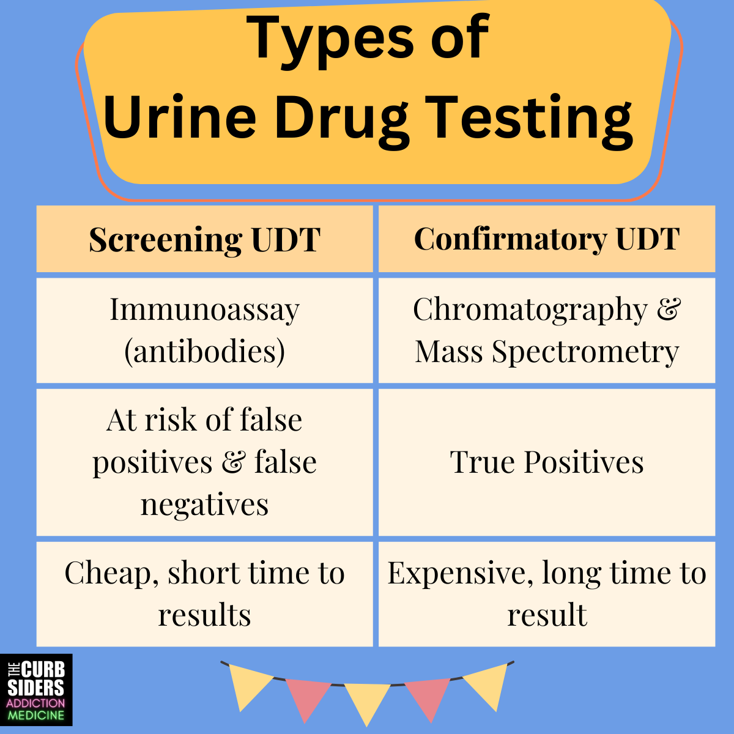
Urine Drug Testing
Use non-accusatory and non-stigmatizing language with an unexpected result
  Language matters among patient with serious illness--> "urine screening" vs "urine drug screening"
Let the patient know up front what you are testing for before ordering
  "We test your urine at least every 6 months to ensure that it is consistent with your prescribed medications and that there are no other substances that you are taking that may interact with the medications we are prescribing. The urine screening test we use tests for … is there anything prescribed or not prescribed to you that would affect these results?"
  You can use this opportunity to clarify if any other substance use.
Frequency of testing: no clear consensus. But recommend at least every six months to annually
Screening urine drug testing are cheap and prone to false positives
Confirmatory urine drug testing use gas or liquid chromatography and usually are paired with mass spectrometry
  Expensive
  Takes time (~2 weeks for NAVIS which SCC utilizes)
  Positive testing = a true positive result
Table by Chan et al., retrieved from #18 Urine drug testing with Dr. Timothy Wiegand. The Curbsiders Addiction Medicine Podcast on August 17, 2023. Accessed April 10, 2026. https://thecurbsiders.com/addiction-medicine-podcast/18-urine-drug-testing-with-dr-timothy-wiegand​. ⁵³
Notes:
Presenter: KN

Slide 55
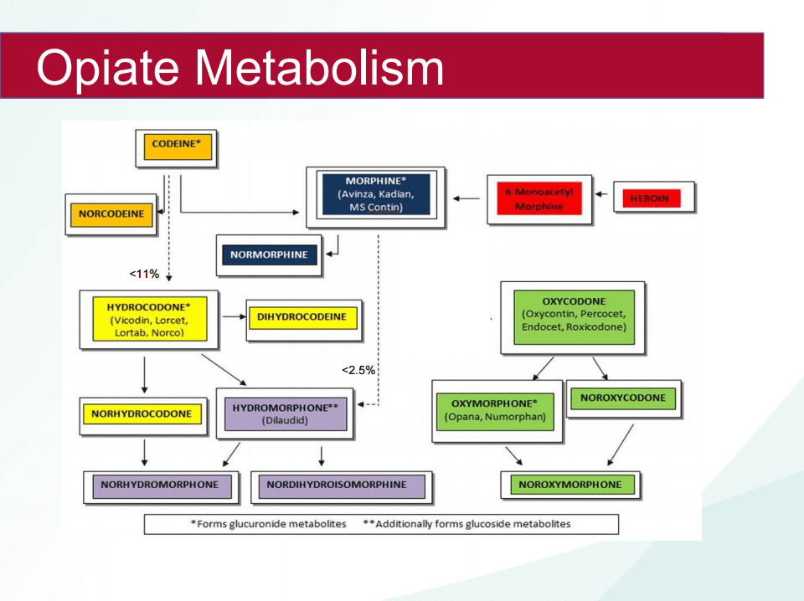
Window of detection for a substance is typically 1-2 days in a urine drug test (can vary by frequency, amount and specific substance)
Make sure to know what a substance metabolizes into. Think about what needs to be present.
Figure by Chan et al., retrieved from #18 Urine drug testing with Dr. Timothy Wiegand. The Curbsiders Addiction Medicine Podcast on August 17, 2023. Accessed April 10, 2026. https://thecurbsiders.com/addiction-medicine-podcast/18-urine-drug-testing-with-dr-timothy-wiegand​. ⁵³
Notes:
Presenter: KN

Slide 56
Urine Drug Testing – Result Interpretation⁵³
Think about your pre-test probability and the likelihood of a positive or negative test?
Review the PDMP and medication list again—is there anything else that can be affecting results?
Review the type of UDS
Call the toxicologist from the lab or company (if a send out test)
Specimen validity testing involves making sure a UDT is valid, and this can be done through many mechanisms (e.g. temperature strip, urine creatinine, urine pH, and specific gravity). Call the lab.
Notes:
Presenter: KN

Slide 57
Urine Drug Testing – Result Interpretation⁵³
Result Interpretation Pearls on UDT
  Regular, heavy use of fentanyl can stay in the system for weeks from last use due to high lipophilicity
  +THC can stay in the system for a long time (weeks-months) from last use with regular or heavy use. THC/Creatinine ratios can help track downward trends
+ (Synthetic) opioids: Institutional dependent, often include oxycodone and methadone
  + Amphetamine prone to false positives caused by many common medications (e.g. bupropion, pseudoephedrine)
+Opiate may mean exposure to codeine, morphine heroin, or be a false positive (hydrocodone or hydromorphone may cross-react with a screening test)
Notes:
Presenter: KN

Slide 58
Urine Drug Testing – Result Interpretation⁵³
Result Interpretation Pearls on UDT
  False positive oxycodone may be from naloxone and naltrexone
  False positive amphetamine may be from bupropion, pseudoephedrine (decongestant), OTC Vick’s decongestant (has L-amphetamine, technically a true positive)
  Common medications that can cause false positive phencyclidine (PCP) may be from dextromethorphan, carbamazepine, tricyclic antidepressants (TCAs), and venlafaxine
  False positive fentanyl may be from risperidone, trazodone, labetalol, and ziprasidone
Notes:
Presenter: KN

Slide 59
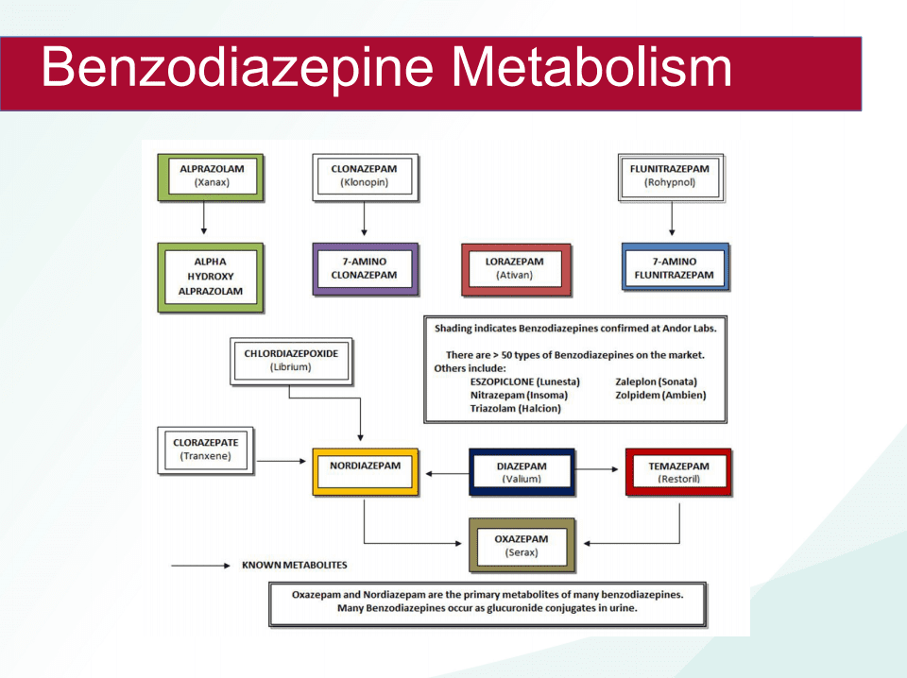
Result Interpretation Pearls on UDT
+Benzodiazepines
  Most UDT target metabolite oxazepam
  Clonazepam is not likely to cross-react with oxazepam and is often not detected
  Some benzos still will cross-react with the oxazepam screening assay
  Many designer benzos may not be detected on UDT
  Sertraline is a common cause of false positives on EDT
  Think about benzo metabolism -->
Figure by Chan et al., retrieved from #18 Urine drug testing with Dr. Timothy Wiegand. The Curbsiders Addiction Medicine Podcast on August 17, 2023. Accessed April 10, 2026. https://thecurbsiders.com/addiction-medicine-podcast/18-urine-drug-testing-with-dr-timothy-wiegand​. ⁵³
Notes:
Presenter: KN

Slide 60
Urine Drug Testing – Result Interpretation⁵³
Result Interpretation Pearls
+Buprenorphine
  Metabolized to norbuprenorphine, buprenorphine-3-glucuronide (bup-g) and norbuprenorphine-3-glucuronide (norbup-g)
  If taking bup, typically see a higher level of norbuprenorphine compared to the buprenorphine parent compound
  If there is only buprenorphine and none of the metabolites, an individual may have interfered with their UDT specimen
Notes:
Presenter: KN

Slide 61
Urine Drug Testing – Summary⁵³
Learn what analytes are tested for on your institution’s UDT
Be aware of common false positives
Understand specimen validity testing and how to apply
Know where to go for additional resources to correctly interpret
Notes:
Presenter: KN

Slide 62
Learning Objectives
Review definitions and epidemiology of substance use from dependence through disorder
Utilize screening tools and deliberate risk mitigation strategies against development of OUD
Utilize a framework for clinical decisions about opioid and other controlled medication regimens and monitoring in patients at risk for or with SUDs
Evaluate urine toxicology monitoring
Integrate medications, opioid rotation, and opioid tapering for SUD treatment to improve quality of life of patients in palliative care
Notes:
Presenter: AZ

Slide 63
Pharmacotherapy
Opioid rotation may be necessary in OUD
  Focus on buprenorphine for management of pain
Notes:
Presenter: AZ

Slide 64
Medication-Assisted Treatment (MAT) = Medications for Opioid Use Disorder (MOUD)
"MOUD" is preferred
Core medications
  Buprenorphine +/- naloxone
  Methadone
Purpose:
  Decrease cravings, withdrawal, illicit opioid use, and overdose risk
  Increase retention in treatment
Pearls:
  Should be used long-term
  Medications are primary and drive outcomes
Notes:
Presenter: AZ

Slide 65
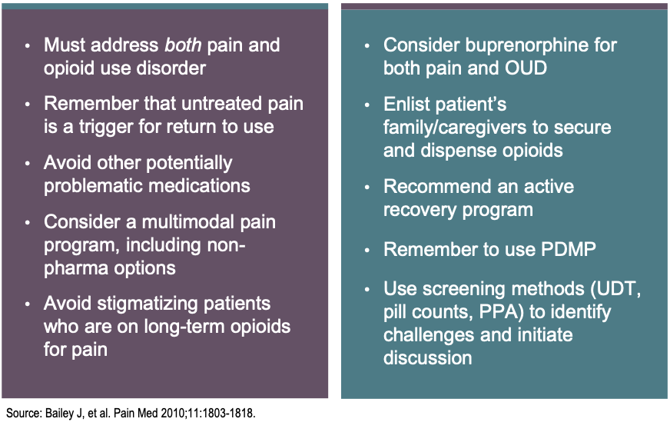
MOUD
Treat the pain + the OUD
Substitution with another opioid with lower risk and longer half-life (i.e., methadone or buprenorphine)
  Buprenorphine is also used clinically and is often formulated with naloxone (Suboxone) to block rewarding effects if inappropriately taken intravenously rather than orally.
  Also if concern for diversion.
Figure by Bailey et al., retrieved from doi:10.1111/j.1526-4637.2010.00982.x on May 3, 2026.⁵⁴
Notes:
Presenter: AZ

Slide 66
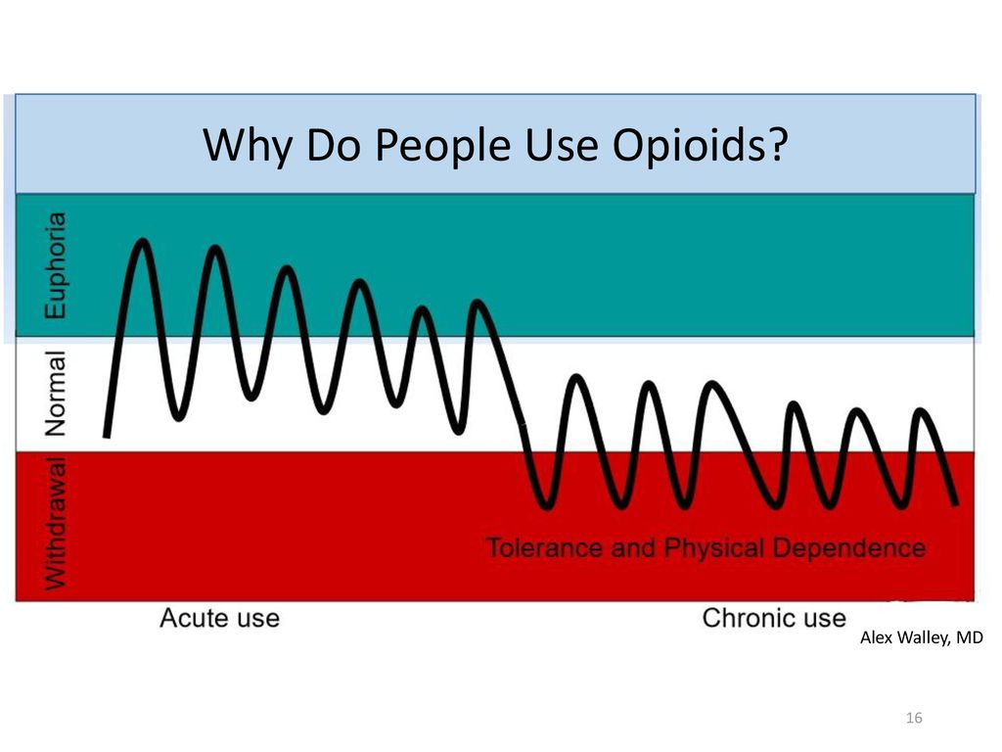
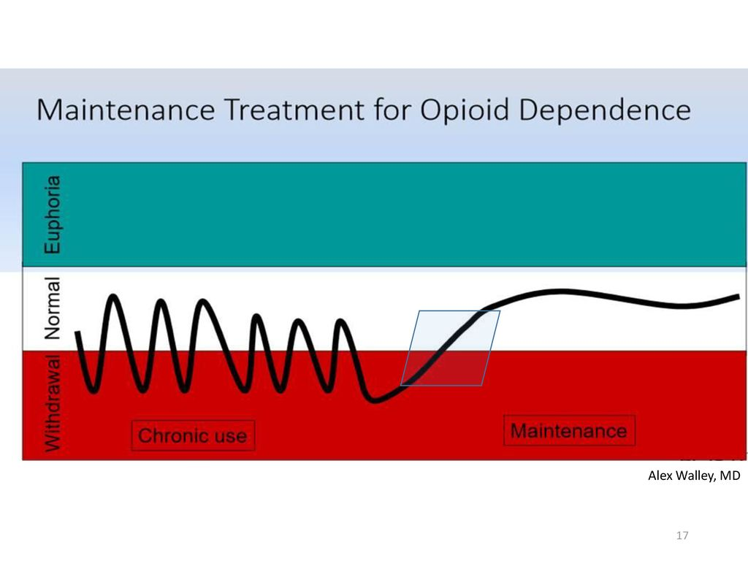
Medication for Opioid Dependence
Figure by Alex Walley. Retrieved on May 2,2026.³³
Notes:
Presenter: AZ
Which brings us to MOUD
Why do people use opioids? Euphoria or positive feeling. But, it could also be for relief of negative feelings if that be physical pain, emotional pain like post traumatic stress from past trauma or depression. For vulnerable people whose brain is primed to feel better or have more energy from opioids due to genetic variability or chronic dysphoric state, they will continue to have that desire to feel normal and continue to use opioids.
But, the body and brain wants homeostasis. So there is an allostatic response that happens where the body decreased its own endogenous opioids and internalizes opioid receptors and increases dynorphins and stress response to offset the exogenous opioid load. This happens more quickly and more pronounces in the vulnerable patient. Then they feel HORRIBLE without opioids and continue to use to feel normal.
What pharmacologic properties might be good treatments for OUD? Medications that keep the patient feeling normal

Slide 67
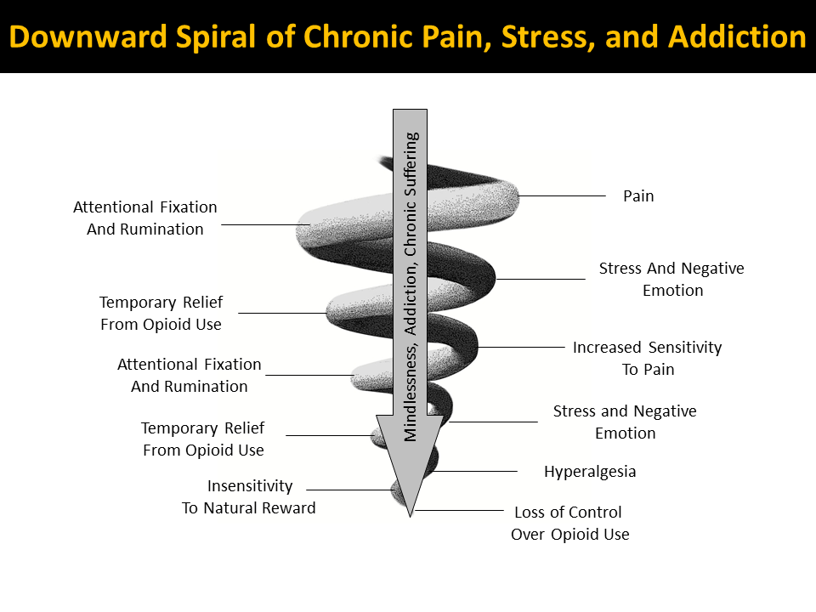
Figure by Garland et al., retrieved from DOI: 10.1016/j.neubiorev.2013.08.006 on May 5,2026.⁵⁵

Slide 68
Buprenorphine, "The Safest Opioid"?
Consider use of buprenorphine as first-line in patients with cancer
Insurance appeals often needed
Know that there may be severe withdrawal effects in some patients
Tightly binds to mu-opioid receptors to provide analgesic effects and prevent other opioids from binding
  Blocks euphoric effects of other opioids
Notes:
Presenter: AZ
https://pubmed.ncbi.nlm.nih.gov/40471576/

Slide 69
Naloxone Co-formulation
AKA: "suboxone"
Naloxone deters injection misuse (causes severe withdrawal if injected or snorted)
Diversion risk is lower with buprenorphine-naloxone compared to full agonists given less euphoric effects
If diverted, it this is usually because of self-treatment of withdrawal, to decrease cravings, or to bridge to treatment
Notes:
Presenter: AZ

Slide 70
Opioid tapering⁵⁶⁻⁵⁷
More likely to be successful if there is shared decision making
  Set expectations at the start (decrease dose vs complete cessation vs rotation to another opioid such as buprenorphine), rate of taper, and treatment of withdrawal symptoms.
  Give anticipatory guidance-->tapering is sometimes painful, but that many patients find that after a period of adjustment (which can be many months) pain returns to baseline or is even improved.
If on chronic opioids, slower taper may be better. If on <1 years, may be faster rate.
Providing expectations is important: If they've been on opioids for years, it may take YEARS to taper
Taper rate must be slow enough to minimize withdrawal symptoms-->insomnia, anxiety, depression, and increased pain, particularly in the short term.
  Withdrawal symptoms: anxiety, insomnia, abdominal pain, vomiting, diarrhea, diaphoresis, mydriasis, tremor, tachycardia, or piloerection--> TREAT! Symptoms last 5-10 days from last dose reduction
Notes:
Presenter: AZ

Slide 71
Opioid tapering⁵⁶⁻⁵⁸
Tapers of approximately 10% per month or slower are likely to be better tolerated than more rapid tapers, when patients have been taking opioids for longer durations (e.g., for a year or longer).
When patients have taken opioids for shorter durations (e.g., weeks to months rather than years), a decrease of 10% of the original dose per week or slower (until approximately 30% of the original dose is reached, followed by a weekly decrease of approximately 10% of the remaining dose) is less likely to trigger withdrawal and can be successful for some patients.
There is an increased risk for overdose with abrupt return to a previously prescribed higher dosage because of loss of opioid tolerance. Ensure they have naloxone.
See: CDC opioid training guidelines, McPherson Opioid tapering, The BRAVO Protocol
Notes:
Presenter: AZ

Slide 72
Opioid tapering⁵⁸⁻⁵⁹
Slow or pause the taper when needed. Be willing to adjust the rate, but don't go back up.
  As patients reach low dosages
  To allow development of new skills for nonopioid management of pain and emotional distress.
  Follow up at least monthly with patients (use your pharmacists, RNs, TMV)
  Integrate behavioral and non-opioid therapies during the taper
    Treat/support underlying psychiatric disorders
  If at high risk for suicide, consult with mental health provider first
  The most common mistake is tapering too fast
Notes:
Presenter: AZ

Slide 73
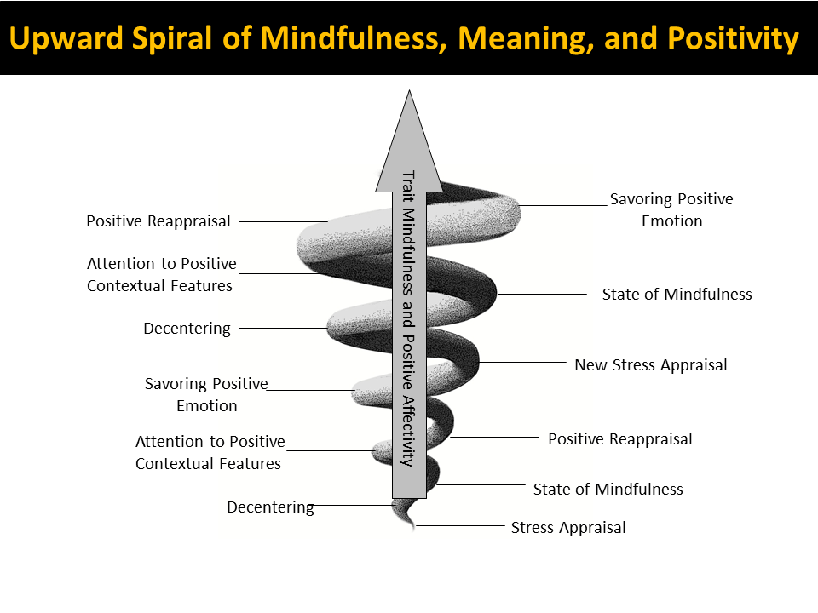
Figure by Garland et al., retrieved from DOI: 10.1016/j.neubiorev.2013.08.006 on May 5,2026.⁵⁵

Slide 74
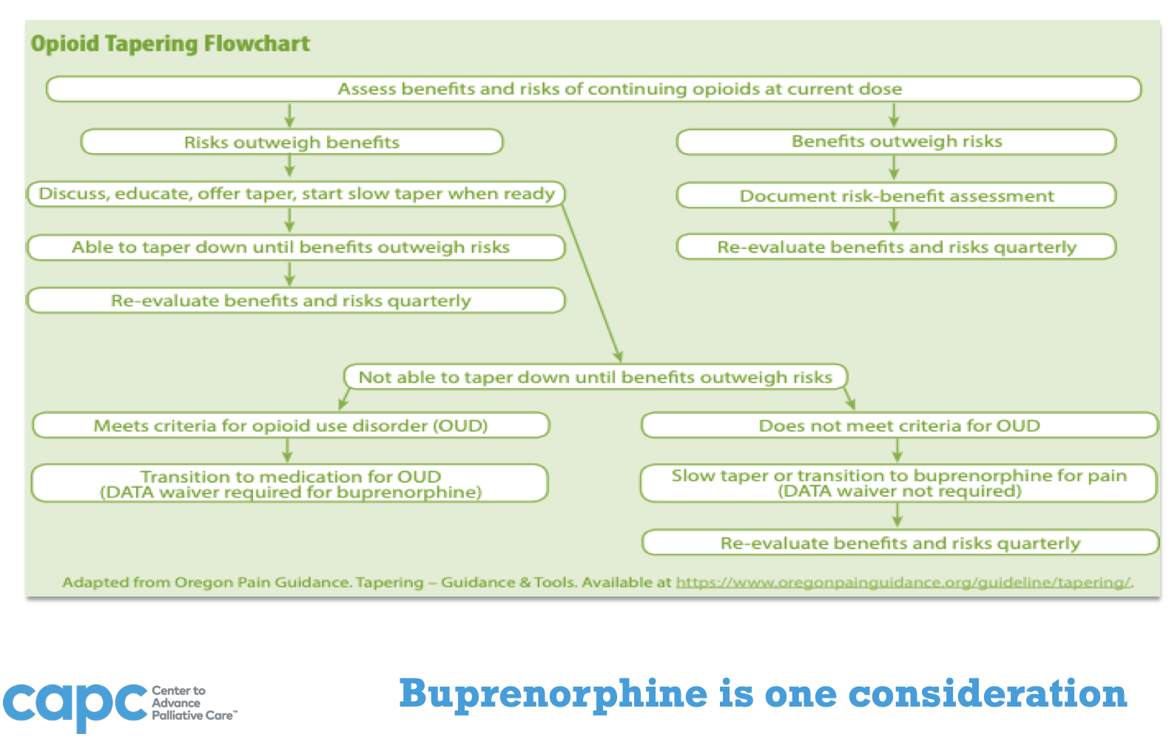
Opioid Tapering Algorithm per CAPC
Center to Advance Palliative Care. Opioid Tapering [educational graphic]. CAPC website. Accessed April 10, 2026. ⁴³
Notes:
Presenter: AZ

Slide 75
What do we need?
Education of medical community, including community pharmacies, to minimize stigma and barriers to prescribing and optimizing buprenorphine
Compassionate and curious attitude toward patients with OUD
Collaboration between palliative care and addiction medicine specialists
Identifying and leveraging available resources within your institution
Notes:
Presenter: AZ

Slide 76
A CASE
81-year-old white male, history of multiple myeloma with lytic bone lesion in L hip many years ago
Initially started on opioids for lytic bone lesions, which were treated with XRT
Over years veteran taking more and more Oxycodone short acting, but no active cancer, no longer on chemotherapy
Discussed using opioids for his dyspnea from COPD with no active cancer
Excessively focused on pill counts, how the 112 wasn't enough for a month, how if the UPS truck was late he would "run out" early, quick to report withdrawals and feared them greatly
Reported having to "borrow" pills from the church ladies he knew, needing more to "pay them back"
Started on Fentanyl patch, didn't decrease IR use, reported no benefit
Notes:
Presenter: KN
First – check in with yourself.
Do the math of how early he was out of medication

Slide 77
CASE Continued
His granddaughter was his paid caregiver, she called one day to tell us he didn't let her manage his pain medications
She expressed concern to one of our providers that he was using Oxycodone "excessively" and she worried he was too drowsy, unsteady on his feet at times
Vet denied pain benefit to using opioids, still gardening, singing in a choir, out and about
Resistant to de-prescribing, even though I explained it was most consistent with his goals to live to be 101, and risks>benefits over the years since we had started the opioids
Notes:
Presenter: KN
So going through the 4Ps
Let's start with – what is the Prognosis? - It is years, so the risk of long term harms on LTOT is considerable. Therefore, if applicable, tapering opioids
Pattern of Opioid Use – this looks like CPOD, possibly mild OUD with taking more than as prescribed and despite negative effects of drowsiness. We do not recommend LTOT for OUD but MOUD immediately. BUT for CPOD, can taper the LTOT or rotated to buprenorphine. Methadone prescribing or OTP is not recommended
Pain – he has chronic secondary pain, or a nociplastic pain, so LTOT is not recommended. He also has opioid dependence which is CPOD so tapering or buprenorphine rotation is recommended
Performance status – he is not home limited, appropriate for clinic based care. We are considering advanced age, renal and liver function and drowsiness and fall risk, so buprenorphine would be preferred. LTOT, especially with tapering, is not off the table, but would warrant closer monitoring. Methadone at OTP or prescribed , with higher risk of drug-interactions and QTc prolongation in a person of advanced age and years long prognosis is lower on the list of recommended plans.
So, from the initial 4Ps, the recommendation would be rotation to buprenorphine or close monitoring with tapering with plan to start buprenorphine treatment with any concern that this is really OUD such as t

Slide 78
PBL Discussion Questions
What are some red flag behaviors here?
How would you approach counseling this patient about his behaviors surrounding his opioid use?
Which screening or assessment tools might you use for this patient?
What would you do next in managing this patient?
Notes:
Presenter: KN
FACILITATOR:
What are some red flag behaviors here?
How would you approach counseling this patient about his behaviors surrounding his opioid use?
Which screening or assessment tools might you use for this patient?
What would you do next in managing this patient?

Slide 79
Selected References
Fast Fact and Concept #127: Substance use disorders in the palliative care patient. Palliative Care Network of Wisconsin. Accessed May 4, 2026. https://www.mypcnow.org/fast-fact/substance-use-disorders-in-the-palliative-care-patient/
Fast Fact and Concept #221: Treatment of pain in patients taking buprenorphine for opioid use disorders. Palliative Care Network of Wisconsin. Accessed May 4, 2026. https://www.mypcnow.org/fast-fact/treatment-of-pain-in-patients-taking-buprenorphine-for-opioid-use-disorders/
Jones KF, Merlin JS, Young SR, et al. Consensus-based guidance on opioid management in individuals with advanced cancer-related pain and opioid misuse or use disorder. JAMA Oncol. 2022;8(6):921-929. doi:10.1001/jamaoncol.2022.1008
McNally GA, Reddy A, Bruera E, et al. Opioid risk mitigation practices of interprofessional oncology personnel: results from a cross-sectional survey. Oncologist. 2023;28(2):e123-e131. doi:10.1093/oncolo/oyac201
Stanos SP, Houle TT. Top 10 tips for treating opioid use disorder. Mayo Clin Proc. 2020;95(9):2054-2063. doi:10.1016/j.mayocp.2020.07.002

Slide 80
References
1.Salins N, Gursahani R, Mathur R, et al. Definition of Terms Used in Limitation of Treatment and Providing Palliative Care at the End of Life: The Indian Council of Medical Research Commission Report. Indian J Crit Care Med. 2018;22(4):249-262. doi:10.4103/ijccm.IJCCM_165_18
2. Centers for Medicare & Medicaid Services. Local Coverage Determination (LCD): Hospice Determining Terminal Status (L34538). Medicare Coverage Database. Updated August 7, 2025. Accessed May 1, 2026. https://www.cms.gov/medicare-coverage-database/view/lcd.aspx?LCDId=34538
3. Sun J, Mehta SH, Astemborski J, et al. Mortality among people who inject drugs: a prospective cohort followed over three decades in Baltimore, MD, USA. Addiction. 2022;117(3):646-655. doi:10.1111/add.15659
4. Murray A, Neale J, Kennedy C. Substance use, stigma, and primary care: a qualitative study of general practitioners’ experiences. BMJ. 2005;331(7529):152. doi:10.1136/bmj.331.7529.152
5. Lam M, et al. Substance use among individuals with cancer: a US analysis. J Clin Oncol. 2024;42(16_suppl):e23133. doi:10.1200/JCO.2024.42.16_suppl.e23133
6. Palliative Care Network of Wisconsin. Fast Fact #127: Substance use disorders in the palliative care patient. Palliative Care Network of Wisconsin website. Accessed April 8, 2026. https://www.mypcnow.org/fast-fact/substance-use-disorders-in-the-palliative-care-patient/
7. Jones KF, Osazuwa-Peters O, Des Marais A, Merlin JS, Check DK. Substance use disorders among US adult cancer survivors. JAMA Oncol. 2024;10(1):e235785. doi:10.1001/jamaoncol.2023.5785
8. Moyo P, Simoni-Wastila L, Griffin BA, Onukwugha E, Harrington D, Alexander GC. Assessment of trends in opioid use disorder and overdose among older adults in the US. JAMA Netw Open. 2022;5(1):e2142983. doi:10.1001/jamanetworkopen.2021.42983
9. Neale KJ, Weimer MB, Davis MP, Jones KF, Kullgren JG, Kale SS, Childers J, Broglio K, Merlin JS, Peck S, Francis SY, Bango J, Jones CA, Sager Z, Ho JJ. Top ten tips palliative care clinicians should know about buprenorphine. J Palliat Med. 2023;26(1):120-130. doi:10.1089/jpm.2022.0399
10. Moryl N, Malhotra VT. Opioid use disorder in patients with serious illness. JAMA Netw Open. 2021;4(12):e2143436. doi:10.1001/jamanetworkopen.2021.43436
11. Edlund MJ, Martin BC, Russo JE, DeVries A, Braden JB, Sullivan MD. The role of opioid prescription in incident opioid abuse and dependence among individuals with chronic noncancer pain. Clin J Pain. 2014;30(7):557-564. doi:10.1097/AJP.0000000000000021
12. Delorme J, Kerckhove N, Authier N, Pereira B, Bertin C, Chenaf C. Systematic review and meta-analysis of the prevalence of chronic pain among patients with opioid use disorder and receiving opioid substitution therapy. J Pain.2023;24(2):192-203. doi:10.1016/j.jpain.2022.08.008
13. Yang S, Boudier-Révéret M, Choo YJ, Chang MC. Association between chronic pain and alterations in the mesolimbic dopaminergic system. Brain Sci. 2020;10(10):701. doi:10.3390/brainsci10100701
14. Ellis MS, Kasper Z, Cicero T. Assessment of chronic pain management in the treatment of opioid use disorder: gaps in care and implications for treatment outcomes. J Pain. 2021;22(4):432-439. doi:10.1016/j.jpain.2020.10.005
15. Substance Abuse and Mental Health Services Administration. Key substance use and mental health indicators in the United States: results from the 2024 National Survey on Drug Use and Health. HHS Publication No. PEP25-07-007, NSDUH Series H-60. Center for Behavioral Health Statistics and Quality; 2025. Accessed May 1, 2026. https://www.samhsa.gov/data/data-we-collect/nsduh-national-survey-drug-use-and-health/national-releases

Slide 81
References
16. Dowell D, Haegerich TM, Chou R. CDC guideline for prescribing opioids for chronic pain—United States, 2016. MMWR Recomm Rep. 2016;65(1):1-49. doi:10.15585/mmwr.rr6501e1
17. Langmann GA, Childers JW, Merlin JS, et al. Caring for patients with opioid misuse or substance use disorders in hospice: a national survey. J Pain Symptom Manage. 2024;67(3):e1-e9. doi:10.1016/j.jpainsymman.2023.10.015
18. Moryl N, Malhotra VT. A case for palliative care and addiction specialists collaboration and joint research. JAMA Netw Open. 2021;4(12):e2143436. doi:10.1001/jamanetworkopen.2021.43436
19. Earnshaw VA. Stigma and substance use disorders: a clinical, research, and advocacy agenda. Am Psychol.2020;75(9):1300-1311. doi:10.1037/amp0000744
20. Neale KJ, Weimer MB, Davis MP, et al. Top ten tips palliative care clinicians should know about buprenorphine. J Palliat Med. 2023;26(1):120-130. doi:10.1089/jpm.2022.0399
21. Farhoudian A, Razaghi E, Hooshyari Z, et al. Barriers and facilitators to substance use disorder treatment: an overview of systematic reviews. Subst Abuse. 2022;16:11782218221118462. Published August 29, 2022. doi:10.1177/11782218221118462
22. Liu L, Zhang C, Nahata MC. Trends in treatment need and receipt for substance use disorders in the US. JAMA Netw Open. 2025;8(1):e2453317. doi:10.1001/jamanetworkopen.2024.53317
23. American Society of Addiction Medicine. The ASAM National Practice Guideline for the Treatment of Opioid Use Disorder: 2020 focused update. J Addict Med. 2020;14(2S Suppl 1):1-91. doi:10.1097/ADM.0000000000000633
24. American Psychiatric Association. Diagnostic and Statistical Manual of Mental Disorders. 5th ed. American Psychiatric Association; 2013.
25. Palliative Care Network of Wisconsin. Fast Fact #68: Opioid risk assessment. Palliative Care Network of Wisconsin website. Accessed April 6, 2026. https://www.mypcnow.org/fast-fact/opioid-risk-assessment/

Slide 82
References
26. Blackwood CA, Cadet JL. The molecular neurobiology and neuropathology of opioid use disorder. Curr Res Neurobiol.2021;2:100023. doi:10.1016/j.crneur.2021.100023
27. Yang S, Boudier-Révéret M, Choo YJ, Chang MC. Association between chronic pain and alterations in the mesolimbic dopaminergic system. Brain Sci. 2020;10(10):701. doi:10.3390/brainsci10100701
28. Ruiz-Tejada M, et al. Chronic pain and opioid use disorder: a systematic review and implications for treatment. Pain Physician. 2022;25(3):E351-E364
29. Williams JT, Ingram SL, Henderson G, et al. Regulation of μ-opioid receptors: desensitization, phosphorylation, internalization, and tolerance. Pharmacol Rev. 2013;65(1):223-254. doi:10.1124/pr.112.005942
30. Johnson SW, North RA. Opioids excite dopamine neurons by hyperpolarization of local interneurons. J Neurosci.1992;12(2):483-488. doi:10.1523/JNEUROSCI.12-02-00483.1992
31. Adapted from Peggy Compton's lecture Neurobiology of Pain and Addiction: Implications for Patients with Chronic Pain and Addictive Disorders [educational material]. Lecture presented May 2, 2026. Accessed May 2, 2026.
32. Ballantyne JC, Sullivan MD, Saxon AJ. Challenging the utility of DSM-5 opioid use disorder criteria for diagnosing problematic prescription opioid use: next steps. J Addict Med. 2026;20(2):146-152. doi:10.1097/ADM.0000000000001526
33. Figure by Alex Walley. Retrieved on May 2,2026.
34. Ferrer-Pérez C, Montagud-Romero S, Blanco-Gandía MC. Neurobiological theories of addiction: a comprehensive review. Psychoactives. 2024;3(1):35-47. doi:10.3390/psychoactives3010003
35. Manhapra A, Sullivan MD, Ballantyne JC, MacLean RR, Becker WC. Complex persistent opioid dependence with long-term opioids: a gray area that needs definition, better understanding, treatment guidance, and policy changes. J Gen Intern Med. 2020;35(Suppl 3):964-971. doi:10.1007/s11606-020-06251-w
36. Palliative Care Network of Wisconsin. Fast Fact #418: Mood disturbances associated with long-term opioid therapy. Published March 2021. Accessed May 3, 2026. https://www.mypcnow.org/fast-fact/mood-disturbances-associated-with-long-term-opioid-therapy/
37. Treede RD, Rief W, Barke A, et al. Chronic pain as a symptom or a disease: the IASP classification of chronic pain for the International Classification of Diseases (ICD-11). Pain. 2019;160(1):19-27. doi:10.1097/j.pain.0000000000001384

Slide 83
References
38. Webster LR. Risk factors for opioid-use disorder and overdose. Anesth Analg. 2017;125(5):1741-1748. doi:10.1213/ANE.0000000000002496
39. Cheatle MD, Compton P, Dhingra L, Wasser T, O’Brien CP. Development of the revised opioid risk tool to predict opioid use disorder in patients with chronic nonmalignant pain. J Pain. 2019;20(7):842-851. doi:10.1016/j.jpain.2019.01.011
40. Center to Advance Palliative Care. Universal precautions for opioid prescribing [educational resource]. Accessed April 9, 2026. https://www.capc.org/documents/download/26/
41. McNally GA, McLaughlin EM, Ridgway-Limle E, Rosselet R, Baiocchi R. Opioid risk mitigation practices of interprofessional oncology personnel: results from a cross-sectional survey. Oncologist. 2023;28(11):996-1004. doi:10.1093/oncolo/oyad214
42. Kale SS, Tosto GD, Rush LJ, et al. Creating a Palliative Care Clinic for Patients with Cancer Pain and Substance Use Disorder. J Pain Symptom Manage. 2024;68(2):e138-e145. doi:10.1016/j.jpainsymman.2024.04.011
43. Figure by Center to Advance Palliative Care. Opioid dose and overdose risk [educational graphic]. https://media.capc.org/on-demand/slides/CAPC_COPY_Master_Session.pdf. Accessed April 10, 2026.
44. Chou R, Fanciullo GJ, Fine PG, et al. Clinical guidelines for the use of chronic opioid therapy in chronic noncancer pain. J Pain. 2009;10(2):113-130.e22. doi:10.1016/j.jpain.2008.10.008
45. Butler SF, Fernandez K, Benoit C, Budman SH, Jamison RN. Validation of the revised Screener and Opioid Assessment for Patients with Pain (SOAPP-R). J Pain. 2008;9(4):360-372. doi:10.1016/j.jpain.2007.11.014
46. American Society of Addiction Medicine. Drug Abuse Screening Test (DAST-10) [screening tool]. Published August 28, 2017. Accessed April 8, 2026. https://www.asam.org/quality-care/clinical-guidelines/screening-assessment-for-addiction
47. American Society of Addiction Medicine. Drug Abuse Screening Test (DAST-10) [screening tool]. Published August 28, 2017. Accessed April 8, 2026. https://www.asam.org/quality-care/clinical-guidelines/screening-assessment-for-addiction
48. Kampman KM, Jarvis M, eds. Principles of Addiction Medicine. 6th ed. American Society of Addiction Medicine; 2019. Section 12.

Slide 84
References
49. Palliative Care Network of Wisconsin. Fast Fact #127: Substance use disorders in the palliative care patient. Published online. Accessed May 3, 2026. https://www.mypcnow.org/fast-fact/substance-use-disorders-in-the-palliative-care-patient/?utm_source=chatgpt.com
50. Jones JM, Fitch K, Chan K, et al. Nonmedical stimulant use among patients with cancer: prevalence, characteristics, and clinical implications. J Pain Symptom Manage. 2023;66(4):e###-e###. doi:10.1016/j.jpainsymman.2023.05.0XX
51. Jones KF, Broglio K, Ho JJ, Rosa WE. Compassionate care for people with cancer and opioid use disorder. Am J Nurs.2023;123(8):56-61. doi:10.1097/01.NAJ.0000947480.74410.06
52. Ho J, et al. A novel framework for approaching pain management in a patient with concurrent opioid use disorder and serious illness [educational presentation]. Presented at: Association for Multidisciplinary Education and Research in Substance Use and Addiction (AMERSA) Annual Conference; 2021; and American Society of Addiction Medicine (ASAM) Annual Conference; 2022.
53. Chan CA, Wiegand T, Stahl N, Sonoda K. #18 Urine drug testing with Dr. Timothy Wiegand. The Curbsiders Addiction Medicine Podcast. August 17, 2023. Accessed April 10, 2026. https://thecurbsiders.com/addiction-medicine-podcast/18-urine-drug-testing-with-dr-timothy-wiegand
54. Bailey JA, Hurley RW, Gold MS. Crossroads of pain and addiction. Pain Med. 2010;11(12):1803-1818. doi:10.1111/j.1526-4637.2010.00982.x
55. Garland EL, Froeliger B, Zeidan F, Partin K, Howard MO. The downward spiral of chronic pain, prescription opioid misuse, and addiction: cognitive, affective, and neuropsychopharmacologic pathways. Neurosci Biobehav Rev. 2013 Dec;37(10 Pt 2):2597-607. doi: 10.1016/j.neubiorev.2013.08.006.
56. Dowell D, Ragan KR, Jones CM, Baldwin GT, Chou R. CDC clinical practice guideline for prescribing opioids for pain—United States, 2022. MMWR Recomm Rep. 2022;71(3):1-95. doi:10.15585/mmwr.rr7103a1
57. Fast Fact and Concept #414: Opioid prescribing—safe practice. Palliative Care Network of Wisconsin. Published 2023. Accessed May 4, 2026. https://www.mypcnow.org/fast-fact/opioid-prescribing-safe-practice/
58. Lembke A. Opioid taper/discontinuation: the BRAVO protocol. University of Washington; updated 2019. Accessed May 4, 2026. https://familymedicine.uw.edu/improvingopioidcare/wp-content/uploads/sites/9/2020/09/BRAVO-updated-2019.pdf
59. Lembke A. BRAVO: the cardinal principles of tapering patients off of chronic opioid therapy. Center to Advance Palliative Care. Accessed May 4, 2026. https://www.careinnovations.org/wp-content/uploads/BRAVO-print-out.pdf

Slide 85
Thank you

