Slide 1
Introduction to Outpatient Pediatric Palliative Care
Jonathan Ebelhar, MD, MSc
Katharine Brock, MD, MS

Slide 2
No Disclosures

Slide 3
Objectives
Recognize the structure and various roles of the outpatient pediatric palliative care interdisciplinary team.
Describe general symptom management approaches in children with serious illness.
Differentiate opioid and non-opioid pain management in pediatric medicine.
Identify integrative and non-pharmacologic strategies in pediatric palliative care.
Discuss death and dying, EOL care, and advance care planning in pediatric patients.

Slide 4
Structure & Roles of the Pediatric Palliative Care Team

Slide 5
Care Coordination
Pediatric subspeciality
Goals of Care
Understand disease
Decision making & advance care planning
Symptom Management
Pain
Hopes
End of life plans – location, legacy, code status
Role of child
Worries
Who & how
Fatigue & dyspnea
Neurologic
Anxiety
Depression
Nausea/ vomiting
Hospice care
Home based PPC, RNs
Social work
Child life
Integrative therapies
Chaplain
Understand options
Figure from Sampalli et al., retrieved from: https://journals.sagepub.com/doi/10.15256/joc.2016.6.83 on Feb 24, 2026¹
Notes:
FACILITATOR:
What is outpatient PPC?

Slide 6
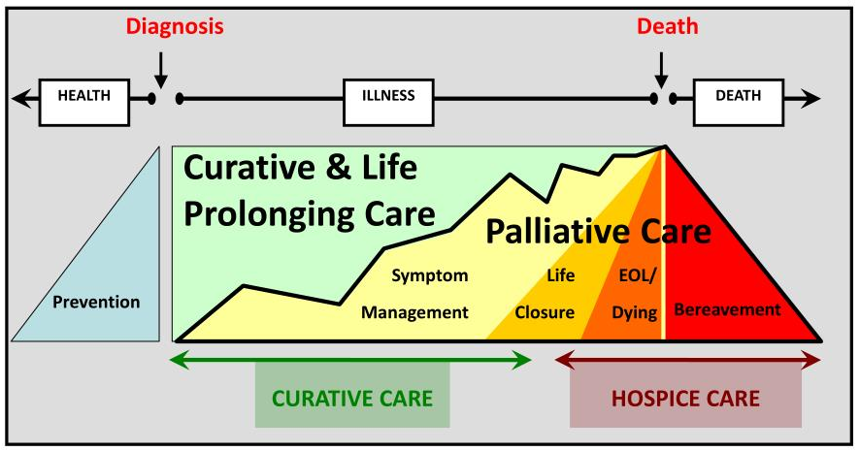
Continuity to outpatient care improves access to PPC services
Offers opportunities to improve access to PPC as well as facilitate care coordination and transitions for children with serious illness.
The bulk of current PPC services are inpatient, yet a large portion of clinical care, symptom management, decision-making, and ACP often occurs in the outpatient and home settings
Figure by a WHO Expert Committee, retrieved from: https://iris.who.int/server/api/core/bitstreams/35e6b75e-5d1d-4e47-8027-23db5a54672f/content on February 24, 2026²
Notes:
FACILITATOR:
Many of you have seen this new model of palliative care that demonstrates a more integrated approach to palliative care from early in the disease course and increasing over time.
However, with strictly inpatient teams where you see different providers each admission, you still run the risk of a choppy integration
Consistent outpatient follow-up throughout the illness trajectory allows for a more seamless integration of palliative care
It’s also important to recognize that some diseases managed in PPC may not have a period of health or prevention before their diagnosis (neonatal insults, congenital or genetic disease, etc) or have any period of “curative” care.

Slide 7
What does outpatient PPC look like?
Models of outpatient palliative care:
  Floating
  Embedded
  Freestanding
  Telehealth
Notes:
FACILITATOR:
- While less important for HPM boards, it is important to recognize the different models of outpatient PPC
Each of these models requires different clinical and IDT staff and its own set of advantages and disadvantages
Floating clinics allows for PC providers to see children with chronic illness in a variety of subspecialty clinic settings
Embedded clinics most commonly seen in conjunction with pediatric oncology
May be operated by either PPC staff or subspecialty staff
Freestanding clinics lead to additional clinic visits for patients and families with increased no-show rate
Less collaboration and communication between specialists
One solution to this is the growth of telehealth clinics, piloting at CHOA in 2026.
Improves accessibility for those with mobility issues, lack transportation, or live in remote areas

Slide 8
Facets of the Outpatient PPC Visit
Assess understanding of illness/disease
Understand goals and accommodation to that disease
Assess psychosocial dynamics
Advance care planning
Provide care coordination
Complex symptom management
Notes:
FACILITATOR:
- These psychosocial dynamics include family structure, support systems for patient and caregivers, school, quality of life, role of spirituality

Slide 9
Interdisciplinary Team (IDT) Roles
Physician/APP
Social Worker
Nurse
Psychology
Child Life
Chaplaincy
Bereavement Coordinator
Notes:
The distinction between many of these roles becomes very blurred depending on individual clinic and hospital resources
Social Worker
Patient/family psychoeducation regarding coping with illness, normalization of stress
Identify and cultivate community resources and practical assistance, financial counseling
Provide perspective on family dynamics and psychosocial factors that may impact care
Individual and family counseling specific to disease process, coping, and planning
Assess and address caregiving resources and needs
Legacy work and memory-making
Bereavement care and grief counseling, including anticipatory responses to and processing of grief
Influence and improving social policy and ethical practice related to HPM
***While an ideal world allows for PC specific SW in the outpatient setting, it often requires collaborating with subspecialty SWs to provide this care in embedded clinics based on resources
Nurses
May be PPC specific or staff of subspecialty service
Helpful with patient and family follow-up regarding symptom management concerns or medication adherence and adjustments
Psychology
Whereas I often view PPC SWs as supporting parents/caregivers/families, pediatric palliative care psychologists provide:
Emotional support
Conduct assessments of psychological well-being of patients/families to help identify mood disorders and evaluate coping mechanisms
Employ various therapeutic techniques (CBT, mindfulness practice, grief counseling, parent and sibling support
Child Life
Specialty training and expertise in child development
Work to provide emotional and spiritual support in a developmentally appropriate way
Tailors an individualistic approach to a child and their family to help cope with difficult hospitalizations, procedures, past experiences.
Can provide education for families around developmentally appropriate ways to discuss serious illness and death and dying with children or siblings.

Slide 10
Who are some additional members of the outpatient palliative IDT?

Slide 11
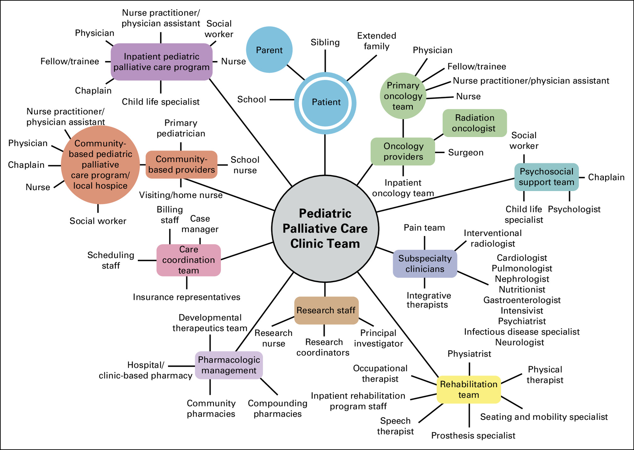
Figure by Brock et al., retrieved from: doi: 10.1089/jpm.2020.0197 on February 24th, 2026.³
Notes:
FACILITATOR:
- Regardless of the staff available within a specific outpatient palliative care clinic, there is a profound communication network involving many of these entities for any given patient.

Slide 12
Liaison between hospital and home
May serve as the physician of record for patients enrolled on hospice
  Hospice agencies have less experience treating children with serious illness or at EOL
Concurrent care hospice
Examples:
  Hands of Hope
  Pediatric Hospice and palliative care of Georgia
Notes:
FACILITATOR:
Hospice agencies rely on our pediatric expertise to help care for these patients
This is particularly true with concurrent style hospice where patients continue to alternate between clinic/hospital and home

Slide 13
Symptom Management

Slide 14
Pain

Slide 15
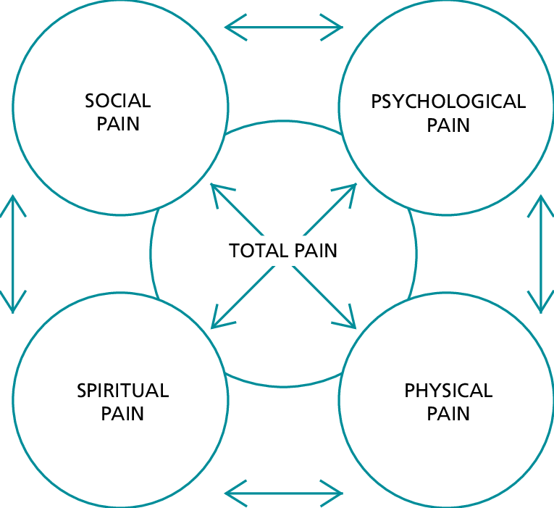
Managing pain in pediatrics requires a total pain approach
Figure by Mehta and Chan, retrieved from https://nursing.ceconnection.com/ovidfiles/00129191-200801000-00008.pdf on March 14, 2026.⁴
Notes:
FACILITATOR:
Like adults, it’s important to consider the concept of total pain when approaching pain management in children.
Must consider the suffering that encompasses ALL of a person’s physical, psychological, social, spiritual, and practical struggles.
In children, these facets can look different:
Physical pain- may not be able to localize and/or vocalize their source of pain
Psychological pain- maybe they are more withdrawn, less into activities or people they previously were
Social pain- school work falters, more distant from friend groups or romantic relationships
Spiritual pain

Slide 16
Pain Physiology
Nociceptive
  Originates from mechanical, chemical, or thermal damage to body tissue
Neuropathic
  Results from abnormal nerve function
    Due to nerve damage by drugs, impingement by tumors, or physical damage to the nerve itself
Nociceptive pain usually responds to conventional analgesics whereas neuropathic pain may not

Slide 17
Nociceptive Pain
Somatic pain
  caused by injury to the skin, other soft tissues, bones, or joints
  Superficial or deep
  Aching, stabbing, throbbing, squeezing, sharp
Visceral pain
  presumably results from activation of nociceptors in the viscera
  Not well-localized
  Cramping, gnawing, squeezing, pressure
Notes:
FACILITATOR:
The visceral nociceptors may be activated by compression, obstruction, infiltration, ischemia, stretching, or inflammation

Slide 18
Pain Severity
<3 years old: FLACC scale⁵
  *Also used for children with developmental disabilities
  F= face, L=Legs, A= Anxiety, C=cry, C= consolability
  0= relaxed and comfortable → 7-10= severe discomfort of pain or both
>3 years old: Wong-Baker FACES Pain Scale⁶
  0= no hurt (happy face)
  10= Hurts worst (tearful face)
Notes:
FACILITATOR:
In pediatrics, pain severity assessment can be much more complicated due to the age or developmental stage of the child.
FLACC scale: Faces, Legs, Activity, Cry, Consolability

Slide 19
WHO Guidelines (2012)⁷
Dosing at regular intervals
(“By the Clock”)
Adapting treatment to the individual child
(“With the Child”)
Using the appropriate route of administration
(“By the appropriate route”)
Using a two-step strategy
(“By the Analgesic Ladder”)

Slide 20
Dosing at regular intervals
When pain is constantly present, analgesics should be administered at regular intervals
  “By the clock” and NOT “as needed”
    PRN = Patient Receives Nothing?
    Regular scheduling ensures steady blood level
    Continually monitoring for side-effects
Aim: Round-the-clock analgesia (with additional PRN analgesia for breakthrough pain or titrating to effect)
Notes:
FACILITATOR:
Regular scheduling reduces the peaks and troughs of PRN-dosing

Slide 21
Adapting treatment to individual child
Tailor treatment to the individual child
  Opioid analgesics should be titrated on individual basis
The effective dose is what relieves the pain
  Different children may respond differently to same dose
  At analgesic dosing-> no sedation expected
Assess response frequently
  Pain Scales
  Look for opioid-induced side effects and toxicity

Slide 22
Using the appropriate routes of administration
Use oral/enteral route, when possible
Alternative routes:
  Intravenous (when patient already has access)
  Sublingual/buccal
  Intranasal
  Transdermal (contraindicated in acute pain)
  Rectal
  Subcutaneous

Slide 23
WHO has moved to 2-step approach for kids No more intermediate step!
WHO Step 2
Moderate to
Severe Pain
Intermediate?
Morphine
or
Oxycodone, Hydromorphone,
Fentanyl, Methadone
WHO Step 1
Mild Pain
Ibuprofen
and/or
Acetaminophen
Other NSAIDs?
Cox-2 Inhibitor?
Tramadol
Codeine
Hydrocodone
Figure by WHO, retrieved from https://iris.who.int/handle/10665/44540 on March 14th, 2026.⁷

Slide 24
Using the WHO two-step strategy
WHO Step 2
Moderate to
Severe Pain
WHO Step 1
Mild Pain
Morphine
or
Fentanyl, Hydromorphone, Oxycodone, Methadone
Ibuprofen
and/or
Acetaminophen
Other NSAIDs?
Cox-2 Inhibitor?
Always consider adjuvants & integrative therapies along side these!
Figure by WHO, retrieved from https://iris.who.int/handle/10665/44540 on March 14th, 2026.⁷
Notes:
FACILITATOR:
Morphine is the gold standard for moderate/ severe pain relief.
WHO guideline Recommendations
Morphine is recommended as the first-line strong opioid for the treatment of persisting moderate to severe pain in children with medical illnesses.
There is insufficient evidence to recommend any alternative opioid in preference to morphine as the opioid of first choice.
Selection of alternative opioid analgesics to morphine should be guided by considerations of safety, availability, cost and suitability including patient-related factors.

Slide 25
Main opioids for Pediatric Use . . .
Morphine*: Gold Standard
Hydromorphone (Dilaudid)
Oxycodone*
Methadone
Fentanyl
  *Not good in renal insufficiency/ failure

Slide 26
. . . Not recommended for pain control
Tramadol (Ultram) for patients under age 12
Codeine (in T3, cough medications)
Meperidine
Nalbuphine (Nubain)
Hydrocodone (Vicodin, Lortab)
Combination analgesia (Vicodin, Lortab, Percocet)
Notes:
FACILITATOR
The FDA and AAP both recommend against use of codeine and tramadol in children <12 years
Ultra-rapid metabolizers cause can result in dangerously high levels of active drug in the body, prompting life-threatening respiratory depression and death

Slide 27
Typical Starting Doses and Intervals
 | Route | Initial dose for children > 6 months. Use mg/kg until 50kg, then adult dose. | Usual dosing interval
Morphine | PO, SL | 0.2 - 0.3mg/kg (10-15mg) | 3-4 hours
 | IV | 0.05 - 0.1mg/kg (2.5 – 5mg) | 2-4 hours
Oxycodone | PO | 0.1 – 0.2 mg/kg (5-10mg) | 4-6 hours
Hydromorphone | PO, SL | 0.04 – 0.08 mg/kg (2-4mg) | 3-4 hours
 | IV | 0.015 mg/kg (0.2-0.6mg*) | 2-4 hours
Fentanyl | IV | 0.5 – 2 mcg/kg (25-75 mcg) | 30 min
Methadone | PO | 0.05-0.1 mg/kg (2.5-5mg) | 8-12 hours
 | IV | 0.025 – 0.05 mg/kg | 8-12 hours
EOL dose and interval will usually be higher and shorter
Infants < 6 months require lower dosing
Table by WHO, retrieved from https://iris.who.int/handle/10665/44540 on March 14th, 2026.⁷
Notes:
FACILITATOR
I will briefly review this, but this table is largely a good table to have as a reference to have for dosing

Slide 28
Myths and barriers to using opioids
Case Scenario:
You are taking care of a child with severe acute pain (e.g. cancer, sickle-cell crisis, major burn etc.). It crosses your mind to administer an opioid such as morphine.
What would be the most common concerns you might hear from your colleagues or parents arguing against opioid use in this child?

Slide 29
Common opioid assumptions
Assumptions act as barriers to appropriate use
Addiction
Over Sedation / Respiratory Depression
Ileus/Gut hypomobility/Constipation
Medication “Too strong”
End of life scenario: “We are giving up”/“Hastening death”

Slide 30
Assumption # 1: Addiction
Important to distinguish between 3 states:
  Tolerance → need to increase dose of opioid over time
  Withdrawal → distressing symptoms occur if opioids discontinued or tapered too fast
  Addiction → a chronic relapsing condition characterized by persistent, compulsive dependence on a behavior or substance despite adverse consequences
  Properly monitored opioid use does not lead to addiction in children

Slide 31
Assumption #2: Over-sedation
Misconception that goal of opioid use is to sedate
Sedation occurs before respiratory depression
  Goal is to provide excellent symptom control (pain, dyspnea) while maintaining function

Slide 32
Assumption #3: Gut hypomotility
No tolerance development to constipation
Gut hypomotility / (sub-) ileus
  Non-opioid analgesics
  Opioids rotation

Slide 33
The hand that forgets the bowel regimen is the hand that disimpacts the patient (*when not neutropenic)
Stool softeners
  1) Osmotic laxatives
    Lactulose 15-30ml PO BID
    Polyethylene glycol (Miralax) 8.5 – 17g PO qday – BID ++
  2) Surfactant laxatives
    Docusate 0.5 – 1mg/kg PO qday – QID
Stimulants
  Senna (< 6 y/o = ½ tab qday, > 6 y/o = 1 tab qday).
    Can be given as suppository
  Bisacodyl 5-10mg suppository qday prn
Others:
  Octreotide (malignant bowel obstruction)
  Low-dose naloxone infusion (0.5-2 mcg/kg/hr for OIC)
  Methylnaltrexone (opioid-induced constipation)

Slide 34
Assumption #4 – We are “Giving Up”
Frequent use of opioids near the end-of-life has led to the myth that they are the cause of death
Proper use of opioids does not cause or hasten death
Multiple adult studies show that palliative patients managed with opioids have a better quality of life and live as long or longer than matched controls

Slide 35
Neuropathic Pain
Notes:
FACILITATOR
The basics of neuropathic pain are similar to that in adult medicine, but it is important to consider some of the dosing and agents that we use more commonly in pediatrics.

Slide 36
Management of neuropathic pain in children
1st line agents:
  Gabapentin (Neurontin)
    Initial dose: 2mg/kg PO TID OR 5mg/kg PO QHS
    Increase by 2mg/kg/dose q2-4 days
    Effective analgesia often 30-45 mg/kg/day (up to 40-60mg/kg/day for <5yo)
    ADE: sedation*, nystagmus, tremor, ataxia, swelling
  Pregabalin (Lyrica)
    Day 1-3: 1mg/kg/dose (50mg max) PO QHS
    Day 4-6: 1mg/kg/dose PO q12h
    Increase q2-4 days to 3mg/kg/dose (max 6mg/kg/dose)
***Both gabapentin and pregabalin must be adjusted for renal dysfunction
Notes:
FACILITATOR:
For those whose pain is exclusively at night, can give half of TDD QHS

Slide 37
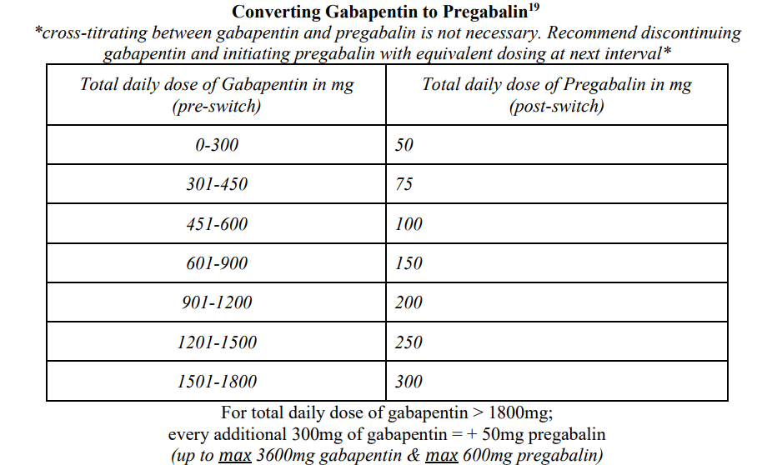
Converting gabapentin to pregabalin
Table by Toth, retrieved from doi:10.1111/j.1526-4637.2009.00796.x on March 19, 2026.⁸

Slide 38
Other agents to consider for neuropathic pain
Tricyclic antidepressants: Amitriptyline, nortriptyline
SNRIs: Duloxetine
  Comorbid anxiety/depression
  Actually, it is 1st line for cancer-related peripheral neuropathy
Clonidine: PO or patch

Slide 39
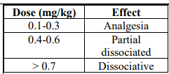
Other agents for pain management
Ketamine dosing:
Acetaminophen:
  10-15mg/kg q4-6 hrs
NSAIDs
  Ibuprofen (not in infants <6 mos)
  Naproxen
  Ketorolac
  Celecoxib*
Topical agents
  Lidocaine patches
  Diclofenac gel
Steroids
Can be used but not commonly in outpatient setting:
  Bisphosphonates (pamidronate, zolendric acid)- metastatic bone pain, hypercalcemia
  NMDA Antagonists (ketamine)- opioid-sparing analgesia
  Dexmedetomidine (precedex)- ICU setting
  Lidocaine infusion
  Interventional approaches
Table from Hoang, retrieved from: https://emottawablog.com/2018/07/update-from-the-k-hole-ketamine-in-the-ed/ on March 18, 2026.⁹
Notes:
FACILITATOR:
Important to remember that celecoxib has minimal to no inhibition of platelet function (for our oncology patients)

Slide 40
Integrative pain management . . .
Combine pharmacological management with supportive/ integrative therapies
Physical methods (e.g. cuddle/hug, massage, comfort positioning, heat, cold, TENS)
Cognitive behavioral techniques (e.g. guided imagery, hypnosis, abdominal breathing, distraction, biofeedback)
Acupuncture, acupressure, aromatherapy

Slide 41
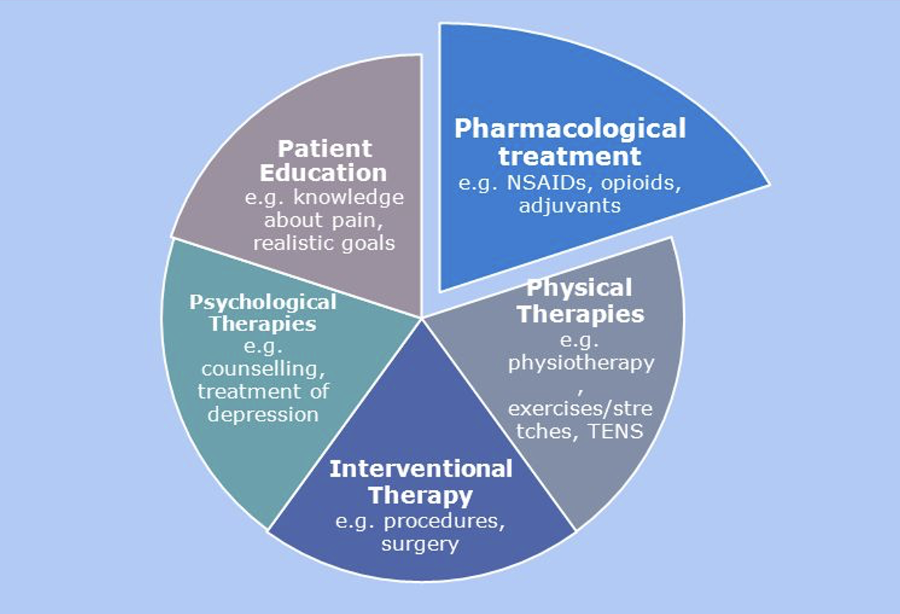
Multimodal Pain Management
Figure from Pergolizzi, retrieved from: doi:10.1185/03007995.2013.810615 on March 18, 2026.¹⁰
Notes:
FACILITATOR:
- Just to wrap up, we primarily focused on pharmacological treatment today, but I would be dishonoring Cecily Saunders if I didn’t discuss the importance of these other means of managing total pain
Rehabilitative interventions such as PT, OT, hydrotherapy, heat/cold therapies, other forms of neurostimulation (like TENS units)
Interventional strategies like nerve blocks, radiation, ablation
Psychological treatments such as psychoeducational interventions, CBT, relaxation, guided imagery, hypnotherapy, psychotherapy
Additionally, it is good to think about complementary/alternative or integrative strategies, many of which have good data around their benefit in pain management
Acupuncture, massage, music therapy, art therapy

Slide 42
Non-pain symptom management in children
Nausea/vomiting
Constipation
Anorexia
Fatigue
Anxiety
Depression
Dyspnea

Slide 43
Nausea & Vomiting - Common Etiologies
Increased ICP, meningeal irritation, anxiety→ Cortex
Motion sickness, vestibular disorders→ Vestibular system
Drugs, inflammation, metabolic disorders, tissue damage→ Chemoreceptor trigger zone (CTZ) & GI tract
The cortex, vestibular system, CTZ, and GI tract act on vomiting center → emesis
Notes:
FACILITATOR:
CNS: ⬆ ICP, Vestibular activation, drug effect
Psych: Anticipatory, uncontrolled pain
Drugs: chemotherapy, antibiotics, opioids
Metabolic: uremia, acidosis, hypercalcemia, hepatic/renal failure
Endocrine: adrenal failure
GI: mucositis, thrush, GERD, obstruction, ileus, constipation
Cardiac: heart failure

Slide 44
Nausea & Vomiting - Non-pharmacologic Management
Small meals (chosen by child)
Avoid discomforting smells
Aromatherapy (lemon/citrus, peppermint, isopropyl alcohol)
Ginger, peppermint
Hypnosis, breathing techniques, guided imagery
Acupressure (P6 point)

Slide 45
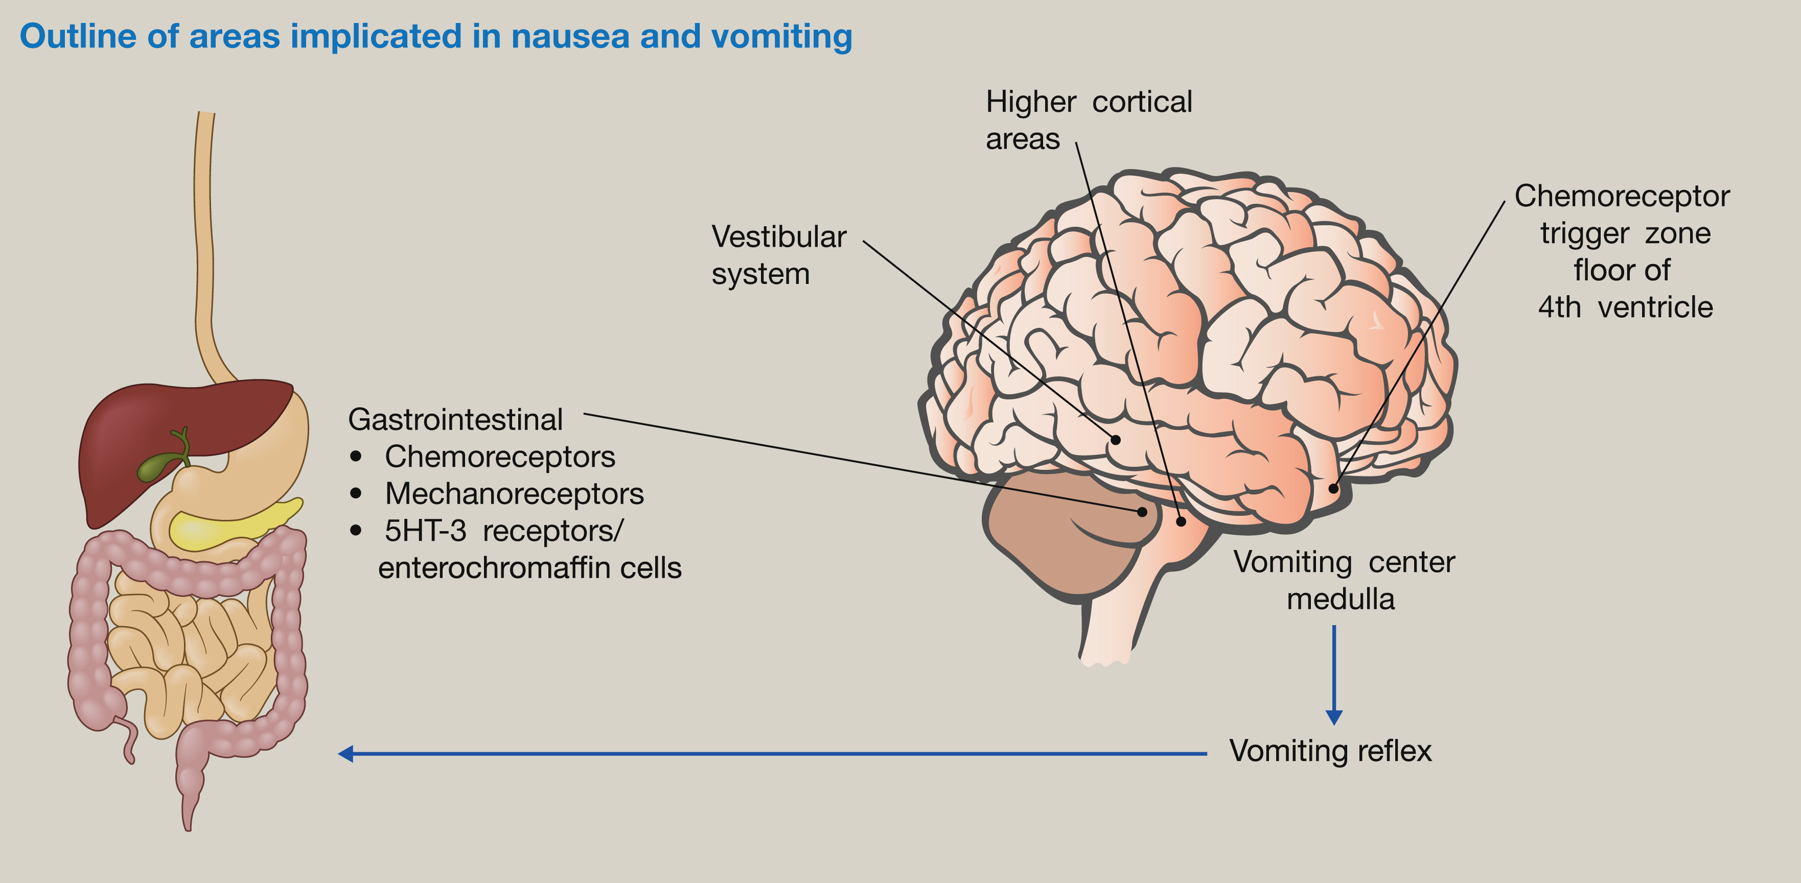
Nausea & Vomiting - Pharmacologic Management
All about the pathways
Med classes:
  5HT₃
  H₁
  D₂
  Acetylcholine
  Neurokinin₁
  Steroids
  THC
  Benzos
Figure by Denholm and Gallagher, retrieved from: doi:10.1016/j.mpaic.2021.07.002 on March 19, 2026.¹¹
Notes:
FACILITATOR:
- Drug examples:
5HT3: ondansetron, granisetron, palonosetron
H1: diphenhydramine, meclizine, cyproheptadine
D2: metoclopramide, haloperidol, olanzapine
Ach: scopolamine, promethazine
NK1: aprepitant
Steroids can be particularly helpful for CNS issues
Avoid using drugs from the same class
Consider adding arrows to where the different classes act! (see blue book)

Slide 46
Constipation
Osmotics (“Mush”)
  Polyethylene glycol, lactulose, milk of magnesia
Stimulants (“Push”)
  Senna, bisacodyl
Whoosh (“Enema”)
  Sodium phosphate (Fleet), soap suds, saline
Glycerin suppositories
Mu receptor antagonists
  Methylnaltrexone

Slide 47
Anorexia
Very commonly seen in our oncology population
Two commonly used agents:
  Cyproheptadine (Periactin)
  Dronabinol (Marinol)
Other agents:
  Olanzapine (Zyprexa)- with comorbid CINV
  Mirtazapine (Remeron)- with comorbid anxiety/depression
Notes:
-

Slide 48
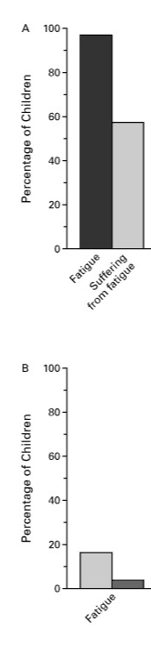

Fatigue
Degree of Suffering from Fatigue in the Last Month of Life.
Success of Treatment of in the Last Month of Life.
“Sometimes all I can do is lay down. Can’t even make it up the stairs.”¹²
“My friends were all jumping around and having fun and I would just be sulking around. It was like I wasn’t really there.”¹³
Figure by Wolfe et al, retrieved from doi:10.1056/NEJM200002033420506 on March 19th,2026¹²
Notes:
FACILITATOR
I want to touch on fatigue because while it may not be the most common symptom we see amongst all patients with serious illness, it is one of the most common and most commonly unaddressed symptoms experienced by children with cancer
Figure
Panel A shows the percentages of children who, according to parental report, had a specific symptom in the last month of life and who had “a great deal” or “a lot” of suffering as a result.
Panel B shows the percentages of children who, according to parental report, were treated for a specific symptom in the last month of life, and in whom treatment was successful (rather than “somewhat successful” or “not successful”).

Slide 49
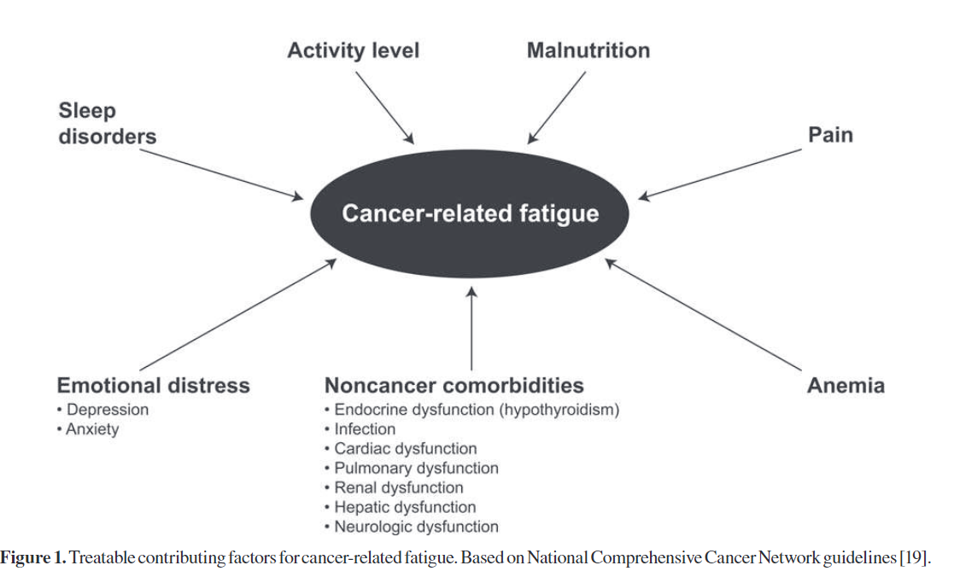
Figure by Mustian et al., retrieved from doi:10.1634/theoncologist.12-S1-52 on March 19, 2026.¹⁴
Notes:
FACILITATOR:
As you can see, there is a lot that can contribute to fatigue, so it is important to take a detailed history and tailor treatment to the underyling cause:
Sleep issues; tailor treatment around improved sleep hygiene
Mood-related issues- tailor treatment to include behavioral interventions, SSRIs/SNRIs, more indepth psychosocial assessment
Disease-related issues (anemia, endocrinopathies, malnutrition)
Impact on daily and social functioning

Slide 50
Management of Fatigue¹⁵⁻¹⁸
Integrative Approaches
  Exercise/physical activity
  Mindfulness
  Cognitive behavioral therapy (CBT)
Pharmacologic therapy
  Methylphenidate
    Short acting (Methylin, Ritalin)
      Children 3-5 years: 1.25 mg in the AM and again at around noon
      Children ≥ 6 years, <50kg : 2.5-5 mg in the am and around noon
      Children >50kg: 5 mg in AM & around noon. Can consider a 3rd dose at 4 pm
      S/e: decreased sleep and appetite
    Long Acting (Concerta)
      Usually start at around 18 mg and increase from there

Slide 51
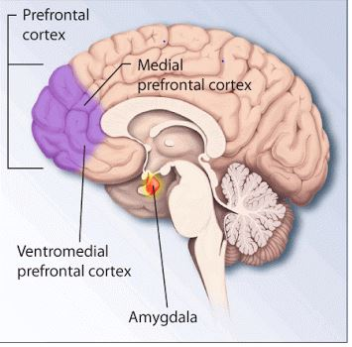
Anxiety¹⁹⁻²⁰
~20% of children with serious illness
Hyperresponsive amygdala and hyporesponsive medial prefrontal cortex
Neurochemical imbalances (serotonin, norepinephrine, GABA)
Distressing, impairs functioning
Image from https://www.researchgate.net/figure/Medial-view-of-prefrontal-cortex_fig1_259484014.²¹
Notes:
FACILITATOR:
With some disease populations upwards of 50% reporting anxious feelings

Slide 52
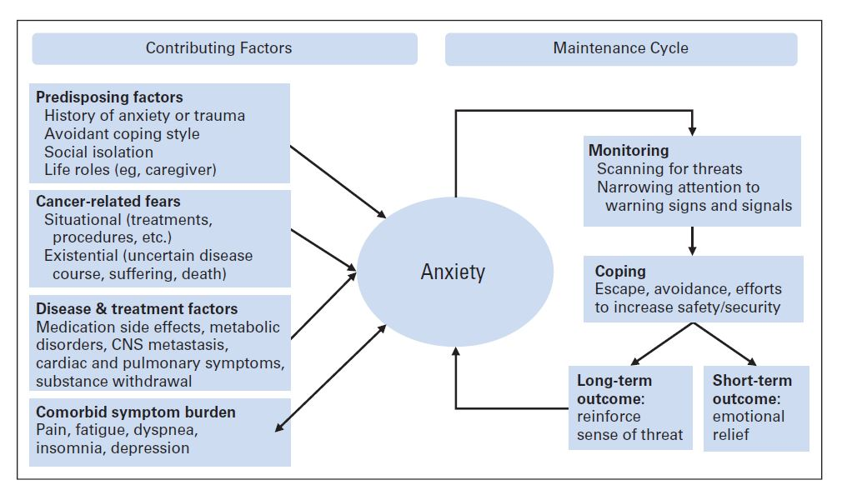
Factors influencing development of anxiety for seriously ill patients
Figure by Traeger, et al., retrieved from . doi:10.1200/JCO.2011.39.4662 on March 19, 2026.²²

Slide 53
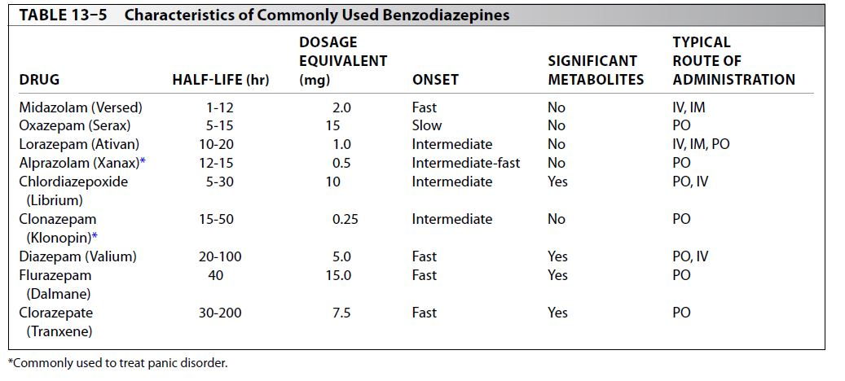
Management of anxiety²³⁻²⁵
Integrative Approaches
  Sleep hygiene
  Exercise
  Relaxation techniques
  Distraction
  Stress management
  Mindfulness
  Cognitive Behavioral Therapy
Pharmacotherapy
  Benzos used for immediate relief with bridge to SSRI/SNRI
Table by Sadock et al., Kaplan & Sadock’s Comprehensive Textbook of Psychiatry. 9th ed., Lippincott Williams & Wilkins; 2009. ²⁶
Notes:
FACILITATOR
Gold standard is psychotherapy + SSRI

Slide 54
Pharmacologic management of anxiety²⁷
Start low and work up. Higher doses often required for efficacy.
SSRI (first-line agents)
  Sertraline (starting 25-50mg. Increase qwk to max 100-200mg daily)
  Citalopram/ Escitalopram (5-10mg. Max 40mg)
SNRI (if also has neuropathic pain)
  Duloxetine (starting 30mg. Increase q2 wks. Max 60mg BID)
  Venlafaxine
TCA ** not in suicidal patients as overdose results in cardiotoxicity **
  Amitriptyline
  Nortriptyline
  S/e: sedation, orthostasis, urinary retention, dry mouth
Atypical anti-psychotics:
  Quetiapine 12.5-25mg
  Olanzapine 2.5-5mg
Mirtazapine (15mg. Max 45mg PO qday)
  Second line, atypical anti-depressant
  Serotonin and histamine agonist
  Can be adjuvant to SSRI
  “S/e”: sedation, appetite stimulation
Buspirone (5mg qd. Titrate to max 30mg BID)
  Non-addictive anxiolytic
  Useful if benzos contraindicated
  Affinity for D2 and 5HT31 (serotonin)

Slide 55
Depression
Prevalence and incidence of anxiety and depression among children, adolescents, and young adults: a systematic review and meta-analysis (Barker MM et al., JAMA Pediatrics 2021). ²⁸
  Includes cancer, CF, HIV, thalassemia, neurologic and kidney disease.
  Most common assessment tools were the Hospital Anxiety and Depression Scale (anxiety) and the Children’s Depression Inventory (depression).
  Depression pooled prevalence 14.3% (range 0.0%-50.0%)
    HIV - highest pooled depression prevalence (24.2%)
  Severe disturbance can lead to poor QOL, worse pain, impaired family relationships.

Slide 56
Definitions²⁹
  DSM-V for full definitions… in brief:
  “Adjustment disorder” - Maladaptive response to stress
    Occurs within 3 months of stressful event
    Persists for no longer than 6 months.
    Impairs social functioning.
  “Depression” – a word and a syndrome.
    Transient feelings of discouragement, disappointment, sadness, grief, existential despair, or despondency (Depression)
    A discrete episode of low mood and neurovegetative symptoms (Major Depressive Episode)
    (3) A relapsing, remitting syndromal illness (Major Depressive Disorder)

Slide 57
DSM 5 Criteria for Major Depression(s):²⁹
Dx requires 4 or more of symptoms below along with:
depressed mood or anhedonia for > 2 weeks
Sleep disturbance (increased or decreased)
Interests (diminished)
Guilt (or preoccupation of thought)
Energy (decreased)
Concentration (decreased)
Appetite disturbance (increased or decreased)
Psychomotor (agitation or retardation)
Suicidal thoughts (or thoughts of death)
Also assess for irritability as this is common symptom in young/ school age kids!
Includes patients dealing with bereavement (a change from DSM-IV)
Bereavement: Often months to two years. Can be a severe stressor that precipitates a major depressive episode.
Bereavement-related depression: symptoms respond to the same treatment

Slide 58
Management of Depression²⁹
Gold standard: psychotherapy + pharmacotherapy
  Psychotherapy
    Cognitive Behavioral Therapy*
    Psychodynamic therapy, dignity therapy, existential psychotherapy, group therapy
  Pharmacotherapy
    SSRIs, SNRIs
    Atypical antidepressants
    Tricyclic antidepressants (particularly with pain)
    Psychostimulants
    Anti-psychotic medication (adjuvant)
Notes:
FACILITATOR:
CBT is the most commonly used in pediatrics

Slide 59
Pharmacologic management of depression²⁹
Start low and work up. Higher doses often required for efficacy.
SSRI (first-line agents)
  Sertraline (starting 25-50mg. Increase qwk to max 100-200mg daily)
  Citalopram/ Escitalopram (5-10mg. Max 40mg)
SNRI (if also has neuropathic pain)
  Duloxetine (starting 20mg. Increase q2 wks up to 60mg)
  Venlafaxine
TCAs
  Amitriptyline
  Nortriptyline
  S/e: sedation, orthostasis, urinary retention, dry mouth
Atypical anti-psychotics:
  Quetiapine 12.5-25mg
  Olanzapine 2.5-5mg
Mirtazapine (15mg up to 45mg/day)
  Serotonin and histamine agonist
  Can be adjuvant to SSRI
  “S/e”: sedation, appetite stimulation
Trazodone
  Often used as a sleep adjuvant
Methylphenidate (psychostimulant)
  1st line monotherapy for depression at EOL
Notes:
FACILITATOR
As you can see, this is quite similar to our management of anxiety with a couple additions

Slide 60
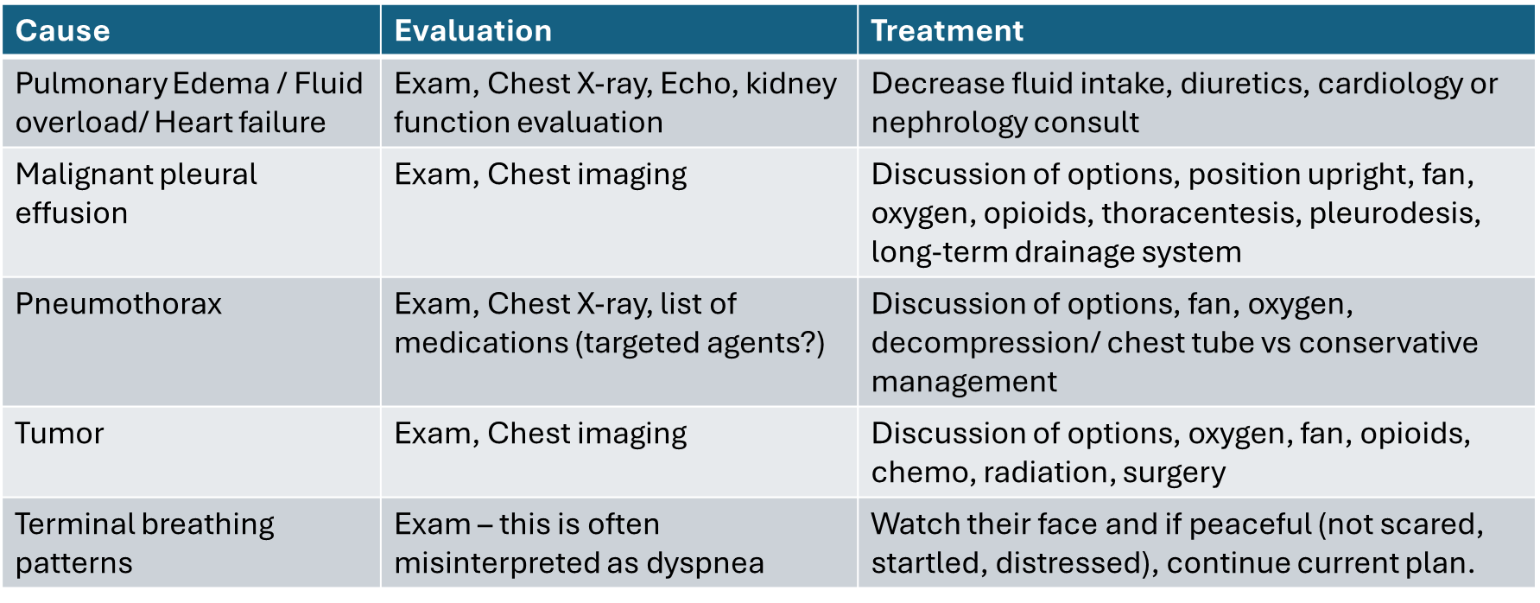
Dyspnea
Table adapted by Brant JM., retrieved from: doi:10.6004/jadpro.2013.4.6.4 on March 21,2026³⁰
Notes:
FACILITATOR
Management of dyspnea in children very similar to management in adults, including the anticipatory guidance of family members, in this case, the parents.
It is always important to evaluate and treat the underlying cause of the dyspnea if possible

Slide 61
Management of ^{Dyspnea 30-32}
Integrative Approaches
  Repositioning
  Fan
  Oxygen*
  Anticipatory guidance
Pharmacologic Therapy
  Opioids are 1st line
    If pain, use prn dose
    If no pain, use 1/3-1/2 of pain dose
  Benzodiazepines
  Anticholinergics (if secretions)
  Bronchodilators (hx of asthma)
Notes:
FACILITATOR
Fan to the face stimulates the 2nd and 3rd branches of trigeminal nerve
HIGH YIELD→ Oxygen works by same mechanism as a fan. Can be useful when patient is hypoxic
Important to remember that the parent may want this more than the child

Slide 62
Symptom Management in Children with Impairment of Central Nervous System
Notes:
FACILITATOR:
To this point, we’ve discussed our general pediatric approach to many of the common symptoms seen in children, particularly those with normal development.
BOOK: Caring for Children Who Have Severe Neurological Impairment by Julie M. Hauer MD

Slide 63
Pain behaviors in children with severe neurologic impairment (SNI)
Vocalizations: crying, moaning
Facial expressions: grimacing, frowning, brow furrowing, eyes wide open
Inconsolability
Interaction: seeking comfort or withdrawn
Physiological: tachycardia, sweating, pale or flushed, tears
Muscle tone: intermittent muscle tensing, fist clenching, tremors, back arching
Movement: increased from baseline, restless, startles
Notes:
FACILITATOR
Inconsolability: not consoled by parent comfort actions, difficult to calm

Slide 64
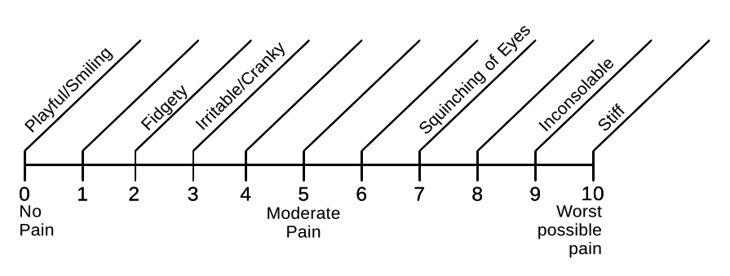
Individual Numeric Rating Scale (INRS)
Figure by Solodiuk JC & Curley MA, retrieved from: doi:10.1016/S0882-5963(03)00090-3 on March 22, 2026.³³
Notes:
FACILITATOR
Parents are able to write in their child’s typical pain behaviors on the lines from 0-10

Slide 65
Chronic neuro-pain
Children with SNI are at increased for chronic neuro-pain
Signs/symptoms:
  Frequently not calm
  Intermittently agitated, irritable, cranky without a consistent explanation
  Chronic poor sleep
  Persists after treating autonomic dysfunction, spasticity/dystonia, GERD, constipation, feeding intolerance
Not explained by testable chronic pain sources
  Dental, hip subluxation, chronic dry eyes, renal stones

Slide 66
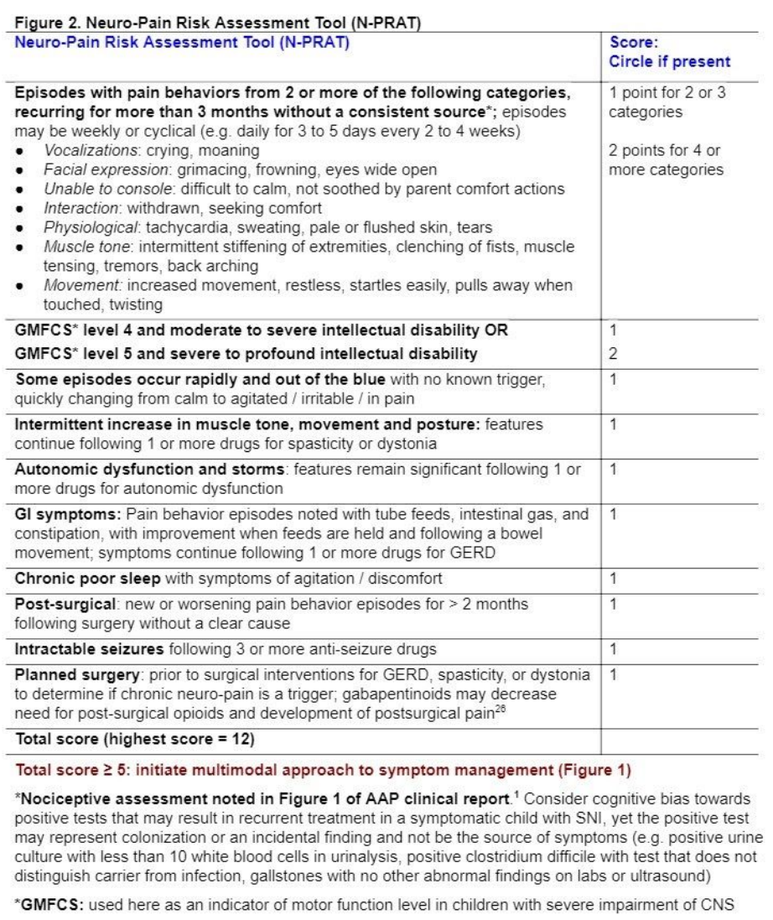
Chronic neuro-pain
Figure by Hauer J. retrieved from: doi:10.3928/19382359-20200816-01 on March 22,2026.³⁴
Notes:
FACILITATOR
Neuro-Pain Risk Assessment Tool (N-PRAT)
Here for reference but this is an assessment tool that can aid decision-making around starting and adjusting treatment for chronic neuro-pain.

Slide 67
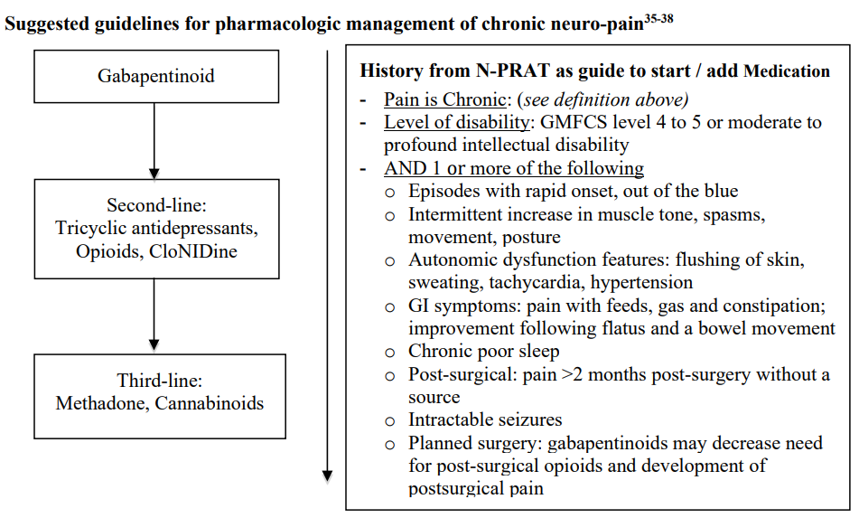
Management of chronic neuro-pain
Initiate a gabapentinoid with defined goals of treatment
Initial trial: 3-4 weeks
Max out 1st line, then add 2nd or 3rd drug if symptoms persist or new sources arise
Figure by Hauer J. retrieved from: doi:10.3928/19382359-20200816-01 on March 22,2026.³⁴
Notes:
FACILITATOR:
Goals of treatment may include pain reduction, improved sleep, and improving feeding tolerance
May have some initial sedation. If sedation persists with good symptom control, can consider reducing other sedating meds
Despite multiple trials, some of these kids still don’t get adequate control of these symptoms related to impaired central nervous system (CNS)

Slide 68
Breakthrough symptoms can still occur
Assess for new pain source
Consider GI tract distention
Review co-morbid problems (GERD, spasticity, dystonia, sleep)
If persistent, add 2nd or 3rd line
Notes:
FACILITATOR:
While chronic neuro-pain can be managed with scheduled medications, it is not cured and many kids still have breakthrough symptoms
This is an important piece of anticipatory guidance to give families
GI tract distention from constipation or too much feeds (metabolism may have decreased)

Slide 69
Non-pharm strategies to promote comfort in children with SNI
Comfort strategies- cuddling, rocking, massage, warm baths, music, adjusting feed rate, venting G-tube
Positional- repositioning, supportive seating systems/bedding
Sensory- weighted blankets, vibratory mats or pillows
Integrative- essential oils, aromatherapy, Reiki, acupressure

Slide 70
Pharmacologic management in children with SNI
Autonomic dysfunction- clonidine, gabapentin, propranolol
Central neuropathic pain/visceral hyperalgesia
Spasticity- baclofen, tizanidine, clonidine, diazepam
Dystonia- trihexylphenidyl, clonidine
Myoclonus- clonazepam
Insomnia- melatonin
Notes:
FACILITATOR:
Won’t go into full detail as you get additional lectures on children with SNI with our specific Emory HPM Pediatric Palliative Care Curriculum but these are a few therapeutic options to consider with these symptoms
- Since many of these symptoms are chronic and fluctuate in intensity, close outpatient follow-up is important in managing these challenging symptoms
Clonidine: better tolerated in children unable to stand (reduces orthostatic hypotension)
Melatonin: often needs higher doses in children with SNI (up to 10-12mg nightly)
Tizanidine: less commonly used in younger children

Slide 71
Death and Dying in PPC
Notes:
FACILITATOR:
In outpatient PPC, we have a unique opportunity to gradually (or not so gradually) support patients and families as they prepare for the death of their child diagnosed with a life-limiting illness.

Slide 72
Children who receive early PPC³⁵⁻³⁹
Improved
Patient & Parent QOL
ACP discussions
Reduced
Symptom burden
Intensity of therapy at EOL
Psychosocial distress during bereavement
Hospice enrollment
Dying at home
Meaningful experiences
Figure by author
Notes:
FACILITATOR:
Many of the benefits that come from early PPC are seen when we examine the EOL experience for children and their families.

Slide 73
Supporting families of children with life-limiting illness
May be mostly parents, mostly patient (AYAs), or a combination of both
Important aspects:
  Prognostic awareness: “days to weeks,” “weeks to months”
  Decision-making
    Role of interventions (medications, nutrition, hydration, surgeries, etc)
    Location of care/death and ACP
  Anticipatory grief and bereavement
  Memory-making and legacy work
  Sibling support
  Symptom management
Notes:
FACILITATOR:
Depending on the age of the child, many of these conversations may be only parents, mostly child, or combination of both
Prognostic awareness can be very challenging in pediatrics
Role of interventions:
Will this intervention increase the child’s QOL?
What burdens may this intervention impose?

Slide 74
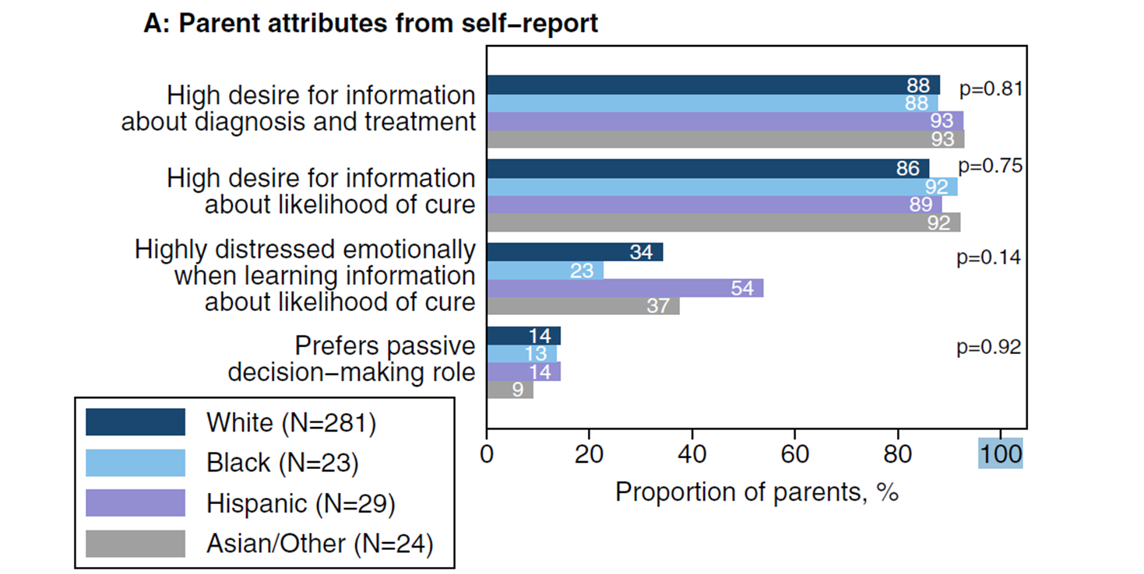
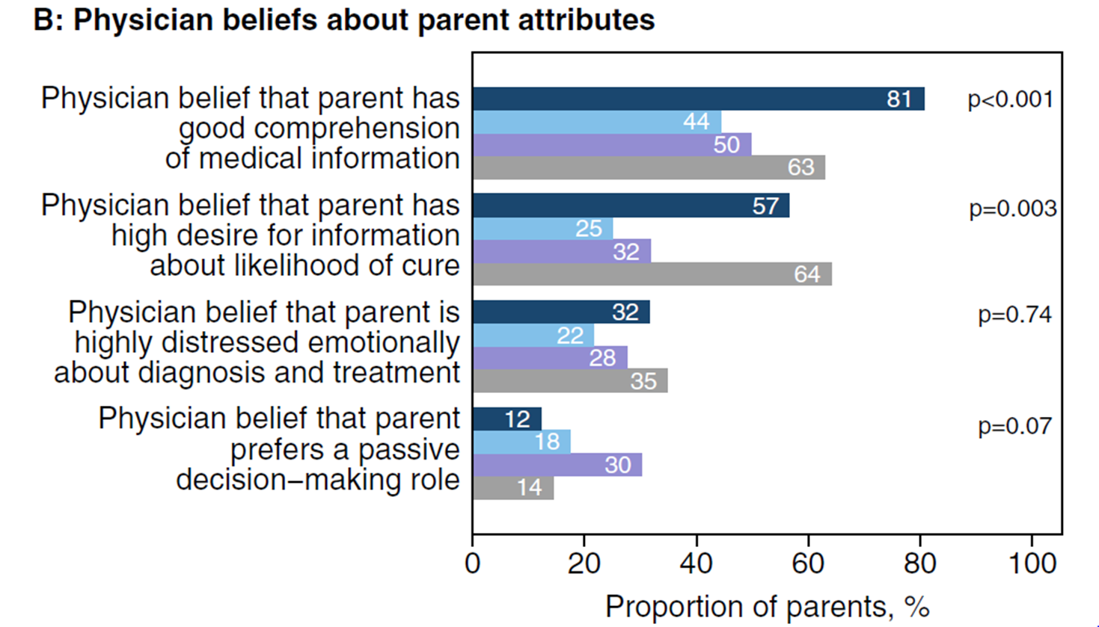
Discussing prognosis with parents
ADAPT model for prognostic awareness (VitalTalk)
Often underestimate the amount of information parents wish to hear
Figure by Ilowite MF, et al., retrieved from: doi:10.1002/cncr.30849 on March 22, 2026.⁴⁰
Notes:
FACILITATOR:
Seen the ADAPT model through VitalTalk which can be a useful model for discussing prognosis throughout a child’s disease course and particularly as they approach EOL. Not a one-time conversation
Goal is to prepare families for what to expect
Information should be provided honestly but with empathy
In pediatrics, we often underestimate the amount of prognostic information to provide families
Approx 90% of families had a high desire for information about diagnosis, treatment, and likelihood of cure
With a smaller percentage experiencing significant emotional distress around this
What’s interesting is the discrepancy between parents and physicians regarding the information they want to hear. This particular study looked at racial and ethnic disparities
This can be a useful model for discussing prognosis with parents, but what about with the child

Slide 75
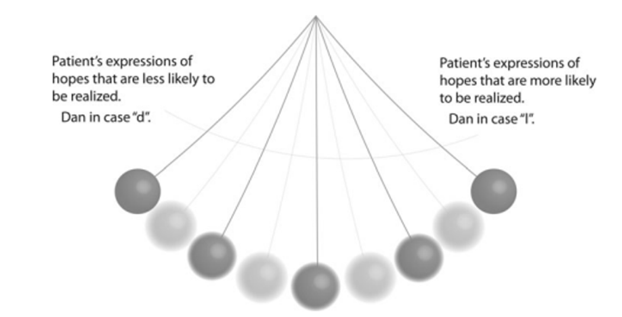
“I’m afraid of taking away hope…”⁴²⁻⁴⁷
Withholding prognostic info associated with:
  More regret and lower levels of hope
  Less peace of mind
Parents given more elements of prognostic disclosure were more likely to report communication-related hope, even when the likelihood of a cure was low
Disclosure of prognosis by the physician should occur early and as things change
  This can support hope, even when prognosis is poor.
Provides an opportunity to diversify hopes
    *People can hope for a miracle/ cure AND at the same time, know they’re going to die.
Figure adapted from Jacobsen et al., adapted from: doi:10.1089/jpm.2013.0254 on March 22, 2026.⁴¹
Notes:
FACILITATOR:
A common misconception among physicians is the worry that communication around prognosis takes away a parent’s hope. In fact, it is just the opposite when provided in an honest and empathic way. And within that diversity of hopes, it’s important to realize that families can swing between these hopes like a pendulum

Slide 76
Discussing prognosis with children⁴⁸
Parents’ desire to be honest but protect their child’s hope
Most children are aware of:
  Changes to their bodies
  Changes to the treatment plan
  Verbal and nonverbal cues from their parents or medical team
Speaking with their parent may reduce anxiety and provide a sense of safety/comfort
Opportunity to more fully participate in their care
Notes:
FACILITATOR:
While the ADAPT model may be a good model for discussing prognosis with parents, what about when the conversation is happening with the child?
Many parents find this is one of the most daunting aspects of their caregiver journey

Slide 77
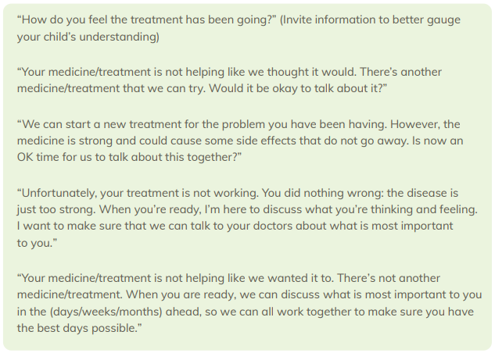
Figure by Courageous Parents Network, retrieved from: https://courageousparentsnetwork.org/guides/ on March 24,2026 ⁴⁸

Slide 78
Parent decision-making
Nearly 90% of parents either prefer shared decision-making or parent-led decisions…ASK!⁴⁴
It’s up to the family to make decisions in the best interest of the child⁴⁹
Expect decisional regret
Don’t be afraid to make recommendations
  And be okay if they don’t agree!
Don’t provide bad choices
Notes:
FACILITATOR:
Similar to adult medicine, shared decision-making is still the gold standard.
The only way to do that is by eliciting goals and values, their hopes and worries, preferences, social and culture factors⁴⁹
And in pediatrics, it’s important to recognize the role that parents want to play in that shared decision-making
Okay to make recommendations ONLY after you have a clear understanding of their goals/values

Slide 79
Power struggle between treatment and QOL
Concurrent style hospice
  Allows both hospice services and treatments for their disease
Serves as a bridge to full hospice care
Allows maintenance of primary providers
Notes:
FACILITATOR:
One of the biggest decisional struggles parents have is this balance between continuing to receive disease-directed treatment and optimizing their child’s quality of life and limiting suffering
Many kids will continue to receive disease-directed therapy (particularly when low risk or minimal symptom burden) up until their death
Since most hospice agencies primarily treat adults, they may has less expertise in managing children at EOL. This often becomes a role of outpatient PPC providers.

Slide 80


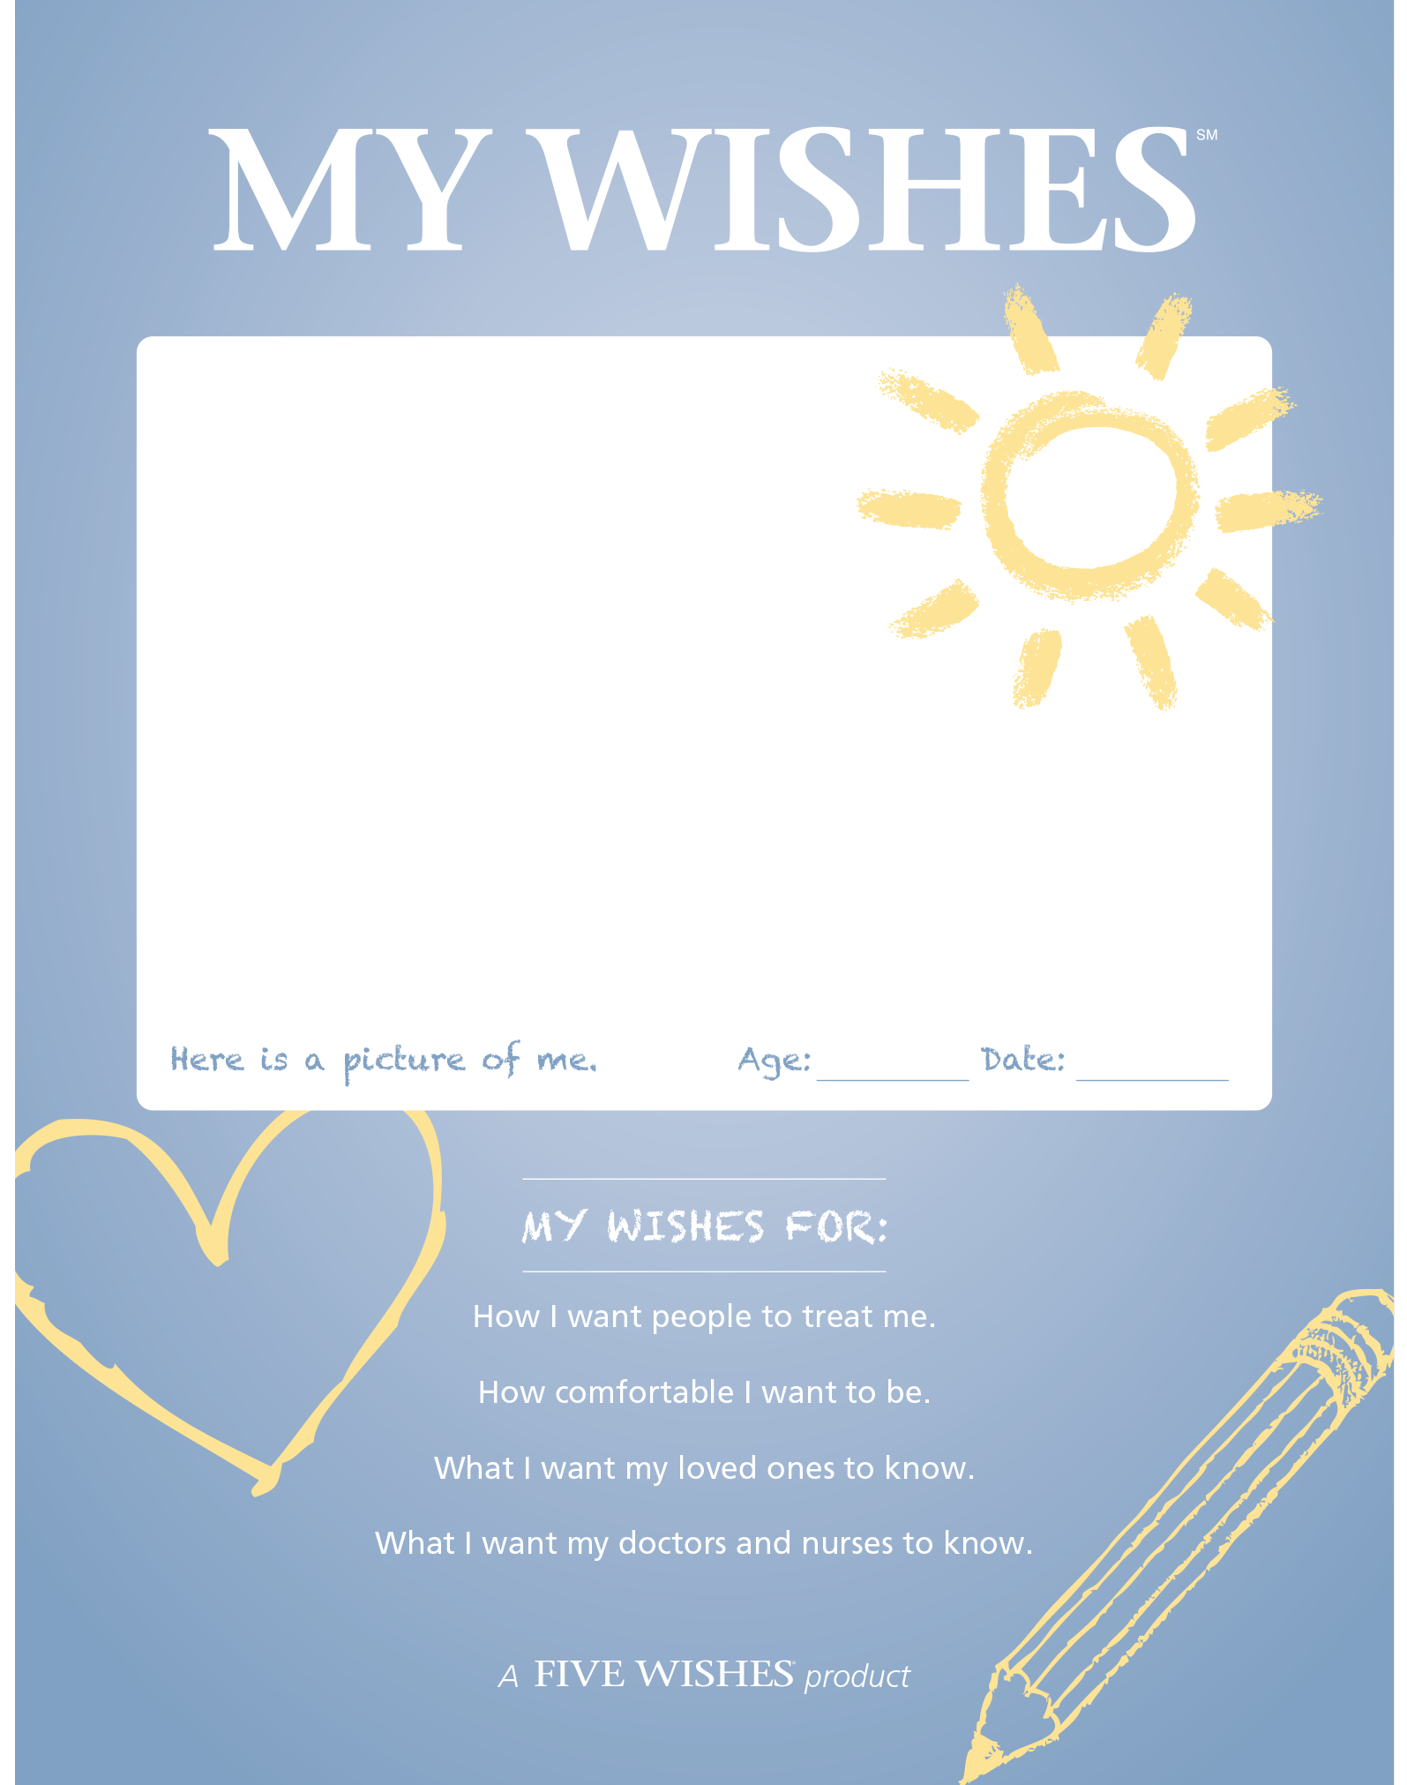

Advance Care Planning
Image from https://www.voicingmychoices.org⁵⁰
Image from https://fivewishes.org⁵²
Image from https://prepareforyourcare.org⁵¹
Advance care planning gives them control when they feel they’ve lost it all.
Image from https://fivewishes.org⁵³
*Dussel V. Looking beyond where children die: determinants and effects of planning a child's location of death. J Pain Symptom Manage. 2009⁵⁴
Notes:
When considering how we guide older children and AYAs, we often use decision-making tools or advance care planning to guide these conversations around what’s most important to them.
Engaging in ACP allows patients and families to spend their time the way they want and increases goal-concordant care.
Most of them die in their preferred location of death, have fewer hospital admits
Parents feel better prepared with less regret during their bereavement
Despite this, we know that we aren’t very good at having these conversations.

Slide 81
Room for improvement in ACP
“Did you feel prepared to address your child’s ____ during the EOL?”
N= 130 parents | Medical Needs | Emotional needs
Very prepared | 9% | 9%
A little/somewhat | 54% | 50%
Not at all | 37% | 41%
It’s called ACP… because it happens in advance!!
  Bucket list
  Legacy building/ memory making activities
  Dying process
  Decision maker/health care proxy
  Code status
  Location of EOL care and death
  Burial/cremation
  Autopsy
Table by Wiener L et al., retrieved from doi:10.1002/pbc.28093 on March 24,2026.⁵⁵

Slide 82

Supporting siblings of children with life-limiting illness
Siblings may feel:⁵⁶
  Abandoned, invisible, or alone
  Jealous/desire to also be sick
  Guilt or relief
  Pressure to achieve/be perfect
  Fearful of the future
Child life, psychology, and SW can help navigate and guide families in supporting siblings
Image from Karst P. The Invisible String. Illustrated by Stevenson G. DeVorss & Company; 2000.⁵⁷
“People who love each other are always connected by a very special String made of love. Even though you can’t see it with your eyes, you can feel it deep in your heart and know that you are always connected to the ones you love.”
Notes:
FACILITATOR:
One of the other major challenges parents have as they navigate a child with a life-limiting illness is how to support the child’s siblings
This a book we frequently recommend for parents navigating these conversations with siblings.
It is a simple story that reminds children and adults they are never truly alone

Slide 83
Considerations as death nears
How the parent can support their child at EOL
How to make meaning and live life now
Who they wish to spend their time with before and at EOL
How they want to be comforted
What and how to honor faith traditions and cultural preferences
What they want their legacy to be
Notes:
FACILITATOR:
-In the outpatient setting, these are conversations we can have in collaboration with the primary team, SW, child life, their school, chaplaincy or community religious organizations, and hospice.

Slide 84
Focus on what parents can do to provide comfort to a child who is dying
Provide your child with the familiar voices, sounds, and touch that will comfort them the most (read favorite books, psalms, listen to music, soothing smells)
  Child life assistance
Continue to bathe, change the position of his/her body, and watch for signs of discomfort.
Practice prayer, rituals and other cultural expressions of importance
  Chaplain, home spiritual advisor assistance
Complementary therapies such as massage and Reiki are often welcomed by families as hands on healing of the child.
Notes:
FACILITATOR:
-When it comes to guiding parents, focus on what they CAN do to comfort their child.

Slide 85
References
Traeger L, et al. Depression, anxiety, and pain in patients with cancer: a longitudinal study. J Clin Oncol.2012;30(23):2887-2893. doi:10.1200/JCO.2011.39.4662
Sampalli T, Dickson R, Hayden J, Edwards L, Salunkhe A. Meeting the needs of a complex population: a functional health- and patient-centered approach to managing multimorbidity. J Comorb. 2016;6:76-84. doi:10.15256/joc.2016.6.83
Cancer pain relief and palliative care. Report of a WHO Expert Committee. World Health Organ Tech Rep Ser.1990;804:1-75. PMID:1702248.
Brock KE, DeGroote NP, Allen KE. Behind the scenes: care coordination time in an outpatient pediatric palliative oncology clinic. J Palliat Med. 2021;24(3):413-417. doi:10.1089/jpm.2020.0197
Mehta A, Chan L. Understanding the concept of “total pain”: a prerequisite for pain control. J Hosp Palliat Nurs.2008;10:26-32.
Merkel SI, Voepel-Lewis T, Shayevitz JR, Malviya S. The FLACC: a behavioral scale for scoring postoperative pain in young children. Pediatr Nurs. 1997;23(3):293-297.
Wong-Baker FACES Foundation. Wong-Baker FACES® Pain Rating Scale. Published 2022. Accessed February 20, 2026. http://www.WongBakerFACES.org
WHO Guidelines on the Pharmacological Treatment of Persisting Pain in Children With Medical Illnesses. Geneva, Switzerland: World Health Organization; 2012.
Toth C. Substitution of gabapentin therapy with pregabalin therapy in neuropathic pain due to peripheral neuropathy. Pain Med. 2010;11(3):456-465. doi:10.1111/j.1526-4637.2009.00796.x
Hoang SM. Update from the K-hole: ketamine in the ED. EMOttawa Blog. Published July 26, 2018. Accessed February 20, 2026. https://emottawablog.com/2018/07/update-from-the-k-hole-ketamine-in-the-ed/
Pergolizzi J, Ahlbeck K, Aldington D, et al. The development of chronic pain: physiological change necessitates a multidisciplinary approach to treatment. Curr Med Res Opin. 2013;29(9):1127-1135. doi:10.1185/03007995.2013.810615
Denholm L, Gallagher G. Physiology and pharmacology of nausea and vomiting. Anaesth Intensive Care Med.2021;22(10):663-666. doi:10.1016/j.mpaic.2021.07.002
Wolfe J, Grier HE, Klar N, et al. Symptoms and suffering at the end of life in children with cancer. N Engl J Med.2000;342(5):326-333. doi:10.1056/NEJM200002033420506
Tomlinson D, et al. Severely bothersome fatigue in children and adolescents with cancer and hematopoietic stem cell transplant recipients. Support Care Cancer. 2019;27(7):2665-2673. doi:10.1007/s00520-018-4537-3
Mustian KM, Morrow GR, Carroll JK, et al. Integrative nonpharmacologic behavioral interventions for the management of cancer-related fatigue. Oncologist. 2007;12(suppl 1):52-67. doi:10.1634/theoncologist.12-S1-52
Robinson PD, et al. Management of fatigue in children and adolescents with cancer and in paediatric recipients of HSCT: a clinical practice guideline. Lancet Child Adolesc Health. 2018;2(5):371-378. doi:10.1016/S2352-4642(18)30058-5
Lopes-Junior LC. Non-pharmacological interventions to manage fatigue and psychological stress in children and adolescents with cancer: an integrative review. Eur J Cancer Care (Engl). 2015;24(6):795-810. doi:10.1111/ecc.12381
Duong N, et al. Mind and body practices for fatigue reduction in patients with cancer and hematopoietic stem cell transplant recipients: a systematic review and meta-analysis. Crit Rev Oncol Hematol. 2017;120:210-216. doi:10.1016/j.critrevonc.2017.11.004
Tomlinson D, et al. Pharmacologic interventions for fatigue in cancer and transplantation: a meta-analysis. Curr Oncol.2018;25(2):e152-e167. doi:10.3747/co.25.3886
Shin LM, et al. Regional cerebral blood flow in the amygdala and medial prefrontal cortex during traumatic imagery in male and female Vietnam veterans with PTSD. Arch Gen Psychiatry. 2004;61(2):168-176. doi:10.1001/archpsyc.61.2.168
Hasler G, et al. Reduced prefrontal glutamate/glutamine and GABA levels in major depression determined using proton magnetic resonance spectroscopy. Arch Gen Psychiatry. 2008;65(2):193-200. doi:10.1001/archgenpsychiatry.2007.19
Author(s) unknown. Medial view of prefrontal cortex [figure]. In: Event-related potentials extraction of working memory using wavelet algorithm. J Comput Sci. 2014;10(2):264-271. doi:10.3844/jcssp.2014.264.271. Available at: View figure on ResearchGate
Traeger L, et al. Depression, anxiety, and pain in patients with cancer: a longitudinal study. J Clin Oncol.2012;30(23):2887-2893. doi:10.1200/JCO.2011.39.4662

Slide 86
References
Newell SA, et al. Psychological distress among cancer patients: a systematic review of screening instruments. J Natl Cancer Inst. 2002;94(8):558-584. doi:10.1093/jnci/94.8.558
Osborn RL, Demoncada AC, Feuerstein M. Psychosocial interventions for depression, anxiety, and quality of life in cancer survivors: meta-analyses. Int J Psychiatry Med. 2006;36(1):13-34. doi:10.2190/EUFN-RV1K-Y3TR-FK0L
Stanley MA, et al. Cognitive behavior therapy for generalized anxiety disorder among older adults in primary care: a randomized clinical trial. JAMA. 2009;301(14):1460-1467. doi:10.1001/jama.2009.458
Sadock BJ, Sadock VA, Ruiz P. Kaplan & Sadock’s Comprehensive Textbook of Psychiatry. 9th ed. Lippincott Williams & Wilkins; 2009.
Traeger L, Greer JA, Fernandez-Robles C, Temel JS, Pirl WF. Evidence-based treatment of anxiety in patients with cancer. J Clin Oncol. 2012;30(11):1197-1205. doi:10.1200/JCO.2011.39.5632
Barker MM, Beresford B, Bland M, Fraser LK. Prevalence and incidence of anxiety and depression among children, adolescents, and young adults: a systematic review and meta-analysis. JAMA Pediatr. 2021;175(7):698-709. doi:10.1001/jamapediatrics.2021.0505
American Psychiatric Association. Diagnostic and Statistical Manual of Mental Disorders. 5th ed, text rev. Washington, DC: American Psychiatric Association; 2022.
Brant JM. Breathlessness with pulmonary metastases: a multimodal approach. J Adv Pract Oncol. 2013;4(6):415-422. doi:10.6004/jadpro.2013.4.6.4
Qian Y, Wu Y, Rozman de Moraes A, et al. Fan therapy for the treatment of dyspnea in adults: a systematic review. J Pain Symptom Manage. 2019;58(3):481-486.e1. doi:10.1016/j.jpainsymman.2019.05.013
Barnes H, McDonald J, Smallwood N, Manser R. Opioids for the palliation of refractory breathlessness in adults with advanced disease and terminal illness. Cochrane Database Syst Rev. 2016;3:CD011008. doi:10.1002/14651858.CD011008.pub2
Solodiuk JC, Curley MA. Pain assessment in nonverbal children with severe cognitive impairments: the Individualized Numeric Rating Scale (INRS). J Pediatr Nurs. 2003;18(4):295-299. doi:10.1016/S0882-5963(03)00090-3
Hauer J. Chronic pain in children with severe impairment of the central nervous system: a framework for assessment and initial management. Pediatr Ann. 2020;49(9):e389-e394. doi:10.3928/19382359-20200816-01
Wolfe J, Friebert S, Hilden J. Caring for children with advanced cancer: integrating palliative care. Pediatr Clin North Am. 2002;49(5):1043-1062. doi:10.1016/S0031-3955(02)00034-2
Weaver MS, Heinze KE, Kelly KP, Wiener L, Casey RL, Bell CJ, Wolfe J, Garee AM, Watson A, Hinds PS. Palliative care as a standard of care in pediatric oncology. Pediatr Blood Cancer. 2015;62(S5):S829-S833. doi:10.1002/pbc.25695
Levine DR, Mandrell BN, Sykes A, et al. Patients’ and parents’ needs, attitudes, and perceptions about early palliative care integration in pediatric oncology. JAMA Oncol. 2017;3(9):1214-1220. doi:10.1001/jamaoncol.2017.0368
Kaye EC, Gushue CA, DeMarsh S, et al. Illness and end-of-life experiences of children with cancer who receive palliative care. Pediatr Blood Cancer. 2018;65(4):e26895. doi:10.1002/pbc.26895
Waldman ED, Wolfe J. Palliative care for children with cancer. Nat Rev Clin Oncol. 2016;13(9): 566-578. doi:10.1038/nrclinonc.2016.96
Ilowite MF, Cronin AM, Kang TI, et al. Disparities in prognosis communication among parents of children with cancer: the impact of race and ethnicity. Cancer. 2017;123(20):3998-4003. doi:10.1002/cncr.30849

Slide 87
References
Jacobsen J, Kvale E, Rabow M, Rinaldi S, Cohen S, Weissman D, Jackson V. Helping patients with serious illness live well through the promotion of adaptive coping: a report from the Improving Outpatient Palliative Care (IPAL-OP) initiative. J Palliat Med. 2014;17(4):463-468. doi:10.1089/jpm.2013.0254
Mack JW, Wolfe J, Grier HE, Cleary PD, Weeks JC. Communication about prognosis between parents and physicians of children with cancer: parent preferences and the impact of prognostic information. J Clin Oncol. 2006;24(33):5265-5270. doi:10.1200/JCO.2006.06.5326
Mack JW, Chen LH, Cannavale K, et al. End-of-life care intensity among adolescent and young adult patients with cancer in the United States. J Clin Oncol. 2015;33(34):3863-3870. doi:10.1200/JCO.2015.61.9233
Mack JW, Joffe S, Hilden JM, et al. Parents’ views of cancer-directed therapy for children with no realistic chance for cure. Arch Pediatr Adolesc Med. 2008;162(11):1060-1065. doi:10.1001/archpedi.162.11.1060
Jackson VA, Jacobsen J, Greer JA, Pirl WF, Temel JS, Back AL. The cultivation of prognostic awareness through the provision of early palliative care in the ambulatory setting. J Palliat Med. 2013;16(8):894-900. doi:10.1089/jpm.2012.0545
Nyborn JA, Olcese M, Nickerson T, Mack JW. “Don’t try to cover the sky with your hands”: parents’ experiences with prognosis communication about their children with advanced cancer. J Palliat Med. 2016;19(6):626-631. doi:10.1089/jpm.2015.0472
Kentor RA, Rosenberg AR, Mack JW, et al. Differences in patient and parent preferences for prognostic communication across disease milestones in advanced childhood cancer. Pediatr Blood Cancer. 2025;72(11):e31964. doi:10.1002/pbc.31964
Courageous Parents Network. Communicating with your child about illness, treatment, and prognosis [educational guide]. Courageous Parents Network. Published 2023-2025. Accessed March 24, 2026. https://courageousparentsnetwork.org/guides/
Sisk BA, Kang TI, Mack JW. Racial and ethnic differences in parental decision-making roles for children with cancer. J Palliat Med. 2020;23(10):1320-1326. doi:10.1089/jpm.2019.0178
Wiener L, Zadeh S, Battles H, Baird K, Ballard E, Osherow J, et al. Voicing My CHOICES™: A Planning Guide for Adolescents and Young Adults. Aging with Dignity; 2012. Accessed March 24, 2026. https://www.voicingmychoices.org
Sudore RL, Schillinger D, Katen MT, et al. PREPARE for Your Care [website]. University of California, San Francisco. Published 2013. Updated periodically. Accessed March 24, 2026. https://prepareforyourcare.org
Aging with Dignity. Five Wishes® [advance directive]. Aging with Dignity; 2011. Updated periodically. Accessed March 24, 2026. https://fivewishes.org
Aging with Dignity. My Wishes® [advance directive for children]. Aging with Dignity. Published 2016. Updated periodically. Accessed March 24, 2026. https://fivewishes.org
Dussel V, Kreicbergs U, Hilden JM, Watterson J, Moore C, Turner BG, et al. Looking beyond where children die: determinants and effects of planning a child’s location of death. J Pain Symptom Manage. 2009;37(1):33-43. doi:10.1016/j.jpainsymman.2007.12.010
Wiener L, Weaver MS, Bell CJ, Sansom-Daly UM. Helping parents prepare for their child’s end of life: a retrospective survey of cancer-bereaved parents. Pediatr Blood Cancer. 2020;67(2):e28093. doi:10.1002/pbc.28093
Courageous Parents Network. Helping children cope with a sibling’s serious illness [guide]. Courageous Parents Network. Published 2025. Accessed March 24, 2026. https://courageousparentsnetwork.org
Karst P. The Invisible String. Illustrated by Stevenson G. DeVorss & Company; 2000.

Slide 88
Thank you!
Don’t hesitate to reach out if you have any questions:
Jonathan Ebelhar (Jonathan.Ebelhar@choa.org)
Katharine Brock (Katharine.Brock@choa.org)
Notes:
FACILITATOR:
In outpatient PPC, we have a unique opportunity to gradually (or not so gradually) support patients and families as they prepare for the death of their child diagnosed with a life-limiting illness.

