Slide 1
Pain and Opioids 101
David Wilkerson, DO
Division of Palliative Medicine

Slide 2
No Disclosures

Slide 3
Objectives
Recognize the unique model of palliative pain management
Define total pain and other pain types
Consider the differential for uncontrolled pain
Review the most common opioids and their formulations
Apply the opioid equianalgesic table
Practice a logical approach to opioid analgesia

Slide 4
Case 1: 55F with metastatic breast cancer. New compression fracture. Consult for pain.

Slide 5
Why Call Palliative Medicine?
Cancer pain or terminal illness
Holistic and interdisciplinary approach
Symptoms as primary problems
Opioid expertise

Slide 6
Total Pain
Coined by Dame Cicely Saunders¹
Multidimensional suffering of those facing serious illness
Pain is not purely a physical sensation but is often a complex interplay of factors
Promotes an interdisciplinary team/approach
Spiritual
Mental
Social
Physical
“The word pain must not trap us into thinking that it demands the immediate use of appropriate drugs.”¹
–Saunders, Living with Dying
Image by Author.

Slide 7
Approach to Pain
Evaluate
Seek Etiology
Target Analgesia
“Terminal pain, or indeed any other symptom, should be approached as an illness in itself, one that will respond to rationally based treatment.”¹
–Saunders, Living with Dying

Slide 8
Pain Types in Palliative Medicine²
Nociceptive
  Somatic
  Visceral
Neuropathic
Nociplastic*
Bone pain
Neuropathic
Visceral
Lymphoedema
Intestinal colic
Headache
Treatment-related
Debility-related
Inflammatory
Acute
Chronic
Breakthrough

Slide 9
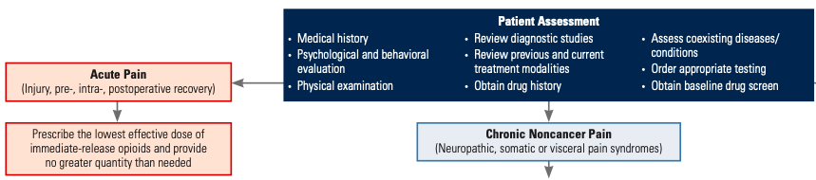
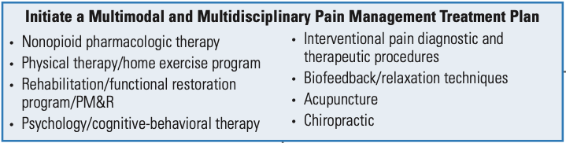
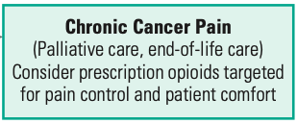
Image by Jason Lefkof, DO 2019, used with permission

Slide 10
Palliative Cancer Pain Management

Slide 11
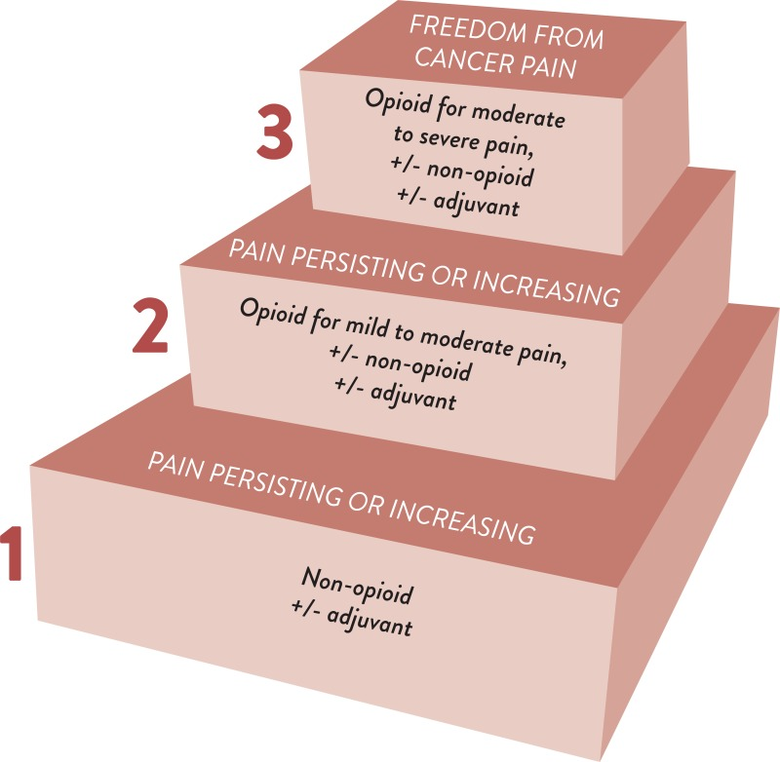
WHO Analgesic Ladder
4
Interventional Pain Modalities
Image from World Health Organization, retrieved from: https://www.who.int/publications/i/item/9789241550390 on 2/8/2026. Image is in the public domain.

Slide 12
Why Opioids?²
Cancer pain is severe and complex
Non-opioid analgesics are often ineffective or contraindicated
Limitations on procedures
Different risk analysis

Slide 13
Opioids are intrinsically risky³
Overdose is uncommon in cancer (but does happen)⁴
Polypharmacy²
Opioid misuse and abuse^{3,5}
Survivorship⁶

Slide 14
Important Reminders
Not all cancer patients have pain^{7,2}
Not all pain is neoplasm-related²
Not all pain is opioid-responsive²
Not everyone should have opioids²

Slide 15
Case 1: Adele
75F with metastatic ovarian cancer diagnosed 2 months ago
She is currently taking oxycodone IR 10mg every 6 hours as needed, around the clock
Pain is uncontrolled; she says the oxycodone isn’t working
Why?

Slide 16
Uncontrolled Pain²
Worsening of disease
Improper medication use
Insufficient dosing
End-dose failure
Central sensitization
Alternative etiology

Slide 17
Case 1: Adele
75F with metastatic ovarian cancer diagnosed 2 months ago
She is currently taking oxycodone IR 10mg every 6 hours as needed, around the clock
Pain is uncontrolled; she says the oxycodone isn’t working
Why?
Is a dose increase indicated?
Is she experiencing end-dose failure?
Is a long-acting opioid indicated?
Is opioid rotation indicated?

Slide 18
Pain Assessment
Is this pain new or different?
Does the medication reduce your pain?
How long are you getting relief?
What is the character of this pain?
Further evaluation
Dose failure
End-dose failure
Choice of analgesic/adjuvant

Slide 19
Case 1: Adele
Pain is sharp, constant, aching
Worse in recent weeks
Pills reduce pain score to 3/10
Pain becomes severe before next dose
75F with metastatic ovarian cancer diagnosed 2 months ago
She is currently taking oxycodone IR 10mg every 6 hours as needed, around the clock
Pain is uncontrolled; she says the oxycodone isn’t working
Why?
Is a dose increase indicated?
Is she experiencing end-dose failure?
No

Slide 20
Pharmacokinetics of Opioids⁸
Drug | Route | Onset | Peak | Duration
Immediate Release Opioids | PO | 30-40 min | 60-90 min | 3-5 hours
 | SQ | 10-15 min | 30-40 min | 4 hours
 | IV | 0-10 min | 15-30 min | 3-4 hours
Fentanyl | IV | 1-2 min | 5-8 min | 60 min
Image by Author.

Slide 21
Case 1: Adele
Pain is sharp, constant, aching
Worse in recent weeks
Pills reduce pain score to 3/10
Pain becomes severe before next dose
75F with metastatic ovarian cancer diagnosed 2 months ago
She is currently taking oxycodone IR 10mg every 6 hours as needed, around the clock
Pain is uncontrolled; she says the oxycodone isn’t working
Why?
Is she experiencing end-dose failure?
Is a long-acting opioid indicated?
Not exactly

Slide 22
Long-Acting Opioids²
Not indicated for acute pain
Higher risk of overdose
Contraindicated in the opioid naïve
When to consider?
Constant, chronic pain
End-dose failure
Patients needing ≥ 4 doses in 24 hours

Slide 23
Case 1: Adele
Opioid Tolerance⁹
≥ 60 MME for 7 days
Wanes within 72 hours of cessation
75F with metastatic ovarian cancer diagnosed 2 months ago
She is currently taking oxycodone IR 10mg every 6 hours as needed, around the clock
Pain is uncontrolled; she says the oxycodone isn’t working
Why?
Is a long-acting opioid indicated?
Yes
Is she opioid tolerant?

Slide 24
Opioid Equianalgesic Table¹⁰
 | Equianalgesic Doses (mg)
Drug | IV | PO
Morphine | 10 | 30
Fentanyl | 0.1 | NA
Hydrocodone | NA | 30
Hydromorphone | 1.5 | 7.5
Oxycodone | 10 | 20
OME =
Oral Morphine Equivalent
MEDD =
Morphine Equivalent Daily Dose
MME =
Morphine Milliequivalent
Image by Author.

Slide 25
Drug | OME
Hydrocodone¹⁰ | 1
Oxycodone¹⁰ | 1.5
PO Hydromorphone¹⁰ | 4
IV Hydromorphone¹¹ | 20
IV Morphine¹⁰ | 3
Fentanyl Patch (µg/h)¹⁰ | 2
5
12.5
2.5
2.5

Slide 26
Case 1: Adele
Opioid Tolerance
≥ 60 MME for 7 days
Wanes within 72 hours of cessation
75F with metastatic ovarian cancer diagnosed 2 months ago
She is currently taking oxycodone IR 10mg every 6 hours as needed, around the clock
Pain is uncontrolled; she says the oxycodone isn’t working
Drug | OME
Hydrocodone¹⁰ | 1
Oxycodone¹⁰ | 1.5
PO Hydromorphone¹⁰ | 5
IV Hydromorphone¹¹ | 12.5
IV Morphine¹⁰ | 2.5
Fentanyl Patch (µg/h)¹⁰ | 2.5
Oxycodone 10mg x 4 = 40mg x 1.5 = 60 OME
Why?
Is a long-acting opioid indicated?
Yes
Is she opioid tolerant?
Yes

Slide 27
Case 1: Adele
75F with metastatic ovarian cancer diagnosed 2 months ago
She is currently taking oxycodone IR 10mg every 6 hours as needed, around the clock
Pain is uncontrolled; she says the oxycodone isn’t working
Why?
Is an opioid rotation indicated?

Slide 28
Opioid Rotation¹²
Switch from one opioid to another to improve the analgesic response or reduce adverse effects
Dose reduce for cross-tolerance (25-50%)

Slide 29
Opioid Adverse Effects³
Sedation
Dizziness
Nausea/Vomiting
Constipation
Tolerance
Respiratory depression
Delayed gastric emptying
Hyperalgesia
Immunologic dysfunction
Endocrinopathies
Muscle rigidity
Myoclonus

Slide 30
Case 1: Adele
75F with metastatic ovarian cancer diagnosed 2 months ago
She is currently taking oxycodone IR 10mg every 6 hours as needed, around the clock
Pain is uncontrolled; she says the oxycodone isn’t working
Why?
Is an opioid rotation indicated?
No

Slide 31
Therapeutic Opioids²
Morphine
Codeine
Hydrocodone
Tramadol
Oxycodone
Hydromorphone
Fentanyl
Methadone

Slide 32
Choosing an Opioid^{2, 13}
Potency
Renal function
Route of administration
Onset
Duration
Cost
Formulation

Slide 33
Metabolism of Opioids²
Hepatic metabolism
Renal elimination

Slide 34
Case 2: Bernie
87M newly diagnosed advanced gastric cancer
He is not pursuing cancer treatment
Intermittent, crampy abdominal pain modestly improved with Tylenol
What do you prescribe?

Slide 35
WHO Analgesic Ladder
Step 2 Analgesics¹³
Hydrocodone
Codeine
Tramadol
Image from World Health Organization, retrieved from: https://www.who.int/publications/i/item/9789241550390 on 2/8/2026. Image is in the public domain.

Slide 36
Hydrocodone²
Vicodin, Norco, Lortab
Combination formulation with acetaminophen
Safer in renal insufficiency
Equianalgesic to morphine
Oral only
Tablets of 5mg, 7.5mg, 10mg

Slide 37
Codeine²
Prodrug
Metabolized to morphine
Enzyme lacking in up to 10% “white population”
Not recommended in renal insufficiency
Increased circulation of metabolites
Antitussive

Slide 38
Tramadol²
Synthetic opioid
Norepinephrine and serotonin reuptake inhibitor
Noninferior to hydrocodone for cancer pain
Off-label indication for cancer pain
Most effective for less severe pain
Reduces seizure threshold
Adverse effect of hypoglycemia
Limited titration

Slide 39
Case 2: Bernie
87M newly diagnosed advanced gastric cancer
He is not pursuing cancer treatment
Intermittent, crampy abdominal pain modestly improved with Tylenol
Should we prescribe hydrocodone?
What other options do we have?

Slide 40
WHO Analgesic Ladder
Step 3 Analgesics¹³
Morphine
Oxycodone
Hydromorphone
Fentanyl
Methadone
Image from World Health Organization, retrieved from: https://www.who.int/publications/i/item/9789241550390 on 2/8/2026. Image is in the public domain.

Slide 41
Morphine²
Inexpensive
Short- and long-acting formulations
Multiple metabolites
Cautioned in renal insufficiency
Many formulations
Unit of equianalgesic table

Slide 42
Oxycodone²
Synthetic
Outside the morphine metabolic pathway
Safer in renal insufficiency
Short- and long-acting formulations
Combined with acetaminophen (Percocet)
Oral only: liquid and tablets
More expensive
1.5x analgesic effect of morphine

Slide 43
Hydromorphone²
Brand Name = Dilaudid
Downstream of morphine metabolic pathway
Dialyzable
Preferred over morphine in ESRD
4-5x the analgesic effect of morphine
IV and PO formulations

Slide 44
Fentanyl²
Synthetic opioid
Lipophilic
Much higher potency
Rapid metabolism
Serotonergic activity
Safest in renal insufficiency
IV, buccal, and transdermal formulations
25mcg/h patch = 50 MME/day¹⁰
100µg IV bolus fentanyl = 10mg IV morphine¹⁰

Slide 45
Methadone²
Mu opioid agonist; NMDA antagonist
Inexpensive
Liquid formulation
Long- and short-acting effects
Delayed achievement of steady state
Long half life
QTc considerations
Safe in renal insufficiency
Cultural stigma

Slide 46
Case 2: Bernie
87M newly diagnosed advanced gastric cancer
He is not pursuing cancer treatment
Intermittent, crampy abdominal pain modestly improved with Tylenol
What do you prescribe?
How frequently do you dose?

Slide 47
Dosing Consideration¹⁴
Always look at renal function
Calculate a creatinine clearance
Presume renal insufficiency in the elderly
Consider hepatic function for dose frequency

Slide 48
Case 3: Charlotte
Fentanyl 25 mcg/h x 2.5 = 63 OME
Oxycodone 5mg x 6 = 30 mg x 1.5 = 45 OME
108 OME
55F with metastatic colon cancer presenting with uncontrolled pain
On Fentanyl 25µg/h patch x3 weeks
Prescribed Percocet 5/325mg q4h as needed; taking 6 tablets daily
Reports pills aren’t giving adequate analgesia
ED ordered 1 mg IV morphine q4h PRN breakthrough
What do you want to know?
What is her current OME?
Is she opioid tolerant?
What PRN dose do you recommend?
What IV breakthrough do you recommend?
Drug | OME
Hydrocodone¹⁰ | 1
Oxycodone¹⁰ | 1.5
PO Hydromorphone¹⁰ | 5
IV Hydromorphone¹¹ | 12.5
IV Morphine¹⁰ | 2.5
Fentanyl Patch (µg/h)¹⁰ | 2.5
Yes

Slide 49
Heuristics of Opioid Dosing²
An appropriate breakthrough dose is ~10% of MEDD
Most of MEDD should be long-acting opioid
Ideal breakthrough needs are 0-3 doses per day
Dose failure warrants an increase in dose by 50-100%
Oral opioids: 30-minute onset, last about 4 hours
Intravenous opioids: rapid onset, last about 2-3 hours

Slide 50
Case 4: Donald
60M with metastatic caecal cancer, prior bowel obstruction s/p colectomy
Presenting to the med onc service with bilious vomiting, uncontrolled abdominal pain
CT demonstrates recurrent malignant bowel obstruction
At home, he takes morphine 15mg q4h as needed, usually 4x/day
Team consults you for pain and symptom management
What do you want to know?
What do you prescribe?

Slide 51
Patient Controlled Analgesia

Slide 52
Deciding on a PCA¹⁵
Is the patient a good candidate?
Should we screen the patient?
What is the purpose of the PCA?
How long do we plan on using it?
What is the transition plan?

Slide 53
Why a PCA?¹⁵
Dose finding
Rapid titration
Parenteral route
Bolus frequency
Patient autonomy

Slide 54
Case 4: Donald
60M with metastatic caecal cancer, prior bowel obstruction s/p colectomy
Presenting to the med onc service with bilious vomiting, uncontrolled abdominal pain
CT demonstrates recurrent malignant bowel obstruction
At home, he takes morphine 15mg q4h as needed, usually 4x/day
Team consults you for pain and symptom management
What is his daily OME?
What PCA bolus dose do you recommend?
At what interval?
Drug | OME
Hydrocodone¹⁰ | 1
Oxycodone¹⁰ | 1.5
PO Hydromorphone¹⁰ | 5
IV Hydromorphone¹¹ | 12.5
IV Morphine¹⁰ | 2.5
Fentanyl Patch (µg/h)¹⁰ | 2.5
60

Slide 55
Pharmacokinetics of Opioids⁸
Drug | Route | Onset | Peak | Duration
Immediate Release Opioids | PO | 30-40 min | 60-90 min | 3-5 hours
 | SQ | 10-15 min | 30-40 min | 4 hours
 | IV | 0-10 min | 15-30 min | 3-4 hours
Fentanyl | IV | 1-2 min | 5-8 min | 60 min

Slide 56
Case 4: Donald
60M with metastatic caecal cancer, prior bowel obstruction s/p colectomy
Presenting to the med onc service with bilious vomiting, uncontrolled abdominal pain
CT demonstrates recurrent malignant bowel obstruction
At home, he takes morphine 15mg q4h as needed, usually 4x/day
Team consults you for pain and symptom management
What is his daily OME?
What PCA bolus dose do you recommend?
At what interval?
Would you start a basal rate?
Drug | OME
Hydrocodone¹⁰ | 1
Oxycodone¹⁰ | 1.5
PO Hydromorphone¹⁰ | 5
IV Hydromorphone¹¹ | 12.5
IV Morphine¹⁰ | 2.5
Fentanyl Patch (µg/h)¹⁰ | 2.5
60

Slide 57
PCA Recommendations¹⁵
Never start a basal rate in a patient with unknown opioid needs
Bolus doses should not be more frequent than peak effect
Interrogate everyday and document in your note
Have a rationale for dose and frequency of bolus
Remember your equianalgesic table
Caution in renal and hepatic insufficiency

Slide 58
Case 5: Esther
84F with metastatic pancreatic cancer admitted to inpatient hospice unit
She is on a morphine NCA at 4mg/h with boluses 4mg q15min
During rounds family notes new onset twitching of the hands and feet
What does this twitching most likely reflect?
What would you recommend next?

Slide 59
Opioid Rotation¹²
Switch from one opioid to another to improve the analgesic response or reduce adverse effects
Dose reduce for cross-tolerance (25-50%)

Slide 60
Case 5: Esther
84F with metastatic pancreatic cancer admitted to inpatient hospice unit
She is on a morphine NCA at 4mg/h with boluses 4mg q15min
During rounds family notes new onset twitching of the hands and feet
To which opioid would you rotate?
What is an appropriate alternative PCA?

Slide 61
Rotating an Opioid Infusion¹²
Calculate the 24-hour OME
Convert to new opioid
Divide by 24 hours
Reduce for cross tolerance
Determine bolus dose and interval

Slide 62
Case 5: Esther
84F with metastatic pancreatic cancer admitted to inpatient hospice unit
She is on a morphine NCA at 4mg/h with boluses 4mg q15min
During rounds family notes new onset twitching of the hands and feet
Calculate the OME
Convert to new opioid
Divide by 24 hours
Reduce for cross tolerance
Determine the bolus dose and interval
4mg/h x 24h (x2.5) = 240 OME
Drug | OME
Hydrocodone¹⁰ | 1
Oxycodone¹⁰ | 1.5
PO Hydromorphone¹⁰ | 5
IV Hydromorphone¹¹ | 12.5
IV Morphine¹⁰ | 2.5
Fentanyl Patch (µg/h)¹⁰ | 2.5
240 ÷ 12.5 = 19 mg IV Dilaudid
19mg/24h = 0.8mg/h
0.8mg/h x 50% = 0.4mg/h

Slide 63
Summary
Approach pain mechanistically: seek etiology to target analgesia
Consider the multitude of reasons for uncontrolled pain in cancer patients
Utilize the opioid equianalgesic table
Rely on the pharmacology to guide your recommendations

Slide 64
Questions?

Slide 65
Cases

Slide 66
Case 6: Frank
72M with end-stage COPD initially presenting in acute hypoxic and hypercapnic respiratory failure, now intubated in ICU. He has continued to be intolerant to reduction in sedation or participate in daily SBTs for over 10 days. Family has since elected for inpatient hospice.
You are placing admission orders. He is currently on a Fentanyl infusion at 300 mcg/h.
What would be an appropriate Dilaudid NCA?
What would be an appropriate morphine NCA?

Slide 67
Case 6: Frank
72M with end-stage COPD initially presenting in acute hypoxic and hypercapnic respiratory failure, now intubated in ICU. He has continued to be intolerant to reduction in sedation or participate in daily SBTs for over 10 days. Family has since elected for inpatient hospice.
You are placing admission orders. He is currently on a Fentanyl infusion at 300 mcg/h.
What would be an appropriate Dilaudid NCA?
Drug | OME
Hydrocodone¹⁰ | 1
Oxycodone¹⁰ | 1.5
PO Hydromorphone¹⁰ | 5
IV Hydromorphone¹¹ | 12.5
IV Morphine¹⁰ | 2.5
Fentanyl Patch (µg/h)¹⁰ | 2.5
Fentanyl 300 mcg/h x 2.5 = 750 OME
750 OME ÷ 12.5 = 60 mg IV Dilaudid
60 mg IV Dilaudid/24 hours = 2.5mg IV Dilaudid/h
2.5mg IV Dilaudid/h x 50% = 1.25mg/h
Basal Rate
Bolus?

Slide 68
Case 6: Frank
72M with end-stage COPD initially presenting in acute hypoxic and hypercapnic respiratory failure, now intubated in ICU. He has continued to be intolerant to reduction in sedation or participate in daily SBTs for over 10 days. Family has since elected for inpatient hospice.
You are placing admission orders. He is currently on a Fentanyl infusion at 300 mcg/h.
What would be an appropriate Morphine NCA?
Drug | OME
Hydrocodone¹⁰ | 1
Oxycodone¹⁰ | 1.5
PO Hydromorphone¹⁰ | 5
IV Hydromorphone¹¹ | 12.5
IV Morphine¹⁰ | 2.5
Fentanyl Patch (µg/h)¹⁰ | 2.5
Fentanyl 300 mcg/h x 2.5 = 750 OME
750 OME ÷ 2.5 = 300 mg IV Morphine
300 mg IV Morphine/24 hours = 12.5mg IV Morphine/h
12.5mg IV Morphine/h x 50% = 6.25mg/h
Basal Rate
Bolus?

Slide 69
Case 7: Greta
34F with AML admitted to the leukemia service for bone marrow transplant.
She has developed mucositis and is no longer tolerating oral intake of any kind
Team consults you for PCA recommendations
She had been taking oxycodone 10mg as oral solution up until today with good effect
What PCA do you recommend?
Drug | OME
Hydrocodone¹⁰ | 1
Oxycodone¹⁰ | 1.5
PO Hydromorphone¹⁰ | 5
IV Hydromorphone¹¹ | 12.5
IV Morphine¹⁰ | 2.5
Fentanyl Patch (µg/h)¹⁰ | 2.5

Slide 70
Case 7: Greta
34F with AML admitted to the leukemia service for bone marrow transplant.
She has developed mucositis and is no longer tolerating oral intake of any kind
You follow up the next day--
She reports having much improved pain control
PCA boluses are effective and last about an hour
Do you start a basal rate?
Do you change any parameters?
Drug | OME
Hydrocodone¹⁰ | 1
Oxycodone¹⁰ | 1.5
PO Hydromorphone¹⁰ | 5
IV Hydromorphone¹¹ | 12.5
IV Morphine¹⁰ | 2.5
Fentanyl Patch (µg/h)¹⁰ | 2.5
Dilaudid 1mg q30min as needed. Max 2mg/h
14 demands; 13 delivered
Total = 13mg IV Dilaudid

Slide 71
Case 8: Henry
56M with metastatic bladder cancer admitted to the oncology service for uncontrolled pain and AKI in setting of obstructive uropathy. He is now status post bilateral nephrostomies.
You are coming onto service to find him on a PCA. He reports good pain control.
Team requests recommendation for an oral regimen
What do you recommend?
Does he need a long-acting opioid?
Can you start one? Which one?
PCA Details:
Dilaudid 0.3mg/h with bolus 0.5mg q30min
7 demands; 7 delivered
Total = 10.7mg IV Dilaudid

Slide 72
Case 8: Henry
56M with metastatic bladder cancer admitted to the oncology service for uncontrolled pain and AKI in setting of obstructive uropathy. He is now status post bilateral nephrostomies.
You are coming onto service to find him on a PCA. He reports good pain control.
Team requests recommendation for an oral regimen
Calculate the OME
Choose a long-acting opioid
What dose of oxycodone SR?
What dose Fentanyl patch?
Drug | OME
Hydrocodone¹⁰ | 1
Oxycodone¹⁰ | 1.5
PO Hydromorphone¹⁰ | 5
IV Hydromorphone¹¹ | 12.5
IV Morphine¹⁰ | 2.5
Fentanyl Patch (µg/h)¹⁰ | 2.5
Total = 10.7mg IV Dilaudid
10.7mg IV Dilaudid x 12.5 = 134 OME
134 OME ÷ 1.5 = 89mg
89mg → 40mg q12h
134 OME ÷ 2.5 = 54mcg/h
54mcg/h → 50mcg/h

Slide 73
References
Saunders C, Baines M. Living with Dying: The Management of Terminal Disease. Oxford: Oxford University Press; 1983.
‌Prommer E, Jacobs P, Mehta AK. Palliative Care and Cancer Pain. Pain Care Essentials and Innovations. Published online 2021:91-111. doi:https://doi.org/10.1016/b978-0-323-72216-2.00007-7
Benyamin R. Opioid Complications and Side Effects. Pain Physician. 2008;2s;11(3;2s):S105-S120. doi:https://doi.org/10.36076/ppj.2008/11/s105
Jairam V, Yang DX, Yu JB, Park HS. Emergency Department Visits for Opioid Overdoses Among Patients With Cancer. JNCI: Journal of the National Cancer Institute. 2019;112(9):938-943. doi:https://doi.org/10.1093/jnci/djz233
Sullivan M. Depression Effects on Long-term Prescription Opioid Use, Abuse, and Addiction. The Clinical Journal of Pain. 2018;34(9):1. doi:https://doi.org/10.1097/ajp.0000000000000603
Jairam V, Yang DX, Verma V, Yu JB, Park HS. National Patterns in Prescription Opioid Use and Misuse Among Cancer Survivors in the United States. JAMA Network Open. 2020;3(8):e2013605. doi:https://doi.org/10.1001/jamanetworkopen.2020.13605
‌Van den Beuken-van Everdingen MHJ, de Rijke JM, Kessels AG, Schouten HC, van Kleef M, Patijn J. Prevalence of pain in patients with cancer: a systematic review of the past 40 years. Annals of Oncology. 2007;18(9):1437-1449. doi:https://doi.org/10.1093/annonc/mdm056
Pasero C, Mccaffery M. Pain Assessment and Pharmacologic Management. Elsevier/Mosby; 2011.
FDA/CDER. EXTENDED-RELEASE (ER) and LONG-ACTING (LA) OPIOID ANALGESICS RISK EVALUATION and MITIGATION STRATEGY (REMS).; 2015. Accessed February 10, 2026. http://www.fda.gov/downloads/drugs/drugsafety/postmarketdrugsafetyinformationforpatientsandproviders
‌Mary Lynn McPherson. Demystifying Opioid Conversion Calculations. ASHP; 2014./ucm311290.pdf
Reddy AS, Dost S, Vidal M, et al. The conversion ratio from intravenous (IV) hydromorphone to oral (PO) opioids in patients with cancer. Journal of Clinical Oncology. 2016;34(26_suppl):197-197. doi:https://doi.org/10.1200/jco.2016.34.26_suppl.197
Knotkova H, Fine PG, Portenoy RK. Opioid Rotation: The Science and the Limitations of the Equianalgesic Dose Table. Journal of Pain and Symptom Management. 2009;38(3):426-439. doi:https://doi.org/10.1016/j.jpainsymman.2009.06.001
‌WHO. WHO Guidelines for the Pharmacological and Radiotherapeutic Management of Cancer Pain in Adults and Adolescents. www.who.int. Published 2019. https://www.who.int/publications/i/item/9789241550390
‌Smith HS. Opioid Metabolism. Mayo Clinic Proceedings. 2009;84(7):613-624. doi:https://doi.org/10.1016/s0025-6196(11)60750-7
‌Hicks CM, Dyck MA, Martin L, Guthrie DM, Stewart SL, Hirdes JP. Patient-Controlled Analgesia for Managing Pain in Adults Receiving Palliative Care: A Scoping Review. Pain Management Nursing. 2025;26(4). doi:https://doi.org/10.1016/j.pmn.2025.02.014

