Slide 1
Pain and Opioids 101 – Part 2
Anne Lips, MD
David Wilkerson, DO

Slide 2
No Disclosures

Slide 3
Objectives
Recall basic principles of pain and longitudinal opioid management.
Identify key universal practices for safer opioid prescribing.
Anticipate predictable adverse effects of opioid therapy, and devise plans for their management.
Develop appropriate follow-up plans for longitudinal opioid management.
Practice opioid dose titration.

Slide 4
A brief review from last time...

Slide 5
Total Pain
Coined by Dame Cicely Saunders¹
Multidimensional suffering of those facing serious illness
Pain is not purely a physical sensation but is often a complex interplay of factors
Promotes an interdisciplinary team/approach
Spiritual
Mental
Social
Physical
“The word pain must not trap us into thinking that it demands the immediate use of appropriate drugs”¹
–Saunders, Living with Dying
Image by Author.

Slide 6
Pain Types in Palliative Medicine²
Nociceptive
  Somatic
  Visceral
Neuropathic
Nociplastic*
Bone pain
Neuropathic
Visceral
Lymphoedema
Intestinal colic
Headache
Treatment-related
Debility-related
Inflammatory
Acute
Chronic
Breakthrough

Slide 7
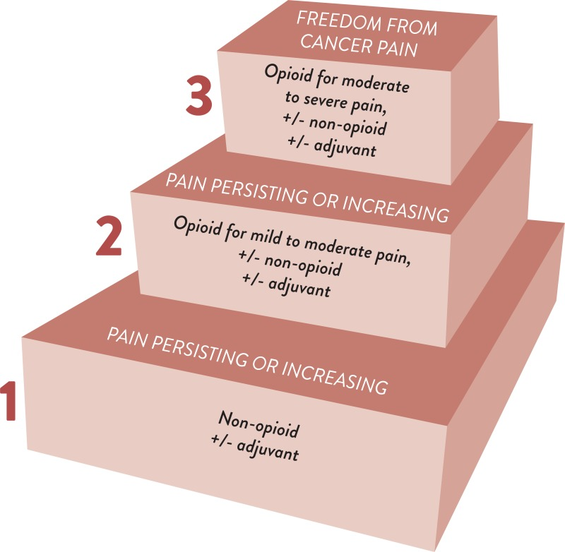
4
Interventional Pain Modalities
WHO Analgesic Ladder
‌Prommer E, Jacobs P, Mehta AK. Palliative Care and Cancer Pain. Pain Care Essentials and Innovations. Published online 2021:91-111. doi:https://doi.org/10.1016/b978-0-323-72216-2.00007-7

Slide 8
Pharmacokinetics of Opioids³
Drug | Route | Onset | Peak | Duration
Immediate Release Opioids | PO | 30-40 min | 60-90 min | 3-5 hours
 | SQ | 10-15 min | 30-40 min | 4 hours
 | IV | 0-10 min | 15-30 min | 3-4 hours
Fentanyl | IV | 1-2 min | 5-8 min | 60 min

Slide 9
Heuristics of Opioid Dosing²
An appropriate breakthrough dose is ~10% of MEDD
Most of MEDD should be long-acting opioid
Ideal breakthrough needs are 0-3 doses per day
Dose failure warrants an increase in dose by 50-100%
Oral opioids: 30-minute onset, last about 4 hours
Intravenous opioids: rapid onset, last about 2-3 hours

Slide 10
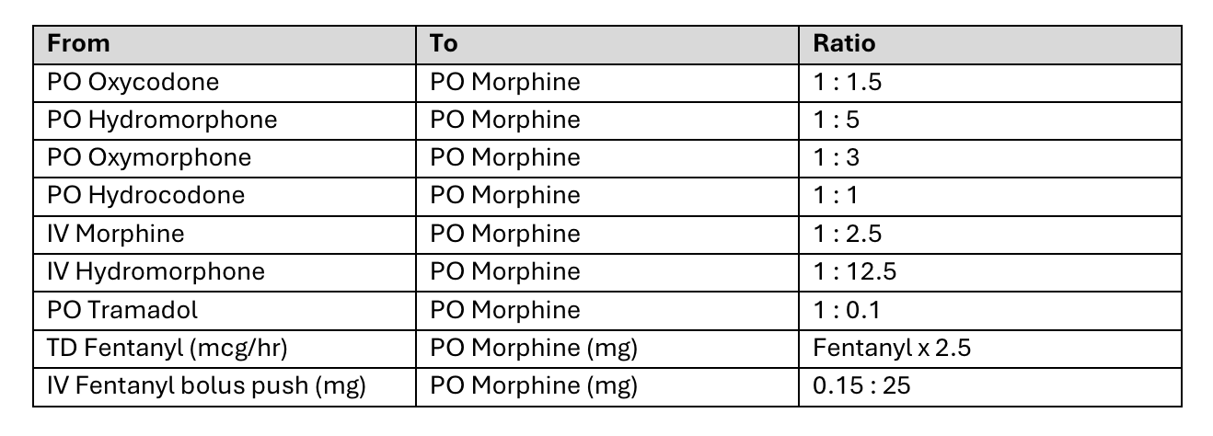
Opioid Formulations, Conversions, and Rotations^{4,5}
Image by Jimi Malik and Rebekka DePew, used with permission.

Slide 11
Today's Focus:
Longitudinal Opioid Management

Slide 12
A Case
62yo woman with hormone receptor positive breast cancer with bone mets presents to palliative care clinic for initial visit. She is on systemic treatment for her disease. She has low back and hip pain, and imaging shows lytic bone lesions in those areas. Her oncologist started her on oxycodone IR 5mg q4hr PRN. She is here for additional help with pain management.

Slide 13
Longitudinal Management—Acute vs Chronic Pain⁶
Acute
Duration of <1 month
Self-limiting, ideally resolves with healing
Pain that continues for 1-3 months
Chronic
Lasts 3 months or longer
Generally stable or worsening
Persists beyond normal "healing" period
Subacute
Triggered by tissue damage
Sudden onset
Can become chronic
Involves peripheral and central sensitization
Notes:
Longitudinal management of opioids = management over time, of pain that is ongoing and typically more chronic.

Slide 14
Principles of Longitudinal Opioid Management⁶
Assess, and reassess, pain over time.
Help patients manage expectations.
Prescribe opioids as safely as possible.
Anticipate and address expected adverse effects from opioids.
Plan and maintain appropriate follow-up.

Slide 15
Assess, and Reassess, Pain Over Time
Always look at the patient first.
Perform a comprehensive pain assessment each visit.
Notes:
Perform comprehensive assessment, to be sure you know what it is that you’re treating with your opioids.

Slide 16
Our Case
What kind of pain does she have?
Is opioid therapy appropriate?
62yo woman with breast cancer metastatic to bone. Low back and hip pain on oxy IR 5mg q4hr PRN.
Pain Assessment
  Quality: Aching
  Location: Low back, hips, doesn't radiate
  Timing: Mostly flares up when she has to walk longer distances
  Intensity/Severity: 7 to 8 out of 10 with walking, otherwise 2 out of 10
  Aggravating/Alleviating Factors: Tylenol doesn't help, oxy helps when she takes it prior to activity
  Functional Impact: Stops her from going on walks with her grandchildren
Notes:
Kind of pain: Somatic, nociceptive pain due to her bone mets. Incident pain that is triggered by or worsens with activity.
Opioid therapy is appropriate.

Slide 17
Principles of Longitudinal Opioid Management⁶
Assess, and reassess, pain over time.
Help patients manage expectations.
Prescribe opioids as safely as possible.
Anticipate and address expected adverse effects from opioids.
Plan and maintain appropriate follow-up.

Slide 18
Pain Management Goals and Expectations
Patient-specific pain scale goals⁷
  What level of pain is tolerable?
Function-based goals
Time
Notes:
Patient-specific pain scale goals: The "0 to 10" scale does not always account for the complexity of the patient experience of chronic pain. Asking the question "what level of pain is tolerabe" for you can help augment the numeric pain assessment and better personalize goals.
Function-based goals: Eliciting what functional capacity is important to the patient that their pain prevents them from doing, and focusing on improving their ability to engage with that activity as a measure of success in pain management.
Time – meaning how quickly to expect to achieve pain relief, etc.

Slide 19
Our Case
Tolerable level of pain: 3
Functional goal: Enjoy walks with grandchildren

Slide 20
Our Case
Our patient says, "I'm a little worried about taking a medicine like oxycodone. Aren't these medicines dangerous?"
Notes:
Discussion about how to respond to "opioid hesitance."
Start by asking open-ended questions to elicit patient's fears/worries.

Slide 21
Principles of Longitudinal Opioid Management⁶
Assess, and reassess, pain over time.
Help patients manage expectations.
Prescribe opioids as safely as possible.
Anticipate and address expected adverse effects from opioids.
Plan and maintain appropriate follow-up.

Slide 22
Opioid Safety: Assessing patient-specific factors
What if our 62yo woman with breast cancer....
  Had stage IV CKD?⁸
    Reduce starting dose if CrCl <50
    Or consider buprenorphine, fentanyl, or methadone²
  Was an 82yo woman?
    Consider reducing starting dose for older patients
  Had cognitive impairment?
    Who will manage and administer meds?
  Was also prescribed a benzo, taken daily for anxiety?⁹
    Concurrent benzo prescription associated with higher rates of overdose
Notes:
CKD: Dose reduction and/or bup/fentanyl/methadone which have better safety profile in terms of accumulation of active metabolites, etc.
Older patients may require lower doses due to age-related changes in metabolism, volume of distribution.

Slide 23
Opioid Safety: Limited evidence for assessing risk for opioid use disorder
CAGE-AID¹⁰
Revised ORT¹¹
Have you ever felt that you ought to cut down on your drinking or drug use? (Y/N)
Have people annoyed you by criticizing your drinking or drunk use? (Y/N)
Have you ever felt bad or guilty about your drinking or drug use? (Y/N)
Hae you ever had a drink or used drugs first thing in the morning to steady your nerves or get rid of a hangover? (Y/N)
Family History of Substance Abuse
  Alcohol (Y/N)
  Illegal Drugs (Y/N)
  Rx drugs (Y/N)
Personal History of Substance Abuse
  Alcohol (Y/N)
  Illegal Drugs (Y/N)
  Rx drugs (Y/N)
Age between 16-45 years
Psychological Disease
  ADD, OCD, bipolar, schizophrenia (Y/N)
  Depression (Y/N)
Risk Factors for developing opioid addiction¹¹:
H/o OUD or other SUD (past or present)
Certain psych dx: anxiety, personality disorder, psychotic disorder
Certain psych meds: atypical antipsychotic, benzo
>120 OME daily
Notes:
For revised ORT, a score of 0-3 indicates low risk for OUD while >3 indicates elevated risk.
For CAGE-AID, any score other than 0 is regarded as "positive" indicating potential for SUD that merits further evaluation/caution.

Slide 24
Opioid Safety: UNIVERSAL PRECAUTIONS
PDMP review with every prescription and refill⁶
Urine drug screens for all patients⁶
Written opioid agreements¹² summarizing:
  Adverse effects
  Patient expectations/responsibilities
  Provider expectations/responsibilities
Notes:
There is WEAK evidence to indicate that opioid agreements have any effect in mitigating risks of opioid-related harms, however agreements may be required by systems or local regulations. One approach to their use is to use the agreement as an opportunity to review risks/harms and expectations/responsibilities with the meds.

Slide 25
Opioid Safety: Naloxone⁶
Per CDC, prescribe naloxone for patients with:
  Previous h/o overdose
  H/o SUD
  Sleep disordered breathing
  50 MME/day or greater
  Concurrent benzo use
  Risk for returning to higher dose (e.g. tapering or recently released from prison)

Slide 26
Opioid Safety: Storage and Disposal⁶
Storage:
  Secure, in original packaging
  Out of reach/sight of children
  Preferably locked
Disposal:
  Drug take-back programs
  FDA website

Slide 27
Our Case
We see our patient again several months later. She has had disease progression including progression of her bone mets. Her pain is severe and is now a constant ache in her hips and lower back, no longer just aggravated by walking. She often finds herself having 7 or 8 out of 10 pain throughout the day, though she continues to take her oxycodone IR 5mg only sparingly, about once a day only before activity (as discussed at the prior visit). It does bring some relief when she takes it, though not as much as it used to.
What next?
Notes:
What next? - Advise taking the oxycodone more frequently, as often as q3-4hr PRN, and consider a dose increase to 7.5 or 10mg. Arrange follow up ideally in 1-2 weeks to reassess.

Slide 28
Our Case
Our patient says, "I don't know about taking more oxycodone like that... The last time I tried that, it made me feel sick."

Slide 29
Principles of Longitudinal Opioid Management⁶
Assess, and reassess, pain over time.
Help patients manage expectations.
Prescribe opioids as safely as possible.
Anticipate and address expected adverse effects from opioids.
Plan and maintain appropriate follow-up.

Slide 30
Transient effects of increasing opioids⁶
Nausea
Drowsiness
Notes:
Counseling regarding driving in particular – avoid at least during times of dose changes etc.

Slide 31
Effects that are NOT transient¹³
Constipation
Traditional laxatives are first line and can prevent/manage most cases of OIC
Example treatment for OIC:
  Senna 2 tabs BID, increase to up to 4 tabs BID if no BM
  Add laxative (polyethylene glycol, milk of magnesia, magnesium citrate)
  If no BM, add bisacodyl suppository and/or try a different laxative

Slide 32
Our Case
We advised our patient to increase her oxycodone IR to 7.5 or 10mg and to take it more often, up to every 3 hours as needed for pain. We prescribed senna 2 tabs nightly with a plan to increase to BID, then add miralax, if not having a good stool at least every other day. We were able to arrange follow up in 2 weeks to reassess her pain.

Slide 33
Our Case
At the two week follow up, she shares she is using the oxycodone IR 7.5mg about every 4 hours around the clock. It's effective, but if she misses a dose her pain becomes severe. She did have to titrate up her bowel regimen after the first few days, but is now stooling well on a combination of miralax and senna.
What should we do?
OME: 7.5mg x 6 = 45mg oxycodone x 1.5 = 67.5 OME
Oxycodone ER 20mg q12hr
Oxycodone IR 7.5mg PRN for breakthrough or incident pain
Notes:
What should we do? - Consider long acting agent.

Slide 34
Principles of Longitudinal Opioid Management⁶
Assess, and reassess, pain over time.
Help patients manage expectations.
Prescribe opioids as safely as possible.
Anticipate and address expected adverse effects from opioids.
Plan and maintain appropriate follow-up.

Slide 35
Arranging follow-up
Within 1-4 weeks of starting opioid or adjusting dose
  1-2 weeks after starting or increasing long-acting
At least 3 months for chronic therapy⁶
Notes:
This is per CDC guidelines on opioid prescribing.

Slide 36
When can meds be titrated?¹⁴
Immediate release oral opioids:
  After 1-2 doses
  Steady state in 3-4 doses if scheduled
Extended release oral opioids:
  After 24-48 hours
TD fentanyl:
  After 72hrs
Methadone:
  After 5-7 days
Notes:
Fentanyl: Effects often start at 12hrs but beak at 18-36hrs

Slide 37
Case Conclusion
We arranged a follow-up phone call for our patient with our clinical pharmacist 1-2 weeks after initiating her oxycodone ER 20mg q12hr. At this visit, she is doing better. 2-3 out of 10 pain, with occasional breakthrough relieved with her PRN oxycodone IR 7.5mg.
She is pooping.
Continue current regimen and follow up in 1 month.

Slide 38
Objectives
Recall basic principles of pain and longitudinal opioid management.
Identify key universal practices for safer opioid prescribing.
Anticipate predictable adverse effects of opioid therapy, and devise plans for their management.
Develop appropriate follow-up plans for longitudinal opioid management.
Practice opioid dose titration.

Slide 39
Questions?

Slide 40
References
Saunders C, Baines M. Living with Dying: The Management of Terminal Disease. Oxford: Oxford University Press; 1983.
‌Prommer E, Jacobs P, Mehta AK. Palliative Care and Cancer Pain. Pain Care Essentials and Innovations. Published online 2021:91-111. doi:https://doi.org/10.1016/b978-0-323-72216-2.00007-7
Pasero C, Mccaffery M. Pain Assessment and Pharmacologic Management. Elsevier/Mosby; 2011.
‌Mary Lynn McPherson. Demystifying Opioid Conversion Calculations. ASHP; 2014./ucm311290.pdf
Reddy AS, Dost S, Vidal M, et al. The conversion ratio from intravenous (IV) hydromorphone to oral (PO) opioids in patients with cancer. Journal of Clinical Oncology. 2016;34(26_suppl):197-197. doi:https://doi.org/10.1200/jco.2016.34.26_suppl.197
Dowell D, Ragan KR, Jones CM, Baldwin GT, Chou R. Prescribing Opioids for Pain — The New CDC Clinical Practice Guideline. New England Journal of Medicine. 2022;387(22). doi:https://doi.org/10.1056/nejmp2211040
Markman JD, Gewandter JS, Frazer ME. Comparison of a Pain Tolerability Question With the Numeric Rating Scale for Assessment of Self-reported Chronic Pain. JAMA Network Open. 2020;3(4):e203155. doi:https://doi.org/10.1001/jamanetworkopen.2020.3155
Coluzzi F, Caputi FF, Billeci D, et al. Safe Use of Opioids in Chronic Kidney Disease and Hemodialysis Patients: Tips and Tricks for Non-Pain Specialists. Therapeutics and Clinical Risk Management. 2020;16(16):821-837. doi:https://doi.org/10.2147/TCRM.S262843
Park TW, Saitz R, Ganoczy D, Ilgen MA, Bohnert ASB. Benzodiazepine prescribing patterns and deaths from drug overdose among US veterans receiving opioid analgesics: case-cohort study. BMJ. 2015;350. doi:https://doi.org/10.1136/bmj.h2698
‌Hinkin CH, Castellon SA, Dickson-Fuhrman E, Daum G, Jaffe J, Jarvik L. Screening for Drug and Alcohol Abuse Among Older Adults Using a Modified Version of the CAGE. The American Journal on Addictions. 2001;10(4):319-326. doi:https://doi.org/10.1111/j.1521-0391.2001.tb00521.
Klimas J, Gorfinkel L, Fairbairn N, et al. Strategies to Identify Patient Risks of Prescription Opioid Addiction When Initiating Opioids for Pain. JAMA Network Open. 2019;2(5):e193365. doi:https://doi.org/10.1001/jamanetworkopen.2019.3365
‌McAuliffe Staehler TM, Palombi LC. Beneficial opioid management strategies: A review of the evidence for the use of opioid treatment agreements. Substance Abuse. 2020;41(2):1-8. doi:https://doi.org/10.1080/08897077.2019.1692122
Crockett SD, Greer KB, Heidelbaugh JJ, Falck-Ytter Y, Hanson BJ, Sultan S. American Gastroenterological Association Institute Guideline on the Medical Management of Opioid-Induced Constipation. Gastroenterology. 2019;156(1):218-226. doi:https://doi.org/10.1053/j.gastro.2018.07.016
Opioid Dose Escalation. Palliative Care Network of Wisconsin. https://www.mypcnow.org/fast-fact/opioid-dose-escalation/

