Slide 1
Resiliency and Sustainable Outpatient Practice
Kim Curseen, MD, FAAHPM

Slide 2
No Disclosures

Slide 3
Learning Objectives
Describe the history of hospice and palliative care and its impact on current clinical practice
Understand workforce challenges facing outpatient palliative care and generate potential solutions
Identify burnout in outpatient palliative care clinicians, and understand protective mitigation strategies at institutional and personal levels
Apply caring for team members and self-care in the outpatient setting

Slide 4
Outline
A brief history of palliative care, as pertains to our workforce and mission
Developing a sustainable palliative care workforce that prioritizes the needs of our patients
Developing personal practices of sustainability and resilience

Slide 5
History of Hospice and Palliative Care

Slide 6
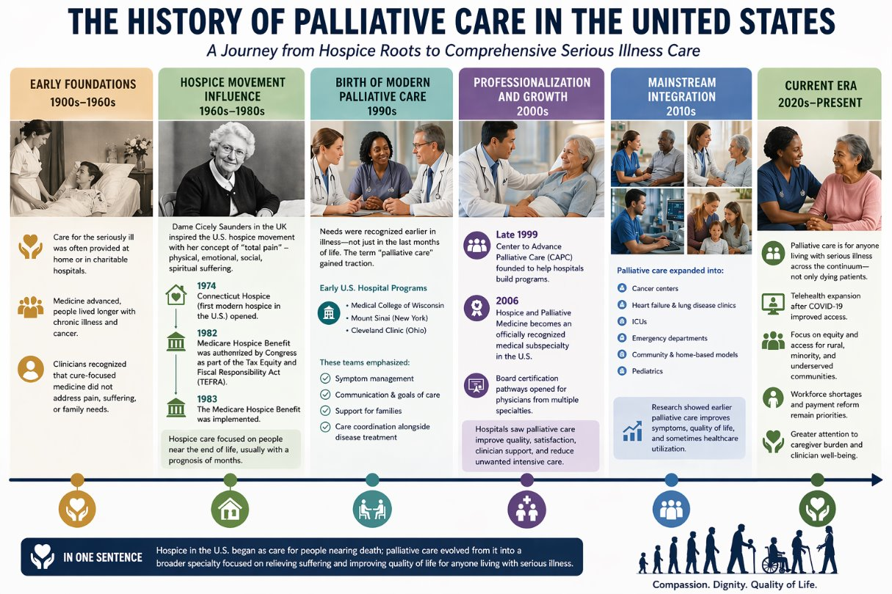
1-4
Figure by OpenAI's ChatGPT, April 2026 (www.chatgpt.com). Figure generated using the prompt: "create a figure demonstrating the history of palliative care in the US using this information."

Slide 7
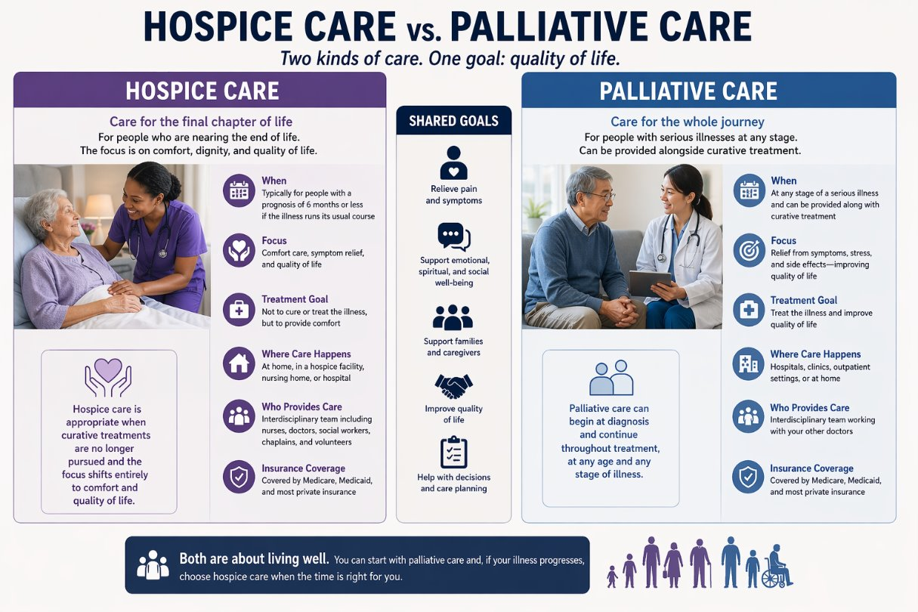
Figure by OpenAI's ChatGPT, April 2026 (www.chatgpt.com). Figure generated using the prompt: "create a figure demonstrating hospice care vs. Palliative care using this information."

Slide 8
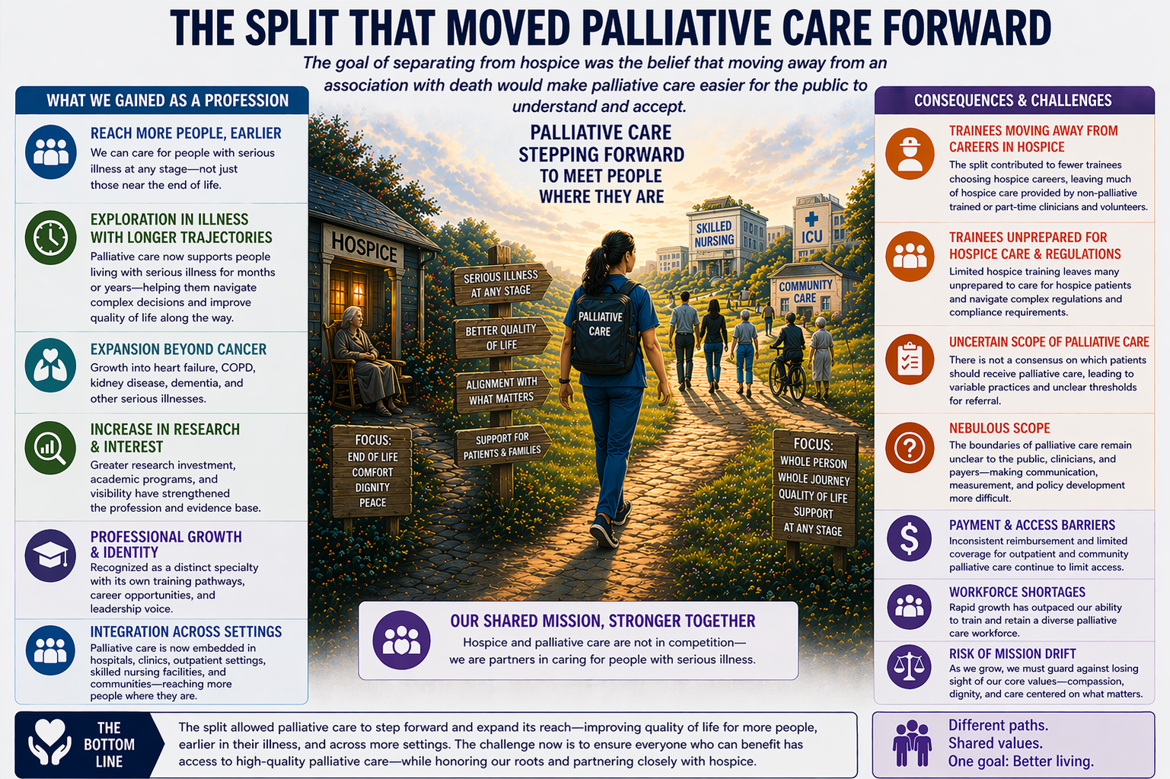
4-6
Figure by OpenAI's ChatGPT, April 2026 (www.chatgpt.com). Figure generated using the prompt: "create a figure demonstrating hospice care vs. palliative care describing how the split from hospice care moved palliative care forward but also created consequences and challenges. Add what was gained and what challenges were created as a consequence. Include the following information"

Slide 9
The Promise of Palliative Care

Slide 10
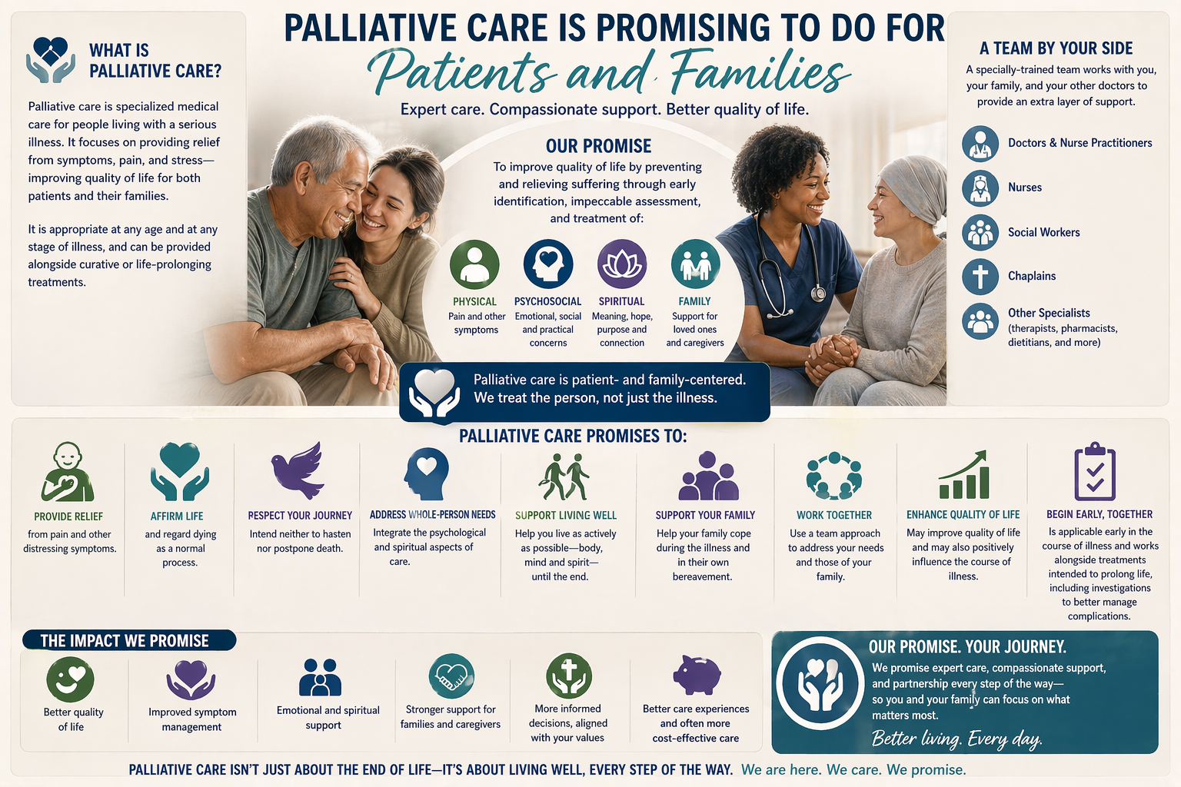
Figure by OpenAI's ChatGPT, April 2026 (www.chatgpt.com). Figure generated using the prompt: "create a figure demonstrating the what palliative care promises to do for patients and familie and the impact also promised to include the following."

Slide 11
Tough Questions
Can we keep this promise?
How can we keep this promise?
Hardest Question of All : Do we want to keep this promise?

Slide 12
Scope
Workforce
Sustainability

Slide 13
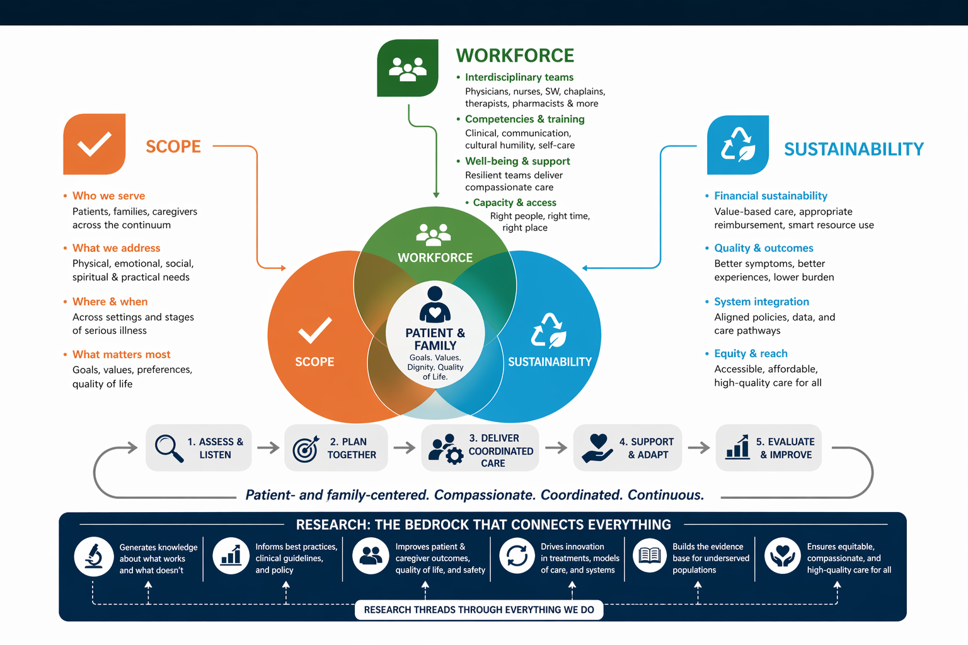
Figure by OpenAI's ChatGPT, April 2026 (www.chatgpt.com). Figure generated using the prompt: "create a figure demonstrating how scope, workforce, and sustainability are centered around the patient and family in palliative care and how research is the bedrock that connects everything that we do in palliative care.Include the following information."

Slide 14
Scope of Palliative Care

Slide 15
Scope of Palliative Care
“Every patient seen by specialty palliative care who does not have serious illness represents an opportunity cost, a patient with refractory symptoms, complex decision-making needs, or irresolvable family-patient goal discordance who could have received expert care instead.^{”4}
“Given that demand for palliative care services is increasing due to population aging and people living longer with life-threatening diseases, maintaining appropriate scope boundaries is essential for maximizing benefit to those who need it most.”⁷

Slide 16
Serious Illness Rubric / Clinical Screening Chart
Scope of Palliative Care
Domain | 0 = None/Mild | 1 = Moderate | 2 = Severe
Mortality / Health Risk | Stable condition | Progressive disease / recurrent exacerbations | High near-term risk, repeated crises
Symptom Burden | Mild symptoms | Persistent symptoms affecting life | Severe or refractory symptoms
Functional Impact | Independent | Some ADL/IADL limitation | Major disability / dependence
Psychological Distress | Mild stress | Anxiety/depression impacting coping | Refractory psychiatric distress / suicidality
Care Complexity | Straightforward care | Multiple clinicians / meds | High complexity, fragmented care
Social Vulnerability | Stable supports | Limited supports / strain | Housing, addiction, severe instability
Decision Complexity | Routine decisions | Important tradeoffs emerging | Major value-laden / repeated decisions

Slide 17
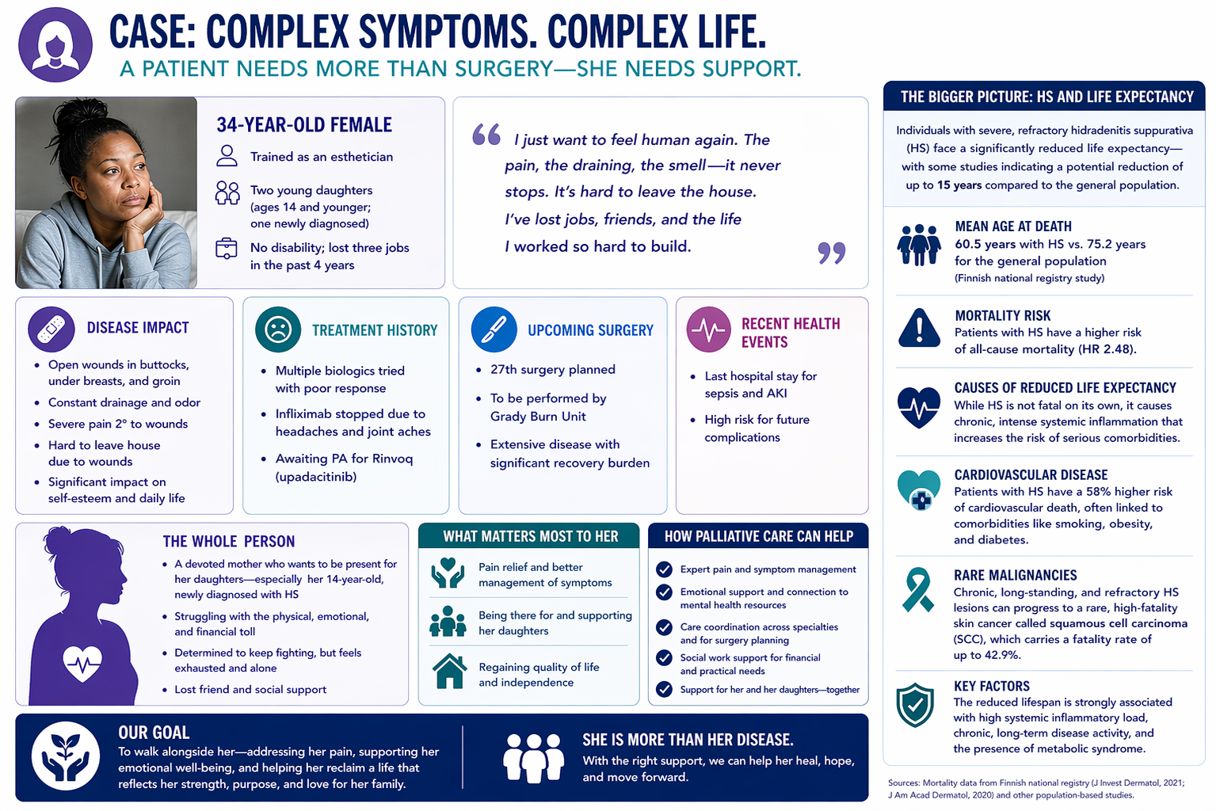
8
8,9
8,9
8
8,9
8
Figure by OpenAI's ChatGPT, April 2026 (www.chatgpt.com). Figure generated using the prompt: "create a figure that demonstrates a patient case using the following information. include these elements that matter most to the patient and how palliative care can help. Demonstrate how she is more than her disease and the bigger picture about HS and life expectancy facts. Include the following information."

Slide 18
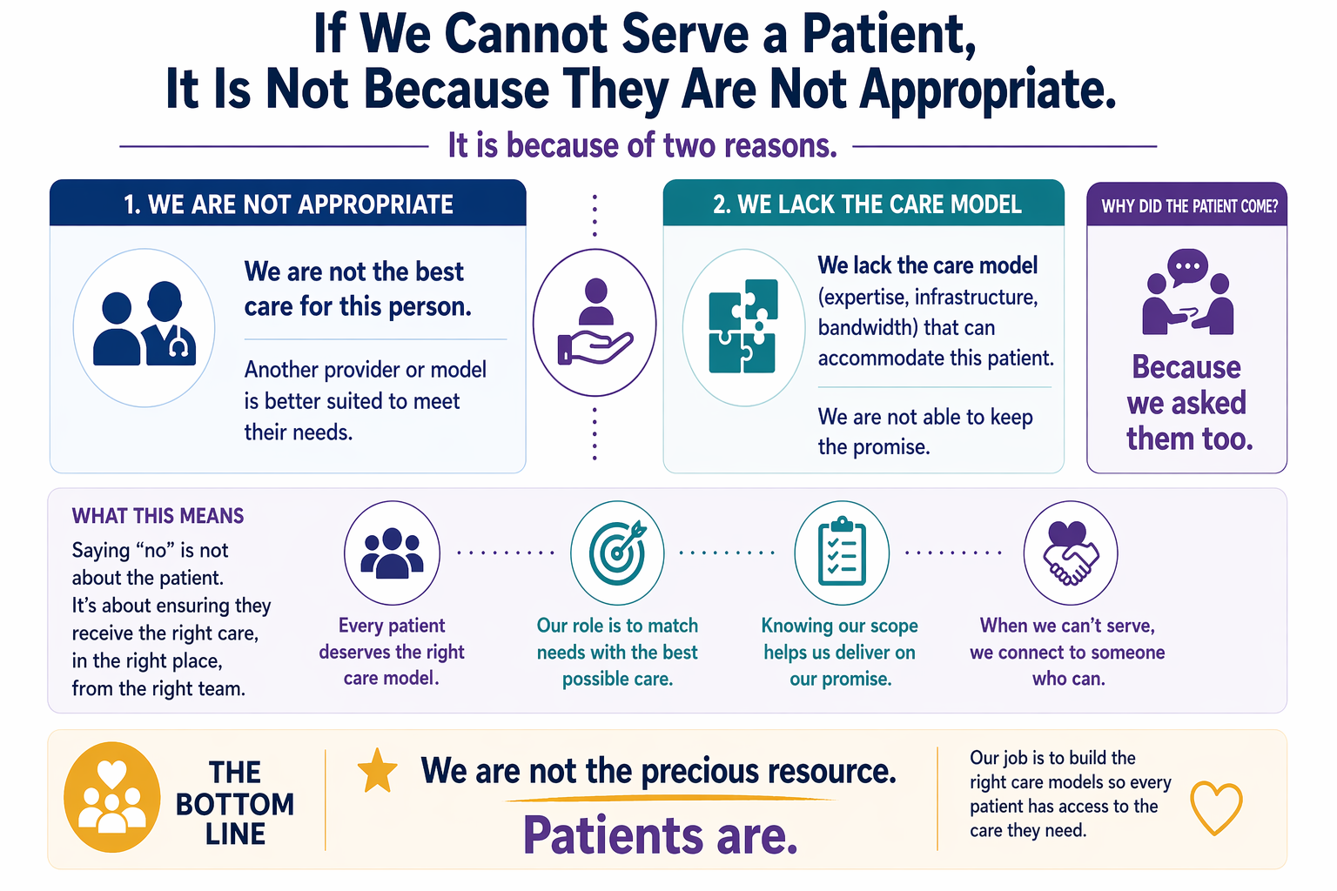
Figure by OpenAI's ChatGPT, April 2026 (www.chatgpt.com). Figure generated using the prompt: "create a figure demonstrating the rationale behind palliative care not being able to serve a patient is not because they are not appropriate using this information."

Slide 19
Sidebar: Pro-Tips
When you are going to see a patient, whether inpatient or outpatient, if your focus is only on what you are not going to do, then don’t bother going.
A patient asking for something does not obligate you to do exactly what they request. What it does require is exploring where and how you can be helpful.
If you keep the patient at the center and make decisions with them based on what they need, situations that initially feel unclear often become much clearer.

Slide 20
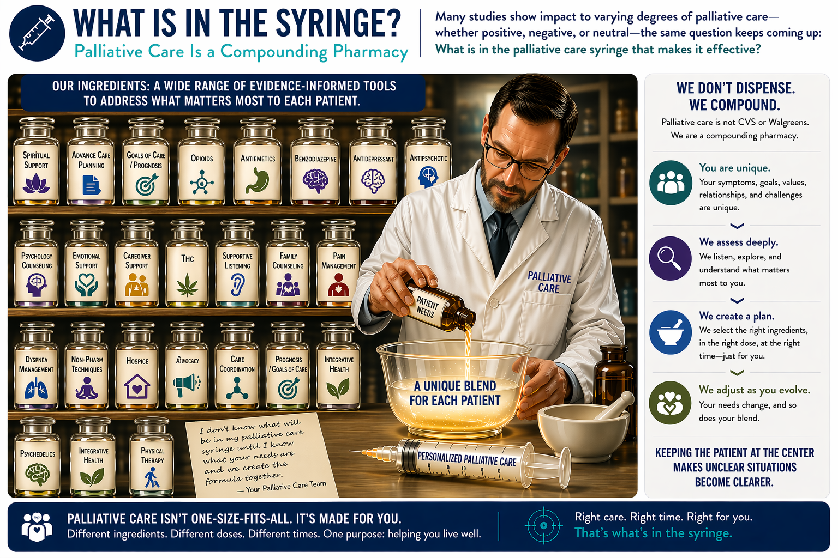
Figure by OpenAI's ChatGPT, April 2026 (www.chatgpt.com). Figure generated using the prompt: "create a figure demonstrating key ingredients of palliative care which makes it patient centered and how it is designed with the purpose of helping patients live well. Include we don't dispense, we compound. Include this information: patients are unique, we deeply assess, we create a plan, we adjust. It is about keeping patients at the center. "

Slide 21
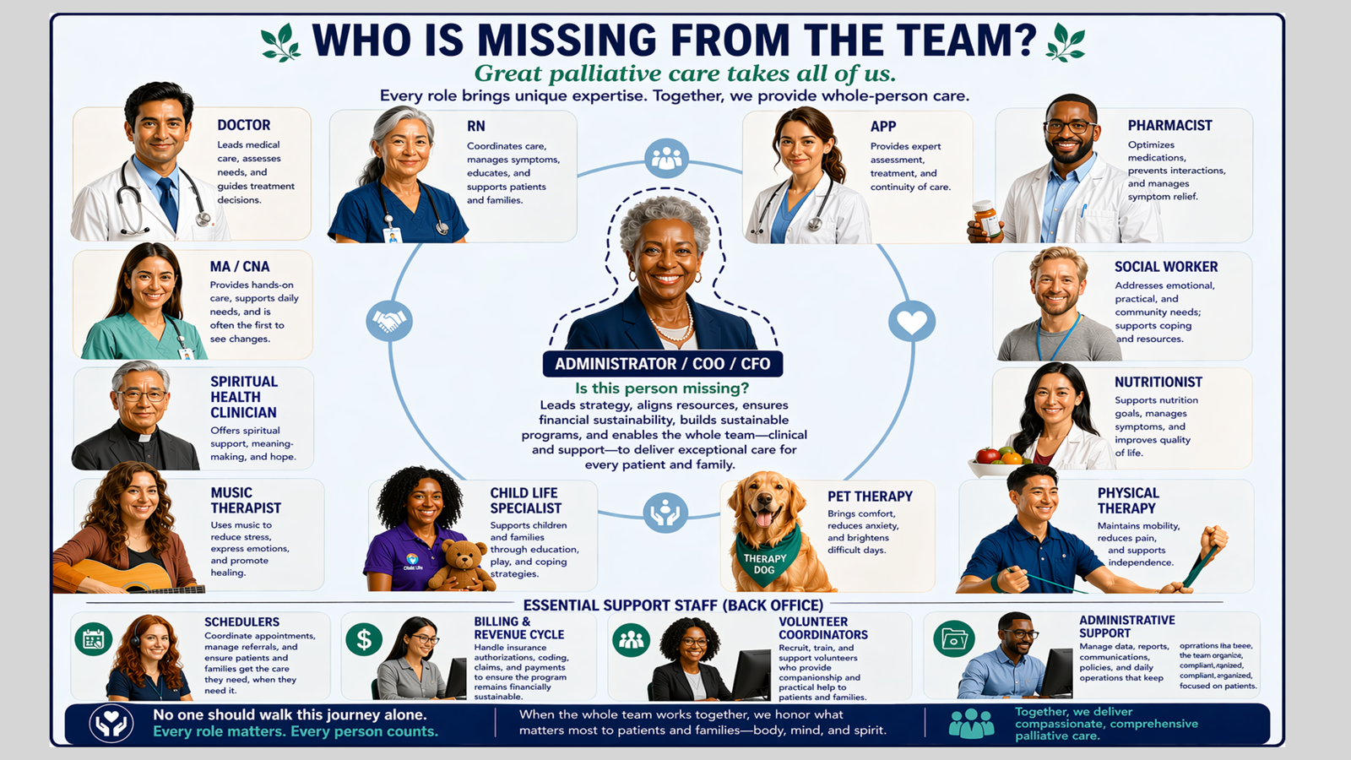
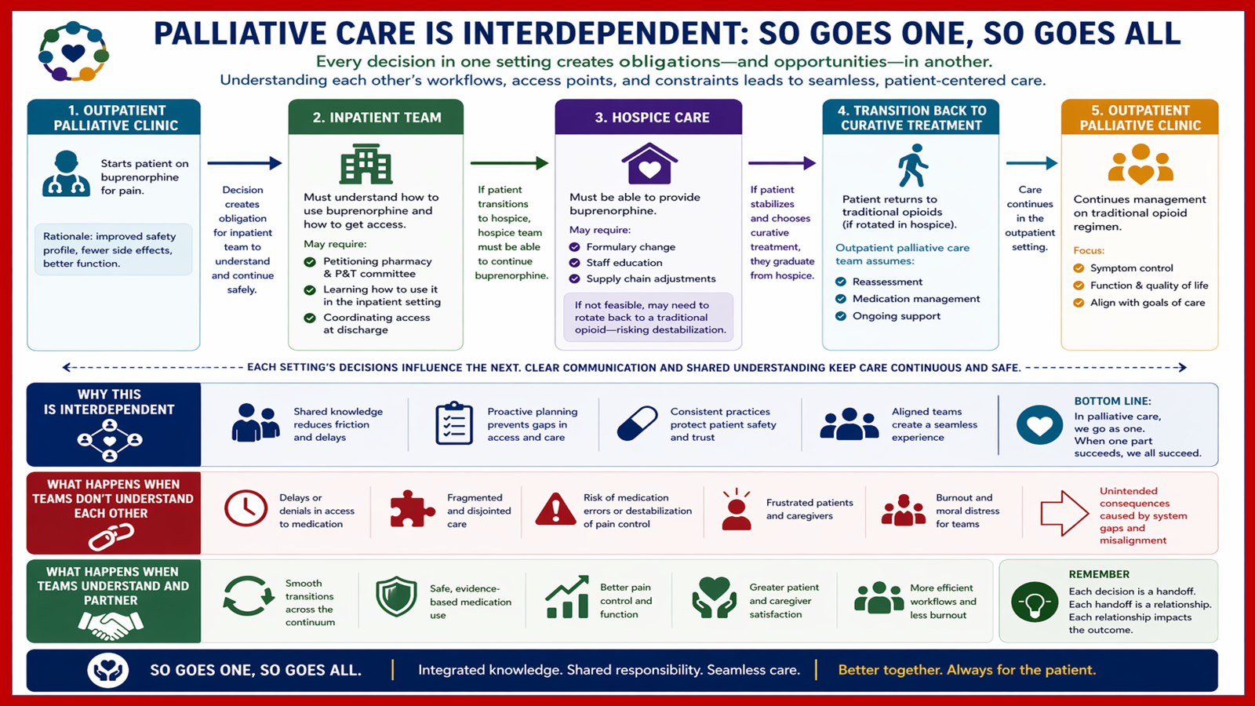

Slide 22
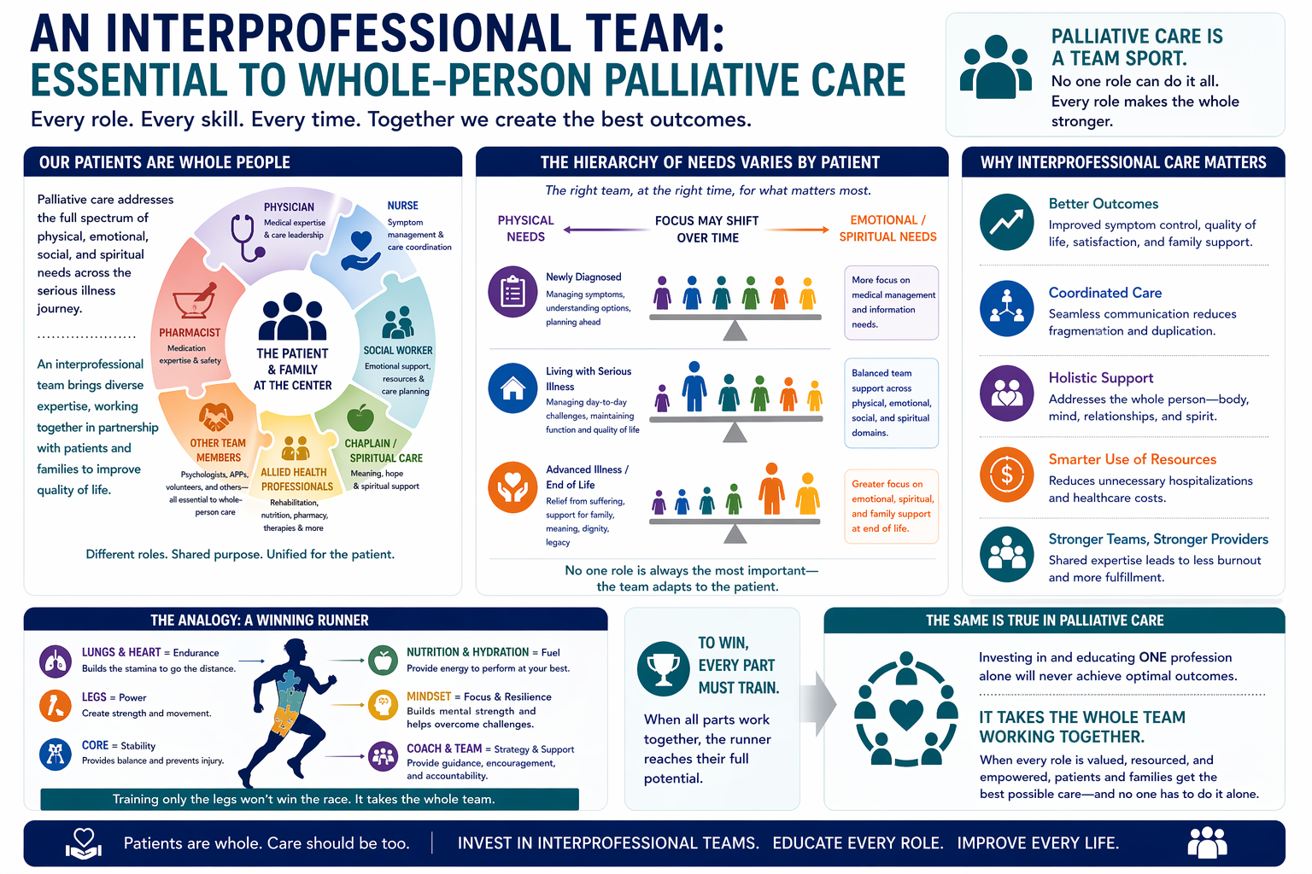

Slide 23
Palliative Care Workforce

Slide 24
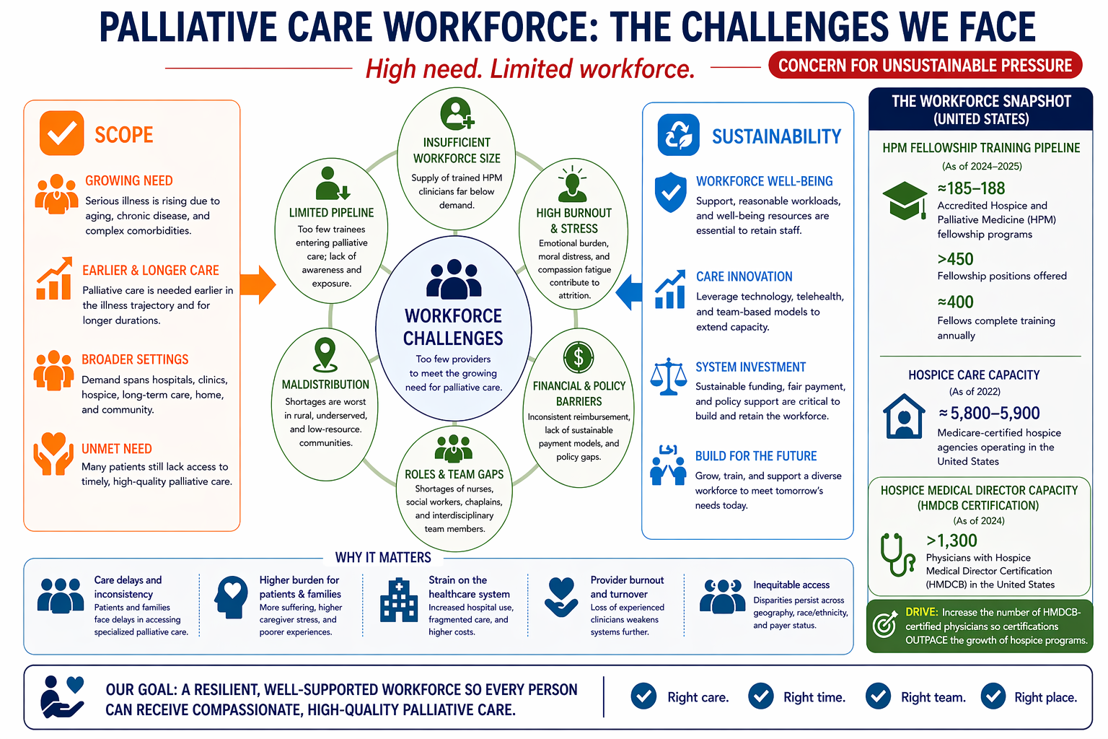
10-13
.
Figure by OpenAI's ChatGPT, April 2026 (www.chatgpt.com). Figure generated using the prompt: "create a figure demonstrating the challenges of palliative care in a limited workforce how there is a high need. Highlight the scope of palliative care and sustainability and some of the workforce palliative care history in a snapshot. Along with why this matters."

Slide 25
Addressing Workforce Challenges¹⁰⁻¹³
Using the right level of care for the right patient at the right time (home-based palliative care, stand-alone palliative care clinics, embedded clinics)
Leveraging interdisciplinary teams
Understanding how Palliative Care fits into reimbursement structures and financial models of care

Slide 26
Personal Sustainable Practice

Slide 27
What is Burnout?
A state of emotional exhaustion or physical exhaustion caused by prolonged exposure to excessive levels of chronic stress¹⁴

Slide 28
Burnout in Palliative Care Clinicians
Prevalence of burnout is high:
  Over 1/3 of palliative care clinicians met criteria for burnout in one study¹⁵
  Another study found that 24-30% of palliative care nurses met criteria for burnout¹⁶
Contributing factors¹⁶:
  Staffing shortages
  Scarcity of resources
  Limited autonomy

Slide 29
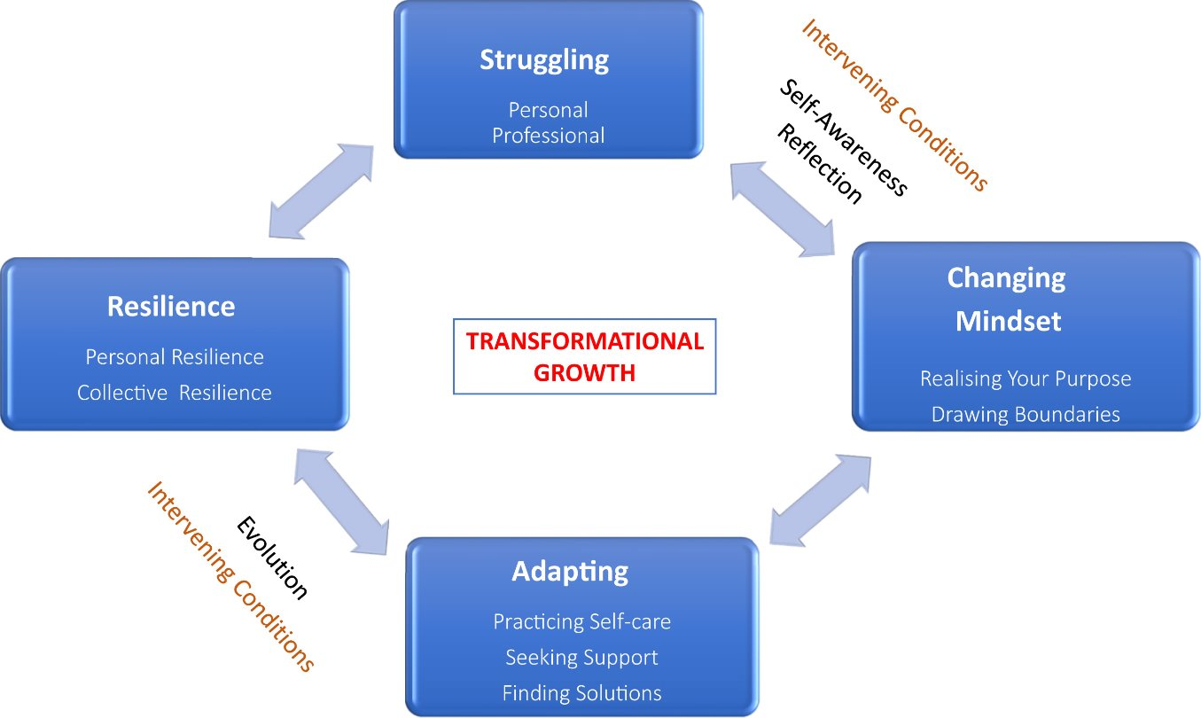
Practices for Personal Sustainability
Qualitative interviews with palliative care clinicians with 10+ years of experience in Singapore¹⁴
Figure by Koh et al, retrieved from https://www.jpsmjournal.com/article/S0885-3924(19)30454-3/fulltext on May 4, 2026.

Slide 30
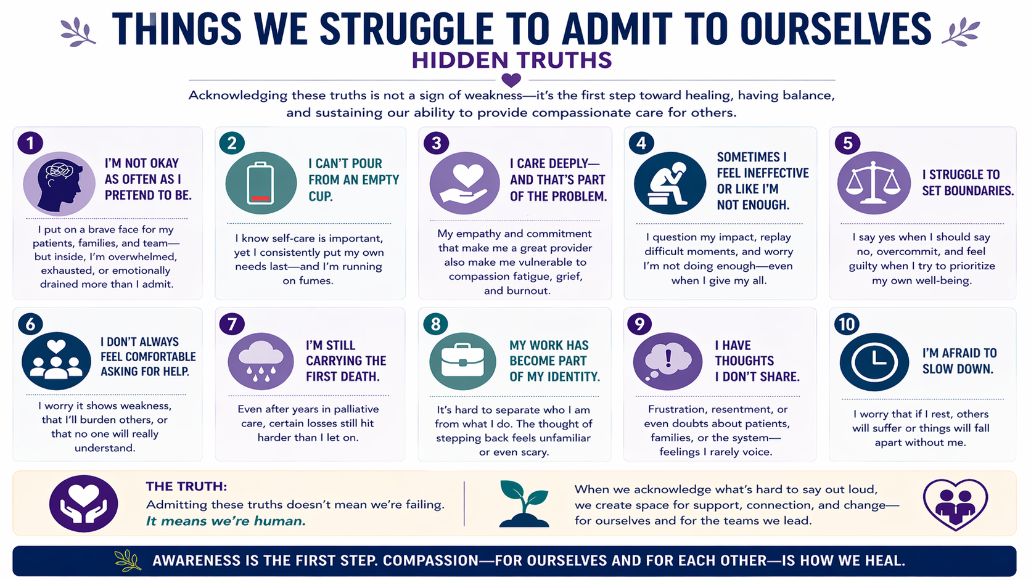
Figure by OpenAI's ChatGPT, April 2026 (www.chatgpt.com). Figure generated using the prompt: "create a figure demonstrating the things we struggle to admit to ourselves and include the following points using this information. Include that awareness is how we heal."
Notes:
It is important us a leaders to show vuneralblity

Slide 31
Combating Burnout: A Multi-Level Approach^{17,18}
Protective factors to prevent burnout:
  High meaningfulness at work
  Collegial trust and emotional safety
  Job satisfaction
  Perceived clinical support
  Working <60 hours/week
  Psychological flexibility, mindfulness, and self-compassion
  Adequate staffing and manageable workload
Effective strategies should be both personal and institutional
  Personal: mindfulness/communication training, self-care practices
  Institutional: supportive culture, adequate staffing, minimizing burdensome documentation, debriefing after difficult cases

Slide 32
Key Takeaways
Palliative care is not one intervention, it is a personalized model of care.
Its value comes from combining the right clinical, psychosocial, spiritual, and practical supports for the right patient at the right time.
The future of palliative care depends on alignment in philosophy and willingness to innovate.
We must match our workforce, scope, and care models with the real needs of patients, families, and healthcare systems. Palliative care is only as strong as it’s weakest part.
Compassion alone is not enough, sustainability matters.
To grow access and maintain quality, palliative care leaders must understand operations, payment models, staffing, and organizational priorities.
Interdisciplinary teams are the treatment.
No single discipline can meet the complexity of serious illness alone; our strength is in coordinated, team-based care. “Investment in only one is really an investment in none.”
Our measure is not only how much suffering we relieve, but how well we accompany people through it.
Palliative care’s enduring role is to help patients and families live as well as possible through serious illness, with skill, honesty, and humanity.

Slide 33
References
1. Lutz S. The history of hospice and palliative care. Curr Probl Cancer. 2011;35(6):304-309. doi:10.1016/j.currproblcancer.2011.10.004
2. Connor SR. Development of Hospice and Palliative Care in the United States. OMEGA - Journal of Death and Dying. 2008;56(1):89-99. doi:https://doi.org/10.2190/om.56.1.h
3. About CAPC | Center to Advance Palliative Care. Capc.org. Published 2015. https://www.capc.org/about/capc/
4. Afezolli D, Bharani A, Rousseau CP, et al. Evolving Scope of Specialty Palliative Care: Guidelines, Implications, and Future Directions. Journal of Palliative Medicine. Published online February 24, 2026. doi:https://doi.org/10.1177/10966218261421745
5. Flint LA, Wallingford G, Tatum P, Bruno J, Fernandez H, Carey EC. Are we Growing Leaders? Exploring Leadership Training in Hospice and Palliative Medicine Fellowship. Journal of Pain and Symptom Management. 2025;70(6):e474-e481. doi:https://doi.org/10.1016/j.jpainsymman.2025.07.015
6. Committee on Approaching Death: Addressing Key End of Life Issues, Institute of Medicine. Dying in America: Improving Quality and Honoring Individual Preferences near the End of Life. National Academies Press (US); 2015. https://pubmed.ncbi.nlm.nih.gov/25927121/
7. Dijxhoorn AFQ, Brom L, van der Linden YM, Leget C, Raijmakers NJ. Healthcare Professionals’ Work-Related Stress in Palliative Care: A Cross-Sectional Survey. Journal of Pain and Symptom Management. 2021;62(3). doi:https://doi.org/10.1016/j.jpainsymman.2021.04.004
8. Tiri H, Jokelainen J, Timonen M, Tasanen K, Huilaja L. Substantially reduced life expectancy in patients with hidradenitis suppurativa: a Finnish nationwide registry study. British Journal of Dermatology. 2019;180(6):1543-1544. doi:https://doi.org/10.1111/bjd.17578
9. Goldburg SR, Strober BE, Payette MJ. Hidradenitis suppurativa. Journal of the American Academy of Dermatology. 2020;82(5):1045-1058. doi:https://doi.org/10.1016/j.jaad.2019.08.090
10. Lupu D, Quigley L, Mehfoud N, Salsberg ES. The Growing Demand for Hospice and Palliative Medicine Physicians: Will the Supply Keep Up? Journal of Pain and Symptom Management. 2018;55(4):1216-1223. doi:https://doi.org/10.1016/j.jpainsymman.2018.01.011
11. Kelley AS, Morrison RS. Palliative Care for the Seriously Ill. Campion EW, ed. New England Journal of Medicine. 2015;373(8):747-755. doi:https://doi.org/10.1056/nejmra1404684
12. Levine S, O’Mahony S, Baron A, et al. Training the Workforce: Description of a Longitudinal Interdisciplinary Education and Mentoring Program in Palliative Care. Journal of Pain and Symptom Management. 2017;53(4):728-737. doi:https://doi.org/10.1016/j.jpainsymman.2016.11.009
13. McCarthy IM, Robinson C, Huq S, Philastre M, Fine RL. Cost Savings from Palliative Care Teams and Guidance for a Financially Viable Palliative Care Program. Health Services Research. 2014;50(1):217-236. doi:https://doi.org/10.1111/1475-6773.12203
14. Koh MYH, Hum AYM, Khoo HS, et al. Burnout and Resilience After a Decade in Palliative Care: What Survivors Have to Teach Us. A Qualitative Study of Palliative Care Clinicians With More Than 10 Years of Experience. Journal of Pain and Symptom Management. 2019;59(1). doi:https://doi.org/10.1016/j.jpainsymman.2019.08.008
15. Boland JW, Kabir M, Spilg EG, et al. Over a third of palliative medicine physicians meet burnout criteria: Results from a survey study during the COVID-19 pandemic. Palliative Medicine. 2023;37(3):343-354. doi:https://doi.org/10.1177/02692163231153067
16. Gómez-Urquiza JL, Albendín-García L, Velando-Soriano A, et al. Burnout in Palliative Care Nurses, Prevalence and Risk Factors: A Systematic Review with Meta-Analysis. International Journal of Environmental Research and Public Health. 2020;17(20):7672. doi:https://doi.org/10.3390/ijerph17207672​
17. Dijxhoorn AFQ, Brom L, van der Linden YM, Leget C, Raijmakers NJ. Prevalence of burnout in healthcare professionals providing palliative care and the effect of interventions to reducesymptoms: A systematic literature review. Palliative Medicine. 2020;35(1):026921632095682. doi:https://doi.org/10.1177/0269216320956825
18. Back AL, Steinhauser KE, Kamal AH, Jackson VA. Building Resilience for Palliative Care Clinicians: an Approach to Burnout Prevention Based on Individual Skills and Workplace Factors. Journal of Pain and Symptom Management. 2016;52(2):284-291. doi:https://doi.org/10.1016/j.jpainsymman.2016.02.002

